Slide 1

Experiments about programming
Notes:
Background 基本思想 概念框架 核心技术 具体应用

Slide 2
Summary
Software architecture
  Algorithm
  Parallelism
Computer hardware
  Disk I/O
  Memory
  CPU
Others
  Compiler
  Precise
  Tools

Slide 3
Algorithm
Data structure
  List vs. Vector
  Map vs. unorder_map(hash)
Algorithm about program itself
Notes:
Folly Hash Practice viewer

Slide 4
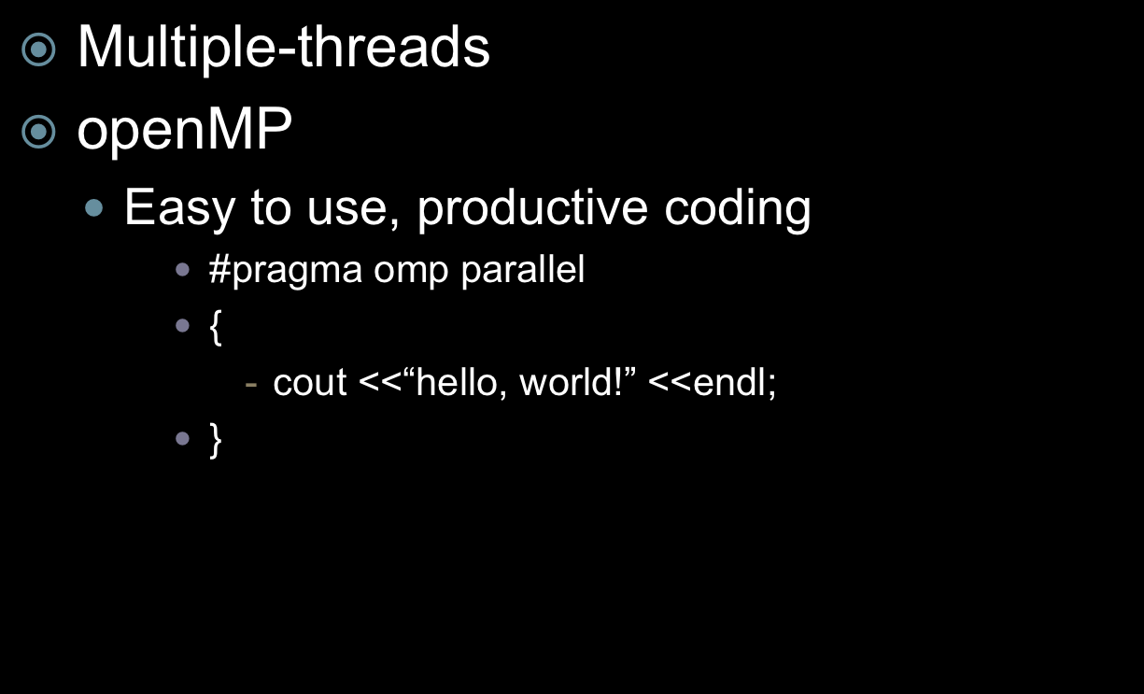
Parallelism(1)
Notes:
CPU GPU， 各个特点, phi, lapack

Slide 5
Parallelism(2)
MPI
  Rank
  Group
  Communicator
    MPI_Bsent
    MPI_Bcast
sendto = (rank + 1) % size;
recvfrom = ((rank + size) - 1) % size;
MPI_Send(outbuf, BUFMAX, MPI_CHAR, sendto, 0, MPI_COMM_WORLD);
MPI_Recv(inbuf, BUFMAX, MPI_CHAR, recvfrom, 0, MPI_COMM_WORLD, &status);

Slide 6
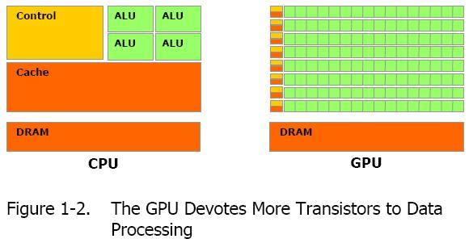
Parallelism(3)
Cuda
  nvidia
openCL
  Easy to port

Slide 7
Disk IO
File buffer size = Disk sector size * N
Map file into memory

Slide 8
Memory
Memory Pool
      62 class StringPool {
      63 struct Block{
      64 Block* next;
      65 char* end;
      66 };
      67 private:
      68 Block* firstBlock; // first in chain of blocks
      69 Block* currBlock; // allocate from this block
      70 char* nextc; // first free byte in currBlock 71 size_t blockSize; // size of normal blocks
      72 73 public:
      74 explicit StringPool (size_t normalBlockSize = 8192);
      75 ~StringPool();
      76 char* alloc (size_t nbytes); 77 char* newString (const char* str);
      78 char* newString (const char* str, size_t len);
      79 };
Notes:
What’s pool? Why pool?

Slide 9
CPU(1)
Branch predict
      107 int data[arraySize];
      108
      109 for (unsigned c = 0; c < arraySize; ++c)
      110 data[c] = std::rand() % 256;
      111 // !!! With this, the next loop runs faster 11.54 seconds VS. 1.93 seconds
      112 std::sort(data, data + arraySize);
      113 long long sum = 0;
      114
      115 for (unsigned i = 0; i < 100000; ++i)
      116 {
      117 // Primary loop
      118 for (unsigned c = 0; c < arraySize; ++c)
      119 {
      120 if (data[c] >= 128)
      121 sum += data[c];
      122 }
      123 }

Slide 10
CPU(2)
Cache
Hyper threading
Pipeline(Duff’s device)
      131 #define DUFF_DEVICE_8(aCount, aAction) \
      132 do { \
      133 int count_ = (aCount); \
      134 int times_ = (count_ + 7) >> 3; \
      135 switch (count_ & 7){ \
      136 case 0: do { aAction; \
      137 case 7: aAction; \
      138 case 6: aAction; \
      139 case 5: aAction; \
      140 case 4: aAction; \
      141 case 3: aAction; \
      142 case 2: aAction; \
      143 case 1: aAction; \
      144 } while (--times_ > 0); \
      145 } \
      146 } while (0)

Slide 11
Compiler
Memory aliasing
      void add1(int* a, int* b){
      *a += *b;
      *a += *b;
      }
Function call
      void a(){ return f()+f()+f()+f() }
      void b(){ return 4*f(); }
      // but if:
      void f() { ++state; }
Notes:
154 void add1(int* a, int* b){
155 *a += *b; // 2次读 1次写
156 *a += *b;
157 } // 共进行6次对内存的访问
165 void a(){
166 return f()+f()+f()+f(); // 调用4次
167 }
168
169 void b(){
170 return 4*f(); // 调用1次
171 }
172 但是如果
173 void f() { ++state; }

Slide 12
Precise
Double VS. float
 | Integer |  | Single |  | Double
Operation | Latency | Issue | Latency | Issue | Latency | Issue
Add | 1 | 0.33 | 3 | 1 | 3 | 1
Mul | 3 | 1 | 4 | 1 | 5 | 1
Div | 11-21 | 5-13 | 10-15 | 6-11 | 10-23 | 6-19
Notes:
Latency issue?

Slide 13
Tools
TCMalloc VS. gnu malloc
ICC VS. GCC

Slide 14
That’s all , thank you very much!

