Slide 1
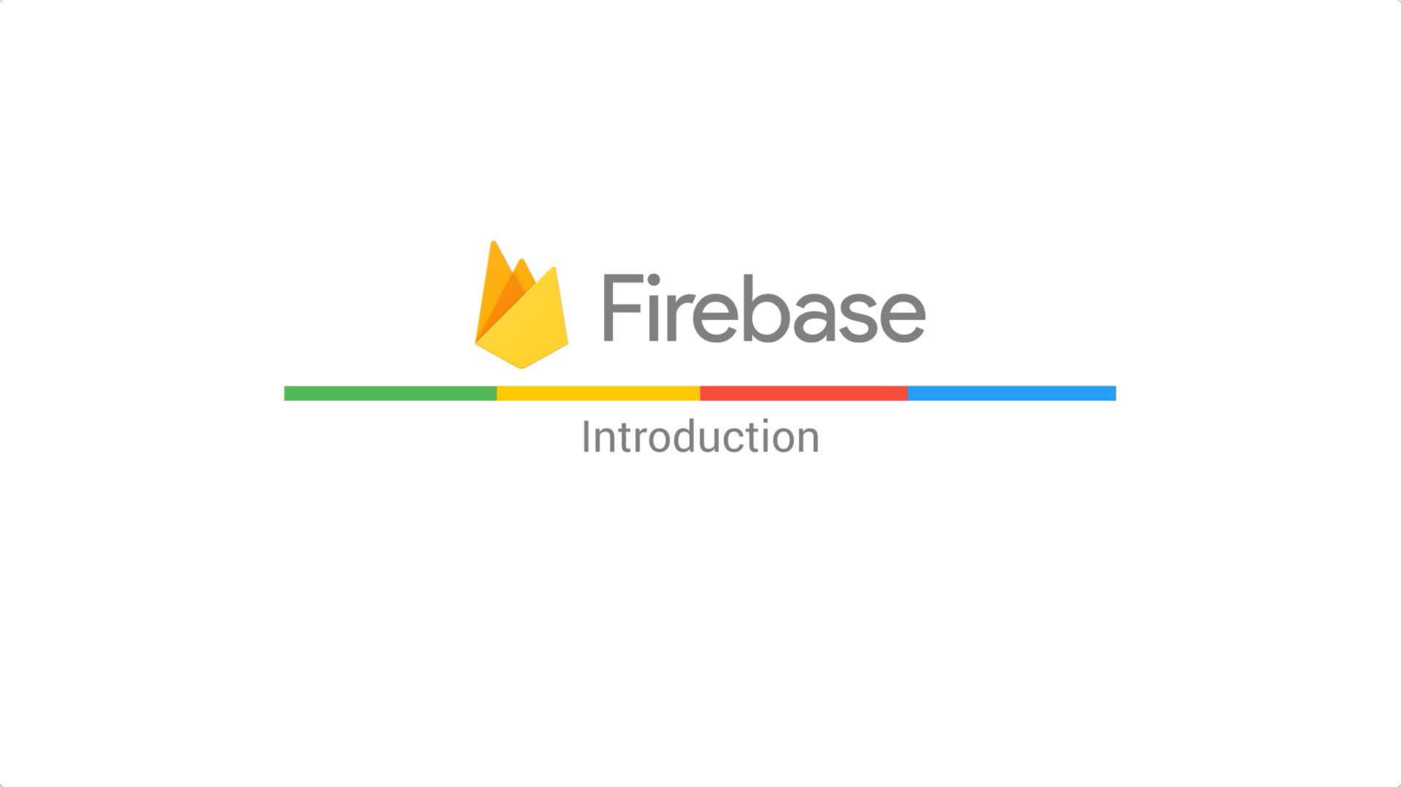

Slide 2
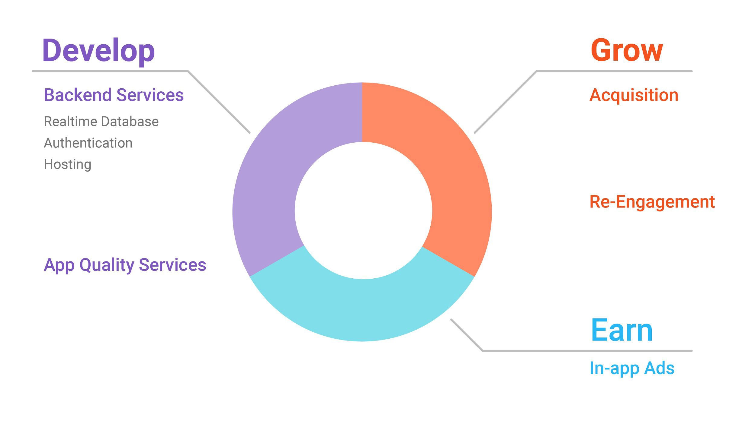

Slide 3
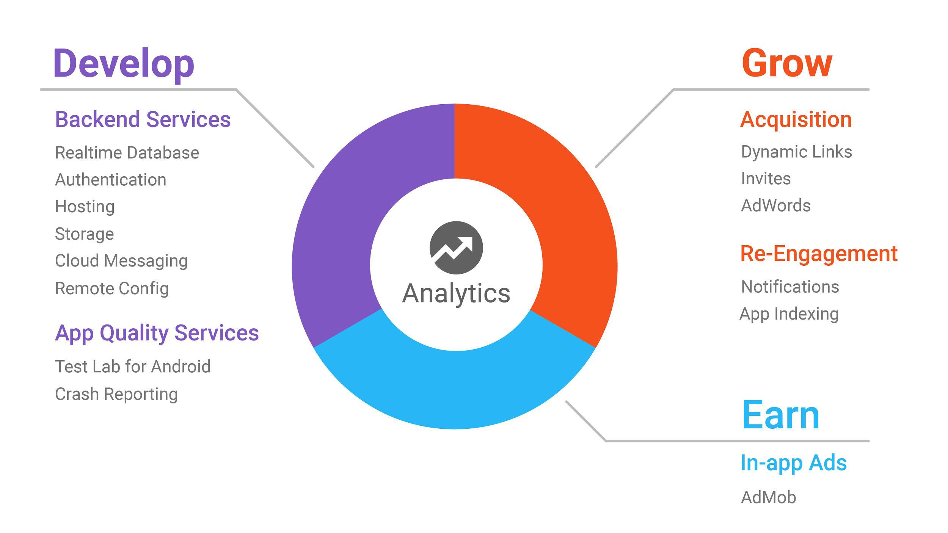
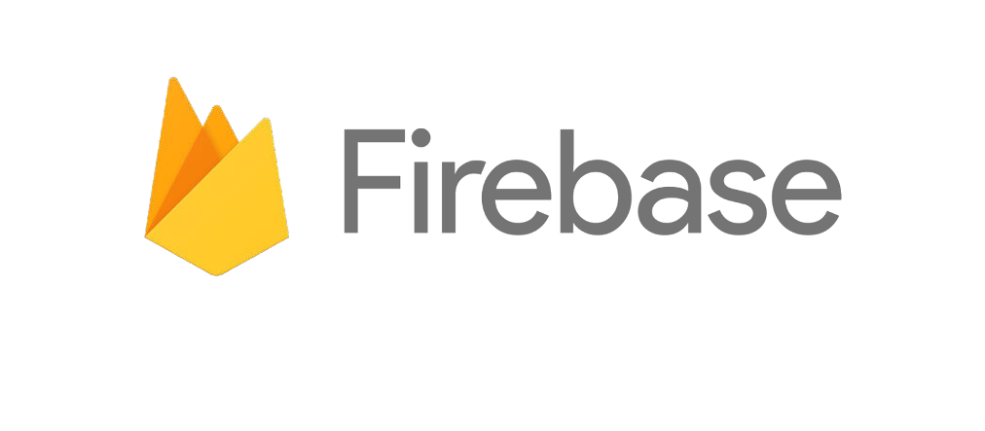

Slide 4
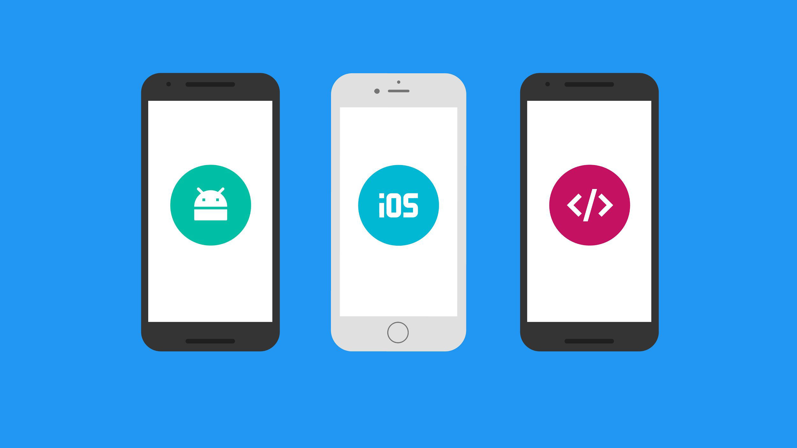

Cross-Platform

Slide 5

Integrated

Slide 6
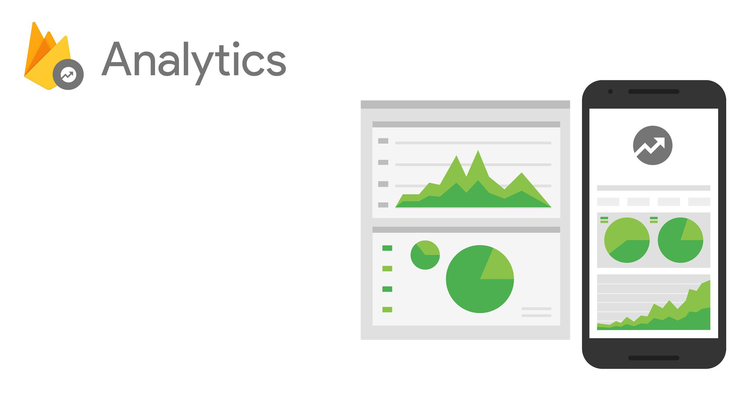
Designed for apps
Event and user centric
Connects across Firebase
Free & unlimited

Slide 7
Determine the effectiveness of notifications and
update your re-engagement strategy.
● Discover what in-app activities trigger in-app
purchases and surface these appropriately; improve
your user's experience to increase engagement and
monetization.
● Remote Config can target custom app experiences
at members of different Analytics audiences and
measure the impact of their experiments using
Analytics reports.
● Analytics will provide campaign attribution reporting
for AdWords, App Indexing, App Invites, Dynamic
Links, and Notifications.

Slide 8
Developing your app

Slide 9
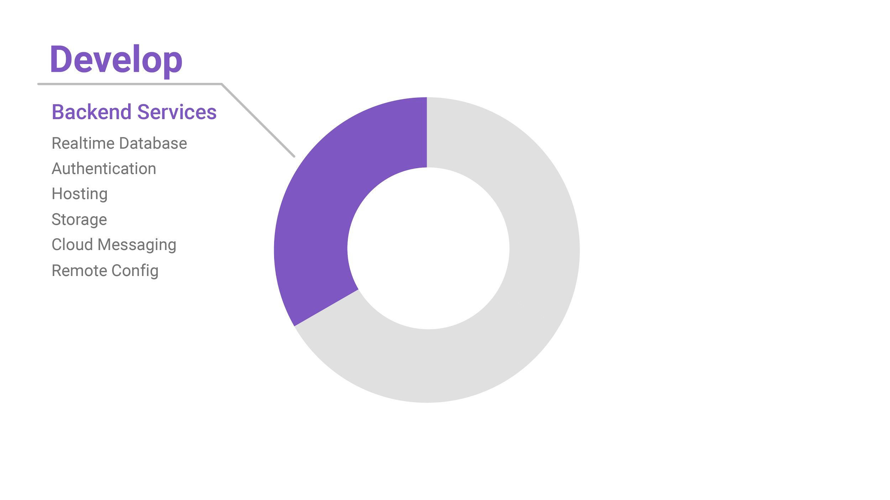
Backend Services

Slide 10
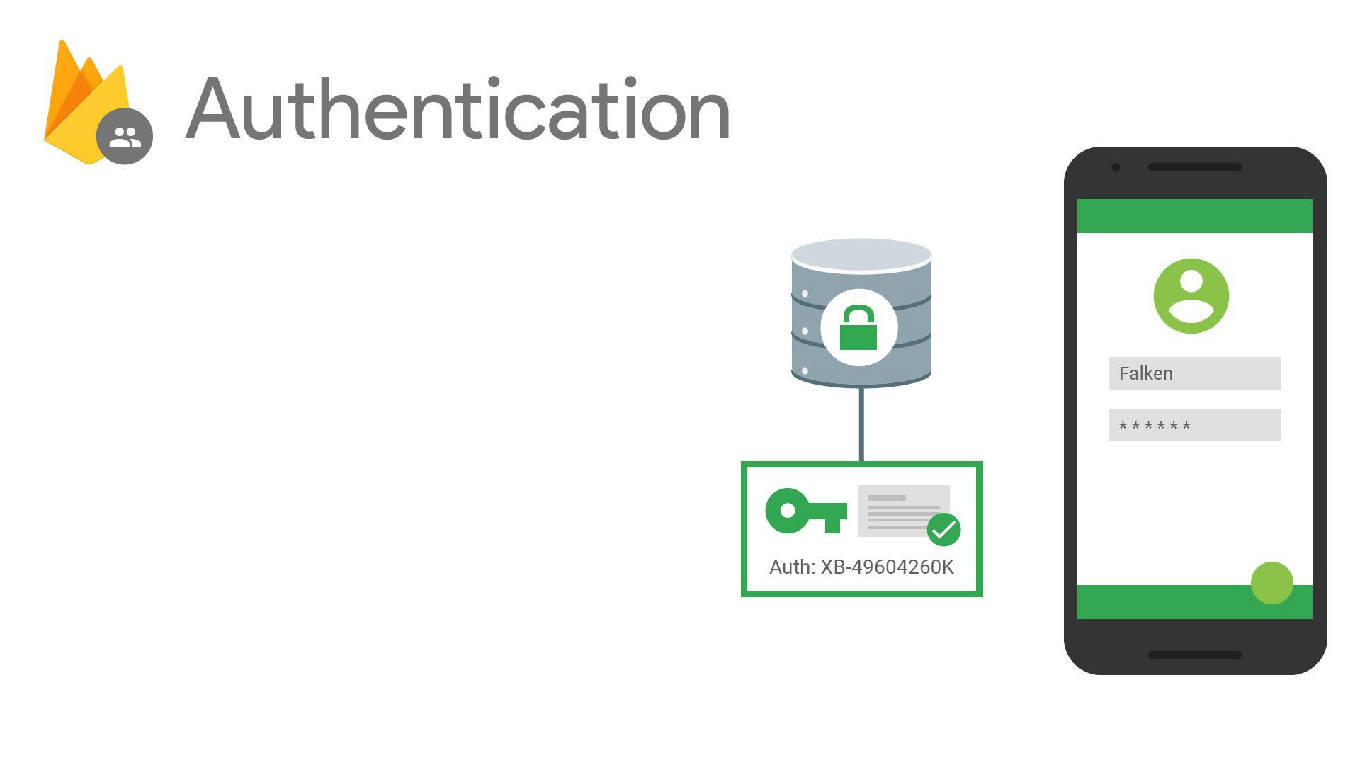
Authentication & account management
Supports:
  Email & password
  Social providers
  Existing auth systems
[New!] Out-of-the box UI

Slide 11
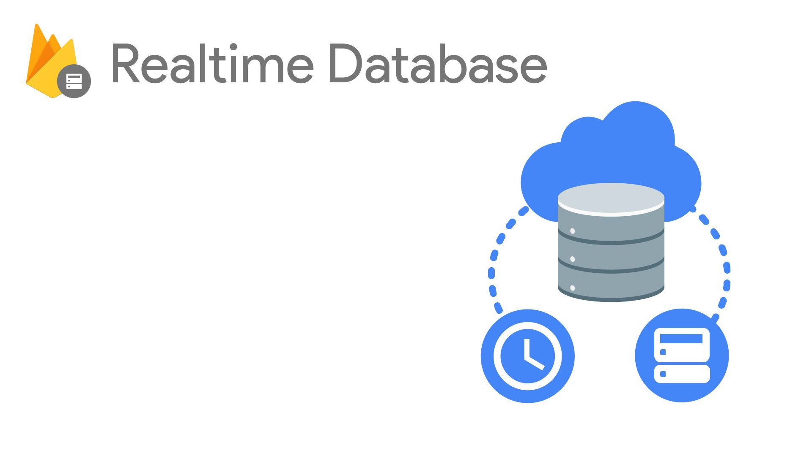
Cloud-hosted NoSQL database
Synchronization & conflict resolution
Access directly from your app

Slide 12
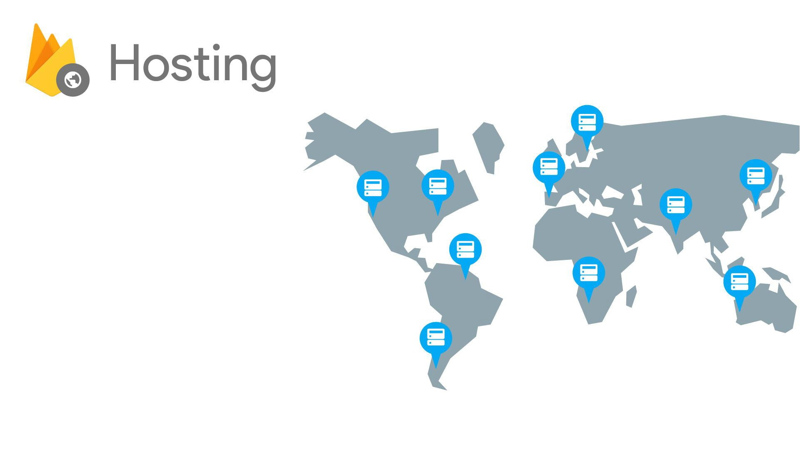
SectionX SectionY SectionZ
Serve static assets (imagesToo)
SSL by default
⋅New: free custom domains

Slide 13
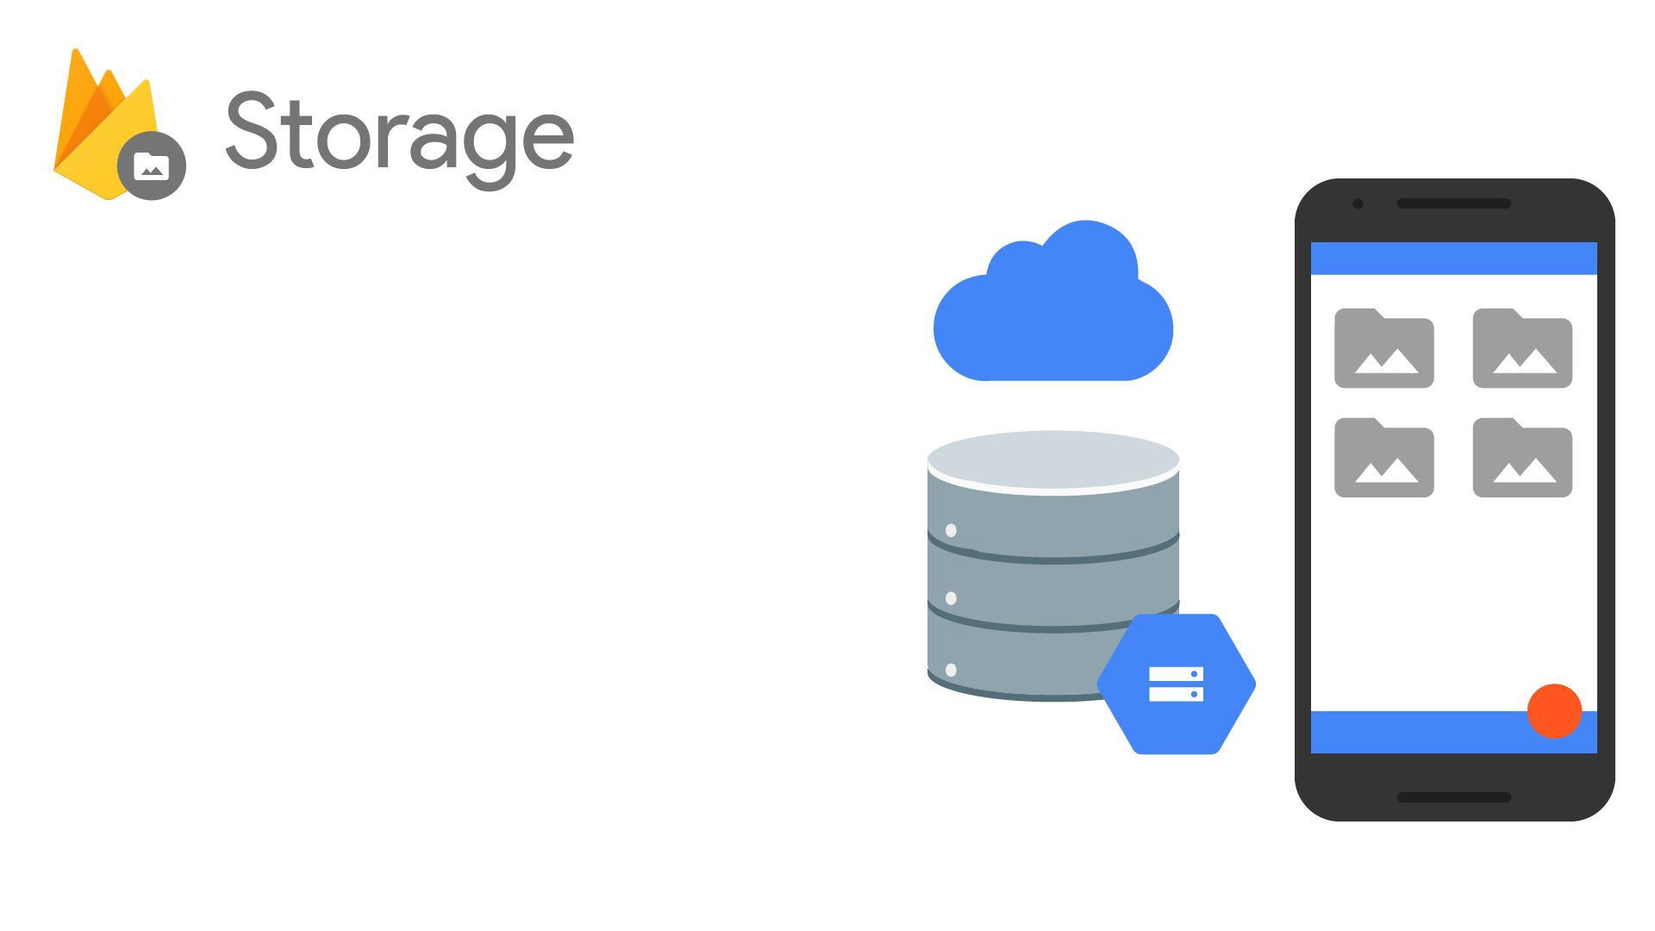
Easy file storage
Handles poor connectivity
Backed by & accessible from Google Cloud Storage

Slide 14
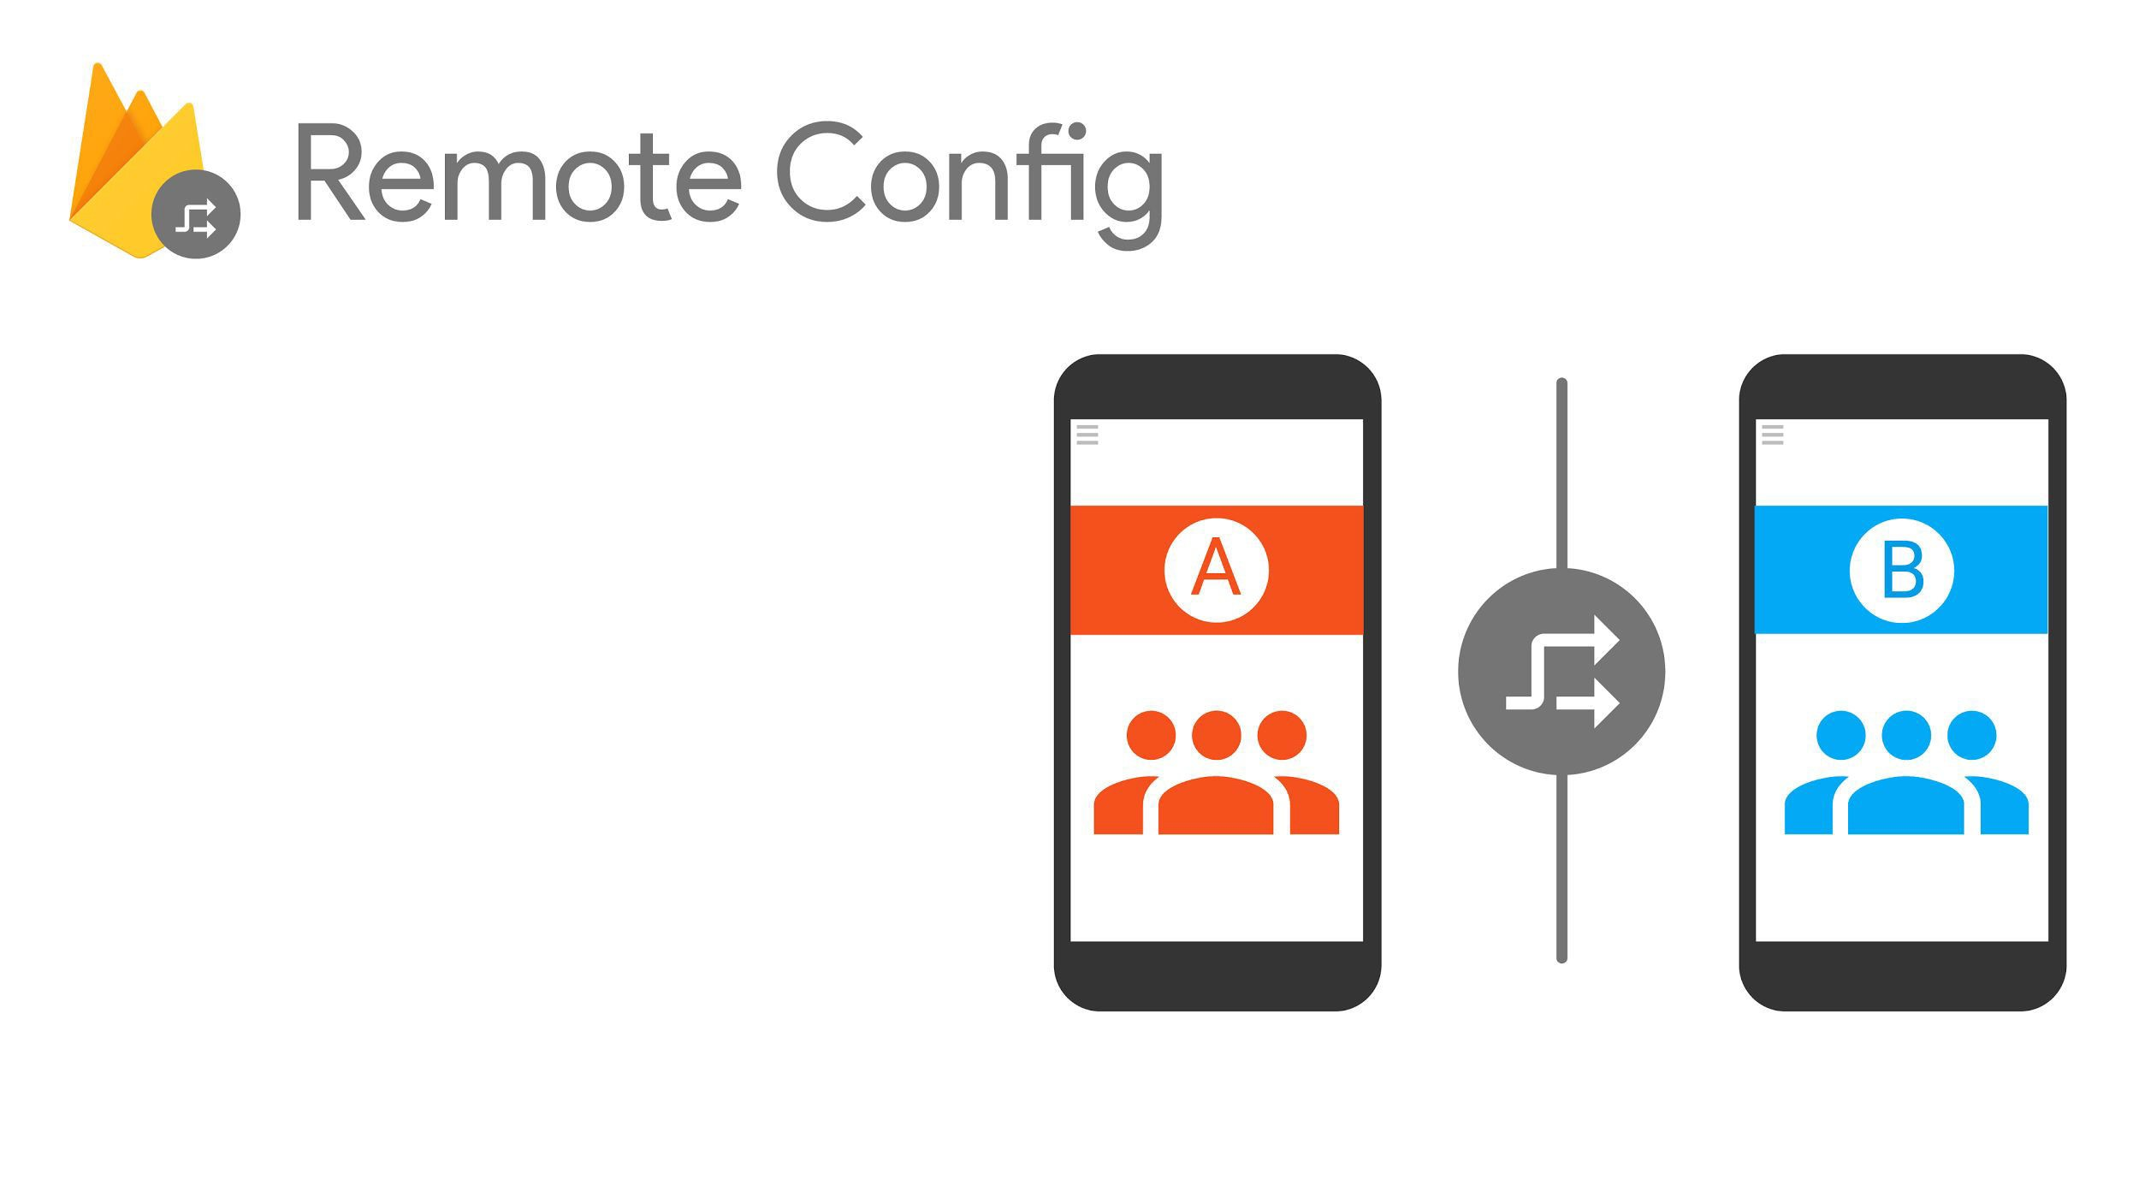
Run A/B experiments or change app behavior
Control custom key-value pairs from the Console
Changes propagate instantly

Slide 15
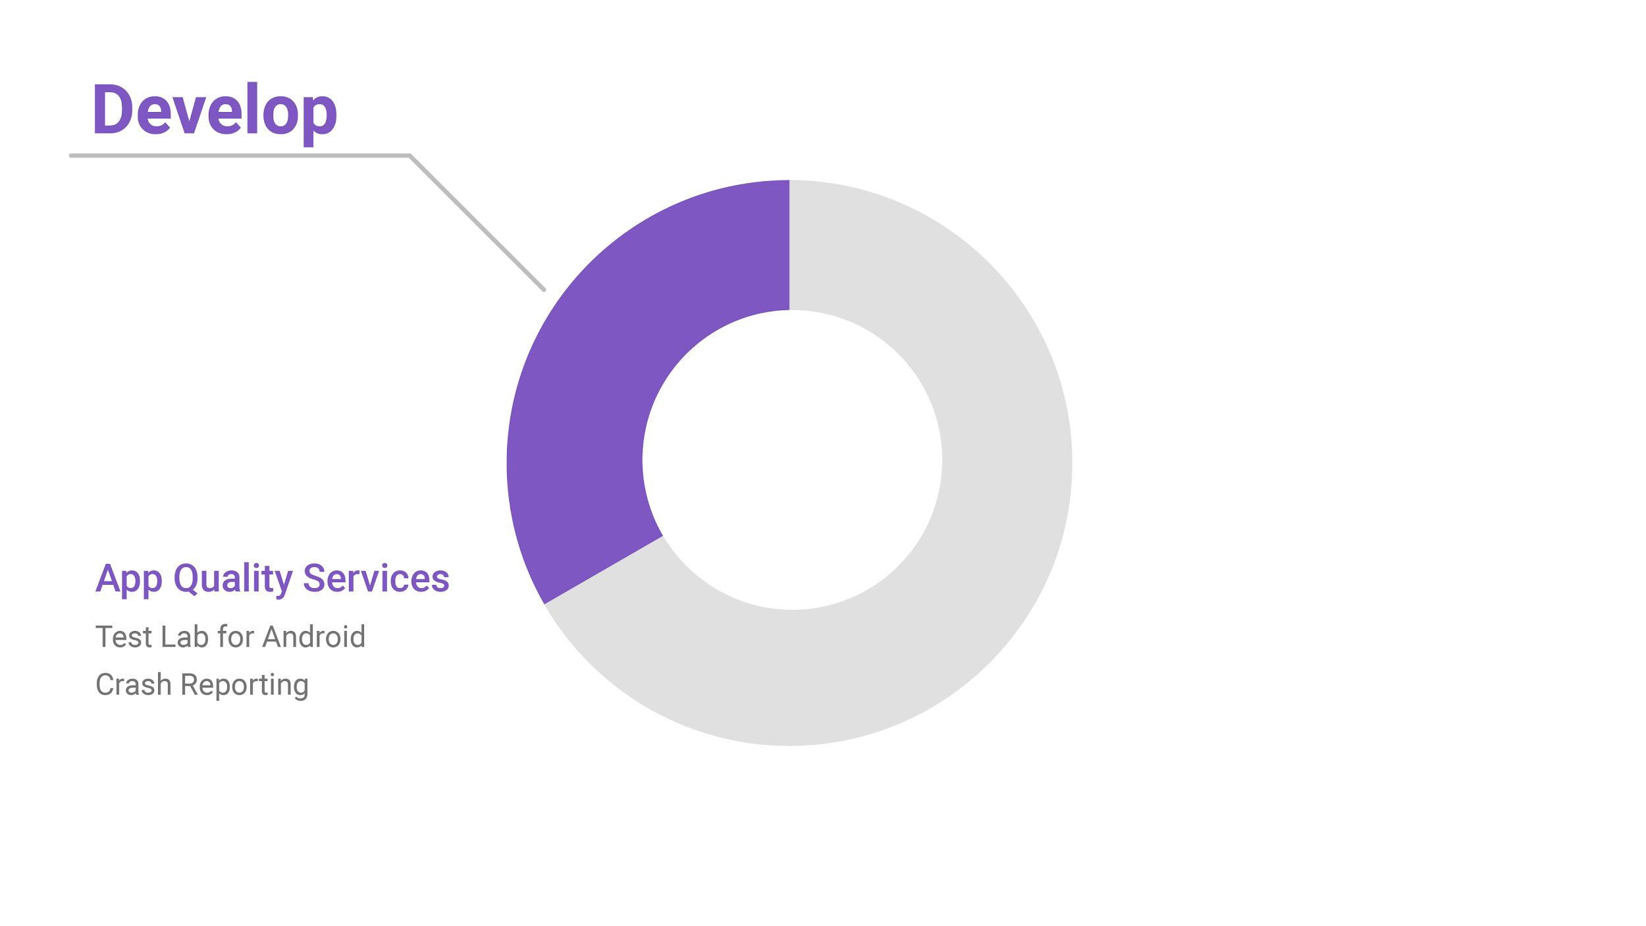
App Quality Services

Slide 16
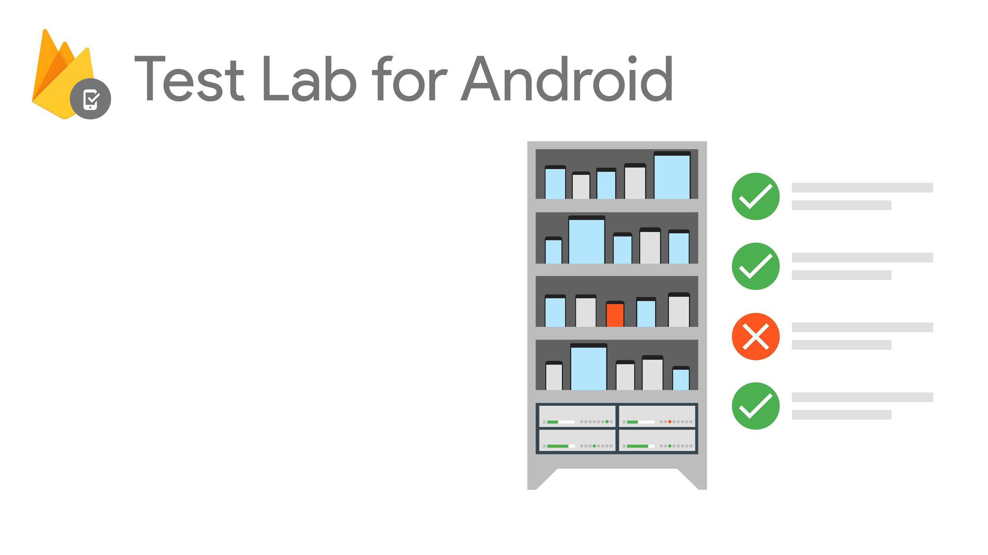
Test on the most popular devices before you ship
Reports & screenshots
Robo & custom tests

Slide 17
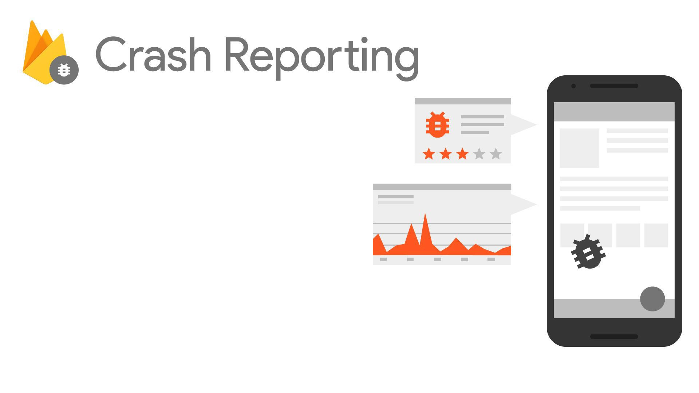
⋅See crashes & impact
⋅ Version & OS drill-down
⋅ Integrated with Analytics

Slide 18
Grow your app

Slide 19
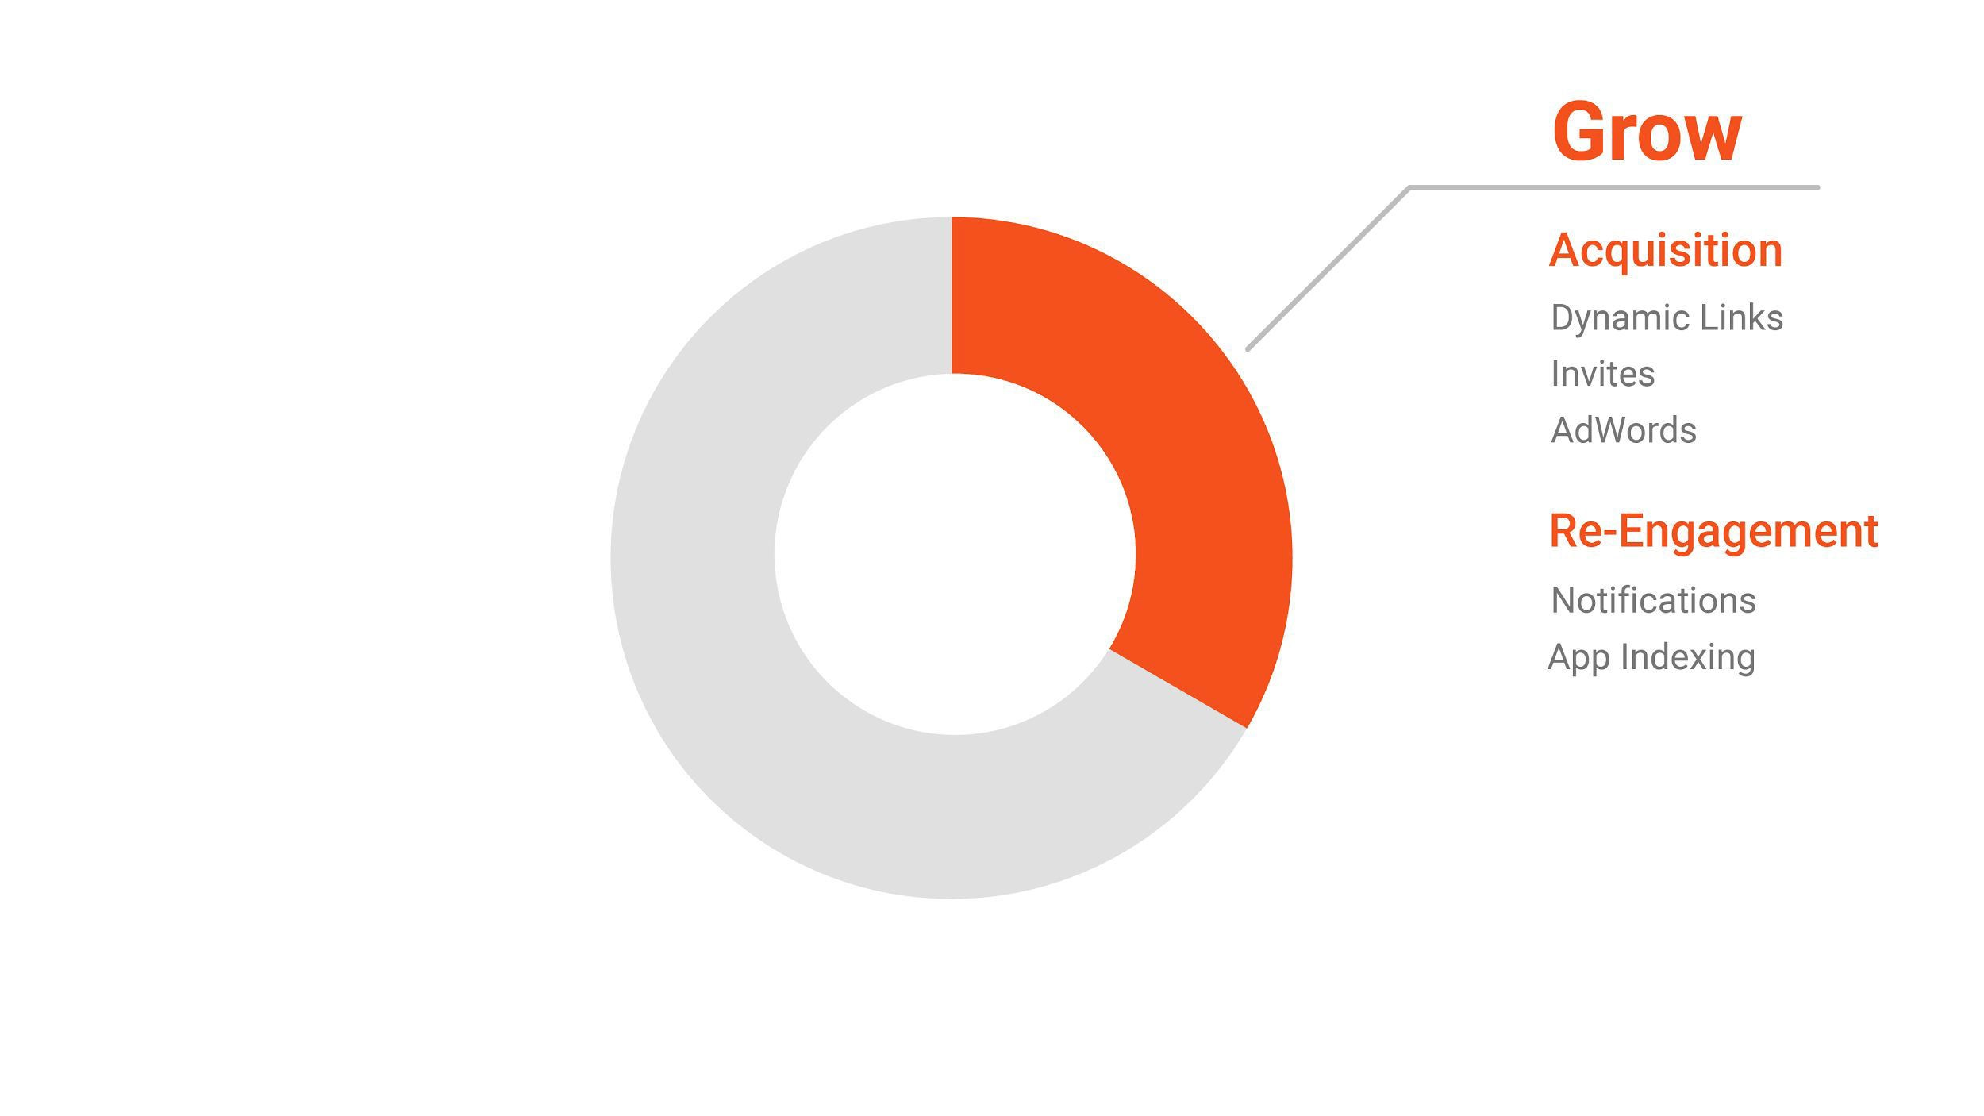

Slide 20
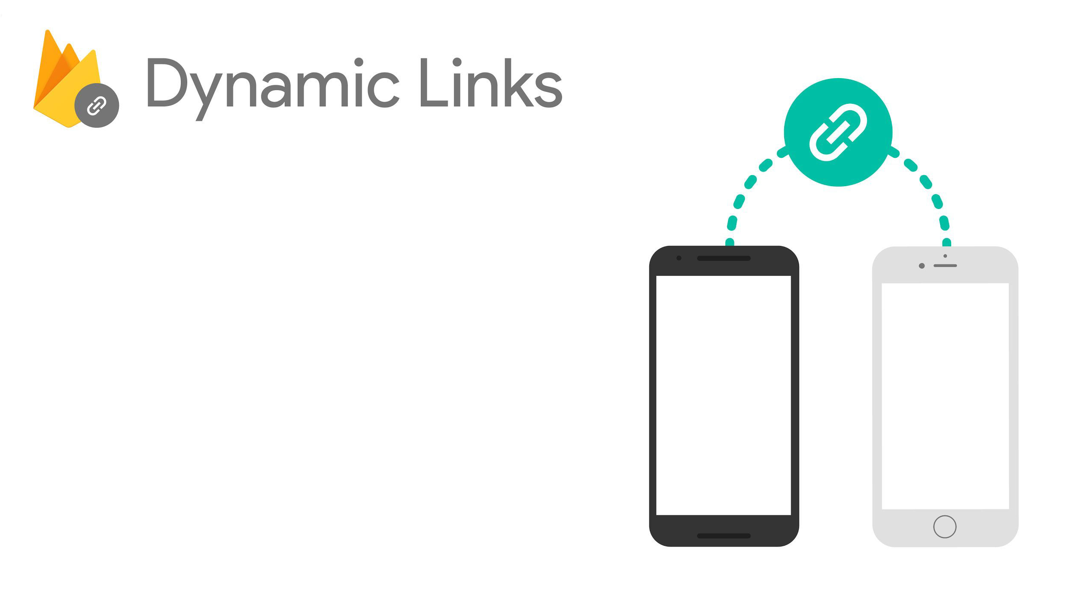


Customize different user
experiences via a single URL
Works across platforms
Preserves URL state, even through app install flow
Analytics insights

Slide 21
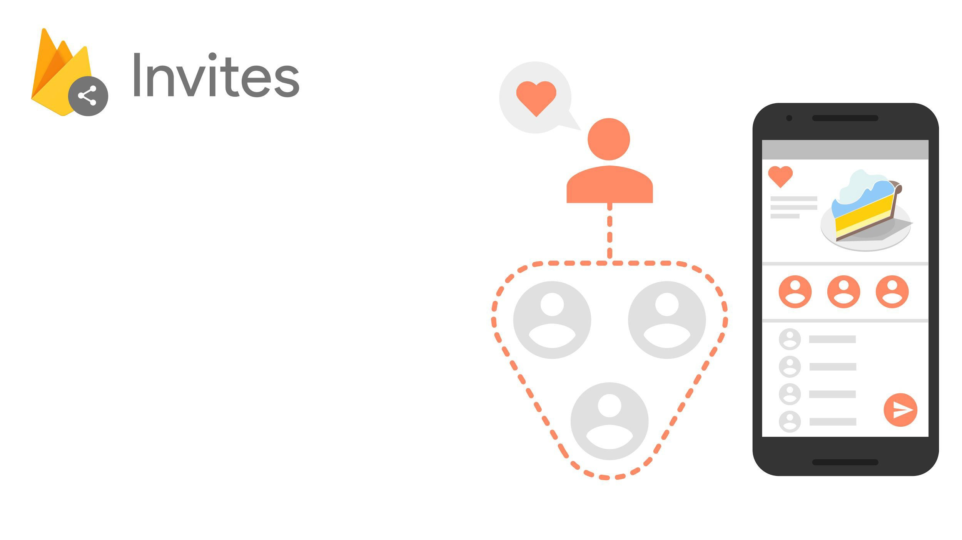
Drop-in widget for app sharing
Supports SMS and Email
Recipient suggestions from
Google
Built on Dynamic Links

Slide 22
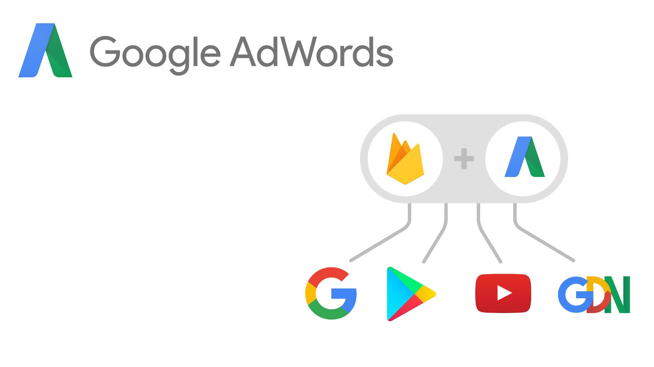
Universal App Campaigns
2B downloads to date
⋅Android & iOS
Audience re-targeting
Conversion tracking and optimization

Slide 24
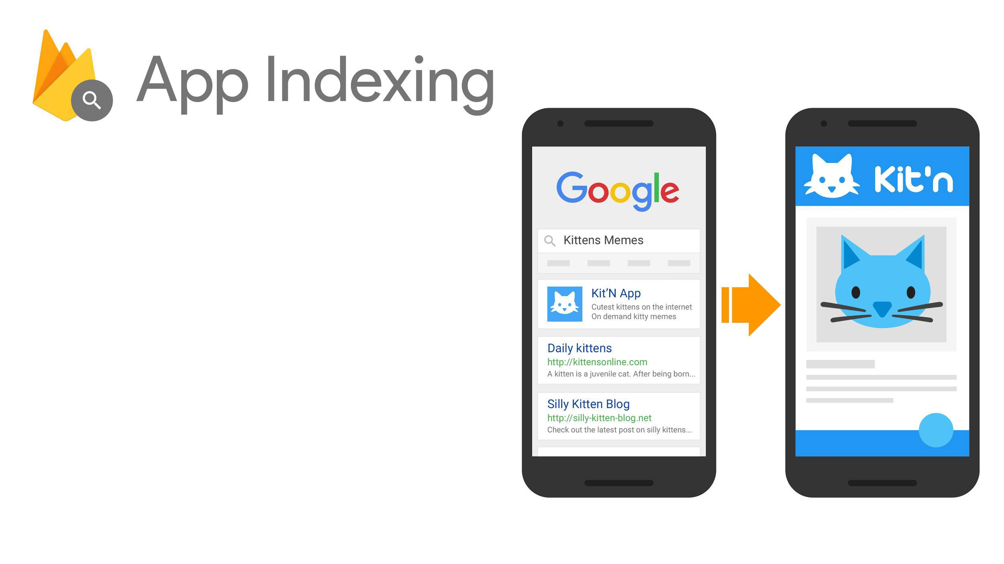
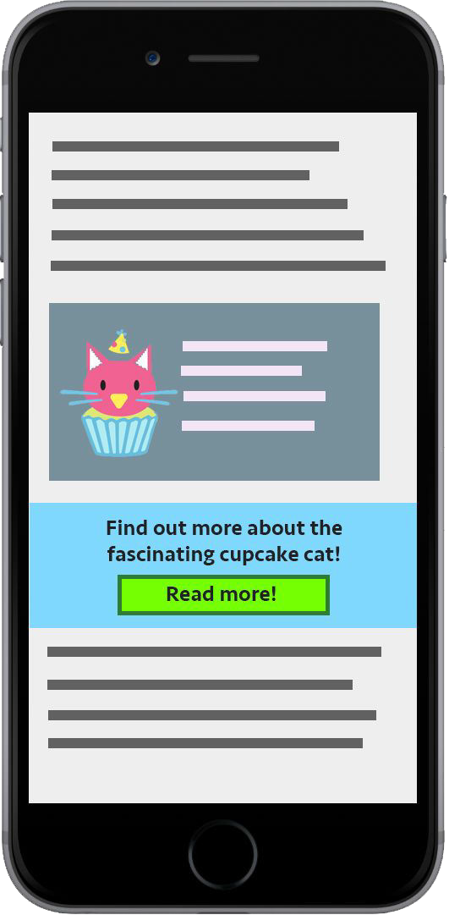

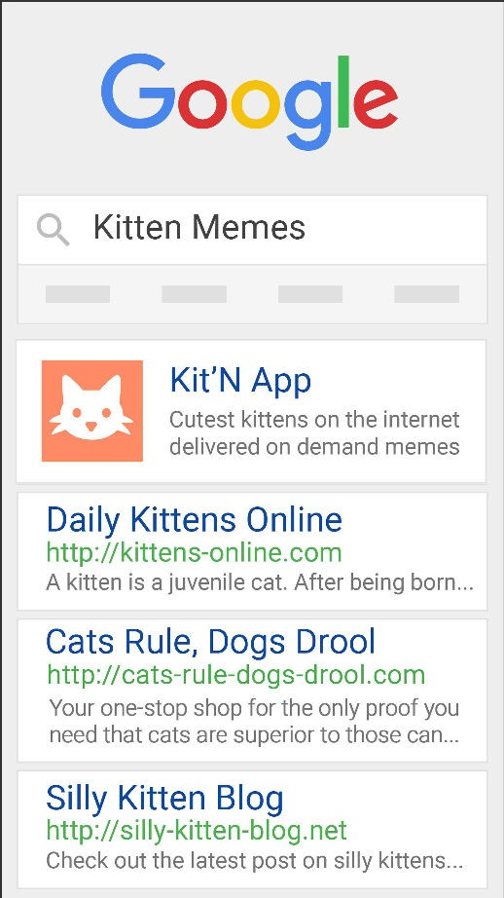
Integrate with Google Search
Index app content
Boost search ranking

Slide 25
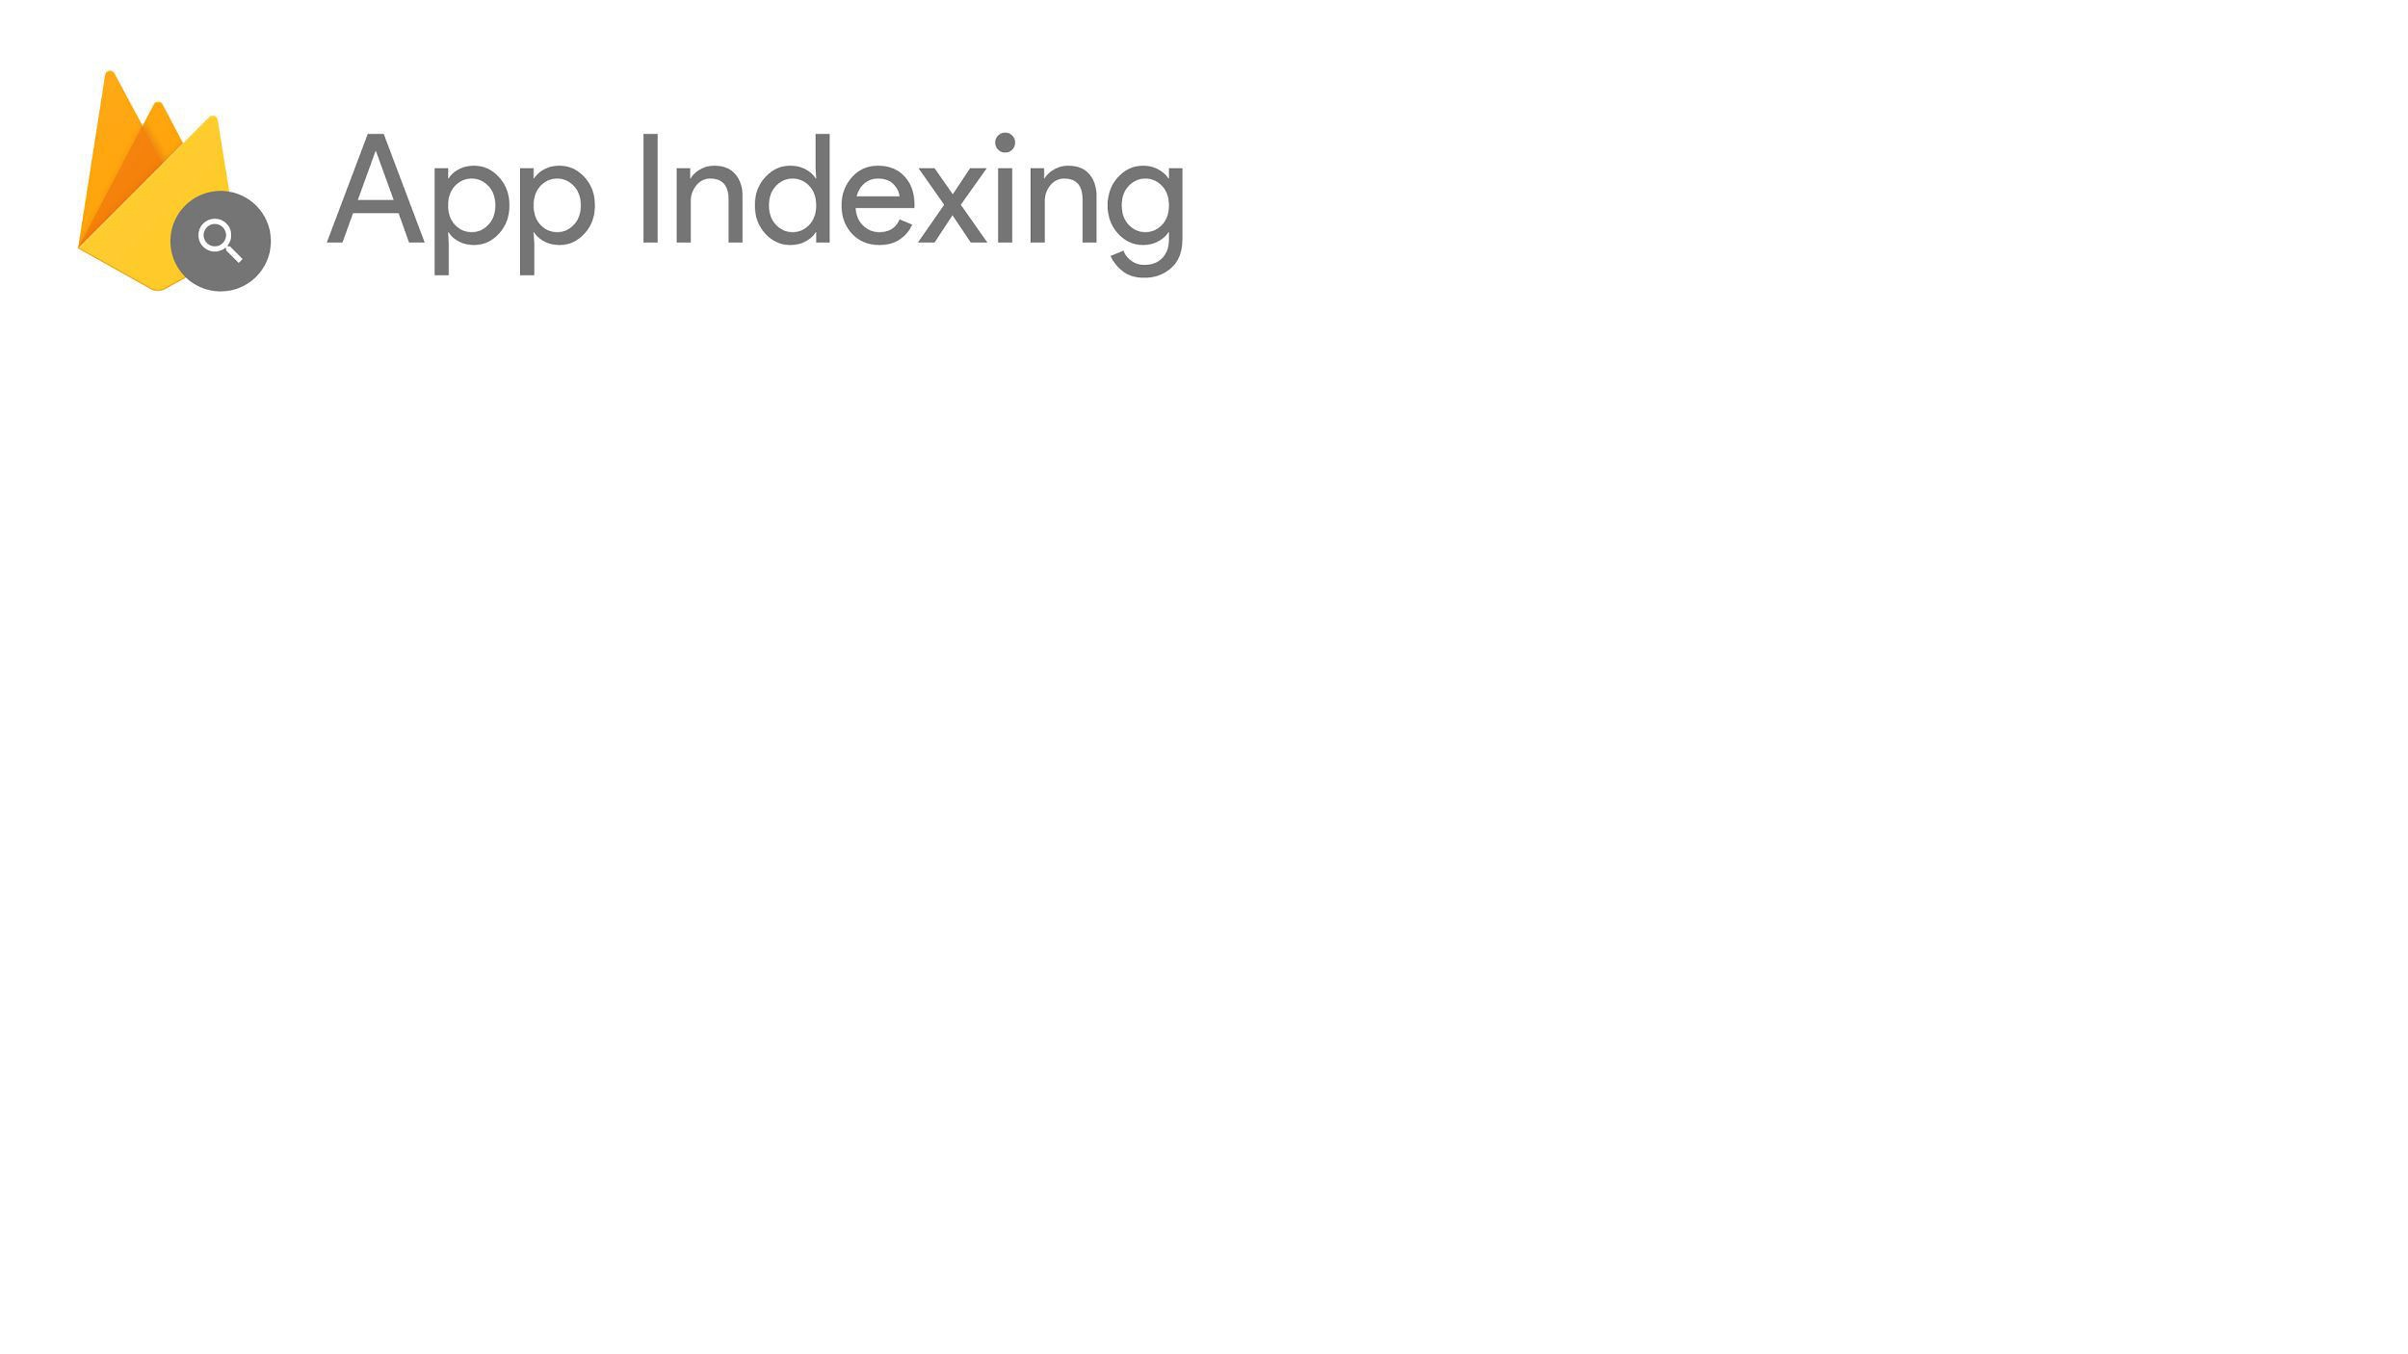


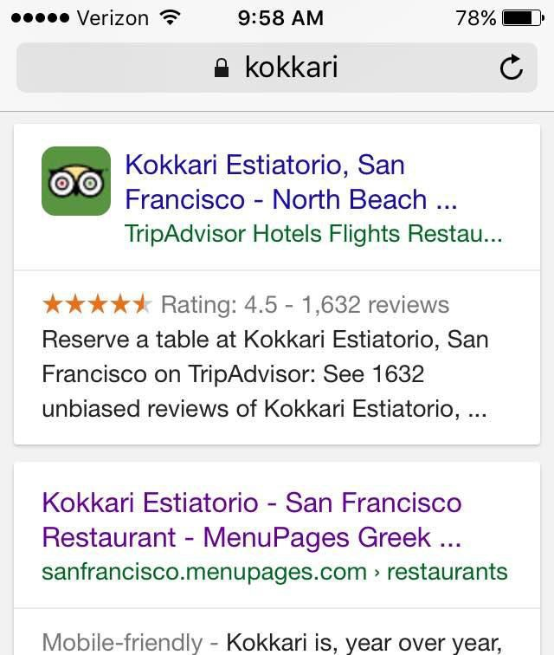
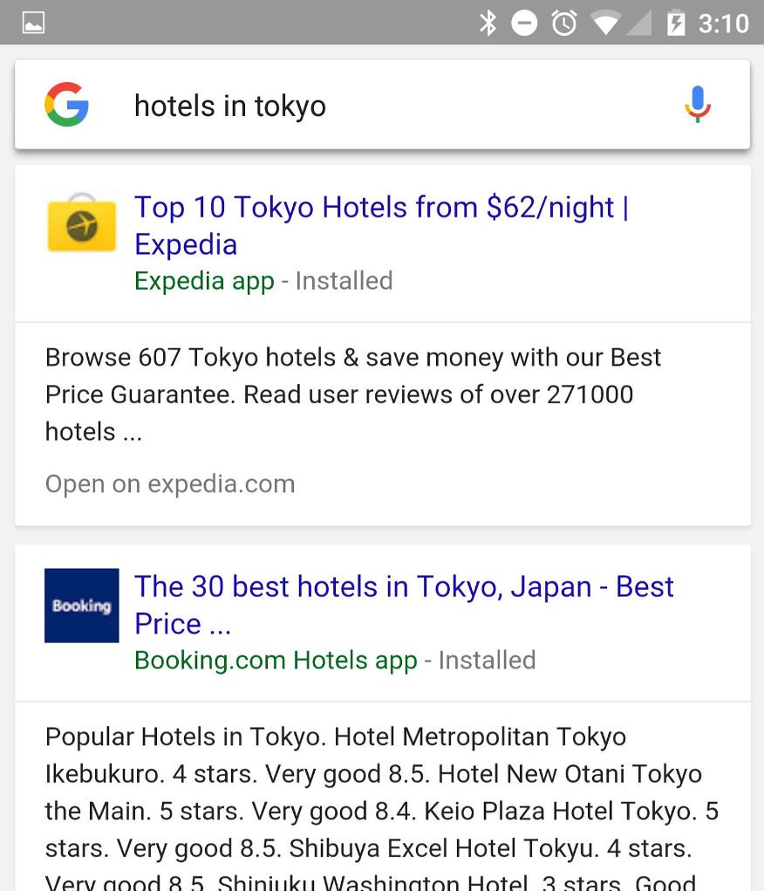

Slide 26
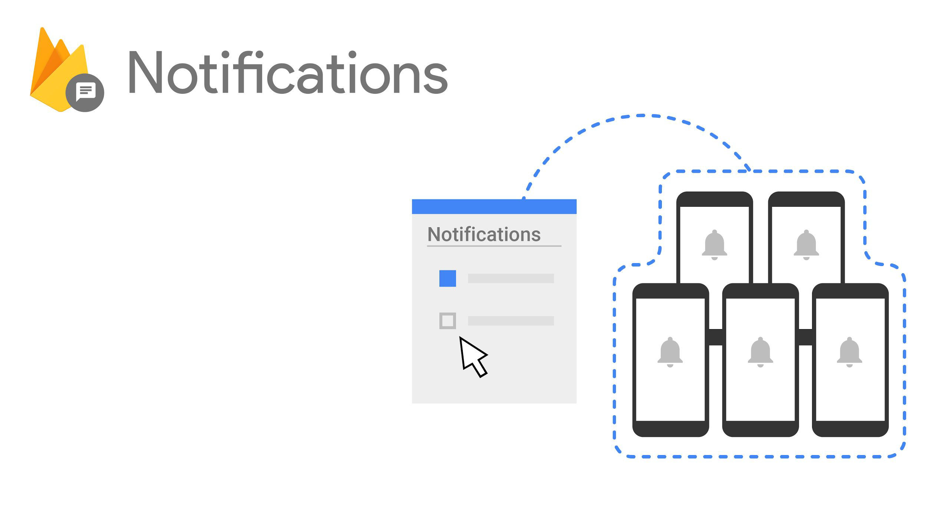

Simple UI, with no coding
Built on Cloud Messaging
Audience targeting
Conversion funnel insights

Slide 27
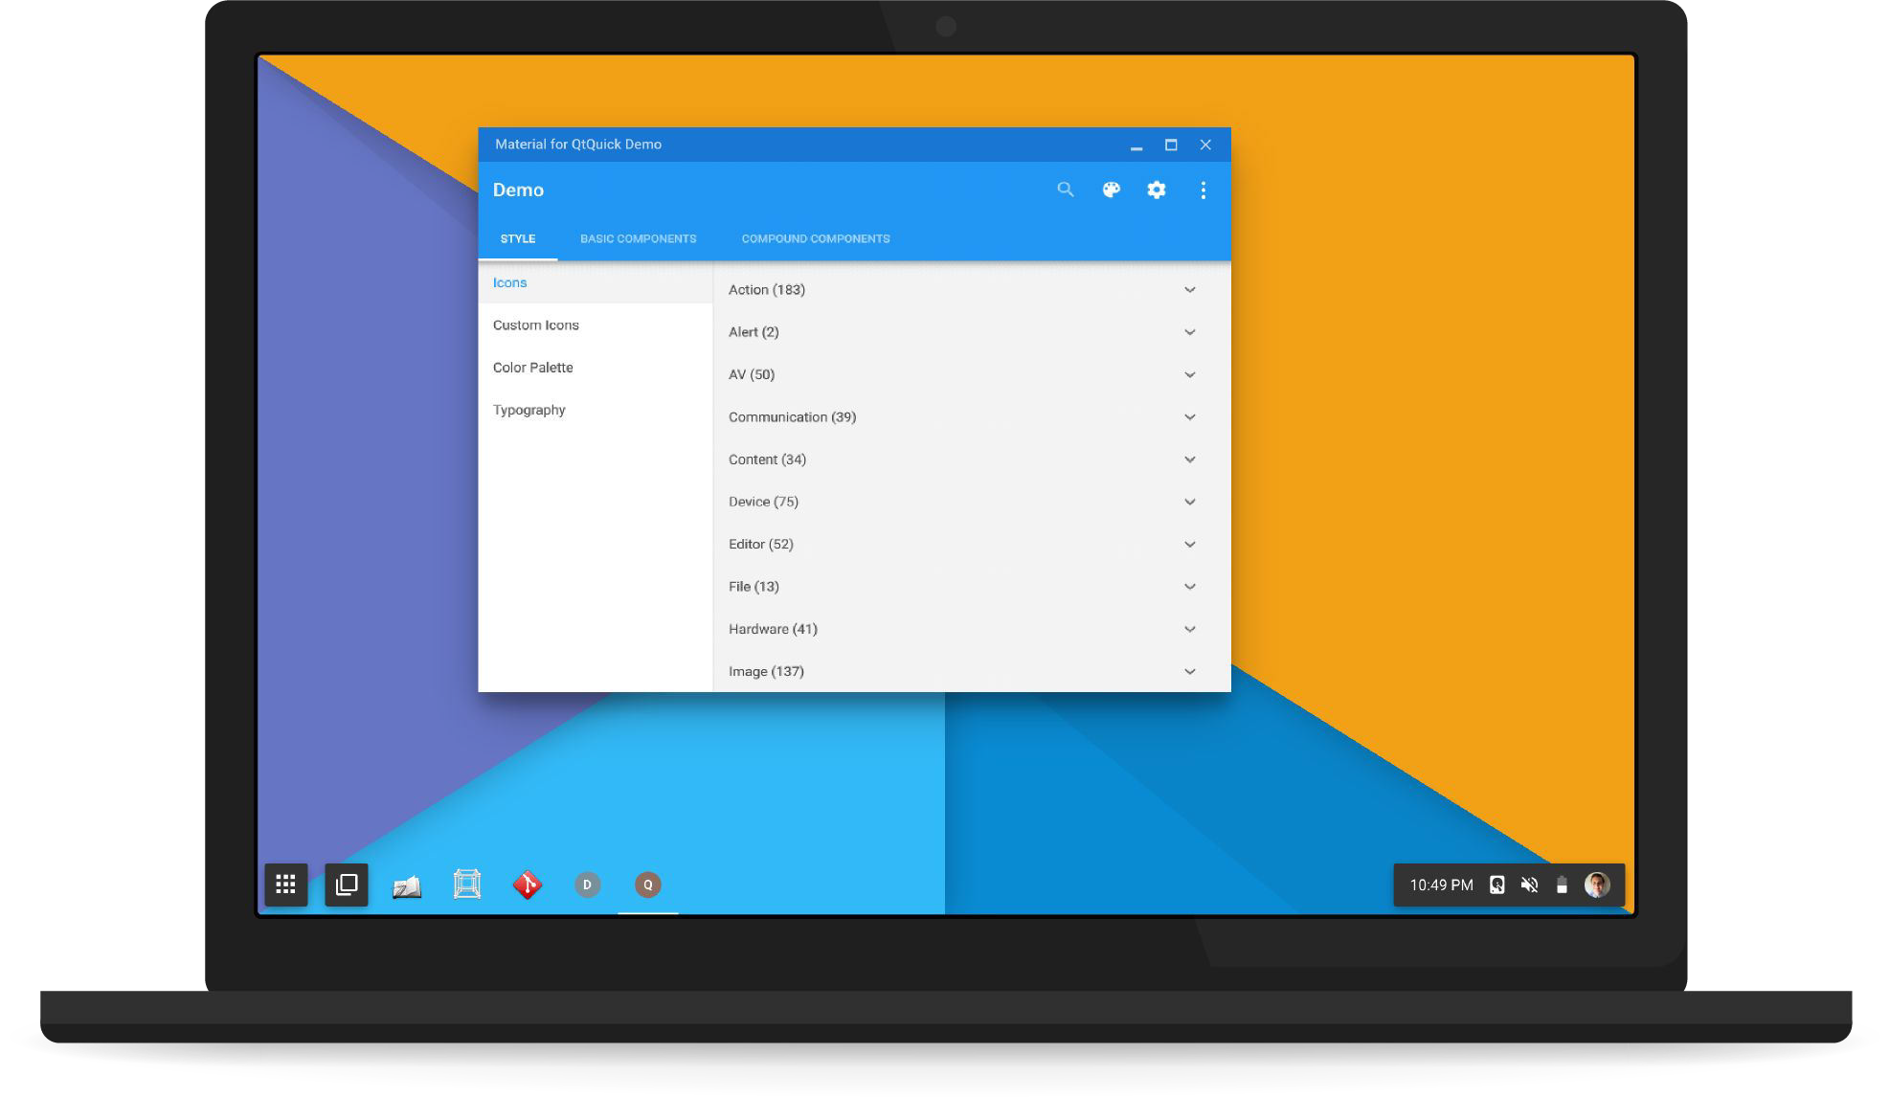
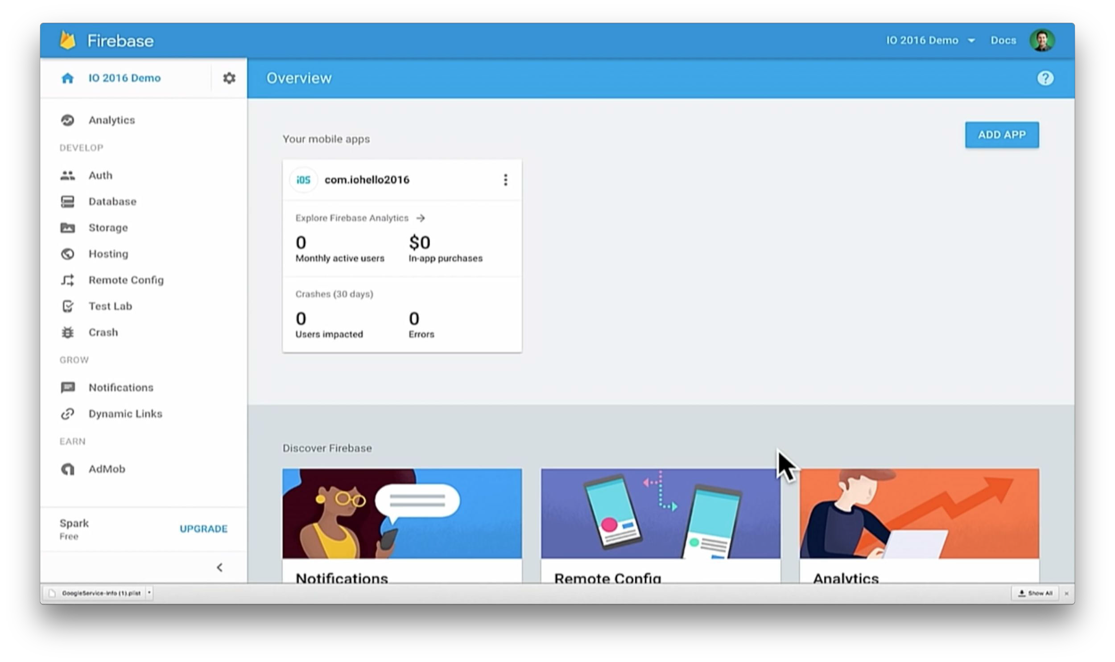
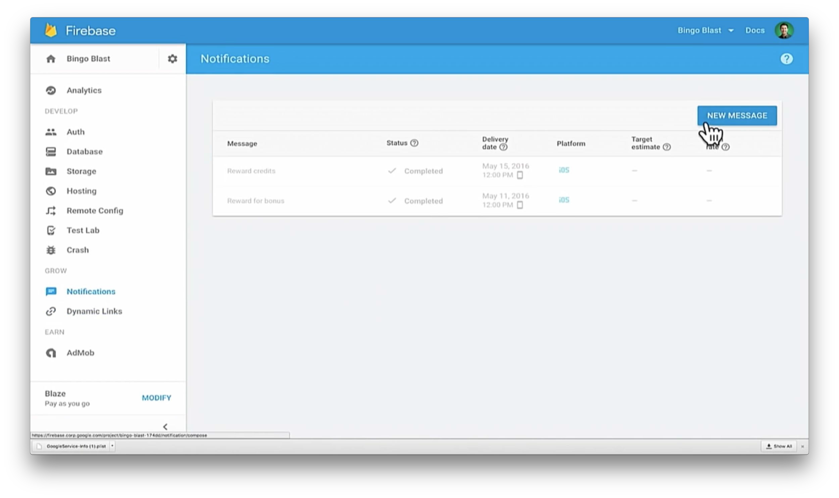

Slide 28
Earn from your app

Slide 29
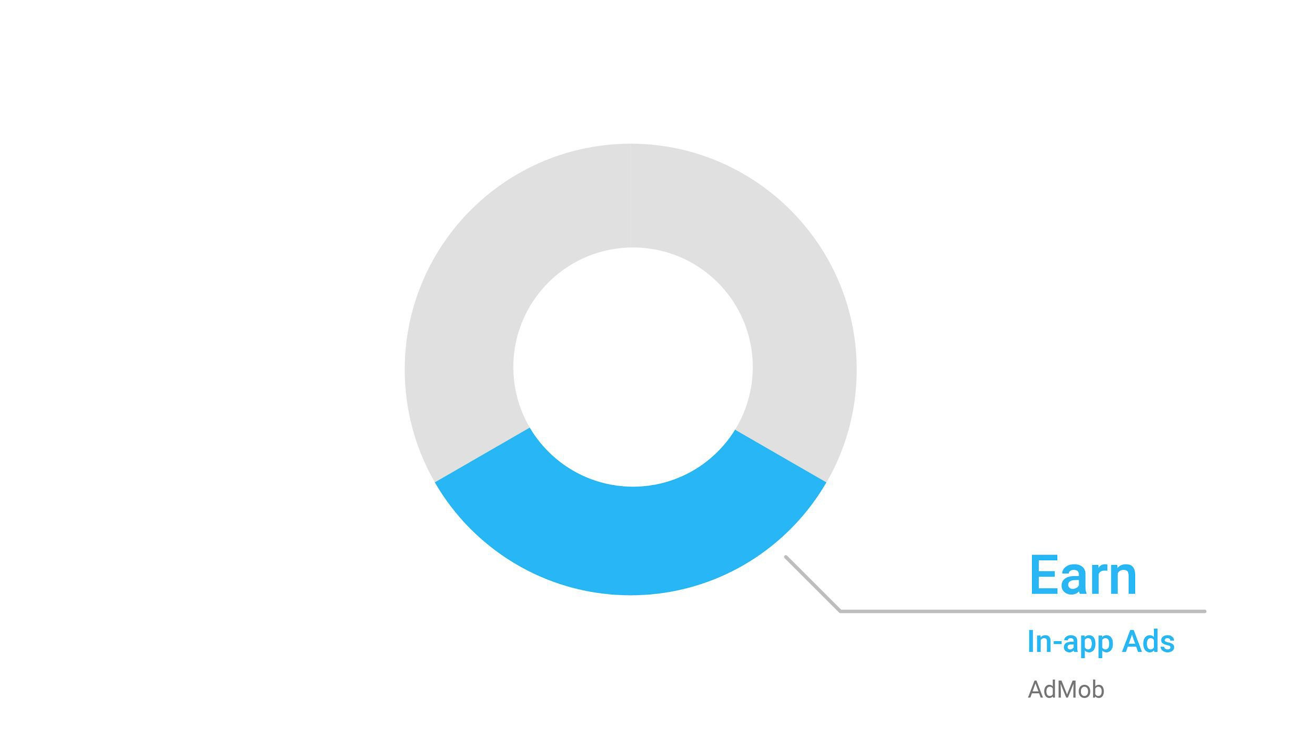

Slide 30
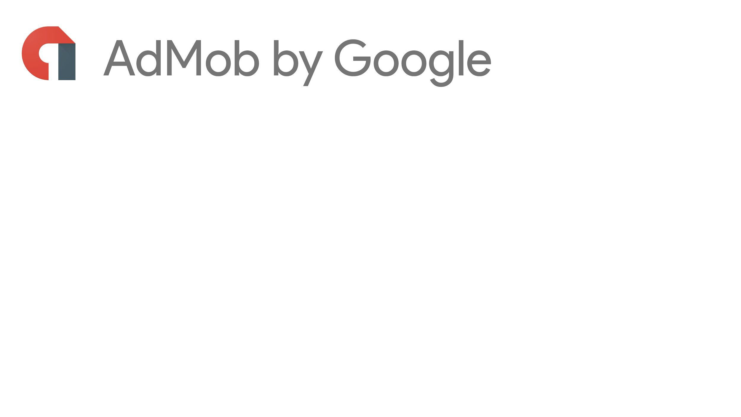


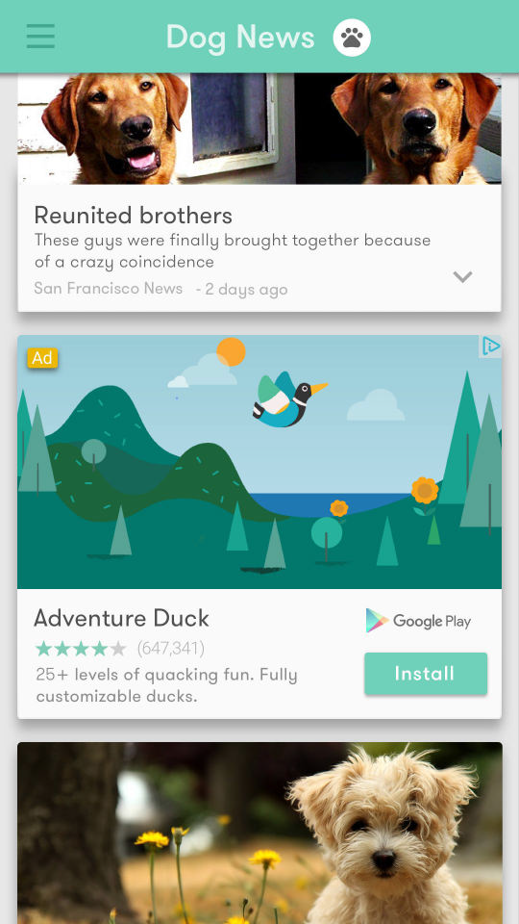


Engaging formats: video, interstitial & native
1M+ apps using AdMob
Integrated with Firebase SDK

Slide 31
Firebase Pricing

Slide 32
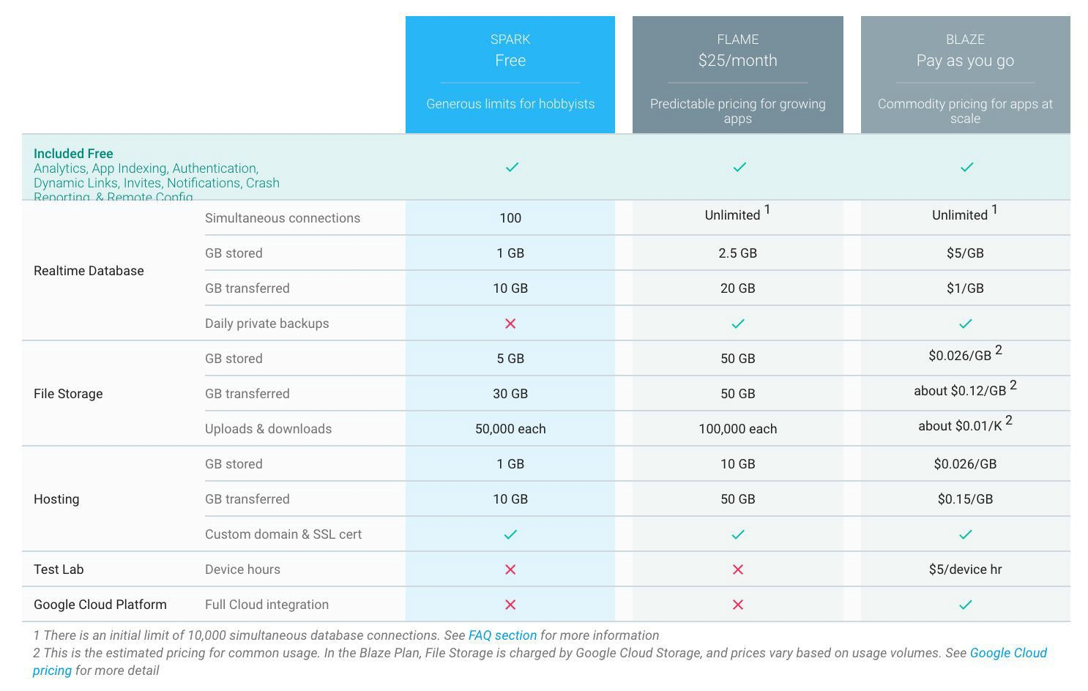

Slide 33

More Firebase
Sample app: FriendlyPix
github.com/firebase/friendlypix
Codelab: FriendlyChat
github.com/firebase/friendlychat
firebase.google.com
youtube.com/firebase
twitter.com/firebase
Get help and join the conversation
firebase.google.com/support
For this presentation check here
github.com/wangerekaharun/firebase
https://bitbucket.org/wangerekaharun/firebase

