Slide 1


Slide 2
Firebase : The Series
#firebasetheseries
@wangerekaharun
A series of firebase codelabs and presentations for both web and android application

Slide 3
PART 2
(Connecting your app to Firebase)
Add Firebase to your Android Project
Add Push Notifications to the app(demo)
What’s new in Firebase in ~ I/O ‘17
Firebase: The Series on GitHub

Slide 4
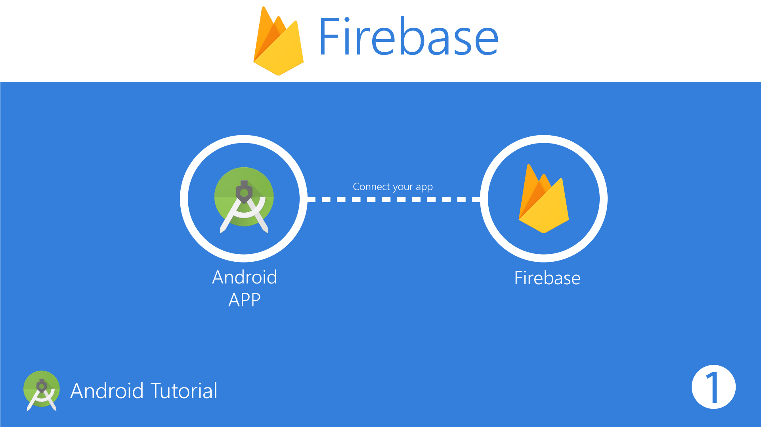

Slide 5
Add Firebase to Your Android Project
Prerequisites
A device running Android 4.0 (Ice Cream Sandwich) or newer, and Google Play services 10.2.6 or higher
The Google Play services SDK from the Google Repository, available in the Android SDK Manager
The latest version of Android Studio, version 1.5 or higher

Slide 6
Use the Firebase Assistant
To open the Firebase Assistant in Android Studio:
Click Tools > Firebase to open the Assistant window.
Click to expand one of the listed features (for example, Analytics), then click the provided tutorial link (for example, Log an Analytics event).
Click the Connect to Firebase button to connect to Firebase and add the necessary code to your app.

Slide 7


Slide 8


Slide 9
Fabric
Crahslytics is going to be integrated into Firebase as the main crash reporting solution.
Digits technology will allow phone number authentication in Firebase, free for up to 10,000 verifications — which should cover most of the regular apps out there.
Phone authentication is available now on iOS and Web and comming to Android in the next weeks.
Digits SDK will be deprecated in the coming weeks, so keep an eye onDigits blog for more info on migration tools.

Slide 10
Opensource
All Firebase SDKs are now open source https://opensource.google.com/projects/firebase-sdk
Firebase Cloud Functions
Cloud functions now integrate with Hosting to provide full dynamic webapps.
Firebase Storage
You can now map existing storage buckets into your Firebase project.
The region in which your data is going to be stored now can be chosen. This is great for legal & performance reasons.

Slide 11
Firebase Database
Expanding to 100,000 simultaneous connections.
Introducing profiler to allow you to introspect bandwidth and latency at path level.
Performance Monitor (beta)
New dashboard to get insights about your app network response latency, success rate, payload size, etc.
Requires you to add a new sdk dependency into your app
https://firebase.google.com/docs/perf-mon/
It uses something called traces to measure time based events. Some are already defined but you can add your own.

Slide 12
Test Lab
Adding first-class support for games: game tests can now run on test lab.
Test lab now allows you to simulate different network conditions, like 4G, 3G, or slower ones.
Expanding device seleccion to Google Pixel and Galaxy S7.
Access to the lates version of Android O.
Firebase Alpha
You can now sign up to get the new stuff before it’s released and provide feedback about it at https://services.google.com/fb/forms/firebasealphaprogram/

Slide 13
Firebase: The Series
Github Repo
https://github.com/wangerekaharun/Firebase-The-Series
Part 1 : Introduction to Firebase
Part 2 : Connecting your app to Firebase
Part 3 : Demo Android App
COPYRIGHT 2017 Apps:Lab Limited
www.appslab.co.ke

