Slide 1
Learning Image Representations for Clustering
Fashion-MNIST: raw pixels, PCA, AE, and VAE
Week 5 mini research project
Question: how does the representation change K-means clustering?
1

Slide 2
Question and dataset
• Fashion-MNIST contains 28 × 28 grayscale clothing images.
• I trained on 20,000 images and evaluated clustering on 10,000 test images.
• Labels were used only after clustering to calculate NMI and ARI.
2

Slide 3
Four representations, one clustering method
• Raw pixels: flatten each image to 784 values.
• PCA: reduce pixel vectors to 20 components.
• AE: use the encoder’s 20-value latent vector.
• VAE: use the encoder’s 20-value mean vector.
• K-means stays fixed at K = 10 for every comparison.
3

Slide 4
AE and VAE
Autoencoder
Variational autoencoder
Image → encoder → z → decoder → reconstruction
Learns to rebuild the input image.
Image → encoder → μ and log σ² → sampled z → decoder
Reconstruction and KL loss shape the latent space.
For VAE clustering, I used μ because it does not change with sampling.
4

Slide 5
Experimental setup
Setting | Value
AE / VAE architecture | 784 → 256 → 64 → latent → 64 → 256 → 784
Optimizer | Adam, learning rate 0.001
Batch size / epochs | 256 / 5
Latent dimensions | 2, 10, 20, 50
K-means | K = 10, n_init = 10, random_state = 42
Week 3 classification: MLP 88.04% | CNN 91.55% (Fashion-MNIST test accuracy)
5

Slide 6
Clustering comparison
Representation | Dimension | NMI | ARI
Raw pixels | 784 | 0.5145 | 0.3497
PCA-20 | 20 | 0.5138 | 0.3506
AE-20 | 20 | 0.4471 | 0.2633
VAE-20 | 20 | 0.5713 | 0.4038
VAE-20 led this run; AE-20 fell below raw pixels and PCA-20.
6

Slide 7
VAE dimension changes the result
Dimension | Recon BCE | VAE loss | NMI | ARI
2 | 266.81 | 274.75 | 0.5327 | 0.3579
10 | 249.30 | 265.45 | 0.5548 | 0.3911
20 | 253.31 | 272.02 | 0.5713 | 0.4038
50 | 262.33 | 277.50 | 0.5095 | 0.3478
Lowest reconstruction BCE and VAE loss: d = 10. Best clustering: d = 20.
A lower VAE loss did not guarantee a higher NMI or ARI.
7

Slide 8
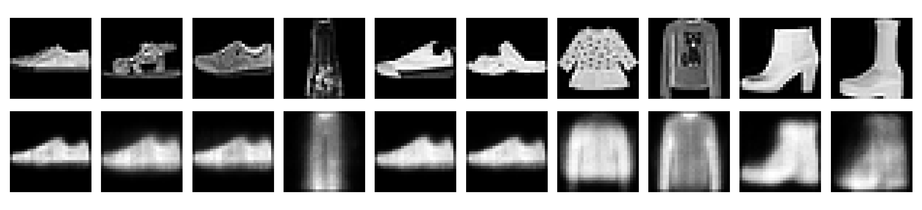
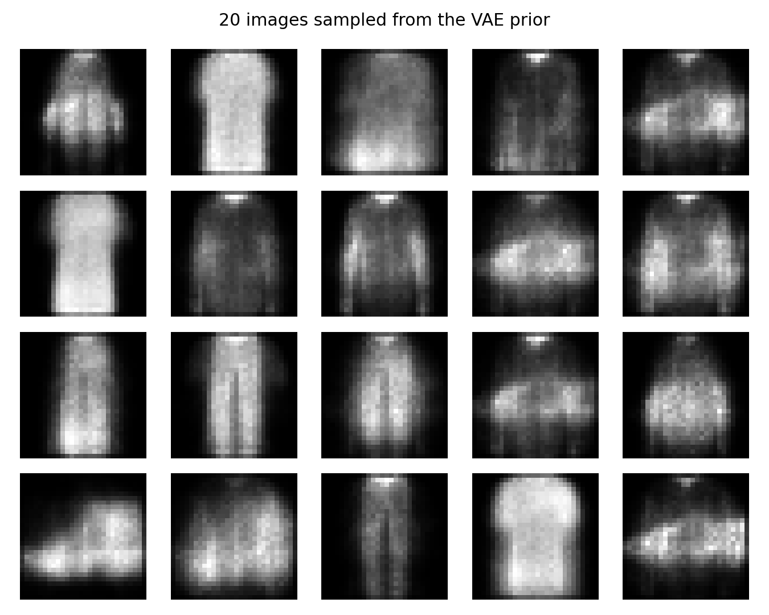
Reconstruction and generation
Top: 10 inputs and their reconstructions.
Right: 20 new images sampled from N(0, I).
Many generated images are recognizable but blurry.
8

Slide 9
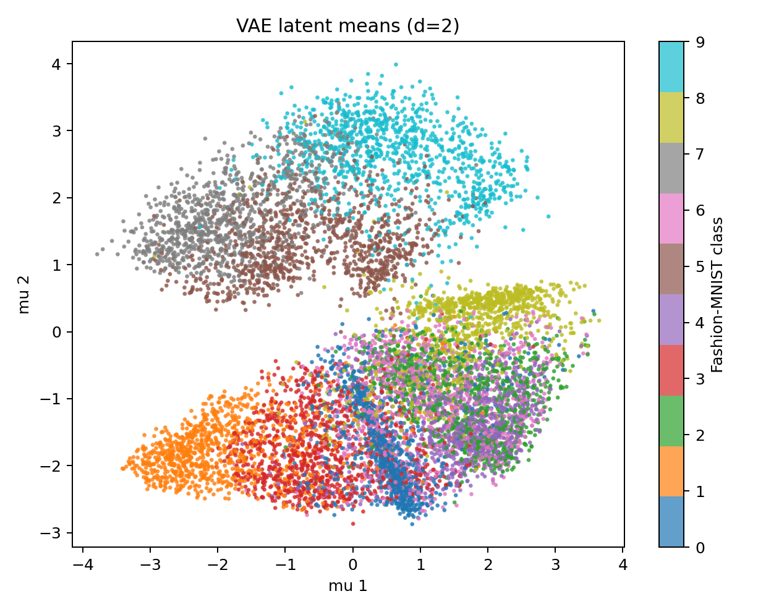
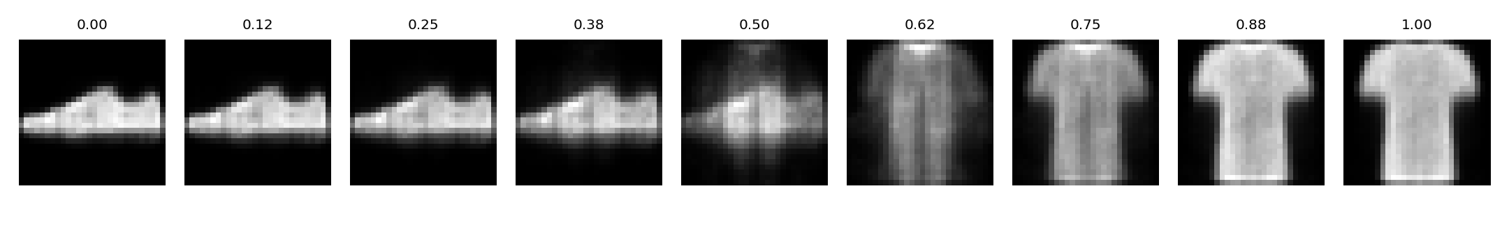
Latent space and interpolation
The 2D latent space has some visible class regions, but many colors overlap.
The sneaker-to-T-shirt interpolation changes gradually.
9

Slide 10
Conclusions and next steps
• Representation choice changed the K-means scores even though K-means stayed fixed.
• VAE-20 reached NMI 0.5713 and ARI 0.4038 in this run.
• Reconstruction quality alone did not predict clustering quality.
• Next: repeat across seeds, train longer, and try a convolutional VAE.
Main limit: five epochs and one random seed make this an initial result.
10

