Slide 1

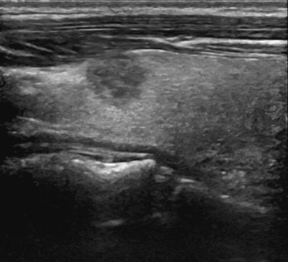
MASK-SAM 架构图
Transformer encoder
Mask decoder
Query
Lx
Backbone
Prompt encoder
Pixel encoder
point
box
mask
Auxiliary module
Freeze

Slide 2
MASK-SAM 架构图
基于掩码注意力机制的 Transformer 编码器
掩码解码器
查询
Lx
骨干网络
提示编码器
级联型像素编码器
点提示
框提示
掩码提示
辅助模块
冻结

Slide 3
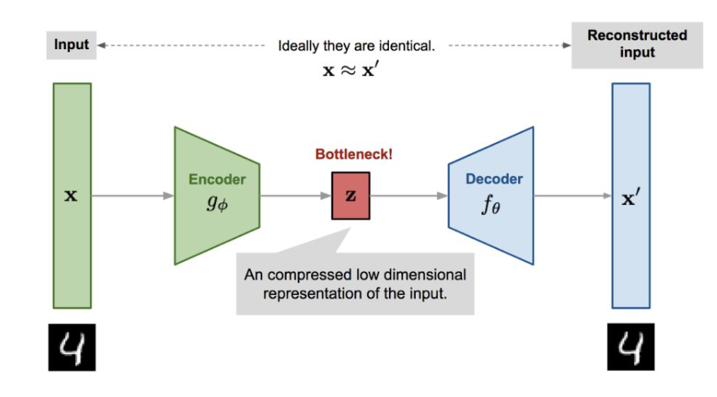
理想情况下
输入
输出
编码层
解码层

Slide 4
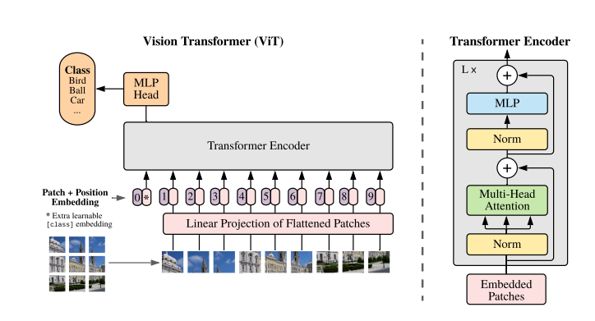
分批次
嵌入
归一化
多头
注意力
归一化
多层
感知层
+
+
递归N次

Slide 5
数据集预处理
步骤一
将每张图像填充为正方形，并调整大小为10124x1024
对图像进行统一的归一化和数据增处理
搭建模型
步骤二
构建模型
定义损失函数
训练模型
步骤三
初始化模型参数，设置超参数
损失函数收敛后，保存模型
性能评估
步骤四
计算IOU， Dice等性能评价指标

Slide 6
Tabel 1 Ablation study on the TN3K test set and prompt
Models | Iou | Dice | Precision
SAM | 0.3200 | 0.4291 | 0.3422
SAM+Unet | 0.6151 | 0.7311 | 0.7500
SAM+(TRFE+） | 0.7495 | 0.8375 | 0.8388
SAM+(BPAT-UNet) | 0.7563 | 0.8423 | 0.8675

Slide 7
Tabel 2 Ablation study on the TN3K test set
Models | Methods/Prompt |  | Iou | Dice | Precision
 | auxiliary module | backbone
SAM |  |  | 0.3200 | 0.4291 | 0.3422
MaskSAM |  |  | 0.5206 | 0.6434 | 0.5603
MaskSAM | ✓ |  | 0.7014 | 0.8030 | 0.7628
MaskSAM | ✓ | ✓ | 0.7600 | 0.8447 | 0.8502

Slide 8
recall: 0.6564, specificity: 0.9483, precision: 0.8245, F1_score:0.6760, acc: 0.8556, iou: 0.5475, mae: 0.1446, dice: 0.6760, hd: 32.0199, auc: 0.8023
Tabel 2 Ablation study on the TN3K test set
模型 | Recall | Accuracy | IoU | Dice | HD95 | Precision
UNet | 0.8007 | 0.9617 | 0.6292 | 0.7379 | 20.5526 | 0.7652
TRFE | 0.8182 | 0.9691 | 0.6850 | 0.7817 | 16.7248 | 0.8248
Deeplabv3+ | 0.4816 | 0.9230 | 0.3638 | 0.4884 | 47.2080 | 0.6848
CPFNet | 0.8101 | 0.9633 | 0.6350 | 0.7490 | 17.1809 | 0.7695
FCN | 0.6564 | 0.8556 | 0.5475 | 0.6760 | 32.0199 | 0.8245
BPAT-UNet | 0.8557 | 0.9722 | 0.7187 | 0.8164 | 14.0578 | 0.8294
TRFE+ | 0.8719 | 0.9713 | 0.7163 | 0.8147 | 12.2701 | 0.8121
MASK-SAM | 0.8891 | 0.9726 | 0.7600 | 0.8447 | 14.3962 | 0.8502

Slide 9
Tabel 2 Ablation study on the TN3K test set
Models | Prompt |  |  | Iou | Dice | Precision
 | point | box | mask
SAM |  |  |  | 0.3200 | 0.4291 | 0.3422
MASK-SAM | ✓ |  |  | 0.5206 | 0.6434 | 0.5603
MASK-SAM |  | ✓ |  | 0.7014 | 0.8030 | 0.7628
MASK-SAM |  |  | ✓ | 0.7600 | 0.8447 | 0.8502

Slide 10
recall: 0.5661, specificity: 0.9613, precision: 0.8369, F1_score:0.6142, acc: 0.8444, iou: 0.4878, mae: 0.1570, dice: 0.6142, hd: 33.0074, auc: 0.7637
Tabel 2 Ablation study on the TN3K test set
DDTI testset | AUC | F1-score | Accuracy | IoU | Dice | HD95 | precision
UNet | 0.8699 | 0.7133 | 0.9578 | 0.5965 | 0.7133 | 23.6443 | 0.7675
TRFE
Deeplabv3+
CPFNet | 0.8965 | 0.7490 | 0.9633 | 0.6350 | 0.7490 | 17.1809 | 0.7695
TransUNet | 0.9278 | 0.7905 | 0.9686 | 0.6926 | 0.8184 | 14.92 | 0.8234
BPAT-UNet | 0.9415 | 0.8164 | 0.9722 | 0.7187 | 0.8164 | 14.0578 | 0.8294
TRFE+ | 0.9278 | 0.8147 | 0.9713 | 0.7163 | 0.8147 | 12.2701 | 0.8121
MASK-SAM | 0.9357 | 0.8447 | 0.9726 | 0.7600 | 0.8447 | 14.3962 | 0.8502

Slide 11
x9
x7
x5
x3

Slide 12
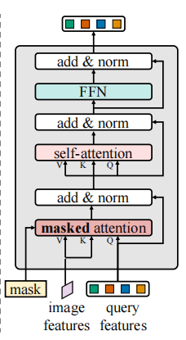
mask
masked attention
self-attention
FFN
image features
K
V
query features
Q

Slide 13
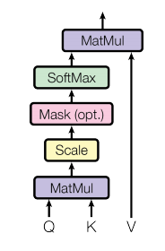
Q
矩阵相乘
缩放
掩码
(可选)
SoftMax
矩阵相乘
K
V

Slide 14
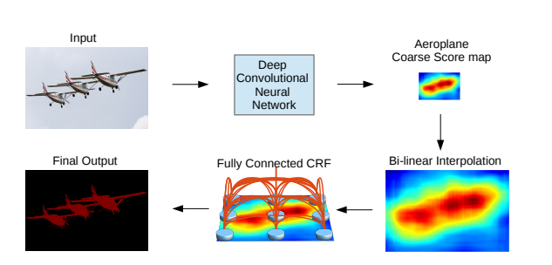
输入图像
深度卷积神经网络
粗略的特征图
输出掩码
双线性插值
双线性插值

Slide 15
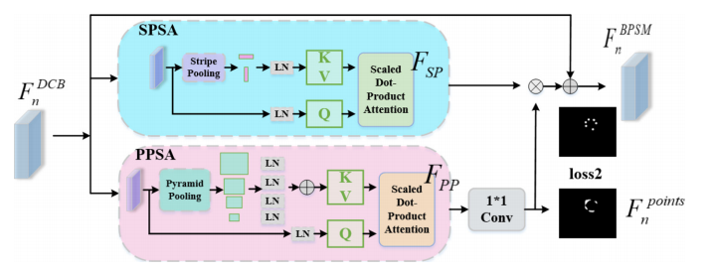
SPSA
条纹池化
点积注意力
×
+
PPSA
条纹池化
点积注意力

