Slide 1
Application of the OHDSI CDM on Korean Healthcare System
Experiences from the OHDSI international data network
October, 20 2015
Department of Biomedical Informatics
Ajou University School of Medicine
Rae Woong Park, MD, PhD

Slide 2
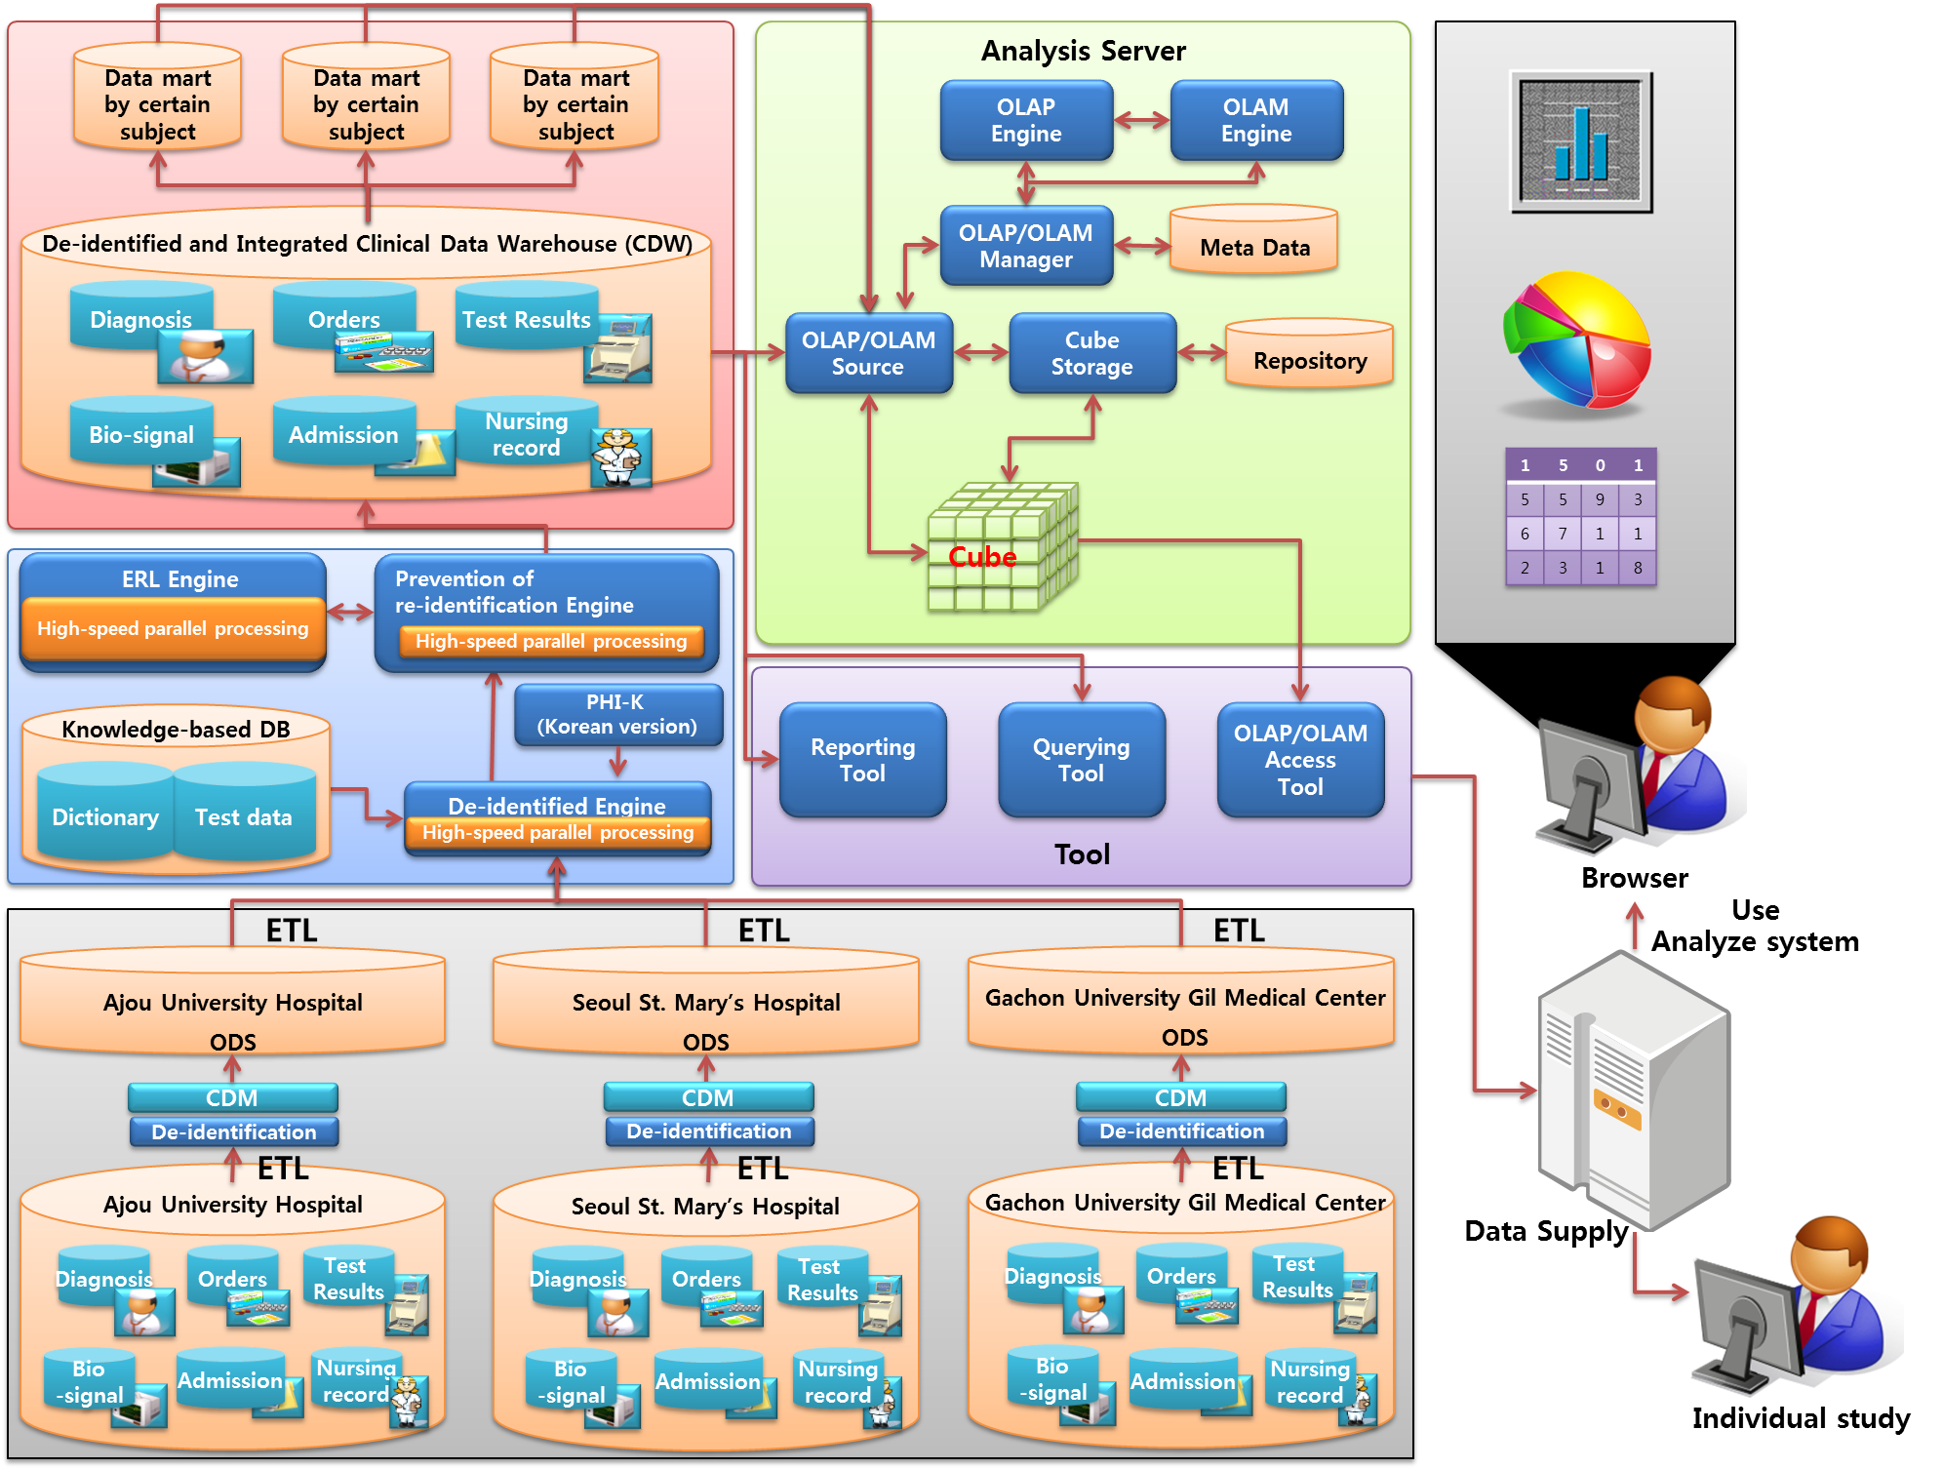
Construction of a de-identified and integrated clinical data warehouse and analysis system
Just finished 3-year project, December 2011 – October 2014

Slide 3
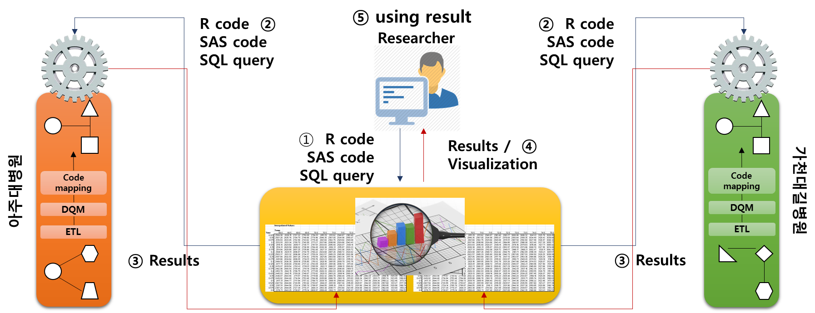
Development of an open-innovative clinical data visualization and analysis service based on OHDSI
Just launched, 3-year project,
December 2014 – October 2017
Ajou Univ. Hospital
2.6 M patients
Integrative Platform for DRN
Gachun Gil Hospital
2.3 M patients

Slide 4
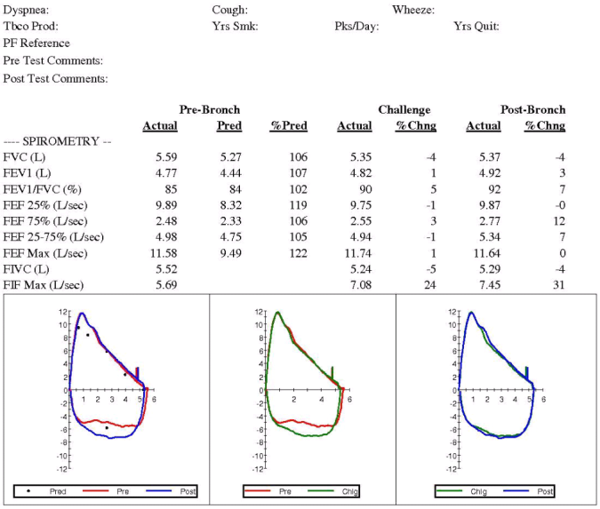
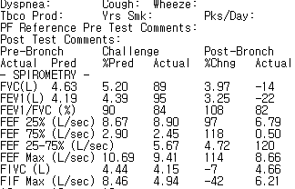



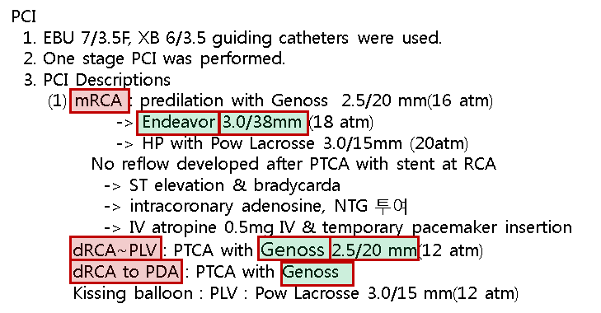

Outcome database construction
1. Paper reports
OCR from free-text medical recording
*OCR: Optical Character Recognition
3. Digitalized data
(lab, med. etc.)
ETL
2. Recordings in free-text format
Parsing
Outcome database

Slide 5



National Infrastructure for Clinical Data Sharing and Secondary Use
Real-time
Batch Process
Real-time feedback
CDSS - allergy, DDI
- Lab results
- medications
- …
4
Hospital
Central Repository
2
3
6
1
Real-time
EMR data
ETL
batch
CDM
(local)
CDW
(integrated)
5
CDW
(Analytics)
Visualizing/
Analytics
EMR
3
Hospital
1
2
3
EMR
CDM
Hospital
1
2
EMR
CDM

Slide 6


National Infrastructure for Clinical Data Sharing and Secondary Use
Hospital A
Central Repository
Hospital B
Center for Clinical Data Exchange
Request for clinical data from other hospitals
3
1
Clinical data in CDM format
4
National Health Information Exchange
Clinical data from other hospitals
CDSS
EMR
EMR
2
Review DB
Secondary Uses
PHR
Public Health
CDSS
Research
Development
Citizens
Government
Clinitians
Industry
Academia

