Slide 1
Method evaluation
Martijn Schuemie

Slide 2
Disclaimer
I am a full-time employee of Janssen R&D
This talk represents my own opinion
At my current location it is already Halloween-eve….

Slide 3

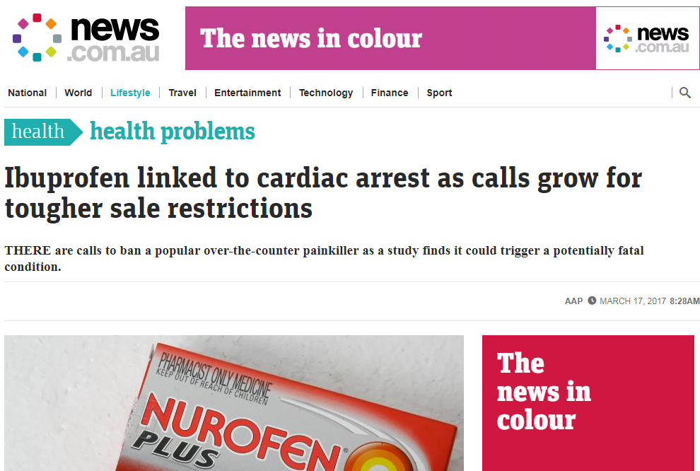
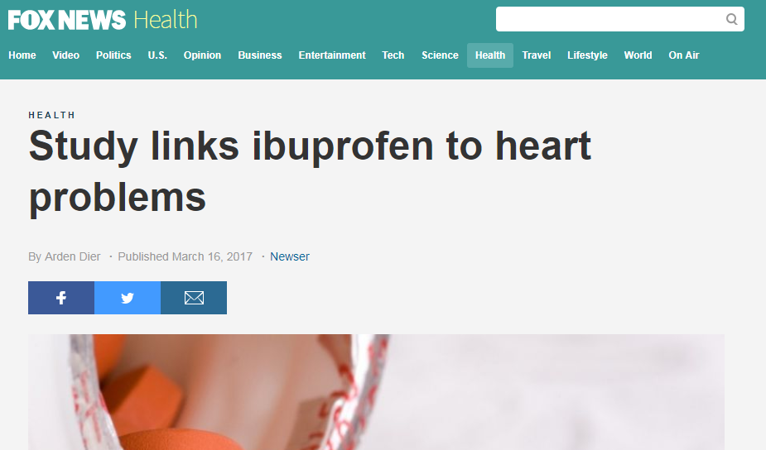
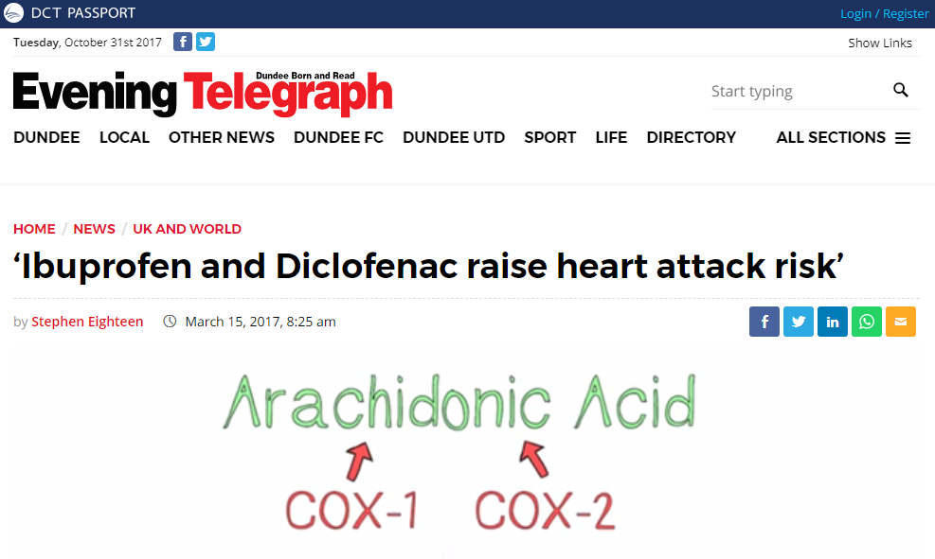
Horrible news!

Slide 4
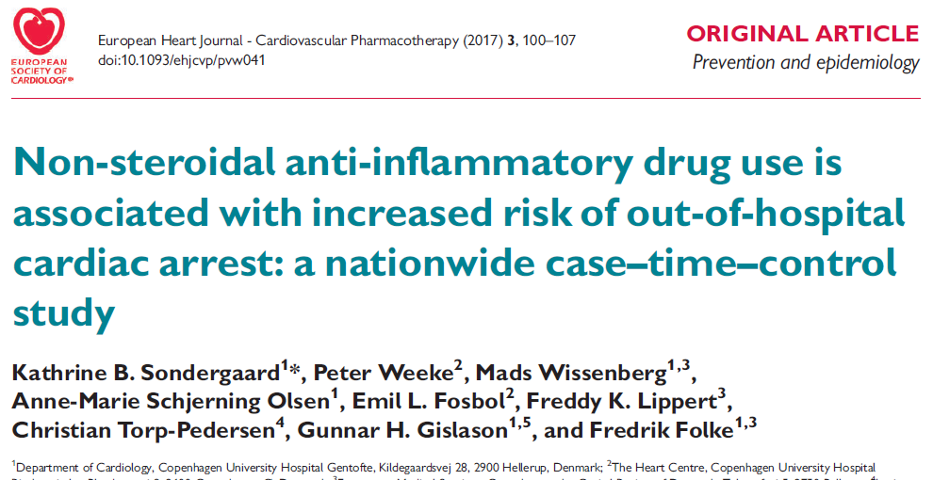
Evidence
Danish study
National cardiac arrest registry (n = 28,947)
Case-time-control design
Ibuprofen – cardiac arrest: OR = 1.31 (1.14-1.51)

Slide 5

How reliable is this?
How reliable is a case-time-control design?
How reliable are observational studies in general?
What about
Confounding?
Measurement error?
Selection bias?

Slide 6

Measuring performance of observational study designs
OBSERVATIONAL
MEDICAL
OUTCOMES
PARTNERSHIP
Original reason for developing the OMOP CDM!

Slide 7
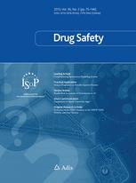
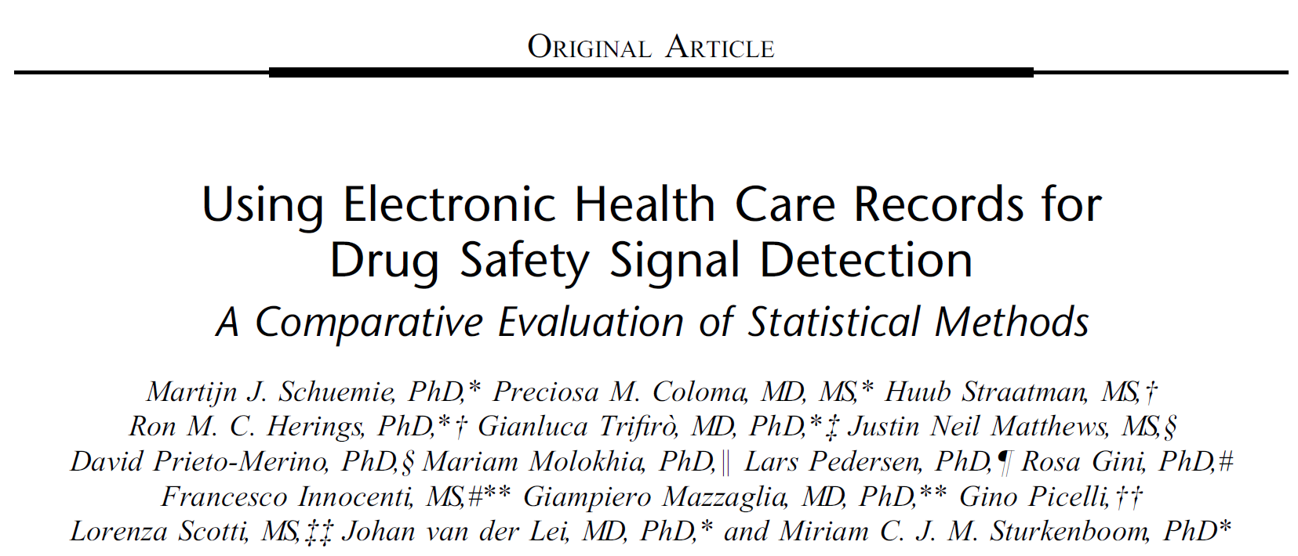
Measuring performance of observational study designs
Gold standard
Drug | Outcome | True effect size
A | X | 1.0
B | Y | 2.0
… | … | …
Methods
Case-control
Cohort method
…
Are estimates in line with the true effect size?
Databases
Database 1
Database 2
…
OBSERVATIONAL
MEDICAL
OUTCOMES
PARTNERSHIP

Slide 8
Issues with previous experiments
Positive controls:
Effect size not known with certainty
Known to doctors
Methods:
Cohort method didn’t use survival model
Self-controlled cohort didn’t truncate to observation period
MSCCS applied shrinkage to drug of interest
…

Slide 9
OHDSI Methods Benchmark
Real negative controls (n = 200)
Pick 4 outcomes and 4 exposures of interest
Acute pancreatitis Diclofenac
GI bleeding Ciprofloxacin
Stroke Metformin
IBD Sertraline
Use LAERTES to identify potential negative controls
Use clinicaltrials.gov + ATC to find potential comparator exposures
Rank by prevalence
Manual review, up to 25 per outcome or exposure of interest
Synthesized positive controls (n = 600)
Based on real negative controls (where true RR = 1)
Fit predictive models for each outcome in exposed population
Sample simulated additional outcomes during exposure based on predicted probability until True RR = desired RR (1.5, 2, and 4)
Target | Comparator | Nesting | Outcome | True effect size
Eszopiclone | Triazolam | Insomnia | Acute pancreatitis | 1
Eszopiclone | Triazolam | Insomnia | Acute pancreatitis, RR=1.5 | 1.5
Eszopiclone | Triazolam | Insomnia | Acute pancreatitis, RR=2 | 2
Eszopiclone | Triazolam | Insomnia | Acute pancreatitis, RR=4 | 4
Ciprofloxacin | Azithromycin | Otitis media | Alcohol abuse | 1
Ciprofloxacin | Azithromycin | Otitis media | Alcohol abuse, RR=1.5 | 1.5
Ciprofloxacin | Azithromycin | Otitis media | Alcohol abuse, RR=2 | 2
Ciprofloxacin | Azithromycin | Otitis media | Alcohol abuse, RR=4 | 4
… | … | … | … | …

Slide 10
OHDSI Methods Benchmark
Can be used both for
Effect estimation: Effect of Target on Outcome
Target | Comparator | Nesting | Outcome | True effect size
Eszopiclone | Triazolam | Insomnia | Acute pancreatitis | 1
Eszopiclone | Triazolam | Insomnia | Acute pancreatitis, RR=1.5 | 1.5
Eszopiclone | Triazolam | Insomnia | Acute pancreatitis, RR=2 | 2
Eszopiclone | Triazolam | Insomnia | Acute pancreatitis, RR=4 | 4
Ciprofloxacin | Azithromycin | Otitis media | Alcohol abuse | 1
Ciprofloxacin | Azithromycin | Otitis media | Alcohol abuse, RR=1.5 | 1.5
Ciprofloxacin | Azithromycin | Otitis media | Alcohol abuse, RR=2 | 2
Ciprofloxacin | Azithromycin | Otitis media | Alcohol abuse, RR=4 | 4
… | … | … | … | …

Slide 11
OHDSI Methods Benchmark
Can be used both for
Effect estimation: Effect of Target on Outcome
Comparative effect estimation: Effect of Target on Outcome compared to Comparator
Target | Comparator | Nesting | Outcome | True effect size
Eszopiclone | Triazolam | Insomnia | Acute pancreatitis | 1
Eszopiclone | Triazolam | Insomnia | Acute pancreatitis, RR=1.5 | 1.5
Eszopiclone | Triazolam | Insomnia | Acute pancreatitis, RR=2 | 2
Eszopiclone | Triazolam | Insomnia | Acute pancreatitis, RR=4 | 4
Ciprofloxacin | Azithromycin | Otitis media | Alcohol abuse | 1
Ciprofloxacin | Azithromycin | Otitis media | Alcohol abuse, RR=1.5 | 1.5
Ciprofloxacin | Azithromycin | Otitis media | Alcohol abuse, RR=2 | 2
Ciprofloxacin | Azithromycin | Otitis media | Alcohol abuse, RR=4 | 4
… | … | … | … | …

Slide 12
OHDSI Methods Library
Set of R packages
Implementing most well-known designs
CDM – to – estimate (+ diagnostics)
Are used in OHDSI studies
Cohort Method
Self-Controlled Case Series
Self-Controlled Cohort
Case-control
Case-crossover
s
s
s
s
s
New-user cohort studies using large-scale regression for propensity and outcome models
Self-Controlled Case Series analysis using few or many predictors, includes splines for age and seasonality.
A self-controlled cohort design, where time preceding exposure is used as control.
Case-control studies, matching controls on age, gender, provider, and visit date. Allows nesting of the study in another cohort.
Case-crossover design including the option to adjust for time-trends in exposures (so-called case-time-control).

Slide 13
Databases
Truven MDCD
(US Insurance claims)
Truven CCAE
(US Insurance claims)
?
(Other OHDSI dbs)

Slide 14
Metrics
Coverage: how often is the truth in the 95% confidence interval?
Type 1 error: how often is the null rejected when the null is true?
Type 2 error: how often is the null not rejected when the null is not true?
…

Slide 15
Results!
http://data.ohdsi.org/MethodEvalViewer/

Slide 16
Overall conclusions
The good
Cohort method using PS matching has high coverage but relatively low power.
The bad
(Nested) case-control has low coverage, often overestimating the true effect size with very narrow confidence intervals.

Slide 17
Evidence
Danish study
National cardiac arrest registry (n = 28,947)
Case-time-control design
Ibuprofen – cardiac arrest: OR = 1.31 (1.14-1.51)

Slide 18

Does Ibuprofen cause heart attacks?
“I have no idea whether that drug is dangerous or not,”
“But I sure as hell know that particular analysis didn’t shed any light on the question.”
David Madigan in Nature 513, 472 (25 September 2014)

Slide 19

Questions?

