Slide 1
HL7 Decision Support Service (DSS) and Virtual Medical Record (vMR) Standards, and OpenCDS Open-Source Implementation
August 14, 2012
HL7 Ambassador Webinar
Kensaku Kawamoto, MD, PhD
Director, Knowledge Management and Mobilization
Assistant Professor, Department of Biomedical Informatics
University of Utah
kensaku.kawamoto@utah.edu

Slide 2
HL7 Decision Support Service (DSS) Standard

Slide 3
Decision Support Service (DSS) – Overview
Business purpose:
  To facilitate implementation and maintenance of clinical decision support (CDS) applications
Approach:
  Evaluates patient data (inputs) using knowledge modules and returns machine-interpretable conclusions (outputs)
Normative HL7/ANSI standard
Notes:
SCT 14May

Slide 4
DSS – Architectural Overview
Institution A
Trigger
Queries for required pt
data
Patient Data Sources
Patient data,
knowledge modules to use
Client Decision Support Apps
Conclusions about patient
Decision Support Service
2
Institution B
Queries for required pt
data
Patient Data Sources
Client Decision Support Apps
1
Knowledge Modules
Notes:
SCT 14May

Slide 5
DSS Knowledge Module (KM) – Components
Descriptive traits
  E.g., authors, keywords, purpose, explanation
Data requirements
  Example
    Input: patient’s list of active problems and medications
    Output: disease management recommendations
Semantic requirements
  Example
    Input Requirement: HL7 Continuity of Care Document (CCD), HL7 vMR Input
    Output Requirement: HL7 Care Plan, HL7 vMR Output
Notes:
SCT 14May

Slide 6
DSS KM – Sample Inferences
Sample Evaluation Input | Sample Evaluation Output
Patient age, gender, past health maintenance procedures | List of health maintenance procedures due or almost due
Medication identifier, age, gender, weight, serum creatinine level | Recommended maximum and minimum doses for medication given patient's estimated renal function
Insurance provider, data relevant to prescription | Prior authorization to prescribe medication
CCD | Wide range of care recommendations
Notes:
SCT 14May

Slide 7
DSS – Primary Service Operations
1. Evaluate Patient
Decision Support Service
Modules to use, required data
Service Client
Patient-specific evaluation results
2. Find Knowledge Modules
Search criteria
Modules meeting criteria
3. Describe Knowledge Module
Module of interest
Description of module
4. Get Data Requirements
Modules of interest
Data requirements
Notes:
SCT 14May

Slide 8
HL7 Virtual Medical Record (vMR) Standard

Slide 9
Background
A “holy grail” of clinical informatics is scalable, interoperable CDS
Key requirement for interoperable CDS and re-use of CDS knowledge resources = use of a common patient data model
  Referred to as a “Virtual Medical Record” or vMR (Johnson et al., AMIA Annu Symp Proc, 2001)
Lack of a common vMR has been a major barrier to sharing knowledge and scaling CDS
Notes:
SCT 14May

Slide 10
Example Challenge without VMR
Observation Blood Pressure
Code = BP Systolic = 120 mmHg
Value = 120/80 mmHg Diastolic = 80 mmHg
Observation Vital Sign
Code = BP Type = BP
Observation Value = 120/80
Code = SBP Units = mmHg
Value = 120 mmHg
Observation
Code = DBP
Value = 80 mmHg
Notes:
SCT 14May

Slide 11
vMR Goal
Provide common information model upon which interoperable clinical decision support resources (e.g., rules) can be developed

Slide 12
Project History
Analysis of data required by 20 CDS systems from 4 countries (Kawamoto et al., AMIA 2010)
Refinement of vMR via implementation within OpenCDS
Adopted in September 2011 as Informative Specification

Slide 13
Why Not Just Use the CCD as the vMR?
CCD does not include all needed information
  E.g., Family history model suitable for CDS
CCD is not sufficiently intuitive for direct use by CDS knowledge authors
Notes:
SCT 14May

Slide 14
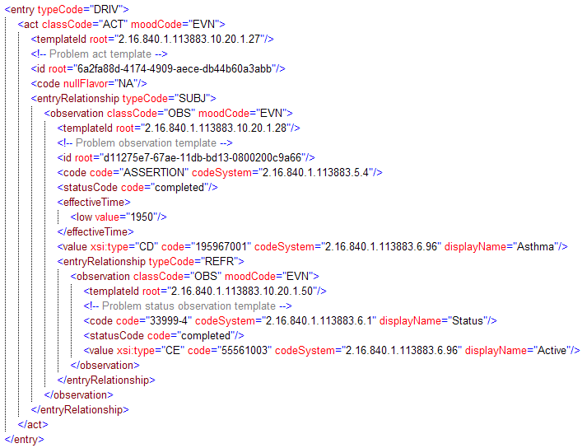
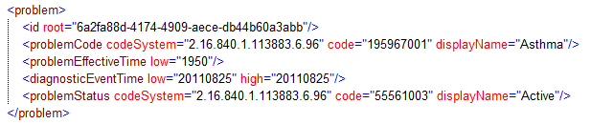
Problem Model – CCD vs. VMR
Notes:
SCT 14May

Slide 15
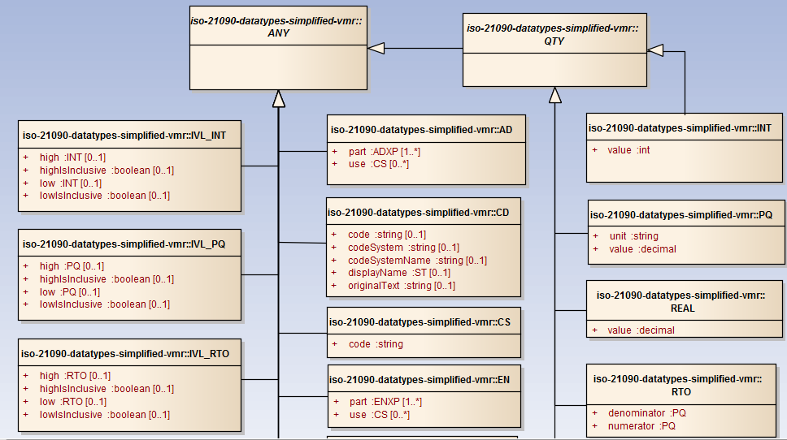
Simplified ISO 21090 Data Types
Notes:
SCT 14May

Slide 16
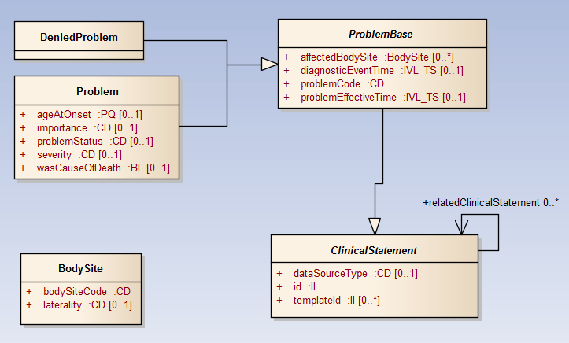
Example Clinical Statement
Notes:
SCT 14May

Slide 17
Further Information
DSS:
http://hssp-dss.wikispaces.com/hl7_specification
vMR:
http://wiki.hl7.org/index.php?title=Virtual_Medical_Record_(vMR)
Notes:
SCT 14May

Slide 18
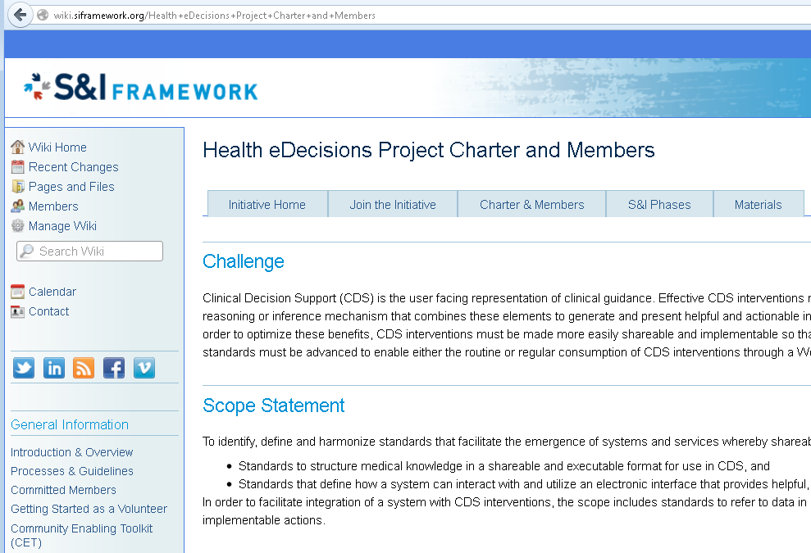
Consideration for MU Stage 3 CDS Criteria
Notes:
SCT 14May

Slide 19
OpenCDS

Slide 20
OpenCDS
Goal
  Facilitate widespread availability of advanced CDS capabilities through open-source, collaborative development of standards-based DSS infrastructure, tooling, and high-value services
Methods
  Support HL7 DSS and vMR standards
  Leverage open-source JBoss Drools rules engine
  Develop all components required to author, test, and operationally support standards-compliant DSSs
1.0 release freely available under Apache 2 open-source license

Slide 21















Collaborators

Slide 22
OpenCDS – Architectural Overview
Standard Interface:
HL7 Decision Support Service Standard
(http://hssp-dss.wikispaces.com)
Standard Data Models:
HL7 Virtual Medical Record (vMR) Standard
[ http://wiki.hl7.org/index.php?title= Virtual_Medical_Record_(vMR) ]
Institution A
Trigger
Queries for required pt
data
Patient Data Sources
Patient data,
knowledge modules to use
Client Decision Support Apps
Conclusions about patient
Decision Support Service
Institution B
Queries for required pt
data
Patient Data Sources
Client Decision Support Apps
Knowledge Modules
Notes:
SCT 14May

Slide 23
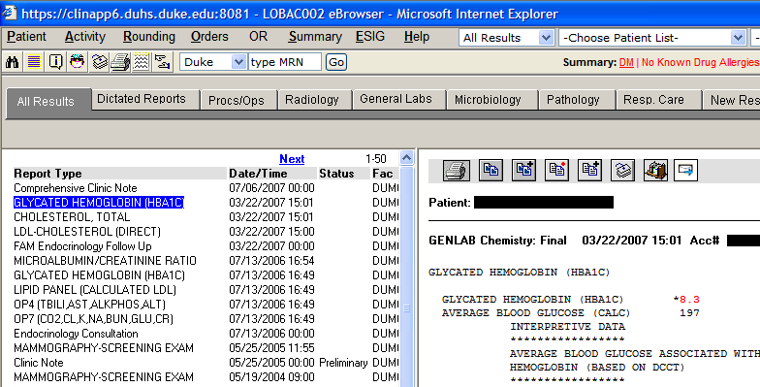
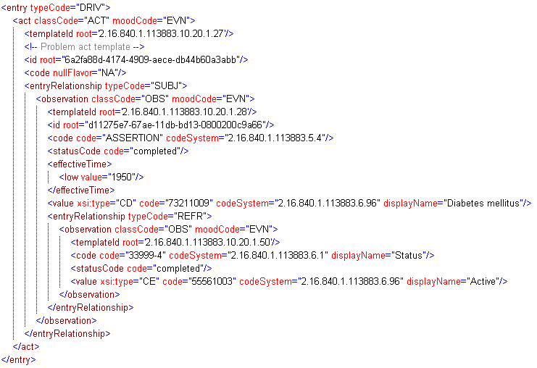
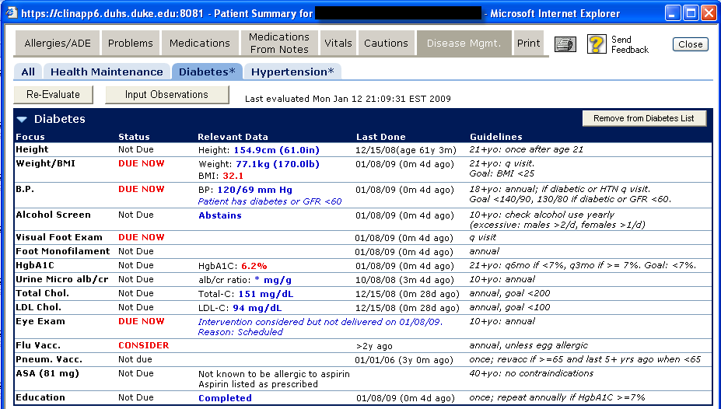
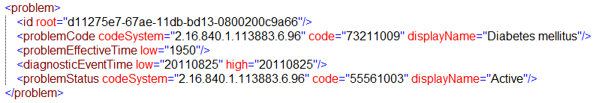
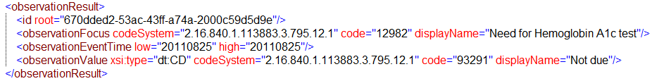
CDS Services – Example
Eval. Result
VMR
CCD
Pt data
Decision Support Service
Patient Data Sources
EHR System
Notes:
SCT 14May

Slide 24
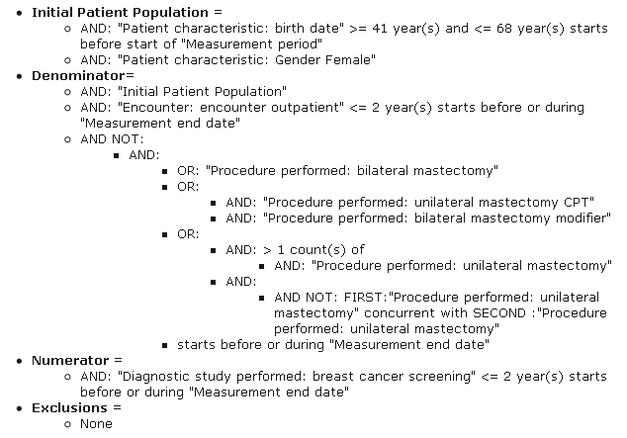
NQF Measure 31 for Meaningful Use

Slide 25
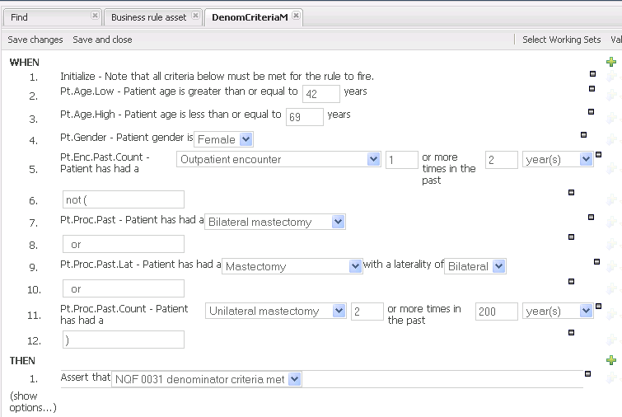
OpenCDS Implementation – Denom.

Slide 26
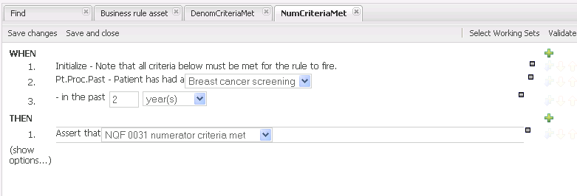
OpenCDS Implementation – Numerator

Slide 27
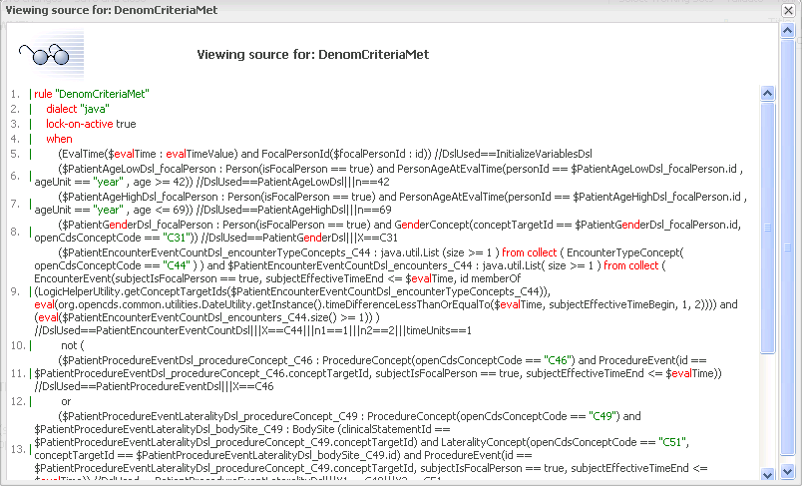
OpenCDS Implement. – Underlying Details

Slide 28
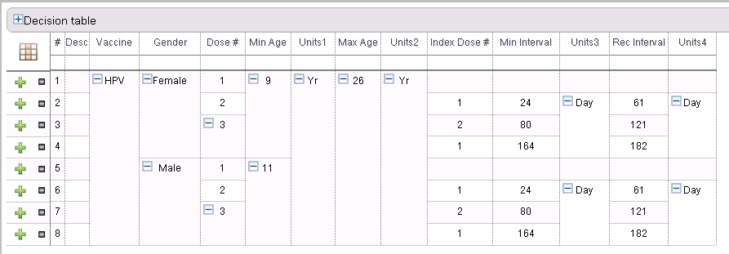
OpenCDS Implementation – Decision Table

Slide 29
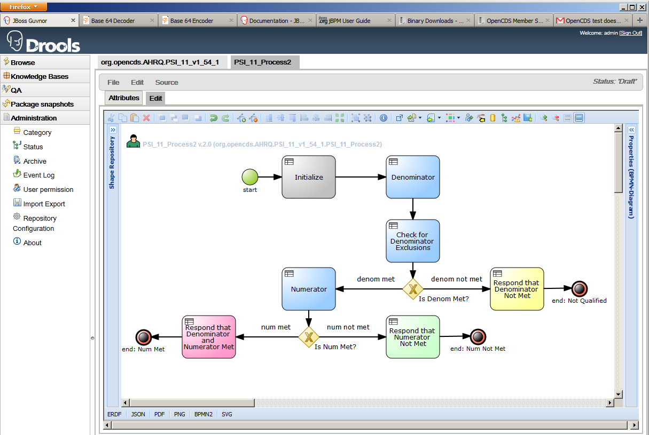
Web-Based Authoring – Flow Control

Slide 30
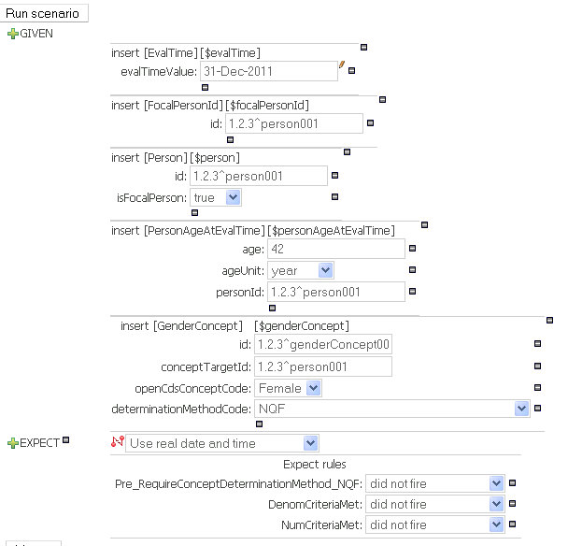
Testing Environment

Slide 31
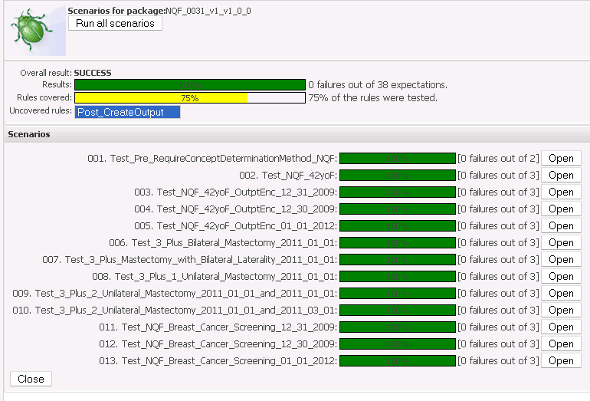
Batch Regression Testing

Slide 32
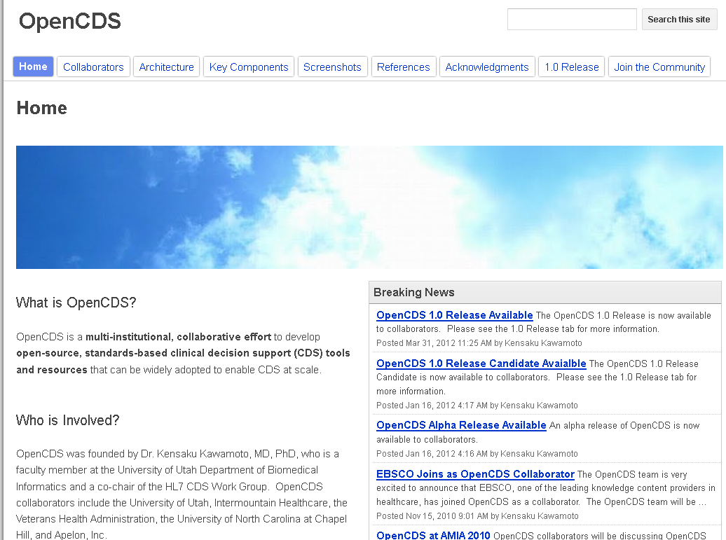
www.opencds.org
Notes:
SCT 14May

Slide 33
Acknowledgements
Financial support
  NHGRI K01 HG004645 (PI: K. Kawamoto)
  University of Utah Dept. of Biomedical Informatics
  University of Utah Information Technology Services
  Utah Beacon Community Subcontract (PI: Bruce Bray)
Numerous OpenCDS collaborators
  https://sites.google.com/site/opencdspublic/collaborators
  In particular, David Shields of University of Utah
Notes:
SCT 14May

Slide 34
Questions?
Kensaku Kawamoto, MD, PhD
Director, Knowledge Management and Mobilization
Assistant Professor, Department of Biomedical Informatics
University of Utah
kensaku.kawamoto@utah.edu

