Slide 1
临床决策支持系统
-更好、更安全、更高效医疗的驱动力
Syed Tirmizi, M.D.
Medical Informatician

Slide 2
临床决策支持系统
定义(What)
业务场景 (Why)
用例(How)

Slide 3
什么是决策支持
信息层面….
病人个案数据与医学知识相结合获得一些针对个案的建议/意见
工具….
  易于使用、易于嵌入到工作流中
  更加智能、快速
  提高医疗质量 减少医疗过失

Slide 4
临床决策支持
只要是能够帮助我们更好的做出医疗决策 降低医疗过失、提高医疗水平的任意工具
To be acceptable and effective :
在诊疗时可用Available at point of Care
准确Accurate
反应迅速Quick
提高效率Increase provider efficiency
易于使用Easy to use

Slide 5
临床决策支持系统
运用知识库来辅助医务人员在病人照护中进行临床决策的计算机软件
a set of knowledge-based tools that are fully integrated with both the clinician workflow components of a computerized patient record, and a repository of complete and accurate data
为医师、病人提供医学知识，相关病人信息，适时的进行过滤、展现以促进医疗服务providing clinicians or patients with clinical knowledge and patient-related information, intelligently filtered and presented at appropriate times, to enhance patient care
Clinical Decision Support in Electronic Prescribing: Recommendations and an Action Plan
Report of the Joint Clinical Decision Support Workgroup
JONATHAN M. TEICH, MD, PHD, JEROME A. OSHEROFF, MD, ERIC A. PIFER, MD, DEAN F.SITTIG, PHD,
ROBERT A. JENDERS, MD, MS, THE CDS EXPERT REVIEW PANEL
J Am Med Inform Assoc. 2005;12:365–376.

Slide 6


Patient Safety & Quality Gaps Acknowledged
“98,000 Hospital Patients Die Yearly Because of Adverse Events”
  (IOM, 1999)
“Virtually Every Patient Experiences a Gap Between the Best Evidence and the Care They Receive”
  (IOM, 2001)

Slide 7
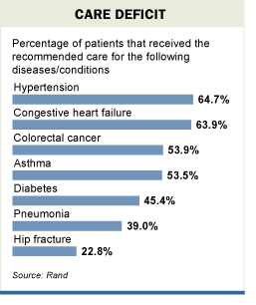
Chances of Receiving Appropriate Preventive Care is about 50% - NEJM

Slide 8
门诊药物不良事件
整体上
  25% 门诊病人出现ADE
  39% 可预防
  抗抑郁药和抗高血压药是最多的
老年人(超过65岁)
  5%的Adverse Events in 5% of population per year
  28% 可预防
Gandhi et al, NEJM 2003;348(16):1556-1564
Gurwitz et al, JAMA 2003;289:1107-16

Slide 9
Employer/Payor CDS应用的业务场景- 糖尿病
Estimated avg $21,000/year per diabetic employee in absenteeism, disability and medical costs (study of 6 employers with 375,000 employees
Glycemic control is associated with $1000-$2000 medical costs savings/year to payor
Currently, we are “reimbursed” to measure HgA1c annually (captured claim for test ordered)
Will soon be reimbursed for maintaining control through test result surveillance, goal is < 7
Tonya Hongsermeier, MD, MBA
        Partners Healthcare Systems

Slide 10
医疗服务中的知识处理
Knowledge Processing Required for Care Delivery
Medical literature doubling every 19 years
  Doubles every 22 months for AIDS care
2 Million facts needed to practice
Genomics, Personalized Medicine will increase the problem exponentially
Typical drug order today with decision support accounts for at best, Age, Weight, Height, Labs, Other Active Meds, Allergies, Diagnoses
Covell DG, Uman GC, Manning PR.
Ann Intern Med. 1985 Oct;103(4):596-9

Slide 11

Drilling for the Best Information
POEMs –Patient-Oriented
Evidence that Matters
Cochrane Library
EB Practice Guideline
Clinical Evidence
Clinical Inquiries
Specialty-specific
POEMs
Best Evidence
Reviews: Textbooks, Up-to-Date, 5-Minute Clinical Consult
Usefulness
Medline

Slide 12
Decision Support Architecture
Electronic Health Record
Hospital
Database
EBM Scripts
Patient
Data
Guideline Links
Structured Messages
Patient Data
Interactive forms
Decision
Support
Engine
Decision Support Component
Drug indications
Decision Support
Contraindications
Drug interactions
Decision Support
Local Scripts
Knowledge in computer-readable form
is probably more easily translated, shareable
and divided into modules than full guidelines
EMR
workstation

Slide 13
”The BIG picture”
KNOWLEDGE
Guidelines
Graded evidence
Databases: drugs,
laboratory, genome
Images and videos for
training skills
Cost-effectiveness
Ethical summaries
Patient information
Patient data
Genome map
Probably
beneficial
therapy
Decision
support
Patient’s values
and choices
Doctor’s interpre-
tation and
experience
Resource
limits
Simulation
Individualized
prediction of
the effects
of treatment
Selection of
treatment
Database of ”all”
previous patients

Slide 14
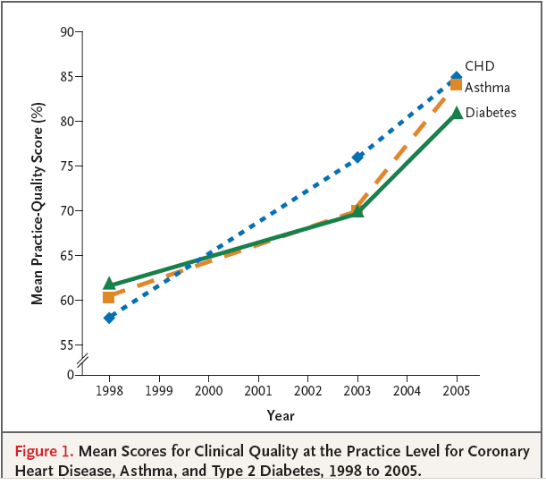
Campbell S et al.
Quality of primary
care in England with the introduction
of pay for performance.
N Engl J Med
2007;357:181-190
Pay for
performance
introduced

Slide 15
Decision Support in CPRS
Alerts (Order checking, allergies, meds)
Reminders
Smart orders
Dialogue notes with embedded links
Online access to books, journals, e-tools

Slide 16
预防中央静脉导管感染的核对表
Setting Michigan ICU’s
Intervention 5 item checklist (sterile field, etc) developed at Johns Hopkins for inserting central lines
Results
  Line infection rate: Fell from 4 % to 0 %
  Total savings: $200,000,000 and 150 lives
Pronovost et al N Engl J Med 2006

Slide 17
决策支持的类型
核对表Checklists
提醒&警示Reminders & Alerts
Defaults, Order sets, Integrated tools
Point-of-care (bedside) information
Aids for differential diagnosis

Slide 18
使用提醒“Reminders”
VHA has set national goals for providing preventive health services
These goals are communicated to the field, CDS provided in the form of “Reminders”

Slide 19
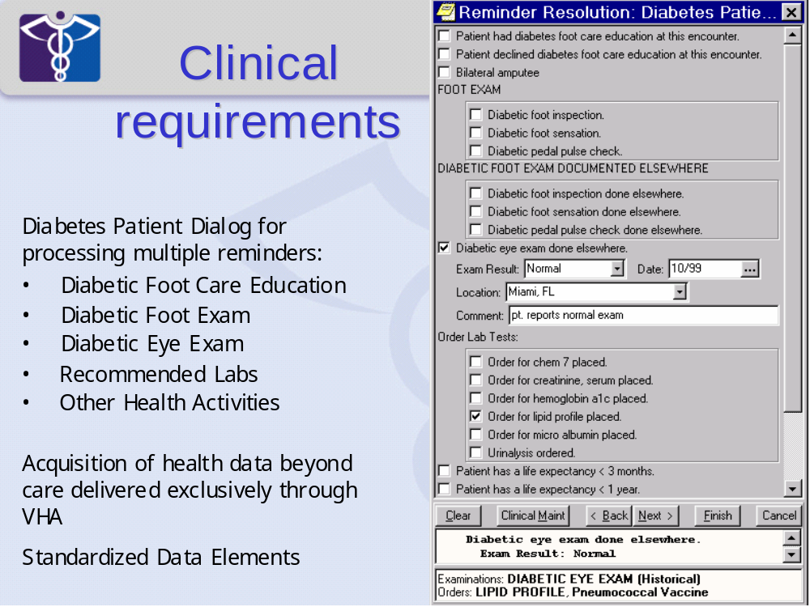
Links Reminder
With Actions
With Documentation

Slide 20
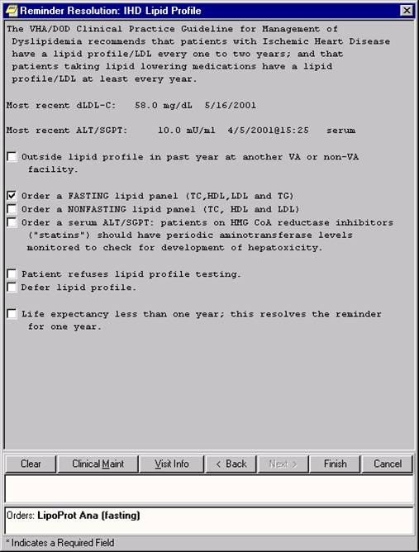

Slide 21
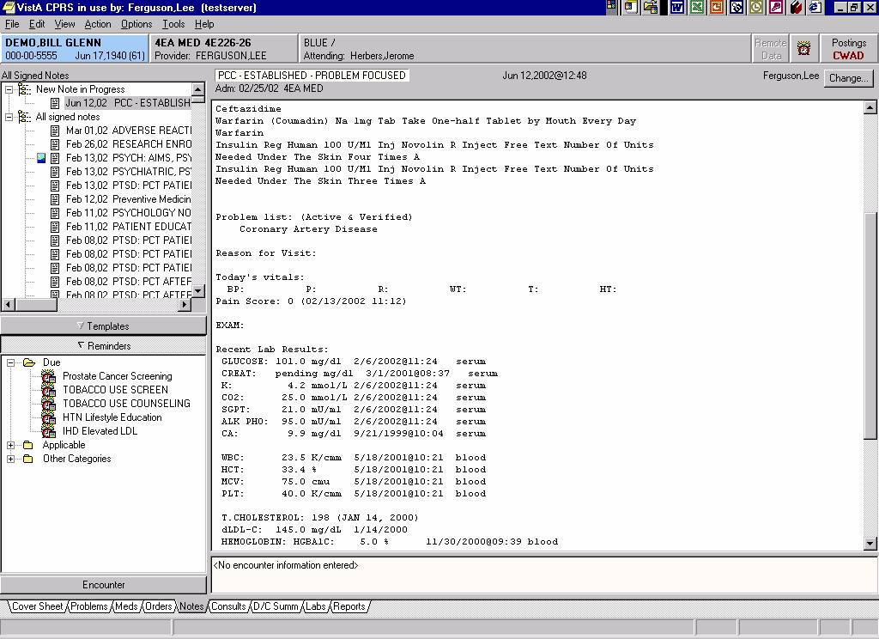
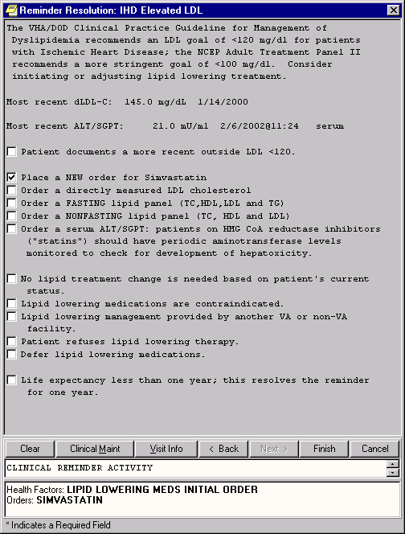

Slide 22
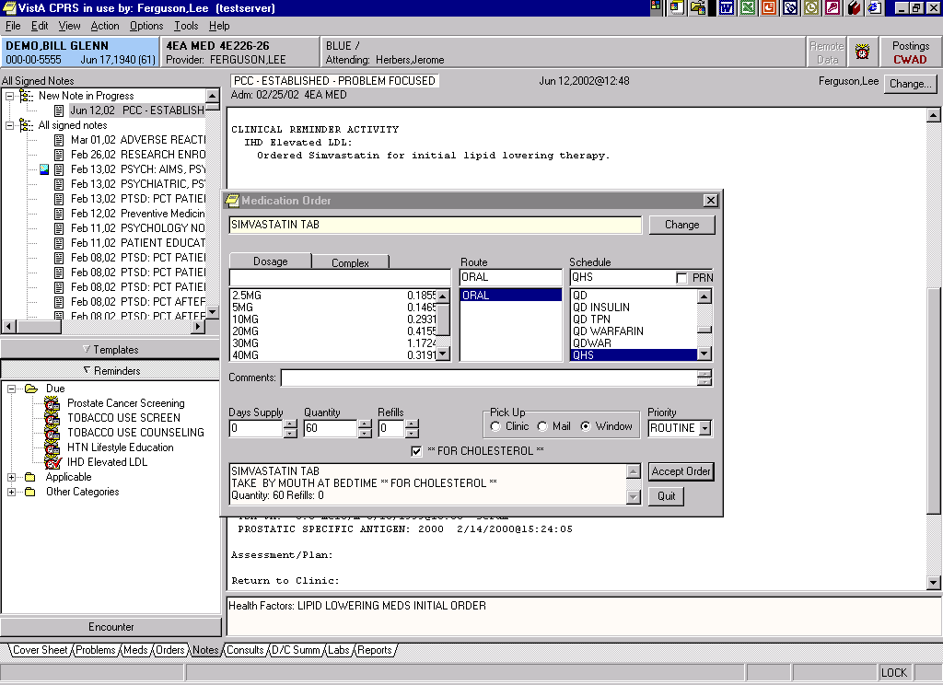

Slide 23
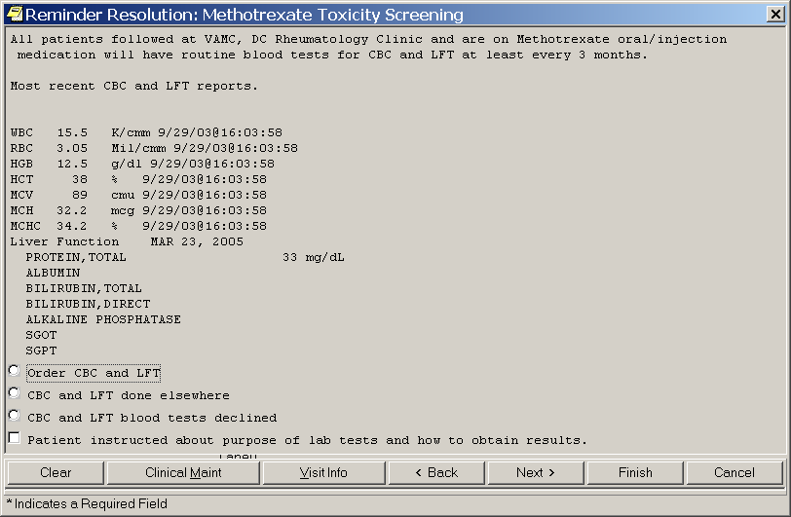

Slide 24
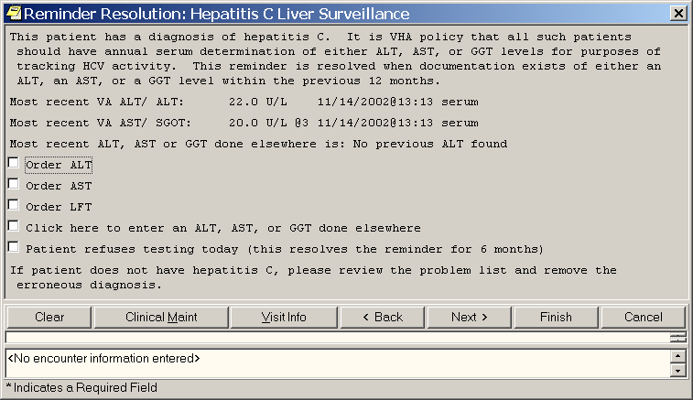

Slide 25
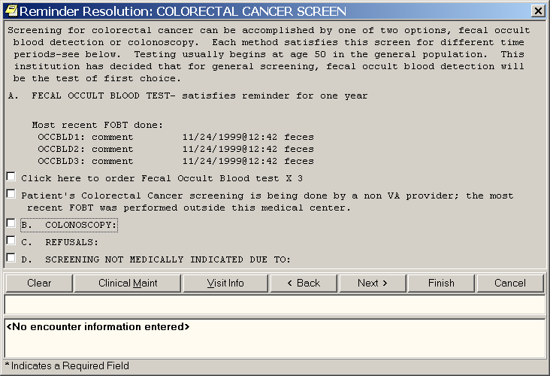

Slide 26
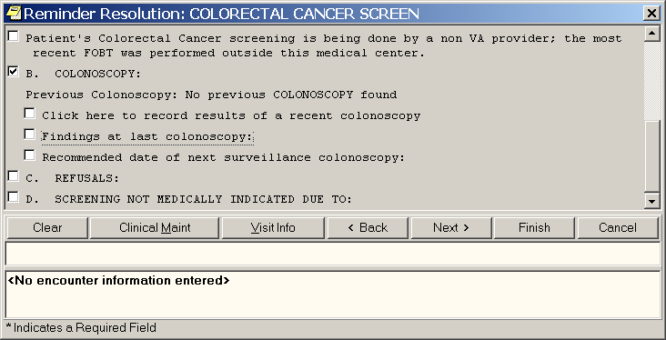

Slide 27
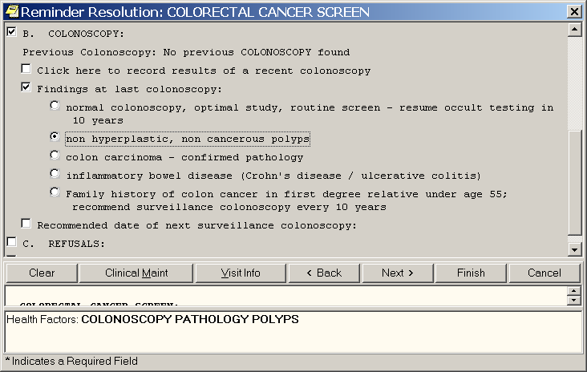

Slide 28
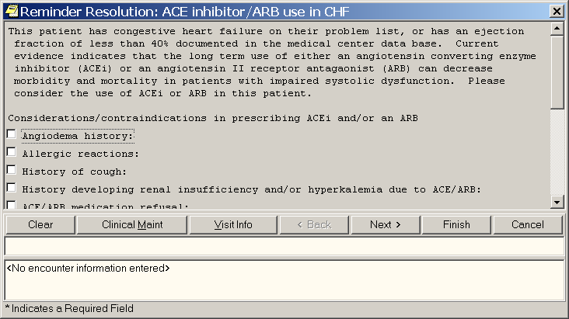

Slide 29
Suggest Use of Thiazide
Set up the reminder dialog so that if the patient is a reasonable candidate for a thiazide and not currently on one, then suggest use of a thiazide.
Suppressed by Cr>2.0, Calcium>10.2, Na+<136 or allergy.

Slide 30
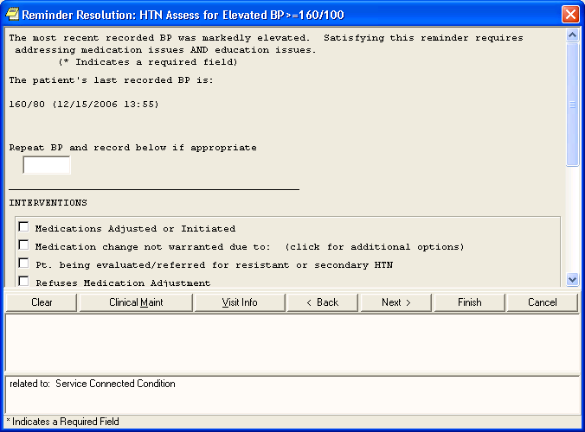
Standard HTN dialog copied from the national reminder

Slide 31
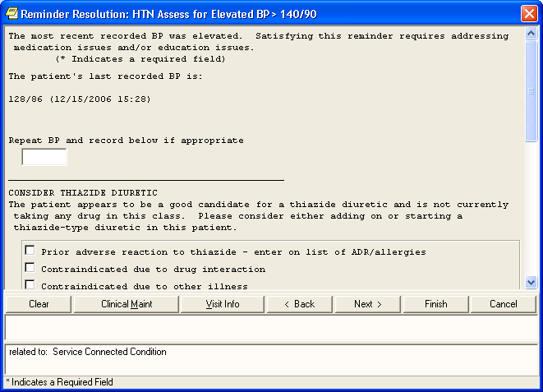
Insert section at the top if the patient is a candidate for use of a thiazide

Slide 32
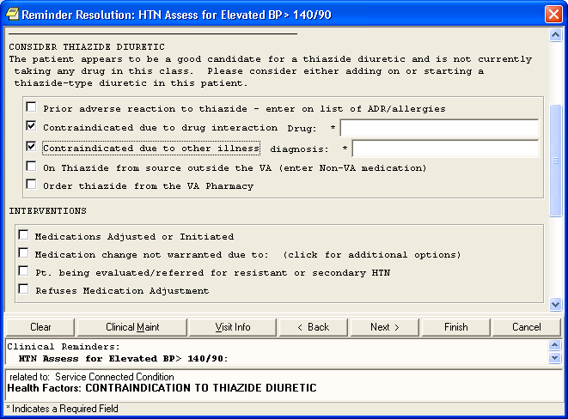

Slide 33
Clinical Reminder Reports
Quality Improvement:
  Provide feedback (team/provider)
  Identify (& share) best practices
  Identify under-performers (develop action plan)
  Track performance
  Can be used to identify patient cohorts who need attention/action

Slide 34
Reminder/Dialogs: Other Uses
Examples: Reminder dialogs linked to note title
Present ordering dialogs
  Medications Orders
    Sildenafil/levitra (screening for risk factors)
    Clopidogrel (Plavix) (updated criteria)
  Discharge Order
    Support medication reconciliation (when pharmacists are not available to review meds)
Gather information for display on Health Summary
  Non VA surgery

Slide 35
Embedded links
(InfoButtons)

Slide 36
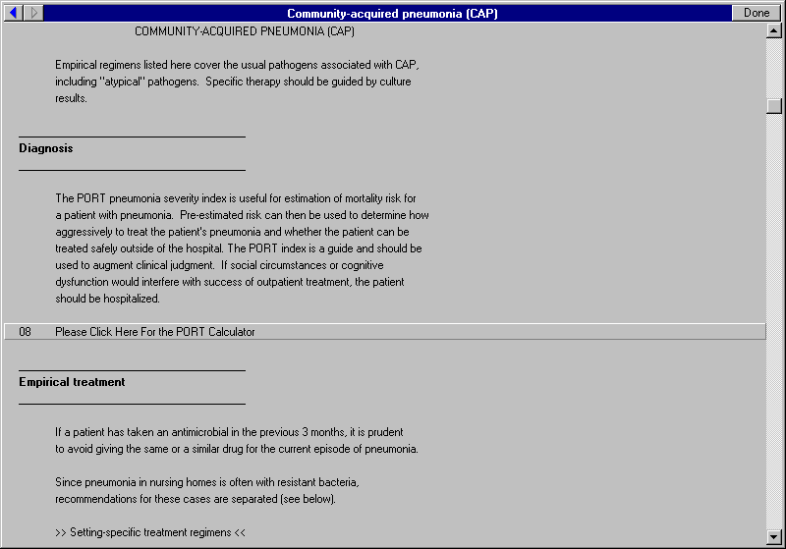

Slide 37
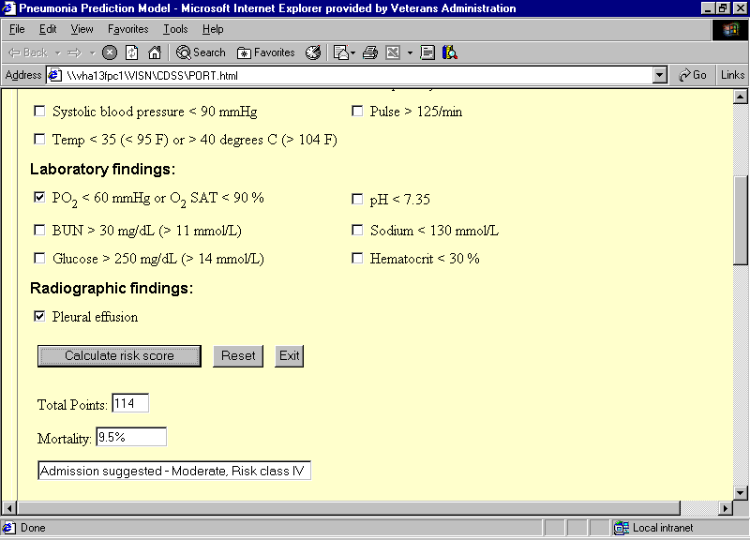

Slide 38
Catheter-Associated UTI
10 % of all hospitalized patients have an indwelling catheter. Essentially all of these are colonized within 14 days and 10 – 25% will develop a significant infection
Most common hospital-acquired infection
Extends stay on average 6 days
Sepsis in 1%
Established principles to avoid UTI
Sterile insertion; Closed drainage systems; Downhill flow

Slide 39
Decision Support & UTI’s
Setting: Yale-New Haven Hospital
Intervention: Pre-post comparison. Computerized alert + nurse empowerment
Results:
  81% reduction in device-days
  73% reduction in nosocomial UTI’s
Topol et al - Am J Med Qual 20: 121-6, 2006

Slide 40
Electronic Alerts to
Adjust Antibiotics for GFR
Setting: Inpatients receiving nephrotoxic antibx or
  antibx that require dosage adjustment for renal function
Intervention: Electronic alert if creatinine increased
Findings Drugs were adjusted or discontinued 22 hours earlier compared to no alert
Rind et al. Arch Int Med 154: 1511-1517, 1994

Slide 41
Reminders – The VA Experience
Diabetes: A1C, eye exam, UA, Lipids, BP
Preventive: Flu, Pneumonia,
Preventive: Alcohol, tobacco, depression
Cancer: Mammography, PAP smear, colon cancer screening

Slide 42
Types of Decision Support
Checklists
Reminders & Alerts
Defaults, Order sets, Integrated tools
Point-of-care (bedside) informatio
Aids for differential diagnosis

Slide 43
Order Sets
INPATIENT
ACS orders
Glycemic control
Anticoagulation
OUTPATIENT
Immunizations
Screening tests (e.g. colonoscopy)
Disease-specific management plans (e.g. diabetes: routing eye and foot exams, A1c, lipids)
Goals
Improve population health, improve quality of care and decrease variability of care, manage healthcare costs

Slide 44
Types of Decision Support
Checklists
Reminders & Alerts
Defaults, Order sets, Integrated tools
Point-of-care (bedside) information
Aids for differential diagnosis

Slide 45
www.medicalmnemonics.com
CAUSES OF URINARY INCONTINENCE
DRIP
Delirium
Restricted mobility/Retention
Inflammation/Infection/Impaction
Pharmaceuticals/Polyuria
SECONDARY NEPHROTIC SYNDROME
DAVID
Diabetes
Amyloidosis
Vasculitis
Infections
Drugs
$ 0

Slide 46

Renal Dosing - 20th Century
$ 24.95

Slide 47
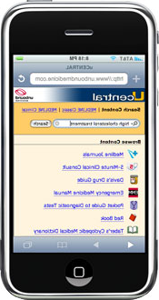
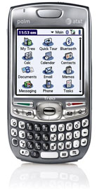
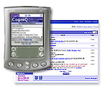
Renal Dosing - 21st Century
$ 300 - $500

Slide 48
Types of Decision Support
Checklists
Reminders & Alerts
Defaults, Order sets, Integrated tools
Point-of-care (bedside) information
Aids for differential diagnosis

Slide 49
Decision Support for Diagnosis
Diagnostic errors are the most likely cause of medical malpractice suits in most specialties & cause enormous personal suffering and harm
Root causes include latent system flaws and cognitive errors; the most common cognitive shortcomings are
  Premature closure
  Context errors
Decision support tools for medical diagnosis provides a wide range of diagnostic possibilities, decreasing the likelihood of premature closure and context errors

Slide 50
Aids for Differential Diagnosis
$ 0
DxPlain
http://www.lcs.mgh.harvard.edu/projects/dxplain.html
Isabel
www.isabelhealthcare.com
$ 750

Slide 51
Systematic Review of Decision Support Systems
68 controlled trials - Found NET BENEFIT in:
Preventive Care 15 of 19
Management: 19 of 26
Drug dosing: 9 of 15 trials
Diagnosis: 1 of 5
Hunt et al. JAMA 280: 1339-46, 1998

Slide 52
Factors Affecting Clinician Acceptance of Clinical Decision Support
Setting: Kaiser Permanente PC
Methods: Survey of 110 clinicians
Findings - Decision Support ….
  Helps me take better care of my pts - 3.6/5
  Is worth the time it takes - 3.5/5
  Reminds me of things I’ve forgotten – 3.2/5
But …..
Sittig et al. BioMed Central 2006

Slide 53
I’m unlikely to use it if I’m behind schedule (80%)
I’m behind schedule > 80% of the time
Sittig et al. BioMed Central 2006

Slide 54
We don’t use it because ….
Its not just time ….
We don’t need it because ….
  We are in full control of our decision-making abilities; We know what our mind is doing at all times
  We are experts in our field with extensive experience

Slide 55
If we would use them …
Decision support tools offer the potential to improve the quality of care for both the patient and populations of patients
These tools offer the potential to improve productivity and provider satisfaction
The evidence that decision support accomplishes these goals is generally positive, but mixed

Slide 56
However
This is NOT about technology…
It is about RESULTS:
Improved Health Care Quality
Improved Health Outcomes

Slide 57
How Do We Compare….
VHA Continues to exceed HEDIS
CLINICAL PERFORMANCE INDICATOR | VA FY 05 | HEDIS Commercial 2004 | HEDIS Medicare 2004 | HEDIS Medicaid 2004
Breast cancer screening | 86% | 73% | 74% | 54%
Cervical cancer screening | 92% | 81% | Not Reported | 65%
Colorectal cancer screening | 76% | 49% | 53% | Not Reported
LDL Cholesterol < 100 after AMI, PTCA, CABG | Not Reported | 51% | 54% | 29%
LDL Cholesterol < 130 after AMI, PTCA, CABG | Not Reported | 68% | 70% | 41%
Beta blocker on discharge after AMI | 98% | 96% | 94% | 85%
Hypertension: BP <= 140/90 most recent visit | 77% | 67% | 65% | 61%
Follow-up after Hospitalization for Mental Illness (30 days) | 70% | 76% | 61% | 55%
HEDIS = Health Plan Employer Data & Information Set
From the National Committee on Quality Assurance (NCQA)

Slide 58
How Do We Compare….
VHA Continues to exceed HEDIS
CLINICAL PERFORMANCE INDICATOR | VA FY 05 | HEDIS Commercial 2004 | HEDIS Medicare 2004 | HEDIS Medicaid 2004
Diabetes: HgbA1c done past year | 96% | 87% | 89% | 76%
Diabetes: Poor control HbA1c > 9.0% (lower is better) | 17% | 31% | 23% | 49%
Diabetes: Cholesterol (LDL-C) Screening | 95% | 91% | 94% | 80%
Diabetes: Cholesterol (LDL-C) controlled (<100) | 60% | 40% | 48% | 31%
Diabetes: Cholesterol (LDL-C) controlled (<130) | 82% | 65% | 71% | 51%
Diabetes: Eye Exam | 79% | 51% | 67% | 45%
Diabetes: Renal Exam | 66% | 52% | 59% | 47%
CLINICAL PERFORMANCE INDICATOR | VA FY 2005 | HEDIS Commercial 2004 | HEDIS Medicare 2004 | BRFSS 2004
Immunizations: influenza, (note patients age groups) | 75% (65 and older or high risk) | 39% (50-64) | 75% (65 and older) | 68% (65 and older)
Immunizations: pneumococcal, (note patients age groups) | 89% (all ages at risk) | Not Reported | Not Reported | 65% (65 and older)

Slide 59
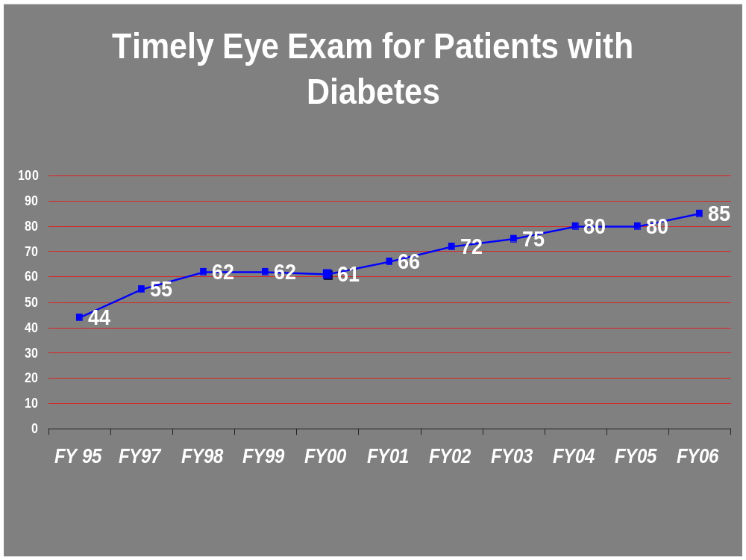

Slide 60
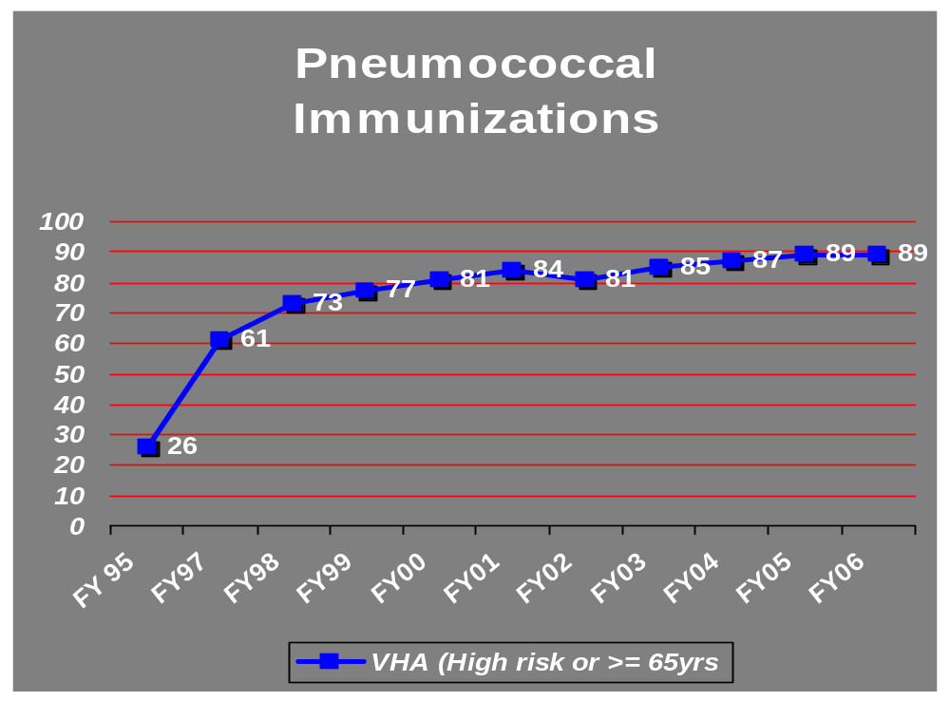
Changed to include refusals as failures

Slide 61
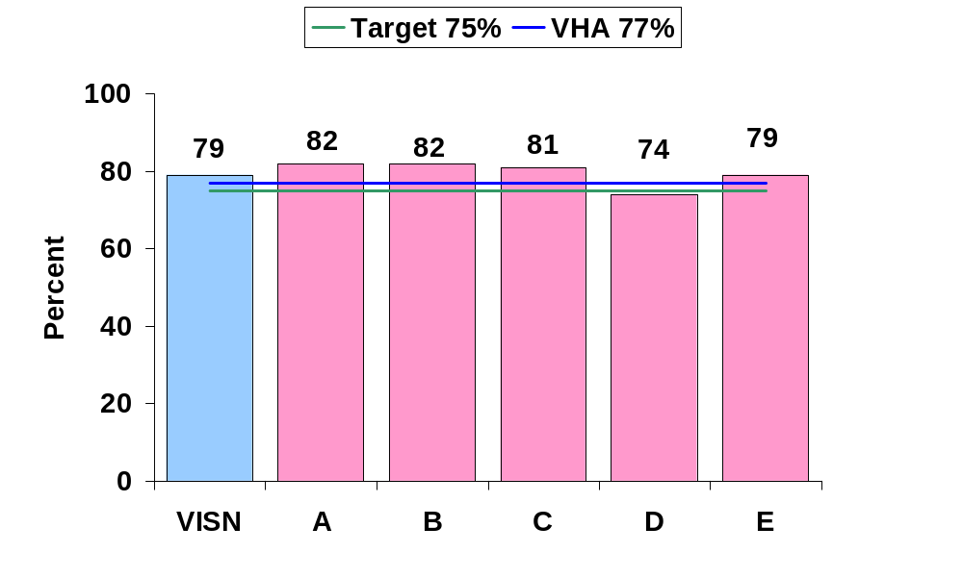
Screening for Colorectal Cancer
EX =
78%
Floor =
67 %
n=
1109
n=128
n=335
n=160
n=321
n=165
Measure 8c – Perf. Period 10/06 – 8/07

Slide 62

The Chronic Disease Care Model
Community
Health System
Resources and Policies
Organization of Health Care
Self-
Management
Support
EHR
Delivery
System
Design
EbMed
DSS
Productive Interactions
Informed,
Empowered Patient
and Family
Patient- Centered | Coordinated
Timely and Efficient | Evidence-based and Safe
Prepared,
Proactive Practice Team
PHR
Improved Outcomes

Slide 63
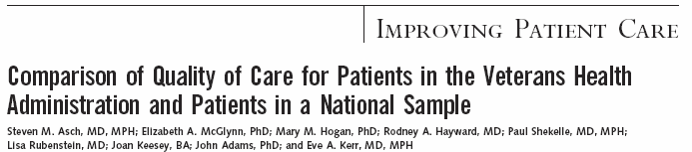
Highest Quality of Care For Patients in VA Measured Broadly
“Patients from the VHA received higher-quality care according to a broad measure. Differences were greatest in areas where the VHA has established performance measures and actively monitors performance.”
Annals of Internal Medicine, December 21, 2004

Slide 64
What is ATHENA DSS?
Automated decision support system (DSS)
  Knowledge-based system automating guidelines
    Built with EON technology
  For patients with primary hypertension who meet eligibility criteria
Patient specific information and recommendations at the point of care
Purpose is to improve hypertension control and prescription concordance with guidelines
Athena in Greek mythology is a symbol of good counsel, prudent restraint, and practical insight
Proc AMIA 2000
Notes:
ATHENA DSS was developed in a collaboration between Stanford Medical Informatics and VA investigators who are also Stanford faculty. ATHENA DSS was built using EON technology for guideline-based decision support, developed by Mark Musen, MD, PhD, and the EON group at Stanford Medical Informatics. The development of ATHENA DSS was funded by National Library of Medicine (NLM) and by VA HSR&D.

Slide 65
Developing a Model Program
To Provide a Model Program that can be extended to other clinical areas
They selected hypertension as a model for guideline implementation because…
Hypertension is highly prevalent in adult medical practice
There are excellent evidence-based guidelines for management
There is also evidence that the guidelines are not well-followed
  a big ‘improvability gap’ in IOM terms
Steinman, M.A., M.A. Fischer, M.G. Shlipak, H.B. Bosworth, E.Z. Oddone, B.B. Hoffman and M.K. Goldstein, Are Clinicians Aware of Their Adherence to Hypertension Guidelines? Amer J. Medicine 117:747-54, 2004.

Slide 66
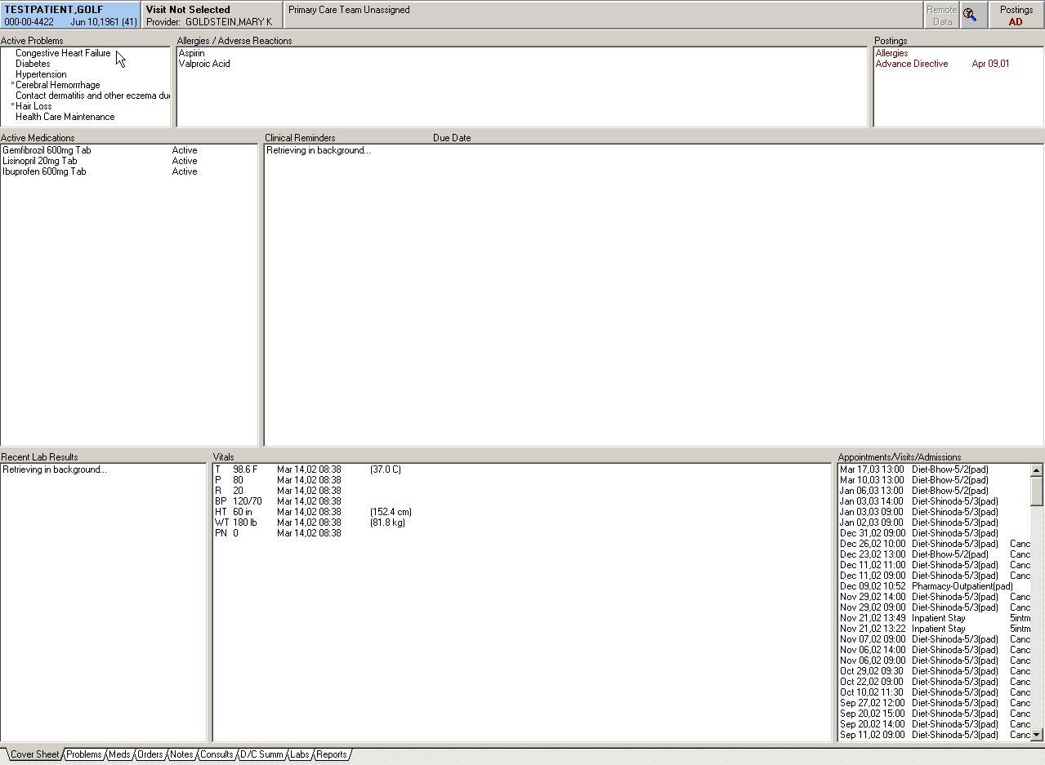
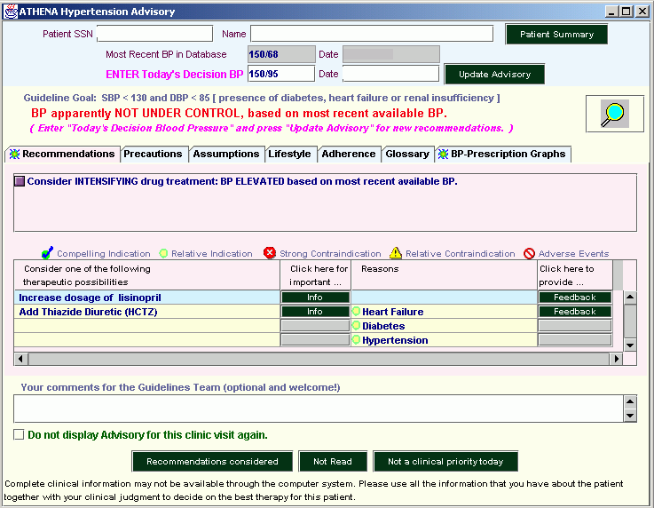
What the Clinician Sees…

Slide 67
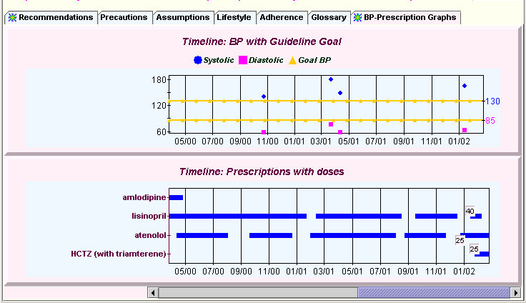
ATHENA Hypertension Advisory:
BP- Prescription Graphs
Goldstein, M. K. and B. B. Hoffman (2003). Graphical Displays to Improve Guideline-Based Therapy of Hypertension. Hypertension Primer. J. L. Izzo, Jr and H. R. Black. Baltimore, Williams & Wilkins.

Slide 68
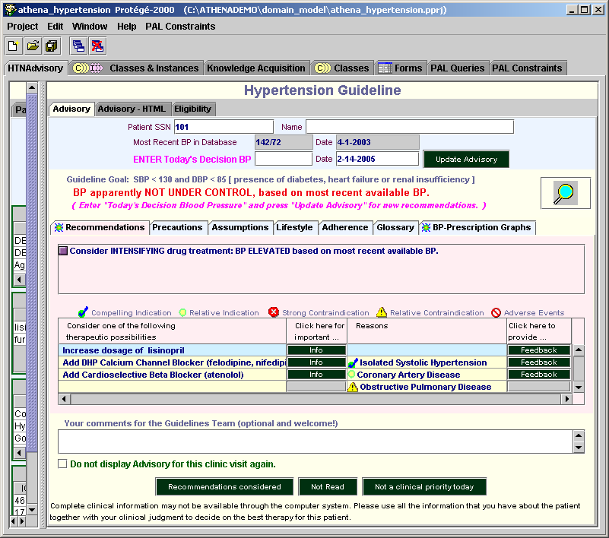
ATHENA HTN Advisory
BP targets
Primary
recommendation
Drug
recommendation

Slide 69
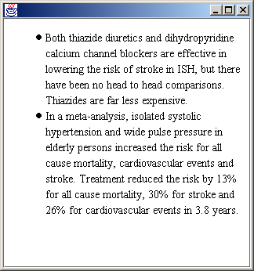
ATHENA HTN Advisory: More Info

Slide 70
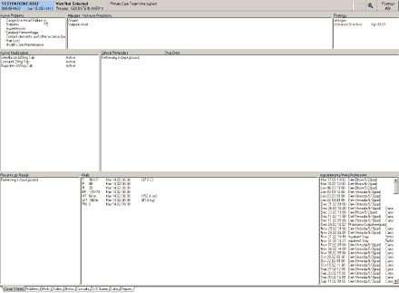
Building ATHENA System From EON Components
VISTA
SQL
Patient
Database
EON Servers
ATHENA Clients
VA CPRS
Temporal
Mediator
ATHENA Clients
Event
Monitor
Event
Monitor
Pre-
computed
Advisories
Data Converter
Guideline
Interpreter
Advisory
Client
Advisory
Client
nightly data extraction
ATHENA
HTN
Guideline
Knowledge
Base
Protégé
ATHENA GUI

Slide 71
Path to Guideline Adherence
The theoretical model we use for the path to guideline adherence is the “Awareness to Adherence” model, in which the clinician must
  Awareness of guideline
  Acceptance of guideline
  Adoption of guideline
  Adherence to guideline
  Pathman, D. E., T. R. Konard, et al. (1996). "The Awareness-to-Adherence Model of the Steps to Clinical Guideline Compliance." Medical Care 34:873-889.

Slide 72
Informatics Support for Clinical Practice
Guideline Implementation
Step | Facilitators | Informatics Support
Awareness | Priming Activities such as profiling of baseline performance | Profiling from pharmacy and diagnosis database
Acceptance | Active education such as Academic Detailing; Clinical Opinion Leaders | Present evidence relevant to patient; allow opinion leaders to browse knowledge
Adoption | Enabling strategies such as incorporation into clinic workflow | Integration with existing EMR
Adherence | Reinforcing Strategies such as reminders | Point-of-care patient-specific advisories

Slide 73

Decision Support for Common Chronic Diseases
The physician often seen as wondering about a clinical question and then seeking out decision support:
X
The “Field of Dreams” approach to medical
informatics implementations:
  If you build it, they will come

Slide 74
Some Technical Challenges
Extracting clinical data from VistA
Generating a popup window that appears in CPRS
  At the right time, in the right clinic settings, for the right clinician, about the right patient
Logging data about activity in the system
Security issues

Slide 75
Some of the Social Challenges
Clinicians extremely time-pressured in clinic
  Strike balance between ease of access to system and ease of ignoring it
Enormous variability in comfort with computers
  And virtually no training time available
Disagreements about the guidelines
  some want VA GLs, some want JNC

Slide 76
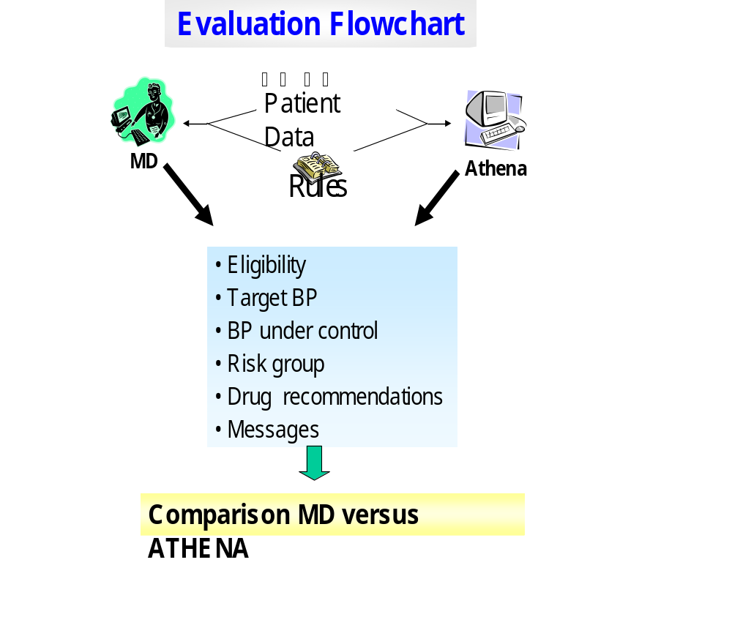
Evaluation
Flowchart
Martins SB et al Proc AMIA 2006 in press

Slide 77
“Physician Testers” in Clinical Setting
Project-friendly physicians who test the system in early stages in clinic
  Understanding it is not yet complete
  Must be prepared to make changes in response to their comments
  Some of these physicians become champions for the system
Include clinical managers in early testing

Slide 78
Consensus Conference Calls
Knowledge updates required in light of newly published clinical trials or new guidelines
  Need a knowledge management process for vetting new material and deciding what will be incorporated
  Make this process known to the clinicians who are end-users (especially local opinion leaders)
  Invite local input to the discussion
  Encode with a system that allows for easy updating
  Goldstein, M.K., B.B. Hoffman, et al, Implementing clinical practice guidelines while taking account of changing evidence: ATHENA DSS, An easily modifiable decision-support system for managing hypertension in primary care. AMIA Symp: 300-4, 2000.

Slide 79
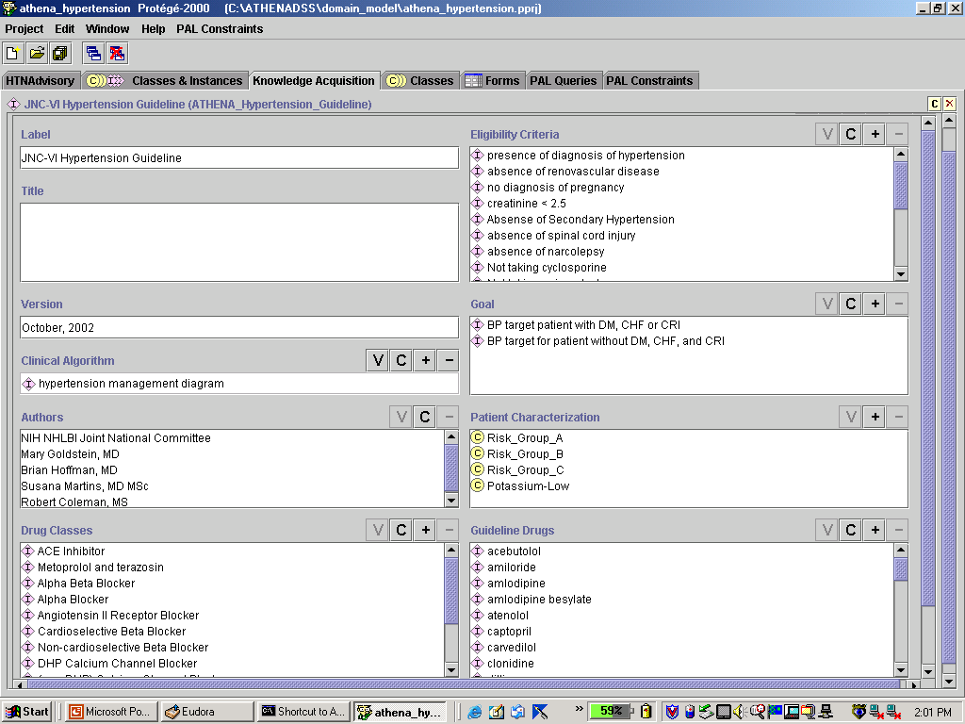
ATHENA Protégé top level

Slide 80
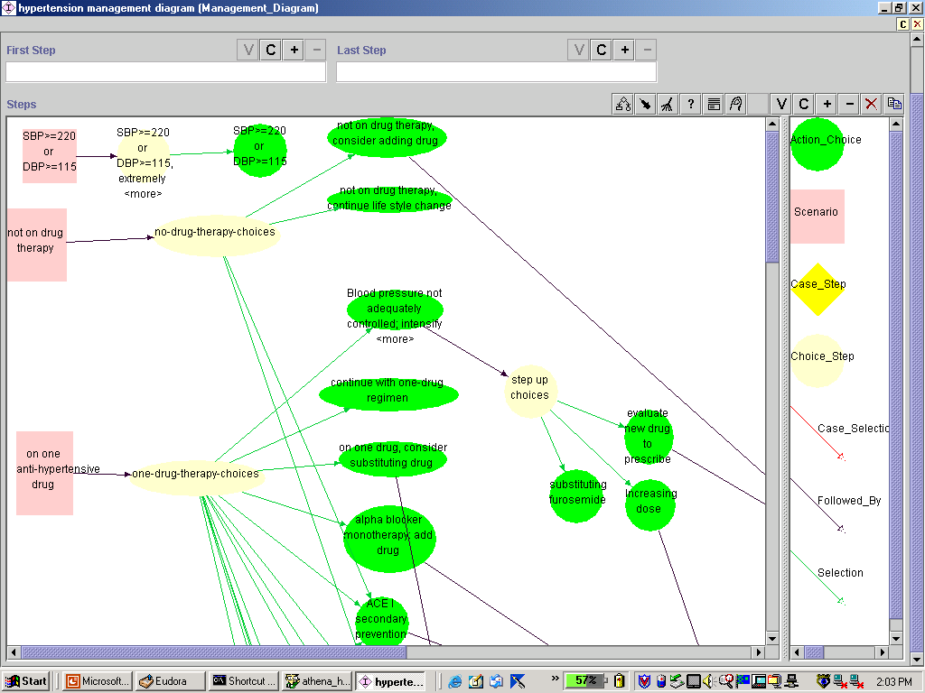
ATHENA Protégé
GL management diagram
Notes:
Our basic guideline management diagram in Protege

Slide 81
ATHENA project
Funded by VA Research Service HSR&D
Hypothesized that guideline-based interventions in management of hypertension can
  Change physicians’ prescribing behavior
  Change patient outcome
Deployed and evaluated at primary care VA clinics in 9 geographically diverse cities over a 15-month clinical trial
Results
  Expert clinicians maintain hypertension knowledge base using Protégé
  Clinicians interacted with the ATHENA Hypertension Advisory at 54% of all patient visits
  Impact on prescribing behavior and patient outcome being analyzed
Notes:
Athena in Greek mythology is a symbol of good counsel, prudent restraint, and practical insight.

Slide 82
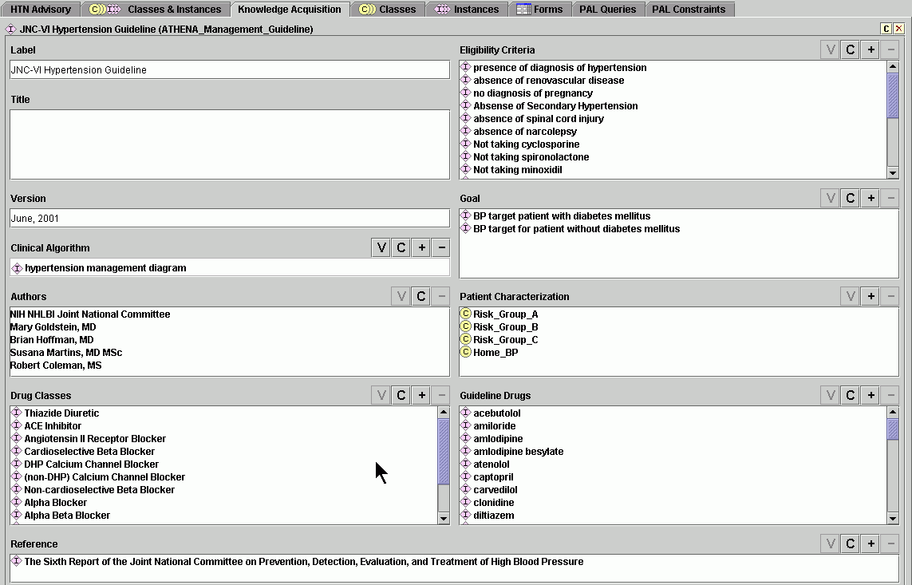
HTN Knowledge Base in Protégé

Slide 83
Execution Engine
  Applies the guideline as encoded in the knowledge base to the patient’s data
  Generates set of recommendations
Tu SW, Musen MA. Proc AMIA Symp; 2000. 863-867

Slide 84

Physician Evaluator (MD)
Internist with experience in treating hypertension in primary care setting
No previous involvement with ATHENA project
Studied “Rules” and clarified any issues
Had “Rules” and original guidelines available during evaluation of test cases
Notes:
Highlight we were not testing clinician knowledge

Slide 85
Elements examined
Patient eligibility
  Did patient meet ATHENA exclusion criteria?
Drug recommendations
  List of all possible anti-hypertensive drug recommendations concordant with guidelines
    Drug dosage increases
    Addition of new drugs
    Drug substitutions
Comments by MD

Slide 86
Comparison Method
Comparing ATHENA vs MD ouput:
  Automated comparison for discrepancies
  Manual review of all cases
Reviewing discrepancies
  Meeting with physician evaluator
  Adjudication by third party when categorizing discrepancies
Notes:
Manual review by SBM

Slide 87
Successful Test
A successful test is one that finds errors
  so that you can fix them

Slide 88
Safety Testing Clinical Decision Support Systems
“Before disseminating any biomedical information resource…designed to influence real-world practice decisions…check that it is safe…”
Drug testing in vivo and in vitro
Information resource safety testing:
  how often it furnishes incorrect advice
  Friedman and Wyatt Evaluation Methods
  in Biomedical Informatics 2006

Slide 89

CDSS to Evaluate: ATHENA-HTN
Electronic Medical
Record System
Patient Data
ATHENA
HTN Guideline
Knowledge Base
DSS developed using the EON architecture from Stanford Medical Informatics (Musen et al)
Guideline
Interpreter/
Execution
Engine
SQL Server
relational database

Slide 90





Methods: Overview
Physician
ATHENA-HTN CDSS
Electronic patient data: Test cases
+
“Rules”
Physician recommendations
ATHENA recommendations
Comparison

Slide 91
Questions? worldmed@gmail.com

