Slide 1
Toward sharing of clinical decision support knowledge
− A focus on rules
Robert A. Greenes, MD, PhD
Arizona State University
Phoenix, AZ, USA
Notes:
One of the most direct and immediate means of providing effective computer-based clinical decision support (CDS) is via single-step rules such as alerts, reminders, and recommendations. Yet there is only limited use of rule-based CDS, mostly in academic medical centers, or at very low levels of functionality elsewhere. Lack of sharing of the knowledge underpinning rule-based CDS is posited as a major impediment to widespread adoption, and reasons for this are explored. An approach to facilitate sharing seeks to overcome these barriers.
<number><number>

Slide 2
Purpose of this talk
Identify key challenges to CDS adoption with focus on rules
  Expressed in terms of 3 hypotheses:
  Sharing is key to widespread adoption of CDS
  Sharing of rules is difficult
  Sharing can be facilitated by a formal approach to rule refinement
Notes:
The purpose of the presentation is described in terms of 3 hypotheses: (1) sharing is key to widespread adoption of CDS rules-based knowledge, (2) sharing is difficult, and (3) sharing can be facilitated by a formal approach to rule refinement.
<number><number>

Slide 3
Hypothesis 1: Sharing is key to widespread adoption of CDS
We know how to do CDS!
  Over 40 years of study and experiments
Many evaluations showing effectiveness
Notes:
Hypothesis 1 is that sharing is key to wide adoption. Methodology of CDS is well understood and effectiveness has been demonstrated.
<number><number>

Slide 4
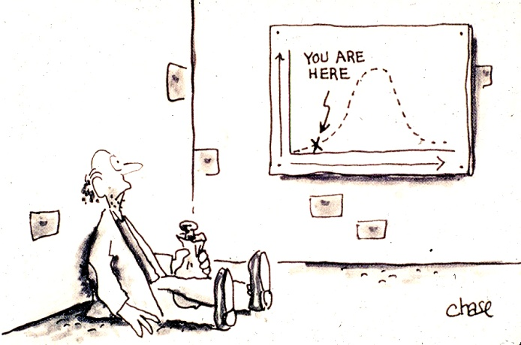
Yet beyond basics, there is very little use of CDS
Positive experience not replicated and disseminated widely
  Largely in academic centers
  <30% penetration
  Much less in small offices
  Pace of adoption barely changing
Only scratching surface of potential uses
  drug dose & interaction checks
  simple alerts and reminders
  personalized order sets
  Narrative infobuttons, guidelines
Notes:
Very little penetration of CDS, and only simple use in most places.
<number><number>

Slide 5
Rules as a central focus
Importance of rules
  Can serve as alerts, reminders, recommendations
  Can be run in background as well as interactively
  Can fire at point of need
  Same logic can be used in multiple contexts
    e.g., drug-lab interaction rule can fire in CPOE, as lab alert, or as part of ADE monitoring
  Can invoke actions such as orders, scheduling, routing of information, as well as notifications
Relation to guidelines
  Function as executable components when GLs are integrated with clinical systems
Poised for huge expansion
  Knowledge explosion – genomics, new technologies, new tests, new treatments
  Emphasis on quality measurement and reporting
Notes:
Rules are a central focus because of their immediacy, their relation to guidelines, the knowledge explosion that increases the importance of point of need information, and increasing emphasis on quality measurement, performance improvement on which depends on CDS.
<number><number>

Slide 6
Adoption challenges
Possible reasons
  Users don’t want it
  Bad implementations
    Time-consuming, inappropriate
    Disruptive
  Adoption is difficult
    Finding knowledge sources
    Adapting to platform
    Adapting to workflow and setting
    Managing and updating knowledge
But new incentives and initiatives rewarding quality over volume can address #1
  Health care reform, efforts to reduce cost while preserving and enhancing safety and quality
And #2 AND #3 can be addressed by sharing of best practices knowledge
  Including workflow adaptation experience
Notes:
Reasons for lack of broad adoption can include (1) resistance by users, (2) bad implementations, and (3) difficulty in determining best available knowledge, implementing and adapting CDS to workflow, and managing and updating the knowledge. Issue (1) can be overcome by incentives rewarding quality over volume. Issues (2) and (3) can be addressed b approaches to sharing of best practice knowledge, including methodologies for adaptation to workflow and setting.
<number><number>

Slide 7
Hypothesis 2: Sharing of rules is difficult
Rules knowledge seems deceptively simple:
  ON lab result serum K+
  IF K+ > 5.0 mEq/L
  THEN Notify physician
Even complex logic has similar Event-Condition-Action (ECA) form
  ON Medication Order Entry Captopril
  IF Existing Med = Dyazide
AND proposed Med = Captopril
AND serum K+ > 5.0
  THEN page MD
Notes:
Hypothesis 2 is that even rules that appear simple are difficult to share. The surface form of the rule is straightforward, typically Event-Condition-Action (ECA) form.
<number><number>

Slide 8
Why is sharing not done?
Perception of proprietary value
  Users, vendors don’t want to share
  Non-uptake even with:
    Standards like Arden Syntax for 15 years, GELLO for 5 years
    Knowledge sources such as open rules library from Columbia since 1995, and guidelines.gov, Cochrane, EPCs, etc., - most not in computable form
    Failure of initiatives such as IMKI in 2001
Lack of robust knowledge management
  To track variations, updates, interactions, multiple uses
    Same basic rule logic in different contexts
    Beyond capabilities of smaller organizations and practices to undertake
Embeddedness
  In non-portable, non-standard formats & platforms
  in clinical setting
  in application
  in workflow
  in business processes
Notes:
Yet actual rules have incorporated in them business and workflow considerations that users and vendors may think give them a market advantage. Also the lack of robust knowledge management is daunting and prevents ready import and export of rules. Finally, the embeddedness in workflow and business processes, application and system platforms and languages, and clinical settings make them non-portable.
<number><number>

Slide 9
Example of difficulty in sharing
Consider simple medical rules, e.g.,
  If Diabetic, then check HbA1c every 6 months
  If HbA1c > 6.5% then Notify
Multiple translations
  Based on how triggered, how/when interact, what thresholds set, how notify
  Actual form incorporates site-specific thresholds, modes of interaction, and workflow
Notes:
A good example is 2 basic diabetes HbA1c management rules widely used. Their actual implementations, however, make them look markedly different.
<number><number>

Slide 10
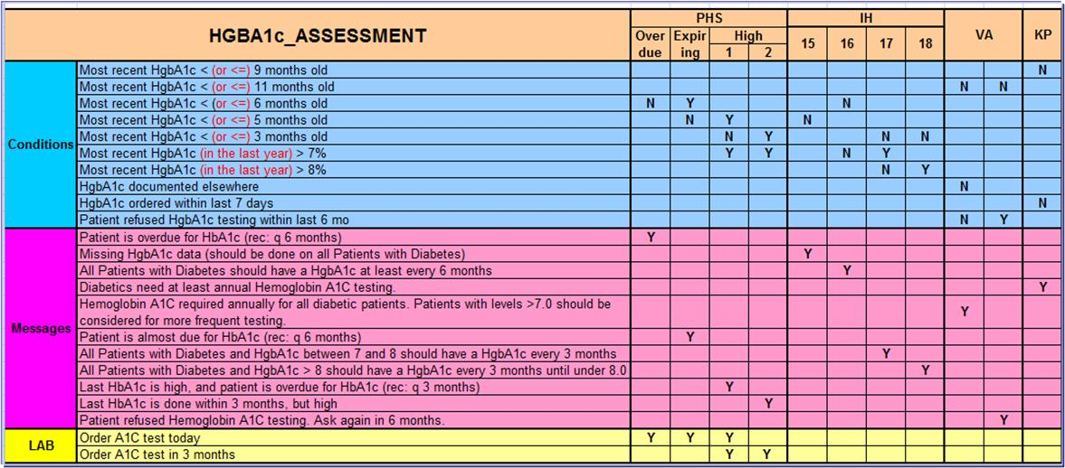
Multiple rules have similar intent
Differences relate to how triggered, how delivered, thresholds, process/workflow integration
Challenge is to identify core medical knowledge and to develop a taxonomy to capture types of implementation differences
Notes:
Analysis of renditions of the rules in Partners HealthCare, Intermountain Health, the VA, and Kaiser Permanente, carried out by Saverio Maviglia as part of the Morningside Initiative is demonstrated as separate columns in the table shown here. Variations reflect triggering, thresholds, timing, and other factors that were wanted with particular implementations.
<number><number>

Slide 11
Setting-specific factors (“SSFs”)
Triggering/identification modes
  Registry, encounter, periodic panel search, patient list for day, …
  Inclusions, exclusions
Interaction modes, users, settings
Data mappings & definitions, e.g.,
  What is diabetes - code sets, value sets, constraint logic?
  What is serum HbA1c procedure?
Data availability/entry requirements
  Thresholds, constraints
Logic/operations approaches
  Advance, late, due now, …
Exceptions
  Refusal, lost to follow up, …
Actions/notifications
  Message, pop-up, to do list, order, schedule, notation in chart, requirement for acknowledgment, escalation, alternate. …
Notes:
A basic rule can be modified in response to a wide variety of setting-specific factors (“SSFs”), at a particular site, for a particular application environment and system platform, and with its particular workflow processes.
<number><number>

Slide 12
Hypothesis 3: Sharing can be facilitated by a formal approach to rule refinement
Develop an Implementers’ Workbench
Start with EBM statement
Progress through codification and incorporation of SSFs
Output in a form that is consumable “directly” by the implementer site or vendor
Notes:
We posit that an implementers’ workbench can aid in refinement of a rule from its EBM statement form through successive stages of coding and formalization, encoding of SSFs, and finally output in a form directly useable in a particular application environment and system platform.
<number><number>

Slide 13
Life Cycle of Rule Refinement
Start with EBM statement
Stage
Identify key elements and logic – who, when, what to be done
  Structured headers, unstructured content
  Medically specific
Formalize definitions and logic conditions
  Structured headers, structured content (terms, code sets, etc.)
  Medically specific
Specify adaptations for execution
  Taxonomy of possible workflow scenarios and operational considerations
  Selected particular workflow- and setting- specific attributes for particular sites
Convert to target representation, platform, for particular implementation
  Host language (Drools, Java, Arden Syntax, …)
  Host architecture: rules engine, SOA, other
  Ready for execution
Notes:
Four stages are identified, beginning with identifying the key elements in the narrative EBM statement, formally encoding them, adding SSFs for a particular implementation, and converting to the target representation. Adapting for SSFs is based on selecting from a taxonomy of SSFs.
<number><number>

Slide 14
Four current projects addressing this challenge
EBM statement
Identify key elements and logic – who, when, what to be done
Formalize definitions and logic conditions
Identify possible workflow scenarios – model rules, defining classes of operation
Convert to target representation, platform, for particular implementation
Idealized life cycle / Morningside / KMR / AHRQ SCRCDS/ SHARP 2B
Notes:
Four current projects are described in this table in terms of how they relate to the four-stage model of rule refinement.
<number><number>

Slide 15
What we hope to accomplish
Implementers’ Workbench (IW)
Taxonomy of SSFs
Knowledge base of rules
Approach
  Vendor, implementer, other project input, buy-in, collaboration
  Taxonomy as amalgam of NQF expert panel, Morningside/SHARP/Advancing-CDS workflow studies, SCRCDS implementation considerations
  Diabetes, USPS Task Force prevention and screening A&B recommendations, and Meaningful Use eMeasures converted to eRecommendations as initial foci
  Prototyping, testing, and iterative refinement of IW
Notes:
In the current SHARP project the goal is to develop an Implementers’ Workbench (IW), a taxonomy of SSFs, a knowledge base of rules in one or more subdomains, and work with stakeholders to refine the goals, model, and implementation design through iterative refinement.
<number><number>

Slide 16
What we expect to share
Experience/know-how
Knowledge content
Methods/tools
Standards/models
Notes:
The result is expected to include shared experience, knowledge content, methods, and models that could become the basis for standards.
<number><number>

Slide 17
Standards/models
Representation
Data model/code sets
Definitions
Templates
Taxonomies
Transformation processes
Notes:
Several aspects of the model may lend themselves to standardization if shown to be useful.
<number><number>

Slide 18
Where CDS should go from here?
Need for coordination
  Multiple efforts underway
  Need to coalesce and align these
Need sustainable process
  Multi-stakeholder buy-in, participation, support, commitment to use
Need to demonstrate success
  Small-scale trials
  Larger-scale deployment built on success
Expansion to many kinds of CDS and domains of application
Notes:
This project is one of several that are currently underway but not aligned. It would be desirable to align these efforts, develop a multi-stakeholder process for sustaining them, seek small-scale successes that can lead to larger-scale initiatives, and expansion to a broad array of CDS capabilities and domains.
<number><number>

Slide 19
Comments? Questions?

