Slide 1

Development and iterative testing of a computerized decision support system to improve opioid prescribing for chronic pain
Jodie Trafton, Ph.D.
VA Center for Health Care Evaluation

Slide 2
Opioids are highly prescribed
Based on number of US prescriptions dispensed in 2005:
  Hydrocodone #3, Tramadol #5, Vicodin #6, Oxycodone #8, Percocet #12
From 1996-2002, opioid prescribing increased 309% in Medicaid programs
  Biggest increase in oxycodone and methadone

Slide 3
Opioid prescribing may be associated with a variety of problems
Misuse/Abuse/Addiction
Lack of Effectiveness
Side-effects
  Lethal
  Troublesome
Legal problems
  For patients
  For physicians
Notes:
Opioids activate reward circuits and thus, like all rewards, will shape behaviors. Depending on the context and pattern of use, these behaviors may be helpful or harmful to emotional well-being and life functioning. When harmful behaviors are learned, opioid use can result in problems with misuse, abuse or addiction.
Opioids may or may not provide reductions in pain and improvements in functioning over the long-term. There is little research testing the long-term (beyond 4 weeks) effectiveness of opiods for treatment of chronic pain, and there is evidence that at least some patients develop tolerance or opioid-induced hyperalgesia and show improvements in pain and functioning when opioid treatment is discontinued.
Additionally, even when opioids do help, they reduce but do not eliminate pain. A 30% reduction in pain is a good response. Patients and providers may have unrealistic expectations for treatment outcome with opioid medications.
All medications have side-effects. Opioid medications produce respiratory depression, especially in opioid naïve patients, and may be lethal if overdosed. They also may produce sedation, constipation, nausea, itching, and problematic psychotic effects in some patients.
Opioid prescriptions may have legal consequences for patients and providers. Patients may choose to illegally sell or share their prescriptions. Providers have been prosecuted for overexuberant prescribing, poor documentation of opioid prescribing, and elder abuse.

Slide 4
Misuse/Abuse/Addiction
Improper use of medications
  e.g. Hoarding, using others Rx, taking more than prescribed
Aberrant behaviors around opioid prescriptions
  e.g. MD shopping, early refills, ER visits
Diversion
Medication addiction
  Need to differentiate dependence and pseudoaddiction
Notes:
A percentage of patients will show problematic behaviors related to their opioid prescriptions. Estimated rates of such behaviors range wildly (3-50%) depending on the patient population studied and the definitions used.
There is not complete consensus on what constitutes problem behavior, but research on opioid misuse is intensifying.
Currently researchers and clinicians have delineated a number of behaviors that may indicate that the patient is having trouble using their medication properly and may have and addition. These include hoarding medication, using other people’s prescriptions, taking more than prescribed, getting prescriptions from multiple doctors, asking for early refills for lost or stolen medication, frequent ER visits, preference for a single opioid or route of administration, buying medication off the street or internet, lying about medication. These behaviors range from relatively common to infrequent and obviously range in intensity. For example, having 25 doctors is much more worrisome than 2.
Diversion is a relatively straightforward problem, not necessarily to detect, but to respond to, but may not be related to addiction.
Identifying addiction is additionally complicated in chronic pain patients where effective analgesics will be sought solely for their their pain relieving effects. To illustrate, in animal self-administration models, a healthy rodent will not self-administer NSAIDS, however, an animal with an induced inflammatory injury will self-administer NSAIDS. Analgesic-seeking behaviors that occur only in search of pain relief are considered normal. Although they may mimic addictive behaviors, they are considered a “pseudoaddiciton”. Some argue that in order to truly diagnosis opioid medication addiction in the presense of chronic pain, one must determine if the behavior persists when the pain is effectively relieved.

Slide 5
Effectiveness
Lack of research evidence for long-term effectiveness
Effect on pain experience versus functioning
  Need to define goals and expectations
Tolerance and dose escalation
Opioid-induced hyperalgesia

Slide 6
Side-effects
Accidental overdose
  Rates have been increasing markedly as opioid prescribing rates have increased. A CDC report found:
    Between 1999 and 2002, the number of opioid analgesic overdoses on death certificates increased 91.2%.
    Among opioid analgesic overdoses in 2002, 54% were from semi-synthetic opioids such as oxycodone and hydrocodone, 32% were from methadone, and 13% were from other synthetic opioids such as fentanyl.
Psychological effects
Sedation
  Accidents
  Mental impairment
Constipation

Slide 7
Legal Problems
Diversion
  According to the NSDUH, 4.8% of people age 12 or older used a prescription opioid non-medically in the last year (2005)
Improper prescribing
Elder abuse

Slide 8
Physicians desire help with opioid prescribing and chronic pain management
Lack training in pain management
Communication difficulties
  Between clinicians
  Between patient and provider
Lack of clear research data to guide decisions
Apparently conflicting goals
  Reduce pain/Prevent negative consequence of medication use
  Legal community: limit use/Medical community: increase use of opioids
Want to be told what to do

Slide 9
Clinical Practice Guidelines are available
Predominantly consensus based
Not strictly operationalized
  Not clear how to implement guideline in practice
Not well followed in practice

Slide 10
Complex problem
Not something that can be fixed with a simple reminder or warning
Many concerns that need to be balanced
Many medication options with subtle differences in indications, dosing strategies, and risks
Simple medical informatics tools are not likely to help substantially

Slide 11
Decision Support
With the support of the SUD QUERI, we decided to develop a computerized decision support system to provide primary care providers with recommendations for individual patients to guide use of opioid therapy for chronic pain based upon the VA/DOD 2003 clinical practice guideline.

Slide 12
Used ATHENA-DSS structure
Integrated with CPRS to fit within clinical workflow
Extracts data from electronic medical record
Data is run through a complex algorithm to generate patient specific warnings and recommendations for care
Recommendations and tools are provided in a graphical user interface
Limited information can be written back to the electronic medical record
Notes:
Sbm- highlight that it is set up to fit in the provider’s clinical workflow. For example, the provider gets our Advisory as a pop up window when he/she selects the patient in CPRS (quasi-integration with CPRS). Provider does not need to activate the program.

Slide 13
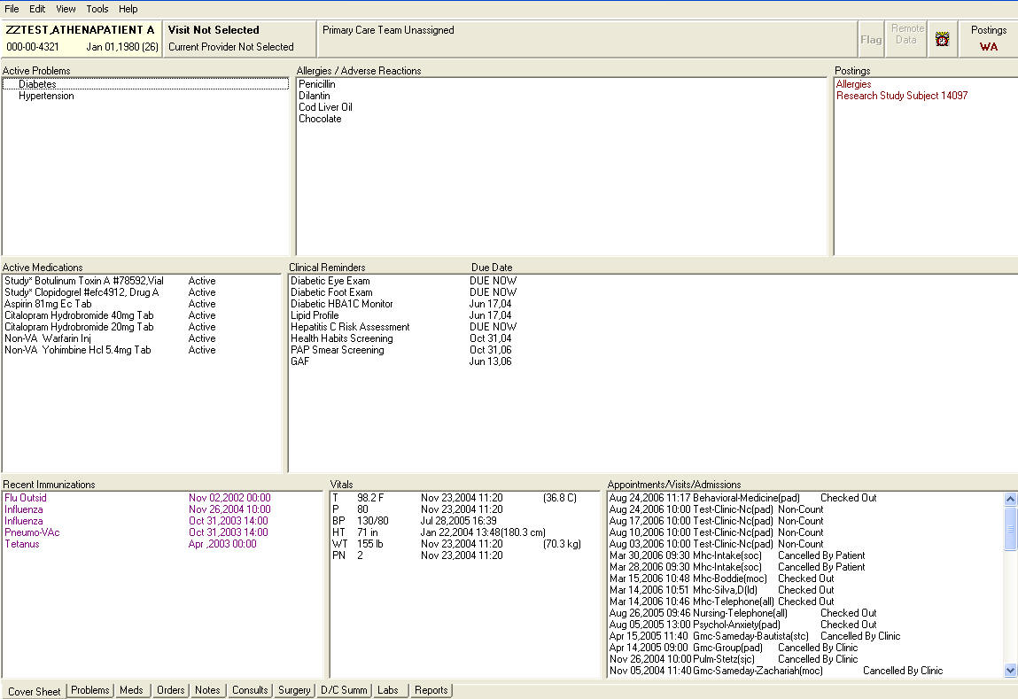
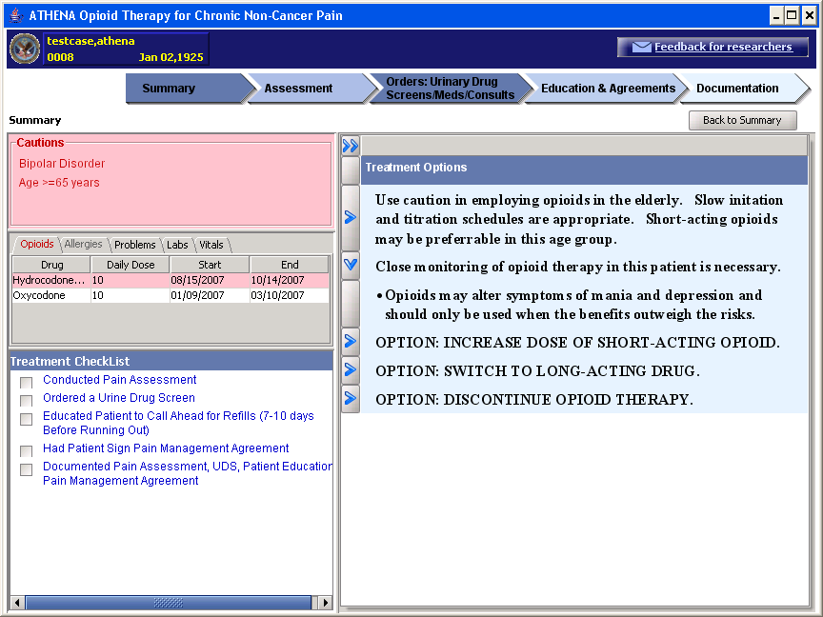
What the Clinician Sees…

Slide 14
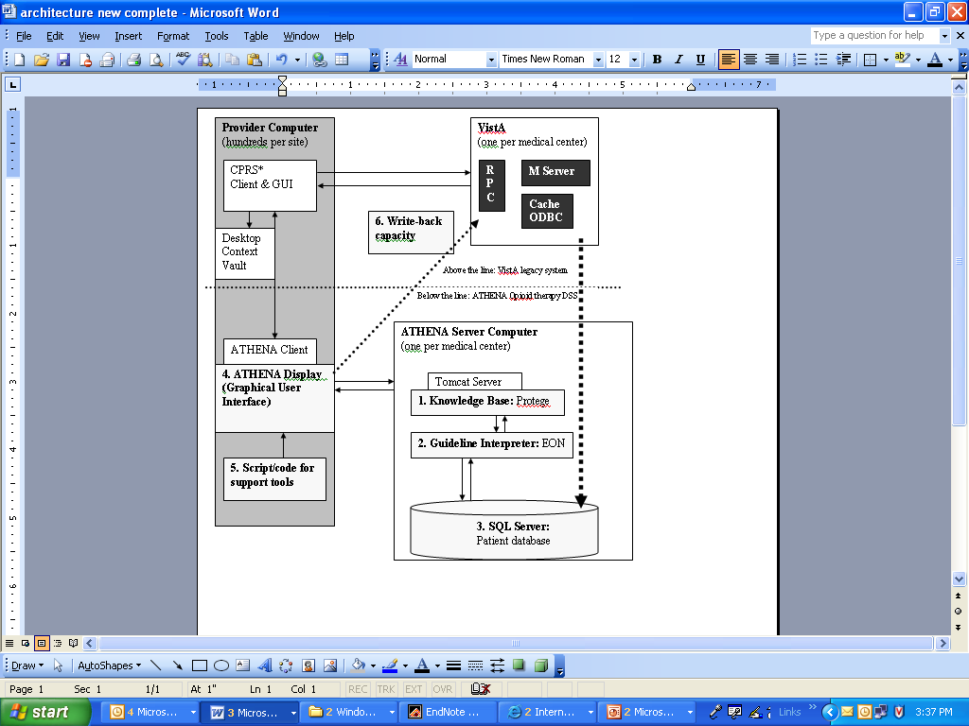
The ATHENA system

Slide 15
Goals
Improve analgesia and functioning
Reduce use, or improve monitoring of effectiveness and negative consequences, in contraindicated patients
Improve screening for and decrease abberrant behaviors (e.g. MD shopping, multiple Rxers, use of ER)
Improve documentation of opioid therapy and chronic pain management plan
Facilitate patient/provider communication and monitoring of chronic pain
Provide clinicians with detailed prescribing information and algorithms to save time and cost
Notes:
Add improve analgesia/activities of daily living?
Provide for informational needs of clinicians when managing chronic pain (conversion calculator, etc.)

Slide 16
Challenge 1
Operationalizing clinical guideline
  More of a guide for good practice strategy than an algorithm for determining correct clinical choices
  Limited to information we could reliably extract from the patient medical record
  Imperfect consensus on best practice even among experts

Slide 17
Our response
Design graphical user interface and tools to foster good practice strategies
  Clinician behavior checklist
    Written back into patient notes
    Provides reminders to complete what can be uncomfortable or time-consuming procedures
  Highlight potentially concerning patient characteristics or medical history for consideration
  Standardized assessment and education tools

Slide 18
Our response cont.
  Scenarios versus recommended strategy
    Focus on providing information that should contribute to management plan
    Present detailed information on how to implement opioid therapy once a broad decision (e.g. initiate treatment, increase dose, switch medication, discontinue medication) has been made

Slide 19
Challenge 2
Designing a system that is useful despite variation in clinicians’ pattern of EMR use
  Use system before visit
  Use system in visit alone
  Use system in visit with patient
  Use system after visit

Slide 20
Our Response
Use relatively simple, concise language
  Not insulting to provider but understandable by a patient
Present information in an order and format that follows clinical process
  Warnings and data tables help before decision
  Dosing instructions help during decision
  Education and treatment agreements help following decision
  Documentation tools help after visit
  Checklists provide either guide for care or review of practice

Slide 21
Current choices for System

Slide 22
Tool bars
Assessment
  Pain assessment and pain reassessment template
    Write back structured notes to VISTA
Orders
  Opioid conversion calculator
  Guide to interpreting UDS results
  Drug tables and adjunctive medication algorithm
Education/Agreements
  Pain management agreement (opioid contract)
  Patient education documents (e.g. Side effect management)
  Information on referrals within and outside VA

Slide 23
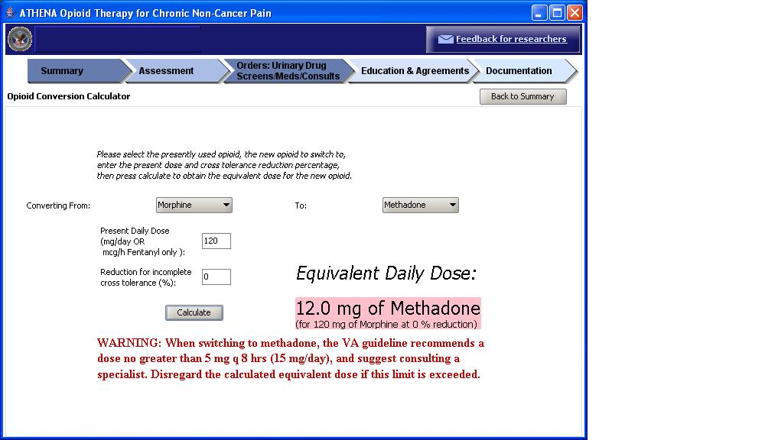
Opioid conversion calculator

Slide 24
Testing Process
Validation that rules matched guideline
  Guideline author assessment
Accuracy assessment
  Clinician validation of recommendations
Usability testing
  Laboratory testing by clinicians
  In-clinic observation of system use
Pilot testing
  Implementation in primary care clinic
  Assess changes in clinical practice
  Assess changes in patient health care use patterns
Iterative up-dating

Slide 25
Guideline rules validation
Rules of the algorithm were written in plain English
These were sent to 3 authors of the VA/DOD clinical practice guideline for opioid therapy
Each rule was assessed and guideline authors indicated whether they agreed or disagreed with the guideline or needed elaboration/clarification
The rules document was revised based upon author comments and re-reviewed iteratively

Slide 26
Example Identified problems
Over generalization of guideline concepts (e.g. although the guideline does not apply to treatment of cancer pain, the guideline may apply to patients with cancer diagnoses, only some personality disorders may be cause for concern)
Miscoding of concepts (e.g. substance abuse diagnosis is not equivalent to diversion)
Concerns about coding in medical record (e.g. medical record diagnoses of substance dependence/abuse may not be accurate, allergies may not really be allergies)
Concerns about need for confirmatory labs (e.g. if UDS is positive)

Slide 27
Accuracy Assessment
System recommendations for sample patient cases were reviewed by experts in pain management and clinicians
System errors or inappropriate recommendations were identified and sent to the knowledge modeling team for correction.
This testing also occurs iteratively and is on-going, as the system must be re-tested every time changes are made.

Slide 28
Sample Identified Problems
Errors in data extract
Errors in categorization of concepts (e.g. diagnoses or lab values)
Poor wording of recommendation
Missing recommendations and warnings
Unanticipated “special cases” (e.g. methadone clinic patient receiving dosing from inpatient program)

Slide 29
Usability Assessment
Volunteer clinicians were asked to use the system while evaluating 3 patient cases. They were asked to verbally walk through their thought process as they used the system.
Clinicians shared their impressions, likes and dislikes of the system, recommendations for improvements and barriers to use in clinical practice, and satisfaction with the system
Conducted Round 1 with 4 clinicians, and are revising system based upon comments
Will repeat when redesigned system is complete

Slide 30
Usability results
Too many recommendations
Recommendations too wordy and disorganized
System will be helpful but will not save time
Generally satisfied with system and would like to use it
Some graphical elements not intuitive
Write-back is highly desirable

Slide 31
Pilot testing
12 primary care physicians recruited to use system in their practice for 6 months
Project manager will observe their use of the system in clinic, and contact them monthly by phone. Clinicians also may enter comments or requests for changes while using the system at any time.
Log system use

Slide 32
Outcomes
System use: What screens and elements were used?
Provider behaviors:
  Use of UDS
  Referral for evaluation of co-morbid conditions (e.g. SUD or mental health care)
  Referral for behavioral health (e.g. exercise therapy, behavioral health consult)
  Better assessment, documentation, and education
  Reduced use of combined short-acting opioids with NSAIDS/acetominophen
  Better adherence to cost algorithm in opioid choice
  Better initiation and titration doses (i.e. dose increases within guideline recommended range)
  Reduced prescribing to patients with contraindicated diagnoses

Slide 33
Research needed
Validation of algorithms to detect risk of negative consequences
  Underway, focus on misuse/abuse/addiction
Evidence to guide initiation, titration, switch, discontinuation choices
Optimizing patient-clinician communication
Larger scale implementation to test impact on patient outcomes

Slide 34
Thank You!
VA HSR&D TRX 04-402
SUD QUERI
The ATHENA-OT and ATHENA-Hypertension teams
  Mary Goldstein, Denise Daniels, Samson Tu, Susana Martins, Dan Wang, Martha Michel, Bob Coleman, Naquell Johnson, John Finney, Steve Balt
The VA Palo Alto Primary Care and Chronic Pain Clinics
  Lars Osterberg, Jan Elliott, Dave Clark
Mike Clark, Charlie Sintek, Jack Rosenberg
Stanford Medical Informatics

