Slide 1
OpenCDS: an Open-Source, Standards-Based, Service-Oriented Framework for Decision Support
November 5, 2012
American Medical Informatics Association Fall Symposium
Kensaku Kawamoto, MD, PhD
Director, Knowledge Management and Mobilization, Univ. of Utah
Assistant Professor, Dept. of Biomedical Informatics, Univ. of Utah
Co-Chair, Health Level 7 (HL7) Clinical Decision Support Work Group
Founder, OpenCDS (www.opencds.org)
kensaku.kawamoto@utah.edu

Slide 2
OpenCDS within Unified Theory
Clinical Knowledge
EHR
EHR
EHR
Structured Knowledge
Encoded and Machine-Interpretable Knowledge
Decision Support Service

Slide 3
OpenCDS (www.opencds.org)
Goal
  Facilitate widespread availability of advanced CDS capabilities through open-source, collaborative development of standards-based CDS infrastructure, tooling, and high-value content
Methods
  Encapsulate CDS capabilities as Decision Support Services (DSSs) that can be integrated with various clinical information systems
  Support relevant CDS standards
  Leverage open-source components (e.g., JBoss Drools, Apelon Distributed Terminology System)
1.1 release freely available under Apache 2 open-source license

Slide 4

















Featured Collaborators

Slide 5
OpenCDS – Architectural Overview
Standard Interface:
HL7 Decision Support Service (DSS) Standard
(http://hssp-dss.wikispaces.com)
Standard Data Models:
HL7 Virtual Medical Record (vMR) Standard
[ http://wiki.hl7.org/index.php?title= Virtual_Medical_Record_(vMR) ]
Institution A
Trigger
Queries for required pt
data
Patient Data Sources
Patient data,
knowledge modules to use
Client Decision Support Apps
Conclusions about patient
OpenCDS Decision Support Service
Institution B
Queries for required pt
data
Patient Data Sources
Client Decision Support Apps
Knowledge Modules
Notes:
SCT 14May

Slide 6
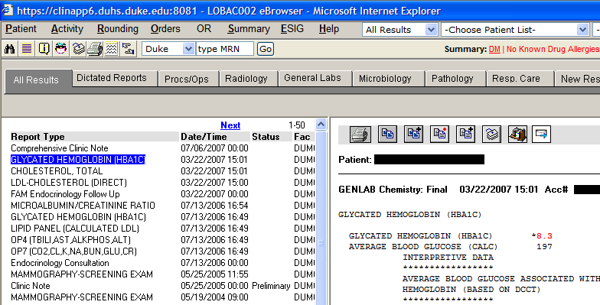
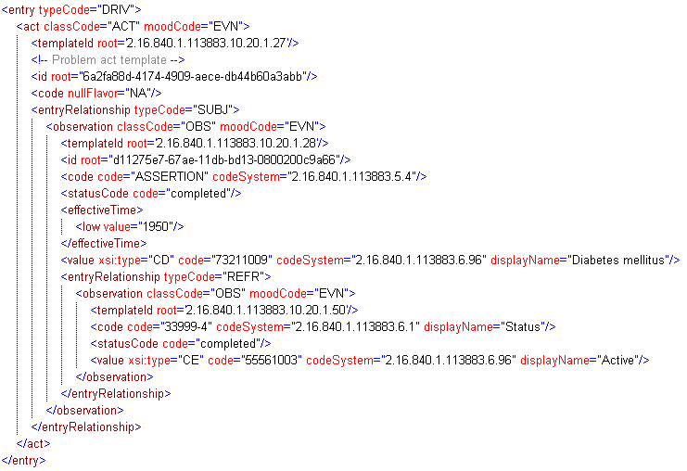
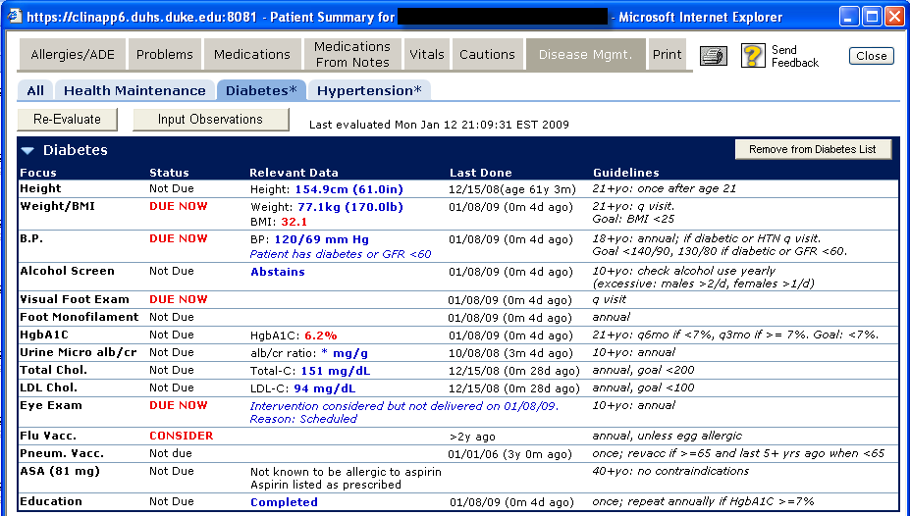
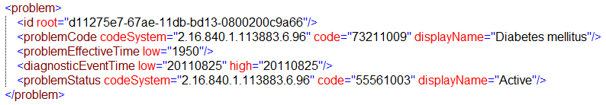
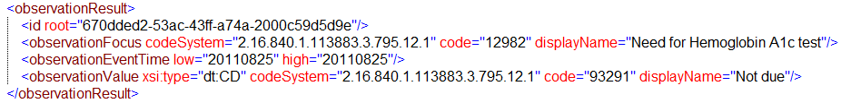
CDS Services – Example
Eval. Result
VMR
CCD
Pt data
Decision Support Service
Patient Data Sources
EHR System
Notes:
SCT 14May

Slide 7
Support for Multiple Knowl. Rep. Approaches
DSS Client
Patient data
Patient-specific care advice
HL7 Decision Support Service Interface
OpenCDS
Adapters
External CDS Engines/Services
(e.g., SEBASTIAN, ECRS,
WarfarinDosing.org)
OpenCDS Knowledge Management and Execution Platforms

Slide 8
WarfarinDosing.org Integration
DSS Client
Patient data
Patient-specific care advice
HL7 Decision Support Service Interface
WarfarinDosing.org OpenCDS Adapter
WarfarinDosing.org

Slide 9
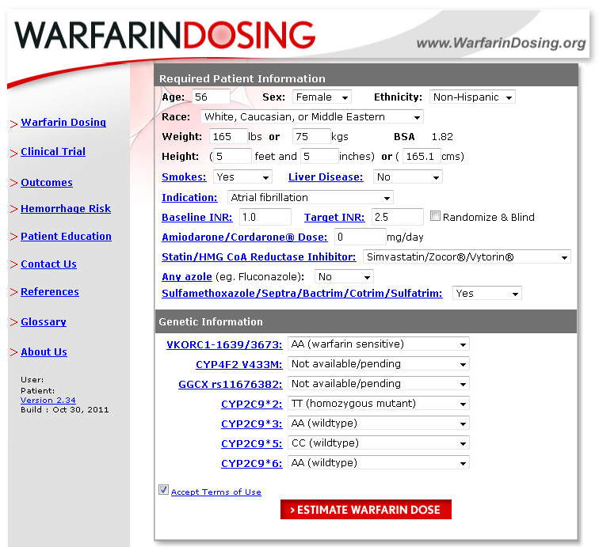
WarfarinDosing.org (Stand-Alone)
Notes:
SCT 14May

Slide 10
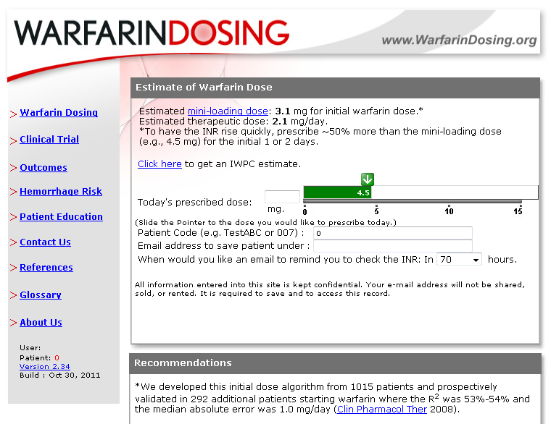
WarfarinDosing.org (Stand-Alone)
Notes:
SCT 14May

Slide 11
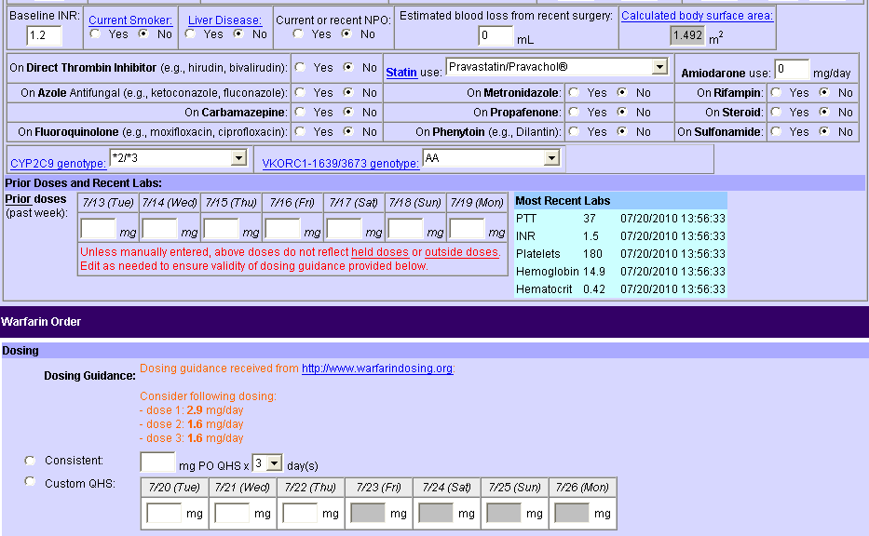
WarfarinDosing.org Integration via OpenCDS

Slide 12
OpenCDS Guvnor Platform
DSS Client
Patient data
Patient-specific care advice
HL7 Decision Support Service Interface
OpenCDS Guvnor Adapter
OpenCDS Guvnor Knowledge Management and Execution Platform

Slide 13
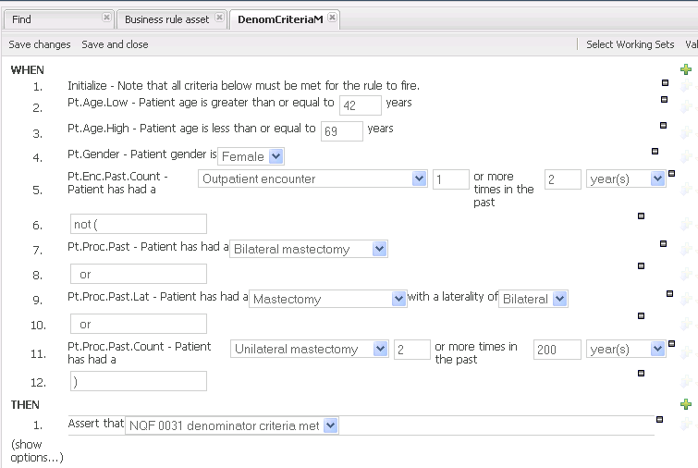
OpenCDS Guvnor Platform – Rules

Slide 14
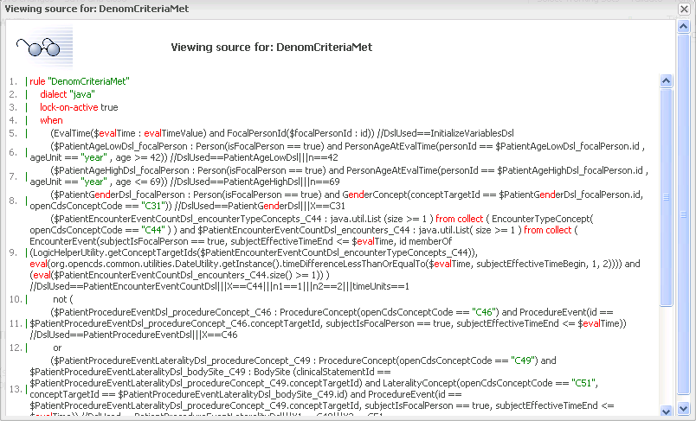
OpenCDS Implement. – Underlying Details

Slide 15
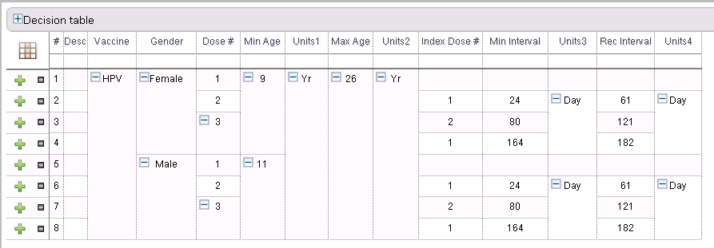
OpenCDS Guvnor Platform – Decision Table

Slide 16
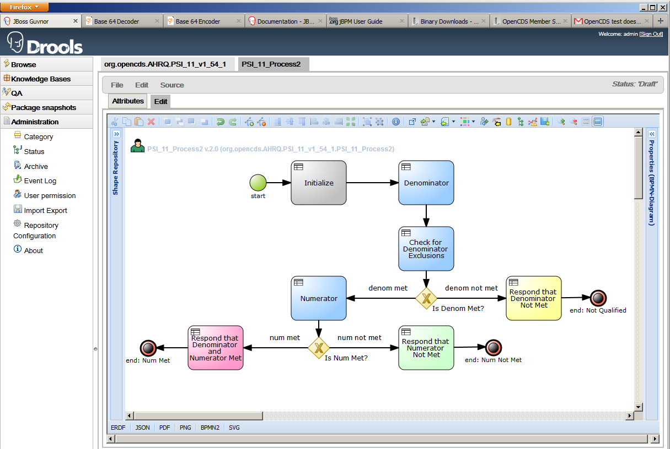
OpenCDS Guvnor Platform – Flow Diagrams

Slide 17
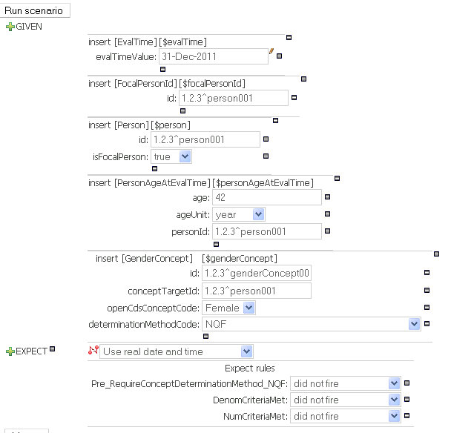
OpenCDS Guvnor Platform – Testing

Slide 18
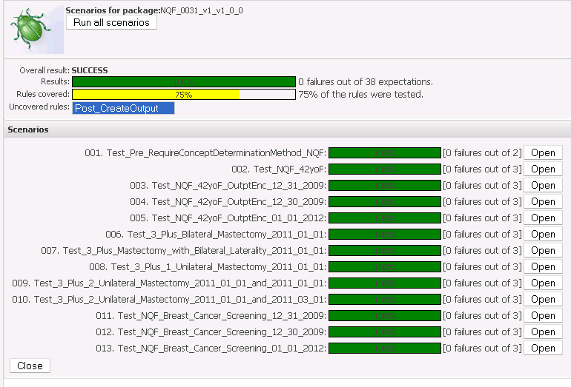
OpenCDS Guvnor Platform – Batch Testing

Slide 19
Immunization Calculation Engine (ICE) Platform
DSS Client
Patient data
Patient-specific care advice
HL7 Decision Support Service Interface
OpenCDS ICE Adapter
ICE Knowledge Management and Execution Platform

Slide 20
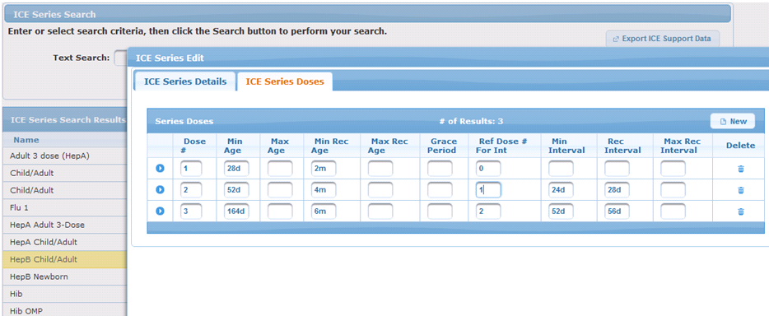
ICE Immunization Schedule Manager
Notes:
SCT 14May

Slide 21
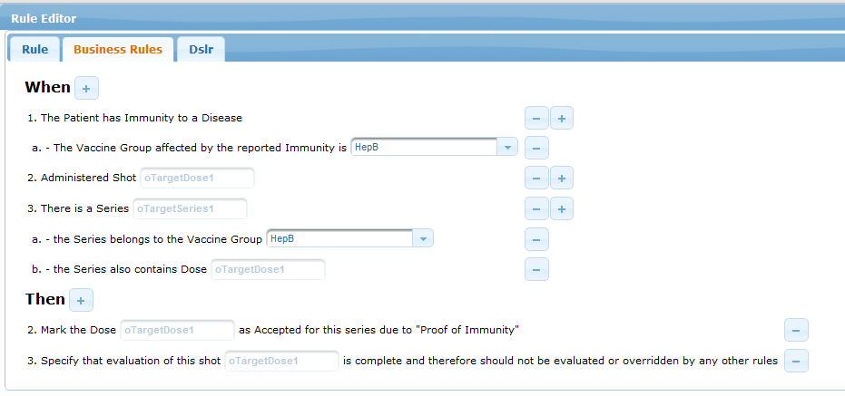
ICE Immunization Rule Manager
Notes:
SCT 14May

Slide 22
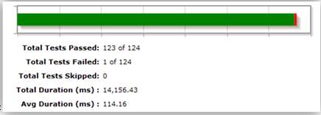
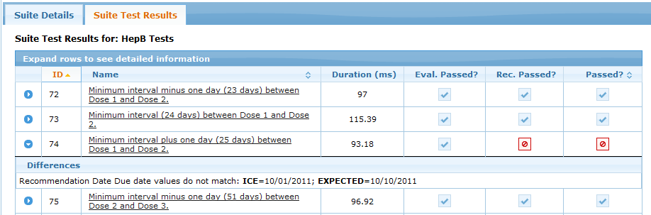
ICE Test Manager
Notes:
SCT 14May

Slide 23
OpenCDS Summary
Clinical Knowledge
EHR
EHR
EHR
Structured Knowledge
OpenCDS
Knowledge
Modules
Encoded and Machine-Interpretable Knowledge
Standard Interface – HL7 DSS, vMR, CCD
OpenCDS Decision
Support Service
Decision Support Service

Slide 24
Acknowledgements
Financial support
  NHGRI K01 HG004645 (PI: K. Kawamoto)
  University of Utah Dept. of Biomedical Informatics
  University of Utah Information Technology Services
  Utah Beacon Community Subcontract (PI: Bruce Bray)
Numerous OpenCDS collaborators
  www.opencds.org → Featured Collaborators
  In particular, David Shields of University of Utah
Notes:
SCT 14May

Slide 25
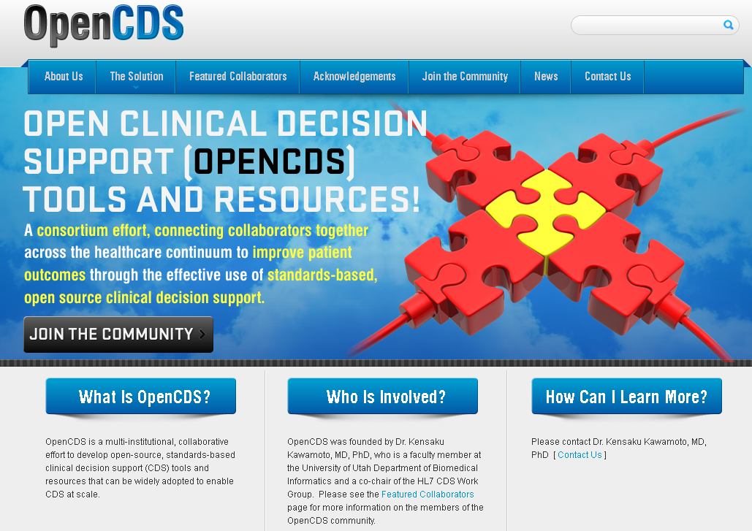
www.opencds.org
Notes:
SCT 14May

Slide 26
Thank You!
Kensaku Kawamoto, MD, PhD
Director, Knowledge Management and Mobilization, Univ. of Utah
Assistant Professor, Dept. of Biomedical Informatics, Univ. of Utah
Co-Chair, Health Level 7 (HL7) Clinical Decision Support Work Group
Founder, OpenCDS (www.opencds.org)
kensaku.kawamoto@utah.edu

