Slide 1
The Health Story Project
Buckeye Symposium 11/13/2010
presented by
Nick Mahurin
CEO, InfraWare

Slide 2
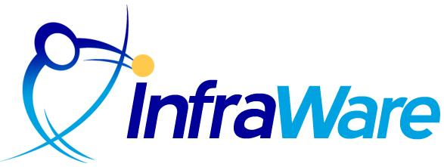

Great Workflow Automation
First Draft Dictation Recognition
Soon: CDA4CDT
Notes:
How do we do that?

Slide 3
The Health Story Project
Buckeye Symposium 11/13/2010
Nick Mahurin
CEO, InfraWare

Slide 4
The Health Story Project
Vision: Comprehensive electronic clinical records that tell a patient’s complete health story.
Goal: All of the clinical information required for good patient care, administration, reporting and research are readily available electronically, including information from narrative documents.
www.healthstory.com

Slide 5


In Summary
Computer image courtesy of M*Modal
  A physician’s practical
  need for fast and easy
  methods for creating
  clinical documentation
The enterprise need for
structured and coded
information capture to support meaningful use
Notes:
Why Health Story?
1.2 billion clinical documents produced in U.S./year
Dictated and transcribed documents around 60% of clinical data
Getting valuable info from narrative documents into the EHR
What if you could …
Continue to use narrative and dictation and
at the same time increase usage of the EMR and
make more records available for the health information exchange?
Dictation is the documentation method of choice for 85% of physician providers
Standardization of dictated notes is an achievable step for providers; Standards are available today

Slide 6
Health Story Project
Non profit, industry alliance
  Founded 2007 by AHIMA, AHDI, Alschuler, MTIA, M*Modal
Associate Charter Agreement: HL7
  Producing data standards for flow of information between common types of healthcare documents and EHR systems
Elected executive committee from member organizations provide direction
  Members support project with active participation and annual membership dues
  Managed by Alschuler Associates and Optimal Accords

Slide 7
Problems Facing Clinicians
According to an American College of Physician Executives survey, 6 in 10 physicians have considered leaving the profession due to:
  burnout
  low morale/depression
  loss of autonomy
  low reimbursement rates
  patient overload
  bureaucratic red tape
  loss of respect, and
  medical liability environment
Complexity and workload is crippling physicians and hindering their ability to deliver high quality care

Slide 8
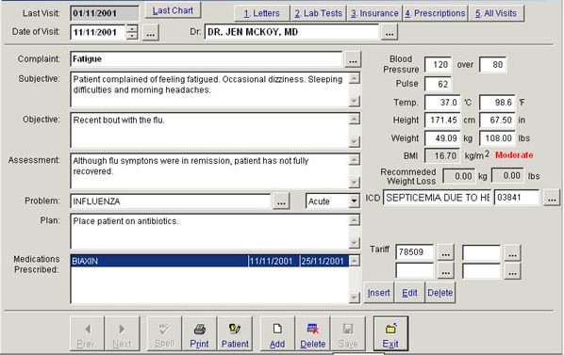
The Current Situation – Structured
Tedious manual process
Time-consuming
Documentation lacks expressiveness of natural language
Lack of Flexibility
Poor user interface
Cost
  Fails to Meet Physician Time vs. Benefit Test
  Cultural resistance
May not meet HIM Requirements
Incomplete and Inadequate Semantic Standards

Slide 9
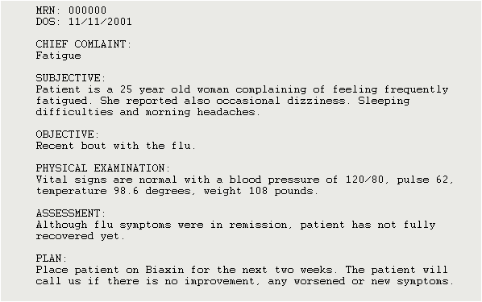
The Current Situation
Transcription is expensive
Subject to turn-around times
Clinical data lost, because documents are neither structured nor encoded
Majority of attested information is only in the document
Contains the unique detail and comprehensive scope of patient information
Supports care decision making
Reimbursement is based on narrative documentation
Retains current workflow, favored by physicians
Under utilized source of data for EMR

Slide 10
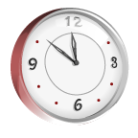
Data Entry Time
The average physician spends 33 seconds dictating an established office visit
92% of all office visits are established
If the average physician sees 40 patients a day, total dictation time of 30 minutes plus time to search for the data.
Using a traditional EHR application, the same number of patients would require 140 minutes of data entry time.
Physicians are not willing to spend an additional 90 minutes per day for data entry.
(40 X 92% x 33 seconds) + (40 x 8% x 125) = < 30 minutes per day

Slide 11
The Tough Choice

Slide 12
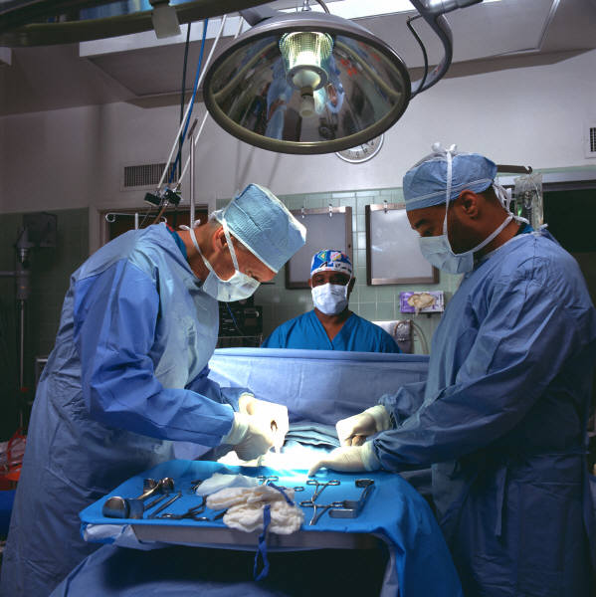
What if you didn’t have to choose?
Structured and encoded clinical content enables…
  pre-signature alerts,
  decision support,
  best documentation practices,
  multiple output formats,
  multi-media reporting,
  data mining
Implements HL7 CDA4CDT standard compliant document types
Increases quality of documentation
THE CODING CONNECTION – better documentation = better coding & DRG optimization = better reimbursement

Slide 13
What has the industry learned…
From Recovery Audit Contract audits?
When asked of Rhonda Buckholtz, CPC, Vice President of Business and Member Development, American Academy of Professional Coders (AAPC)
“What I think we have learned from the hospitals is exactly how valuable it is to have good documentation and communication between facilities and provider offices.”
For the Record, Vol 21, No 24, pp 14-18.

Slide 14

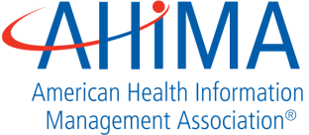







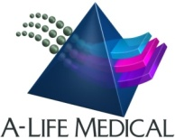
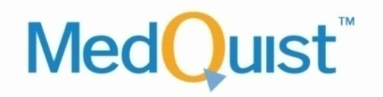
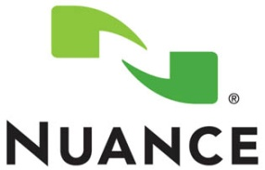




Health Story Members
Founding Members
Promoters
Contributors
Aprima Software | Scribe Healthcare Technologies
All Type | Arrendale Associates | BayScribe
Documentation Services Group | eMTS | Healthline, Inc.
MedEDocs | MD-IT | New England Medical Transcription
Phoenix Medcom | Sten-Tel, Inc.
Participants

Slide 15
Health Story: Guiding Principles
1. Inclusive and open process
2. Leverage current technology investments
3. Enable broad stakeholder engagement
4. Provide a glide path for incremental interoperability
5. Make it easy to meet conformance criteria in NOW
6. Minimize disruption to clinician workflow
7. Base strategy on existing standards
8. Use proven technology

Slide 16
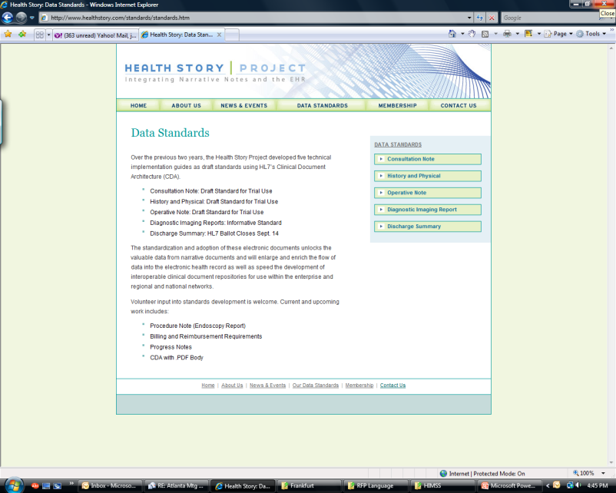
Projects
HL7 Implementation Guides
Completed
History & Physical
Consultation
Operative Report
DICOM Imaging Reports
Discharge Summary (in publication)
Procedure Note (in ballot)
CDA with Unstructured Body (in ballot)
Upcoming
Billing and Reimbursement Requirements
Progress Notes
TBD
www.healthstory.com
Notes:
Procedure Note focus is on endoscopy report

Slide 17
Adoption Strategy
Health Leven Seven (HL7) collaborates with Health Story on development and ballot of technical implementation guides
Medical transcription companies support creation, delivery and enrichment
EHR vendors systems send, receive, display and integrate
Health providers select the approach and receive vendor support for standards-based document creation, management and enrichment
Notes:
Requirement language now available

Slide 18

APPROACH
OK, you had me at physicians not having to change their processes, so technically speaking, how does it work?

Slide 19
Based on HL7 CDA
Clinical Document Architecture supports:
Human readable document
Machine-processable data (e.g. discrete reportable transcription)
Cross platform and application independent
Health Story Approach
Standardize through ANSI SDO (HL7 ballot)
Support Meaningful Use
Minimum | Optimum
CDA header | Standard section codes
Broad industry agreement on clinical content | Reuse of entry-level templates “Templated CDA”
Notes:
Standards provide underlying infrastructure that allow narrative to be delivered to the point of care
Baseline requirement for meaningful use in 2011
Specifications include templates for fielded, coded data that support reuse for safety, reporting and decision support
Requirement for meaningful use in 2012 and beyond

Slide 20
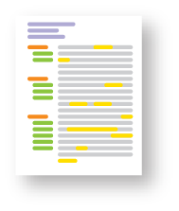
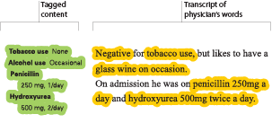
Meaningful Clinical Documents
Meaningful Clinical Documents are a blend between free form text and fully structured documentation that
  represent the thought process, and
  capture the clinical facts
Notes:
Captures meaningful clinical documents
Is the bridge between
free form narrative and expressive notes, and
fully structured clinical data
Improves the quality of clinical documentation
Generates semantically interoperable clinical data that will
solve the fundamental challenges with EMRs - allowing clinical decision support, alerts, decision support, data mining
enable interoperability, reporting, patient safety initiatives, PQRI (pay for performance), PSI (patient safety indicators) and improve billing data capture

Slide 21
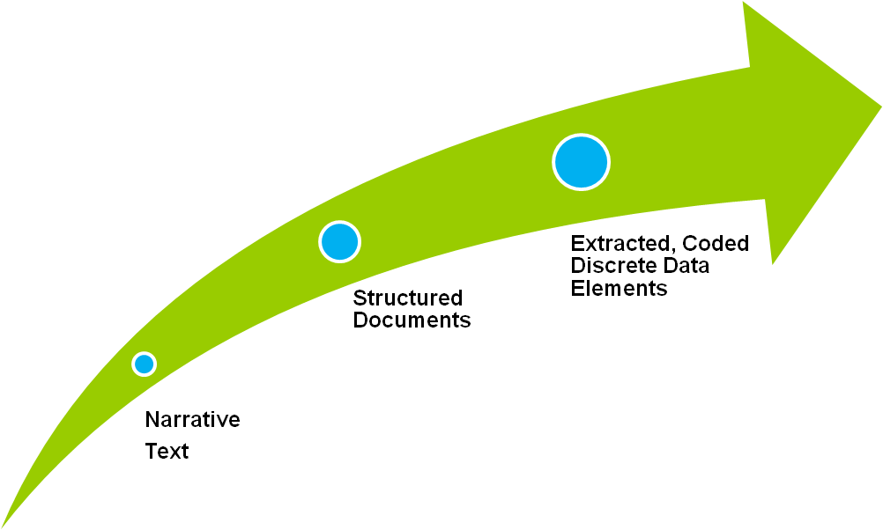
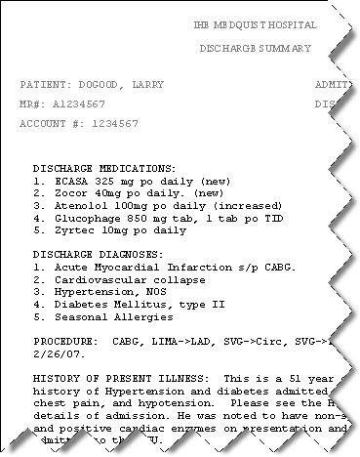
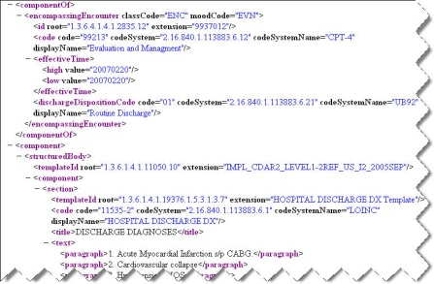
Meaningful Clinical Documents
EHR Repository
Clinical Applications
HIM Applications
SNOMED CT
Disease, DF-00000
Metabolic Disease, D6-00000
Disorder of carbohydrate metabolism, D6-50000
Disorder of glucose metabolism, D6-50100
Diabetes Mellitus, DB-61000
Type 1, DB-61010
Neonatal, DB75110
Carpenter Syndrome, DB-02324
Insulin dependant type IA, DB-61020
Notes:
Structured and encoded clinical content enables…
pre-signature alerts,
decision support,
best documentation practices,
multiple output formats,
multi-media reporting,
data mining
Implements HL7 CDA4CDT standard compliant document types
Increases quality of documentation
Medical text “typed” from dictation has “no meaning”
black marks on a page…
info must be tagged as discrete data elements in order to assign meaning
Clinical documentation uses wide variety of terms with same meaning….
and terms that sound the same that have different meanings…..
authors have a wide variety of styles, accents, methods of dictation…

Slide 22
Impact
Allows providers to choose preferred workflow and documentation methods
Provides on-ramp to EMR system adoption
  pre-populate EMR with structured documents
  integrate legacy documents
Increases the value and usability of narrative documents
Allows intelligent and meaningful re-use of information

Slide 23
Successes
Members generating Health Story/HL7 compliant CDA today: GE Medical, MedQuist, M*Modal
All members planning to generate standards-based documents within the next year
Health Story/HL7 H&P and Consult recommended by HITSP
On CCHIT HIE Roadmap
Included in HIMSS EHR Adoption Model
Notes:
Lakeland Regional Medical Center, FL is live with HL7/Health Story Diagnostic Imaging Reports; reports and discrete data are then integrated into Centricity EMR
M*Modal supports dictation/transcription vendors generating 3,000,000 CDA documents each year
CCHIT: Road.HIE.157: The HIE shall provide the ability to receive and forward a HITSP C/84 document. (2011)

Slide 24

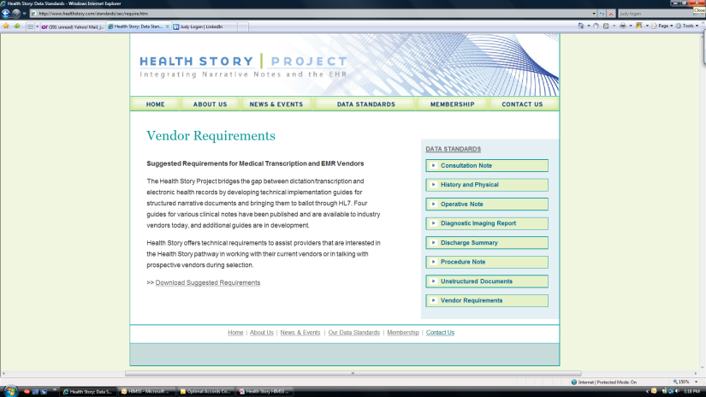
Actionable Next Steps
Is your system capable of producing an HL7 CDA document?
Requirements:
Notes:
- Is transcription vendor capable of producing a CDA document. If not, when?
Is your EMR vendor capable of producing a CDA document
Suggested vendor requirements on the Health Story website

Slide 25

Q&A
Contact Info
Nick Mahurin
CEO, InfraWare
www.infraware.com
Nick.Mahurin@InfraWare.com
877-235-7239

