Slide 1


Introduction to the
Clinical Document Architecture
For the HL7 Child Health Work Group
Gay Giannone MSN, RN
June 10, 2009
www.alschulerassociates.com

Slide 2
Instructor
Gay Giannone MSN, RN
  20 years Neonatal Intensive Care Experience
  Masters in Nursing Administration and Healthcare Informatics -University of Pennsylvania -2004
  Member HL7 SDWG
  CDA certified
  Primary editor on CDA Implementation Guides:
    QRDA
    Public Health Case Report
    Operative Note
  gay@alschulerassociates.com

Slide 3
Objectives
Basic understanding of CDA
Understand relationship between CDA, CCD, CRS
Opportunities for pediatric work in HL7

Slide 4
Part 1 - Outline
Overview of CDA
  Definition
  XML... and more
  Usage
  Let’s take a look...
The “A” in CDA
The Specification
Implementation
Current Work, Summary & Resources
Notes:
Definition: what kind of document is qualified to be a CDA.
Ask who is familiar with XML.
The A in CDA. Actually the standard is just called CD, but was created by a Canadian (just kidding).

Slide 5
CDA History
Clinical Document Architecture
ANSI/HL7 CDA R1.0-2000
ANSI/HL7 CDA R2.0-2005
Created & maintained by HL7 Structured Documents Work Group (SDWG)
A specification for document exchange using
  XML,
  the HL7 Reference Information Model (RIM)
  Version 3 methodology
  and vocabulary (SNOMED, ICD, local,…)
Notes:
XML is the wire format, the RIM is “behind the scenes”
Differences between R1 and R2
----------------------------------------------
The R1 header was derived from the RIM, but the body was hand crafted. This was intentional, because they wanted to limit the scope until they really figured out what they wanted to do.
R2 has coded entries in the body that derive from the RIM.

Slide 6
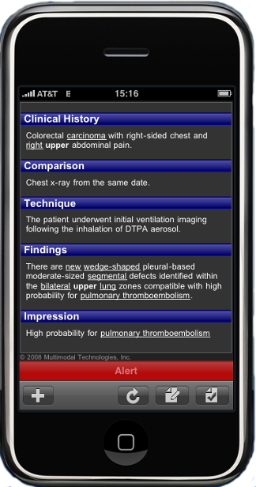
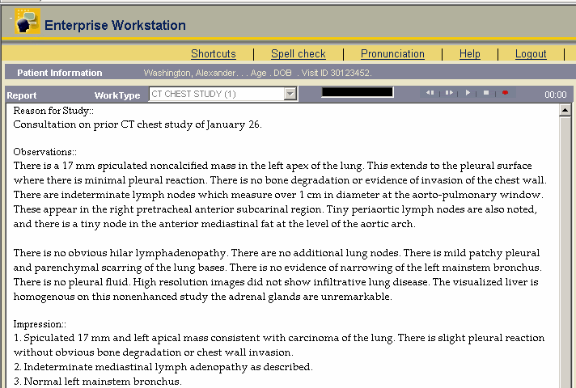
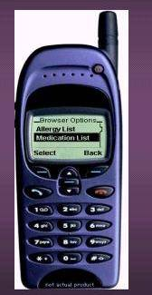
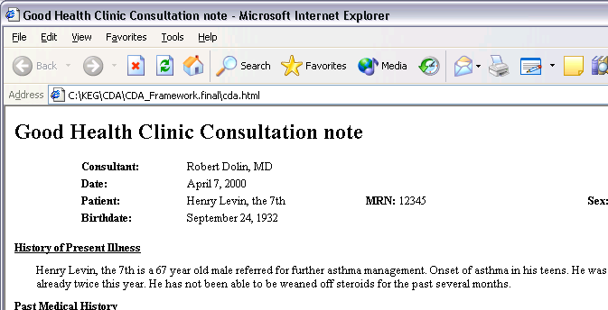
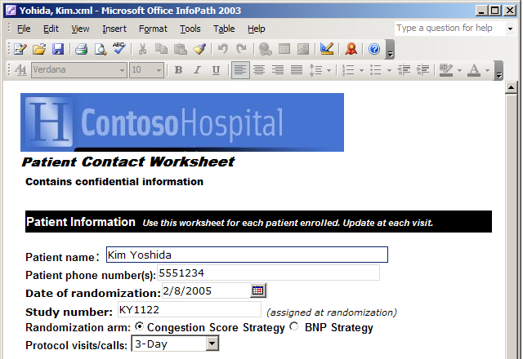
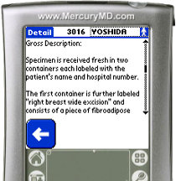
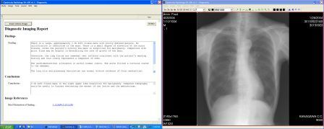
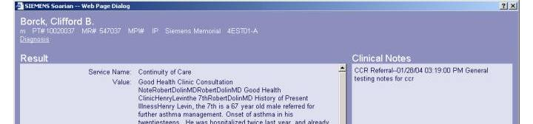
CDA: A Document Exchange Specification
This is a CDA
and this
and this
and this
and this
and this
and this
Notes:
Animation
Anything that would go in a patient’s chart.
Legally attestable
Has a custodian (i.e. the entity holding the record at the time of creation).

Slide 7

CDA: What is a document?
In XML-speak, everything is a “document”
Intuitively, documents:
  reflect historical form of healthcare record
  mix discrete data and free-flowing narrative
CDA restricts the set of healthcare documents

Slide 8
The CDA document defined
CDA Release 2, section 2.1:
A clinical document ... has the following characteristics:
    Persistence
    Stewardship
    Potential for authentication
    Context
    Wholeness
    Human readability
therefore, CDA documents are not:
  data fragments, unless signed
  birth-to-death aggregate records
  electronic health records

Slide 9
CDA Design Principles
priority is patient care, other applications facilitated
minimize technical barriers to implementation
promote longevity of clinical records
scoped by exchange, independent of transfer or storage
enable policy-makers to control information requirements
Notes:
Animation

Slide 10
Investing in Information
CDA can be simple
CDA can be complex
Simple encoding relatively inexpensive
Complex encoding costs more
You get what you pay for:
  like charging a battery,
  the more detailed the encoding
  the greater the potential for reuse

Slide 11
Outline
Overview of CDA
  Definition
  XML... and more
  Usage
  Let’s take a look...
The “A” in CDA
The Specification
Implementation
Current Work, Summary & Resources

Slide 12
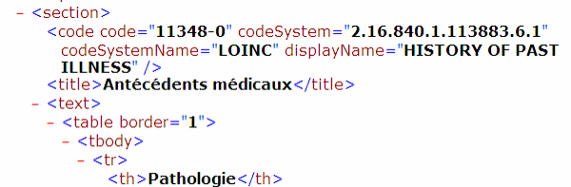
CDA: XML
XML is Extensible Markup Language (www.w3c.org)
In XML, structure & format are conveyed by markup which is embedded into the information
Notes:
Animation
Circles show some coded vocabulary, and a paragraph tag.
This is a CDA R1 example.
Maybe turn this into an R2 example at some point.

Slide 13
and why XML alone isn’t enough
With a few simple tags, and controlled vocabulary, XML can describe anything
but…
the tags need to be defined:
  <orderNum> : HL7: order placed
  <orderNum> : CDISC: visit sequence
CDA tags are defined by the HL7 Reference Information Model (RIM) and use standard controlled vocabulary
Notes:
Animation
Just having meaningful tag names is not enough. There needs to be rigorous definitions behind them.
Two healthcare standards that use the same tag name for different purposes.
HL7 V2 XML representation orderNum.
For CDISC orderNum is the order of a visit in a sequence of visits. If the protocol requires 6 visits and this is the second, it will be #2.
More info
------------------------
XML namespaces can be used to differentiate between the two, but a rigorous definition is still needed to define what the data actually means. The RIM provides this.

Slide 14
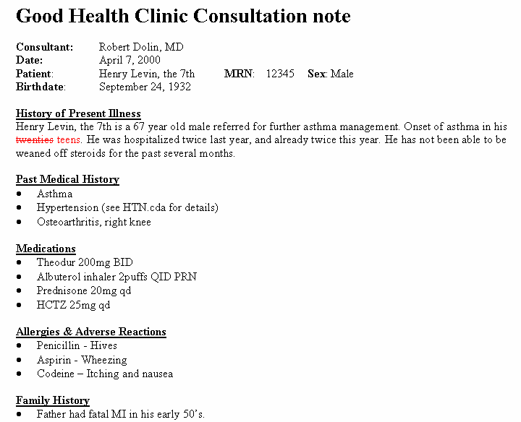
Why isn’t XML + SNOMED enough?
?
“hives”: SNOMED CT 247472004
=
“Dr. Dolin asserts that Henry Levin
manifests hives as a previously-diagnosed
allergic reaction to penicillin”
=
Notes:
Animation
Ask if people know what SNOMED is.
SNOMED has over 100,000 terms defined. Why not just create tags that map directly to SNOMED?
Does SNOMED define what HIVES mean in this context?
In this document, HIVES means that Dr. Dolin asserts…

Slide 15
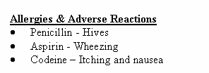
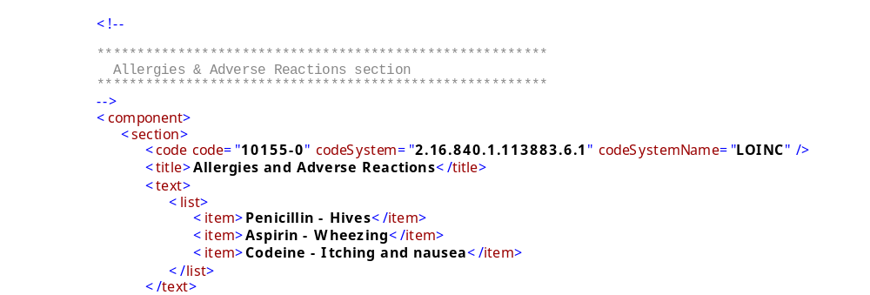
First: human readable
Notes:
First, we always give you the human rendition. You cannot code in CDA to a level that you can unambiguously replace the human readable text.

Slide 16
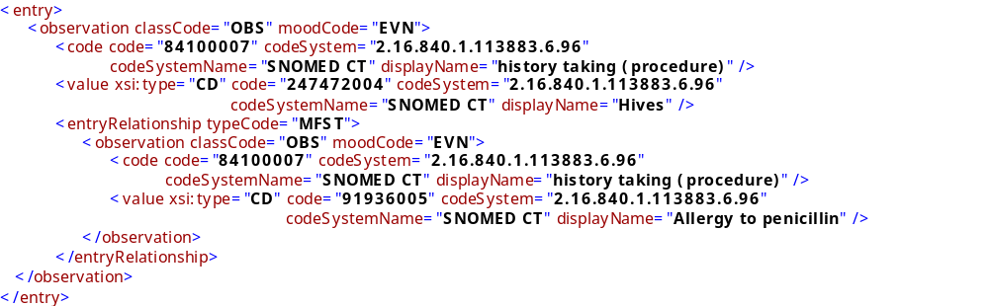
Observation: RIM-defined
History: SNOMED
Hives: SNOMED
Observation: RIM-defined
History : SNOMED
Allergy to penicillin: SNOMED
Relationship: RIM-defined
RIM-defined CDA structures + vocabulary = Hives manifests an allergic reaction to penicillin
Next: series of coded “clinical statements”
Notes:
Animation
Here is an observation (rim defined)
This one is a SNOMED code.
The value is HIVES.
Observation (history taking procedure).
Code: Allery.
The observations are tied by the entry relationship.
Red Elipse: Entry relationship MFST = manifestation.

Slide 17
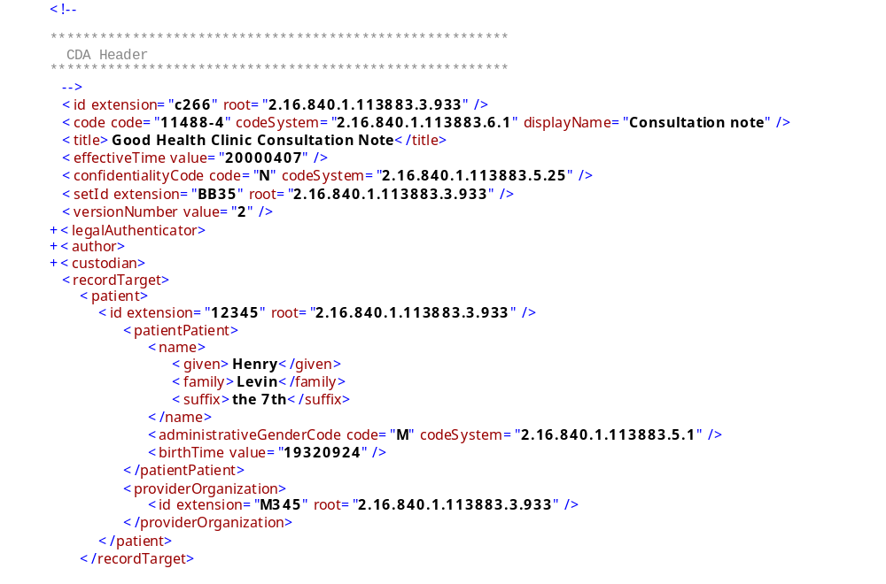
Then: supply context
Who is the subject?
Target: RIM-defined
Id: local
Notes:
Knowing that an allergy to penicillin exists doesn’t do you much good without knowing who it applies to.

Slide 18
Relationship to HL7 messages
CDA complements HL7 messaging specs
A CDA document is a defined and complete information object that can exist outside of a messaging context
A CDA document can be a MIME-encoded payload within an HL7 message
Notes:
HL7 defines a bunch of messages that can be sent between systems or organizations.
More on HL7 messaging in the V3 class next week.
CDA documents do not need an HL7 message to provide context.

Slide 19
Relationship to HL7 messages
CDA documents are encapsulated as MIME packages within HL7 messages
HL7 V3
<someMessage>
<Act.Code code="11488-4“ codeSystem="2.16.840.1.113883..."
displayName="Consultation note"/>
<Act.text type="multipart/related">
MIME-Version: 1.0
Content-Type: multipart/related; boundary="HL7-CDA-boundary"; type="text/xml"; start="10.12.45567.43"
Content-Transfer-Encoding: BASE64 --HL7-CDA-boundary
Content-Type: text/xml; charset="US-ASCII“ Content-ID: &lt;10.12.45567.43>
... Base 64 of base CDA document, which contains ...
<observationMedia classCode="OBS" moodcode="EVN">
<id root="10.23.4567.345"/>
<value mediaType="image/jpeg">
<reference value="left_hand_image.jpeg"/>
</value>
</observationMedia> ...
--HL7-CDA-boundary
Content-ID: &lt;10.23.4567.345>
Content-Location: canned_left_hand_image.jpeg
Content-Type: image/JPEG
... Base64 image ...
--HL7-CDA-boundary--
</Act.text>
</someMessage>
HL7 V2.x
MSH|...
EVN|...
PID|...
PV1|...
TXA|...
OBX|1|ED|...
|...
Notes:
Note the V2 message on the left is plain text, whereas the V3 message on the right is XML (and much more verbose).

Slide 20
Primary Use Cases
access/portability/exchange
  query/locate by patient, provider, practitioner, setting, encounter, date
  access distributed information through common metadata
  document management
integration
  transcription systems
  EHR records
re-use/derivative data
  summaries, reports
  decision support
Notes:
Animation
mModal supports backend speech recongnition that supports transcription systems that can output CDA. Others are dictaphone/nuance, MedQuist, etc.
Almost all transcription vendors use XML internally, then dump their docs down for the end user, because end users aren’t asking for anything better than text.

Slide 21
Outline
Overview of CDA
  Definition
  XML... and more
  Usage
  Let’s take a look...
The “A” in CDA
The Specification
Implementation
Current Work, Summary & Resources

Slide 22
CDA = header + body
CDA Header
  Metadata required for document discovery, management, retrieval
CDA Body
  Clinical report
    Discharge Summary
    Care Record Summary
    Progress Note
    H&P
    Public health report
  … any content that carries a signature
Notes:
Animation

Slide 23
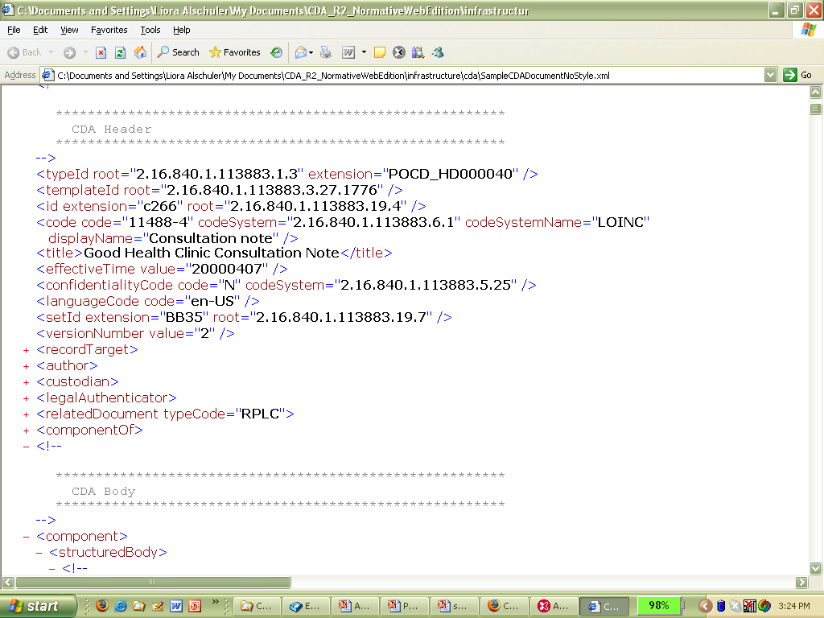
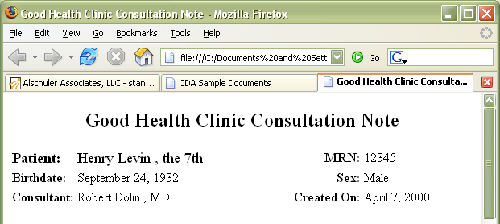
CDA Header: Metadata
Identify
  Patient
  Provider
  Document type...
Sufficient for
  Medical records management
  Document management
  Registry/repository
  Record locator service
  Store, query, retrieve
required

Slide 24
CDA
Specification is generic
  Any document type
  Any clinical content
Simplest body: non-XML
XML body
  Human-readable “narrative block”
    Defines legal content
    Displays with simple style sheet
    Required
  Machine-readable “clinical statements”
    Drives automated extraction, decision support….
    Uses HL7 RIM, controlled vocabulary
    Optional
Notes:
Animation
Non-XML body can be a scanned image, a PDF document, etc.
A CDA must have narative because it is ultimately meant for human consumption.
HL7 messages are appropriate for machine to machine coded data exchanges.

Slide 25
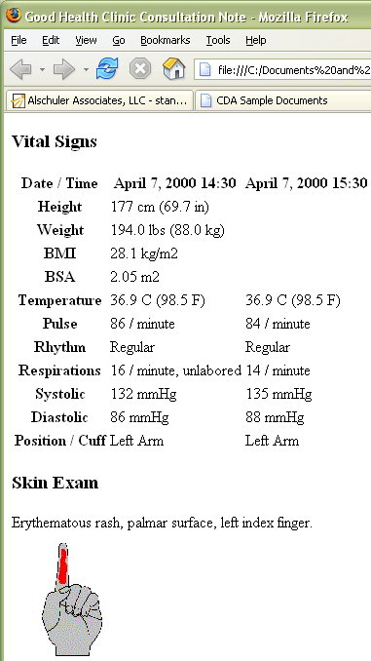
CDA Body: Human-readable report
Any type of clinical document
  H&P
  Consult
  Op note
  Discharge Summary...
Format: tif, PDF, HTML, XML:
  Paragraph
  List
  Table
  Caption
  Link
  Content
  Presentation
required

Slide 26
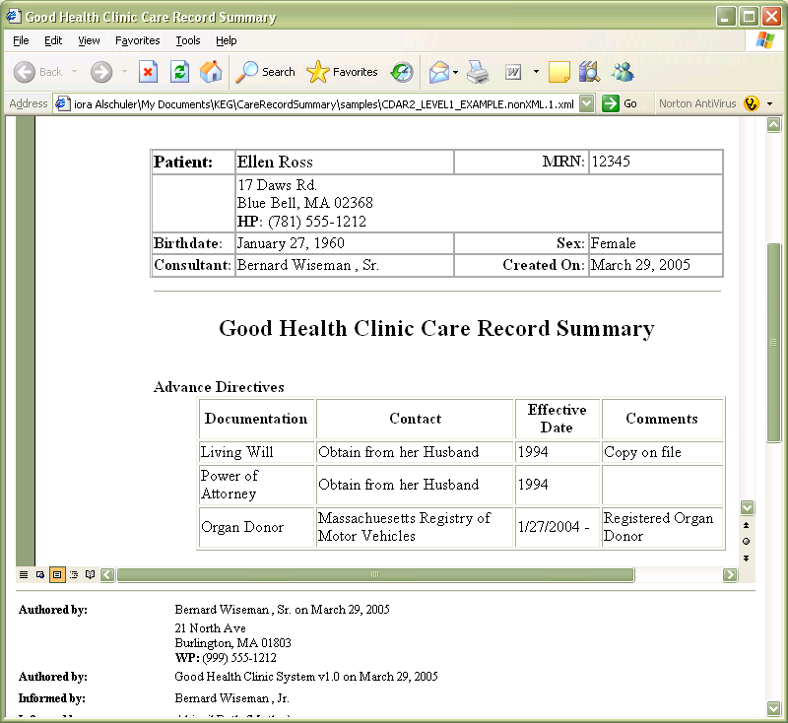
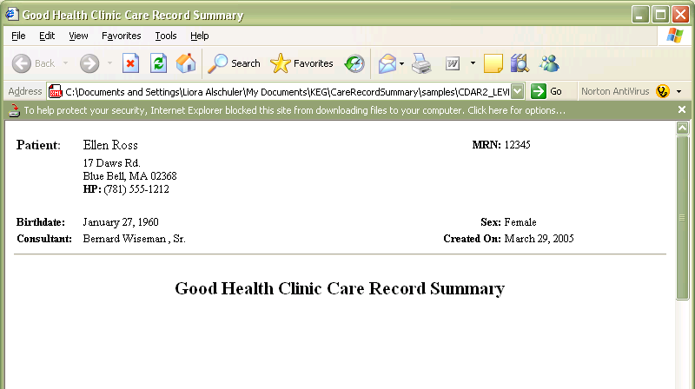
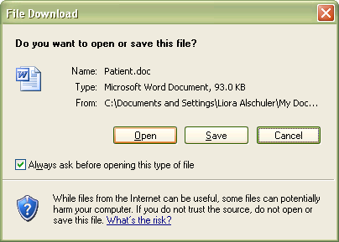
Non-XML CDA Body
Notes:
Animation
Explain how IE launches the non-xml body separately.

Slide 27
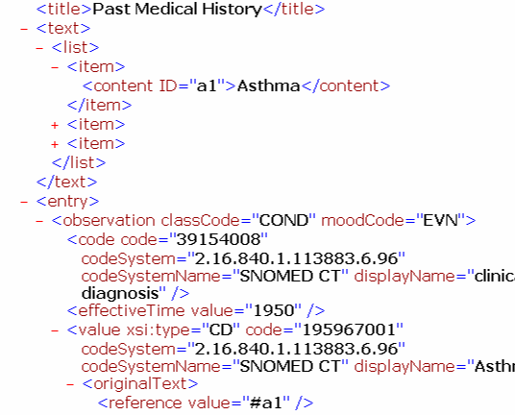
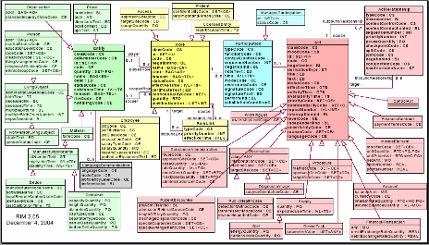
CDA Body: Machine Processible
  Model-based computable semantics:
    Observation
    Procedure
    Organizer
    Supply
    Encounter
    Substance Administration
    Observation Media
    Region Of Interest
    Act
Optional
Notes:
Animation
Machine processible data is optional.

Slide 28
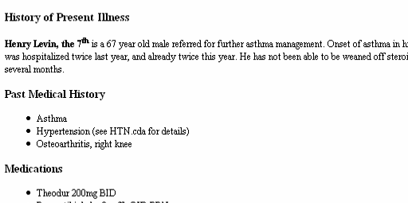
CDA: Incremental Semantic Interoperability
Standard HL7 metadata
Simple XML for point of care human readability
RIM semantics for reusable computability (“semantic interoperability”)

Slide 29
Outline
Overview of CDA
The “A” in CDA
  Levels
  Scalability: simple to complex
The Specification
Implementation
Current Work, Summary & Resources
Notes:
It can be constrained to allow for many different document types, has several conformance levels, and is scalable to provide a low barrier to entry, yet still provide a rich framework for full semantic interoperability.

Slide 30
The CDA Architecture
What is the unit of standardization?
  data element: too narrow
  longitudinal record: too broad
  document: just right
One document standard or many?
  can’t put everything into a single spec
  how to coordinate multiple specs?
CDA architecture:
  generic pattern with rigorous metadata
  specialize/constrain clinical body per document type

Slide 31
Outline
Overview of CDA
The “A” in CDA
  Levels
  Scalability: simple to complex
The Specification
Implementation
Current Work, Summary & Resources

Slide 32
CDA Levels
Levels are distinguished by:
granularity of machine-processible markup
  Level One -- Body is human-readable, no semantic codes.
  Level Two -- Instances with machine-processible section-level semantics.
  Level Three -- Instances that have at least some clinical statements, expressions that are machine-processible to the extent that can be modeled in the RIM.
All levels validate against the generic CDA schema. Additional validation can be provided by templates and constraints on the generic schema.
Notes:
Animation
Level 1 can be non-XML or XML with no coded entries.
Level 2 must have an XML body, and at least one coded section.
Any coded entries at all gives you level 3.
New York Pres is doing level 3, so is mModal.
These levels are just short-hand so that people can understand the rough degree of coding.
Nobody is doing fully coded documents at this time.

Slide 33
Release 2: Levels One, Two, Three
<Section>
<code code="10153-2" codeSystem="LOINC“>
Past Medical History
</code>
<text><list>
<item><content>Asthma</content></item>
<item><content>Hypertension</content></item>
<item><content ID=“a3”>Osteoarthritis, right knee</content></item>
</list></text>
<component1>
<contextConductionInd value="TRUE"/>
<Observation classCode=“COND”>
<code code=”G-1001” codeSystem=”SNOMED” displayName=”Prior dx”/>
<value code=”D1-201A8” codeSystem=”SNOMED”
displayName=”Osteoarthritis”>
<originalText><reference value=”#a3”/></originalText>
</value>
<targetSiteCode code=”T-15720” codeSystem=”SNOMED”
displayName=”Knee joint”>
<qualifier>
<name code=”G-C220” codeSystem=”SNOMED”
displayName=”with laterality”/>
<value code=”G-A100” codeSystem=”SNOMED” displayName=”right”/>
</qualifier>
<originalText><reference value=”#a4”/></originalText>
</targetSiteCode>
</Observation>
</component1>
</Section>
Level 2
human readable
Level 1
machine processible
Level 3
Notes:
Animation
Level 1 – text
Level 2 – coded sections
Level 3 – coded entries

Slide 34
What an architecture provides:
Information can be encoded at varying levels of specificity and understood at the highest, or most appropriate, level of encoding
Information encoded at varying levels can be analyzed at the highest common level
Introduces the concept of “incremental or variable semantic interoperability”

Slide 35
Outline
Overview of CDA
The “A” in CDA
  Document types
  Levels
  Scalability: simple to complex
The Specification
Implementation
Current Work, Summary & Resources

Slide 36
CDA & Incremental Semantic Interoperability
Patients transfer between providers with vastly different IT capabilities
Need to support information requirements at point of care
  Full EMR adoption… not predictable based on past adoption curves
Assume gradually rising, but still heterogeneous levels of sophistication
  Data formats (imaging, text, XML)
  Coded data (metadata, basic structure, simple results reporting, complex clinical statements)
Notes:
Animation

Slide 37


CDA Business Case
CDA hits the “sweet spot” – CDA
encompasses all of clinical documents. A
single standard for the entire EHR is too broad.
Multiple standards and/or messages for each
EHR function may be difficult to implement.
CDA is “just right”.
Implementation experience - CDA has been an ANSI standard since 2000, and has been balloted through HL7's consensus process. CDA is widely implemented.
Gentle on-ramp to information exchange - CDA is straight-forward to implement, and provides a mechanism for incremental semantic interoperability.
Improved patient care - CDA provides a mechanism for inserting
best practices and evidence-based medicine directly into the process of
care (via the same “template” mechanism used to build CCD), thereby making it easier to do the right thing.
Lower costs – CDA’s top down strategy let’s you implement once, and reuse many times for new scenarios.

Slide 38
Investing in Information
Dissecting the curve
What is easy:
  Header
  Human-readable body
  Low degree of coding
What is hard:
  Concensus on semantic content requirements
  Model/vocabulary interface
cost
x
80/20
√
benefit
Notes:
Run the animation.
Header is easy since it can usually be autogenerated from an EMR system.
Human readable body is easy since it can be easily typed in a form or scanned. Some coding can also be pulled from a simple form (checkboxes pulled down).
Green line: realistic path: initial bump is implementing CDA initially.

Slide 39
Outline
Overview of CDA
The “A” in CDA
The Specification
Implementation
Relationship: CDA, CCD, CCR
Current Work, Summary & Resources

Slide 40
Creating CDA Document Types
Add constraints to generic specification
Designed for a community of users
  Scope: US
  Clinical applications: transfer of care, H&P
Can be further specialized for closer communities
  Scope: Massachusetts
  Clinical application: pediatric
Document coded to requirements of the document type
Still valid against generic schema and specification

Slide 41
CDA IGs Balloted through HL7
  Continuity of Care Document:
    Implements ASTM CCR as CDA
    Establishes reusable templates for common types of entries
  CDA4CDT (Health Story):
    History & Physical
    Consult Note
    Diagnostic Imaging Report
    Operative Report
  Healthcare Associated Infection Reports
    Sponsored by CDC
    Reporting to NHSN
    12 report types published, to-date; 2 more in ballot
  Personal Health Monitoring
    Sponsored by Continua Health Alliance
    Adopted by HITSP
  Quality Reporting Document Architecture – HL7 Peds WG co-sponsor
    Prototyped in NHIN demonstrations
    Patient-level data reports are initial category of reporting
  Plan to Plan Personal Health Record Transfer
    Passed ballot
    Sponsored by AHIP/BCBSA
  Minimum Data Set for Long Term Care Reporting
    Passed ballot
    Sponsored by broad range of public and private agencies
  Public Health Case Reports to CDC
    Passed as Informative Document - In ballot reconciliation
  Care Record Summary: Summarization note supporting transfer of care, superseded by CCD

Slide 42
Implementation Guides constrain coding
Not presentation
Not narrative style
Implementers can impose uniform presentation, style
  but just for presentation
  the coding drives machine processing
Distinction becomes more significant with Level 3

Slide 43
Sample Conformance Statements
SHALL contain 1..1 @classCode = OBS "Observation" (CodeSystem: 2.16.840.1.113883.5.6 HL7ActClass) STATIC (CONF: 437).
SHALL contain 1..1 @moodCode = EVN "Event" (CodeSystem: 2.16.840.1.113883.5.1001 HL7ActMood) STATIC (CONF: 438).
MAY contain 0..1 @negationInd (CONF: 1284).
SHALL contain 1..1 code = 11341-5 "History of occupation" (CodeSystem: 2.16.840.1.113883.6.1 LOINC) STATIC (CONF: 439).
MAY contain 0..1 text (CONF: 442).
SHALL contain 1..1 statusCode = completed (CodeSystem: 2.16.840.1.113883.5.14 HL7ActStatus) STATIC (CONF: 440).
SHOULD contain 0..1 effectiveTime (CONF: 443).
SHALL contain 1..1 value (CD), which SHALL be selected from ValueSet 2.16.840.1.114222.4.11.887 Occupation DYNAMIC (CONF: 441).

Slide 44
Outline
Overview of CDA
The “A” in CDA
The Specification
Implementation
Relationship: CDA, CCD, CCR
Current Work, Summary & Resources

Slide 45
CDA: How to Create
Creating CDA documents
  scan or text file
  transcription
  eForms
  desktop applications
  EHR
  DICOM Structured Report transform

Slide 46
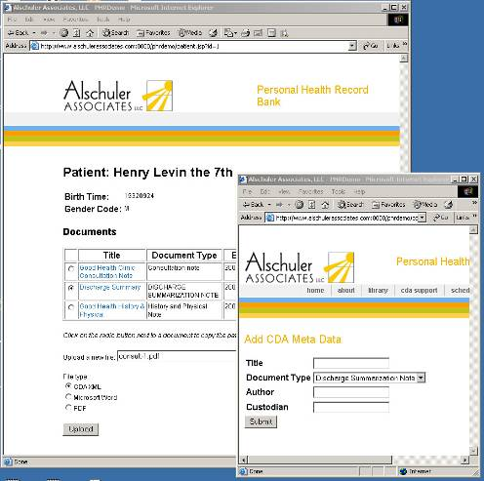
The Simplest CDA
Inherit patient context
Enter
minimal
metadata
Point to document body

Slide 47
CDA: How to Manage
Clinical Data Repository?
Custom Database?
Good old file system?
Document management system?
Personal health record?
Notes:
Clinical Data Repositories (CDRs) already manage large amounts of clinical data. CDAs can be generated from data in a CDR. CDRs may not be the best place to store CDA documents with non-XML bodies. Inefficient use of the CDR storage media. Little or no electronic information for the CDR to absorb.
Custom Database: A lot of up-front work is required. End result can be highly tailored to an organizations needs. Storing large variable length CDAs in database fields can be inefficient. Need to use BLOBs or CLOBs. Target audience: Medium to large organizations with their own software developers and DBAs.
File System: The simplest solution – store in folders on a hard drive without a database. Cheap and efficient storage. Does not facilitate structured searching. Metadata is not “bubbled up” to database fields that can be easily searched and sorted…now where did I put that file? Target Audience: Individuals or very small practices
Document management system: Stores metadata in a database, but generally keeps documents on the file system. Best of both worlds. Robust support for versioning and document transformation. Commercial solutions (Documentum, IBM, etc.) can be expensive. Open source solutions (Alfresco, etc.) are fairly new and untested. Generally need to be customized to support clinical documents. Some vendors may have pre-build solutions available.
PHR: Patient centric. Focused on clinical data. Most have some limited document management capabilities, but may not be sufficient for enterprise wide management.

Slide 48
CDA: How to Distribute
There are many ways to distribute CDA documents.
  Fax
  Sneaker-net
  Email
  X12
  HL7 messaging
  Custom Web Services (SOAP, XML-RPC, REST)
  XDS

Slide 49
Outline
Overview of CDA
The “A” in CDA
The Specification
Implementation
Relationship: CDA, CCD, CCR
Current Work & Resources

Slide 50
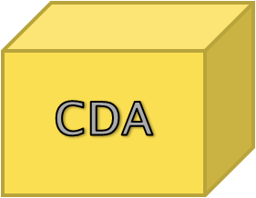
The ABC’s of CDA
Added domain rules
Rules from CCR
Added domain Rules
H&P
CCD
QRDA
PHCR
Notes:
CCD and CCR were developed at the same time and were useful.
Vendors asked to be provided which one should be implemented.
The result was ASTM and HL7 working together to create CCD which is a constrained CDA and contains reusable HL7 message constructs

Slide 51




ASTM CCR+HL7 CDA = CCD
The primary use case for the ASTM CCR is to provide a snapshot in time containing a summary of the pertinent clinical, demographic, and administrative data for a specific patient.
From its inception, CDA has supported the ability to represent professional society recommendations, national clinical practice guidelines, standardized data sets, etc.
From the perspective of CDA, the ASTM CCR is a standardized data set that can be used to constrain CDA specifically for summary documents.
The resulting specification is known as the Continuity of Care Document (CCD).

Slide 52
Outline
Overview of CDA
The “A” in CDA
The Specification
Implementation
Relationship: CDA, CCD, CCR
Current Work & Resources

Slide 53
CDA beyond CCD
Not everything we want to exchange is a CCD Transfer of Care Summary
  H&P, Consult, other doc types
  summaries that specialize CCD
Let’s look at what’s happening with development of other document types...

Slide 54
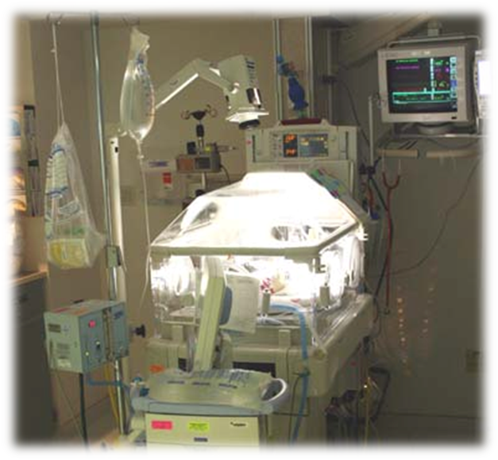

Get involved to ensure pediatric needs:
Participate in design review
  through HL7 Structured Documents WG
  weekly calls, at working group meetings
Participate in the ballot
  as HL7 member or non-member
Encourage implementation
  from your vendor
  within professional society
  within practice group

Slide 55
The Health Story Project
Project initiated in January, 2007
  M*Modal
  AHDI(was AAMT)/MTIA
  AHIMA
Strong support from dictation / transcription and document management industries
Cooperation/coordination with HL7, IHE, EHR vendors and providers

Slide 56
Health Story Mission
Develop CDA Implementation Guides (IGs) for common types of electronic healthcare documents
Bring them through the HL7 ballot process
Promote their use and adoption by healthcare organizations and health information exchange networks

Slide 57
Rationale
Enlarge and enrich the flow of data into the electronic health record
Speed the development of interoperable clinical document repositories
Bridge the gap between narrative documents produced through dictation and the structured, computable records within an EHR

Slide 58












Project Members
Founders
Promoters
Participants

Slide 59
CDA for Collaborative Care
Health Story:
  Consult Report, Operative Note
  Diagnostic Imaging Reports with DICOM
Continua Health Alliance: Personal Health Monitoring
CMS Minimum Data Set
Plan to Plan Personal Health Record
IHE Profiles: variants on H&P, many additional types

Slide 60
CDA for Secondary Usage: Analysis, Reporting
Public Health:
  Healthcare Associated Infection Reports
    Centers for Disease Control and Prevention National Health Safety Network
  Case Reporting
    CDC National Center for Public Health Informatics
  Cancer Abstract submission
    North American Association of Central Cancer Registries
Quality:
  Quality Reporting Document Architecture
More in the works

Slide 61
Investing in Information: phased approach
Lay groundwork
  CDA header metadata
  XML R1 or R2 CDA body
Build
  Consensus on requirements
  Understanding of modeling process
  Vocabulary glossary
Understand
  Relationship of vocabulary to model
Introduce interoperable semantic content as requirements and business drivers dictate

Slide 62
Current SDWG work
Last cycle:
  Generic Structured Documents domain
  Public Health Case Reports
  Additional Healthcare Associated Infection Reports
Future:
  Generic CDA for Reporting, Additional Public Health Case Reports
  further work with domain committees
    Anesthesiology
    Genomics
  Update CCD
  CDA R3: target 2010 ballot

Slide 63
CDA R3 Preview
CDA R3
Schedule
  Requirements gathering: 2009
  Ballot: For comment January 2010
  Publish: End 2010 ?
Issues
  Adopt Clinical Statement model
    Sufficiently tested? Mature? Implemented?
    Will the CS model be adopted by the HL7 domain committees?
  Adopt the RIM
    How to maintain consistency and simplicity?
  Backward compatibility
    Same principles as R1-R2
    Larger body of existing work
    Now, includes detailed clinical data

Slide 64
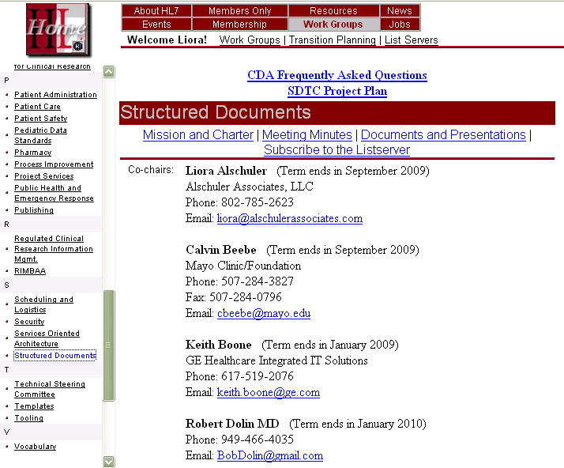
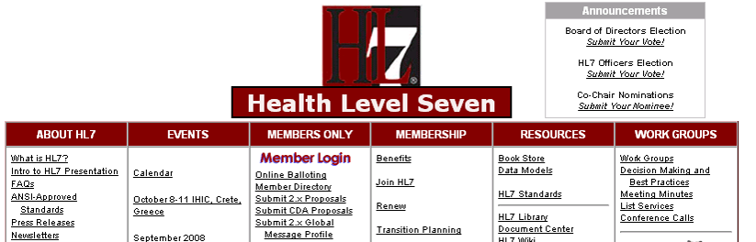
Current ballots & more…
1
Thursdays 10-12 ET
Open to all
Subscribe and call into weekly SDWG meetings
770-657-9270 310940#
NOW: listservs for both CDA and CCD

Slide 65
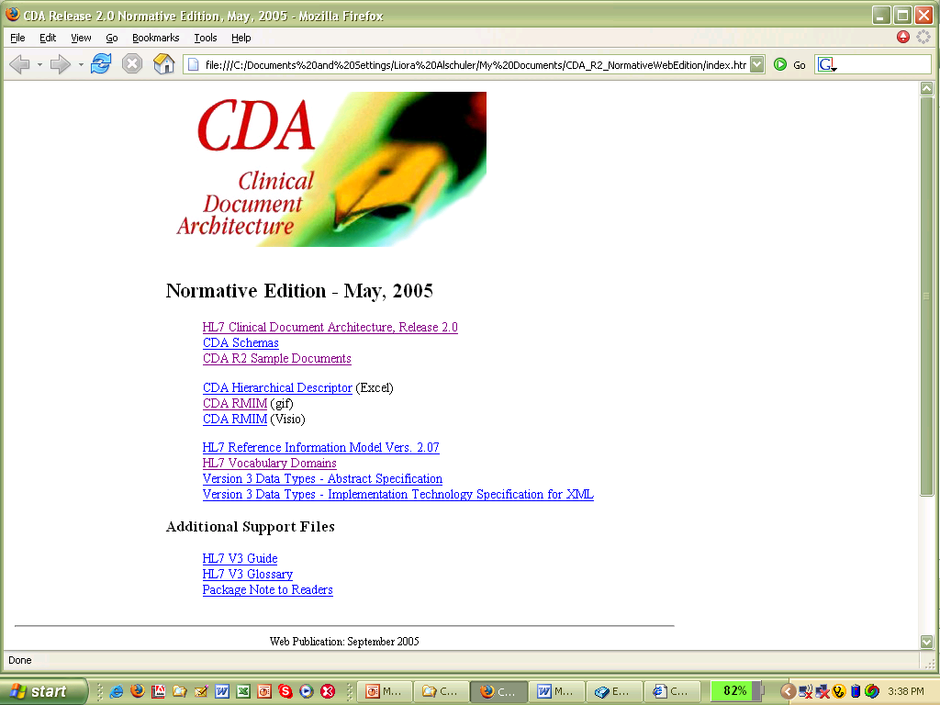
Available to HL7 members
CDA Normative Edition: Web publication

Slide 66
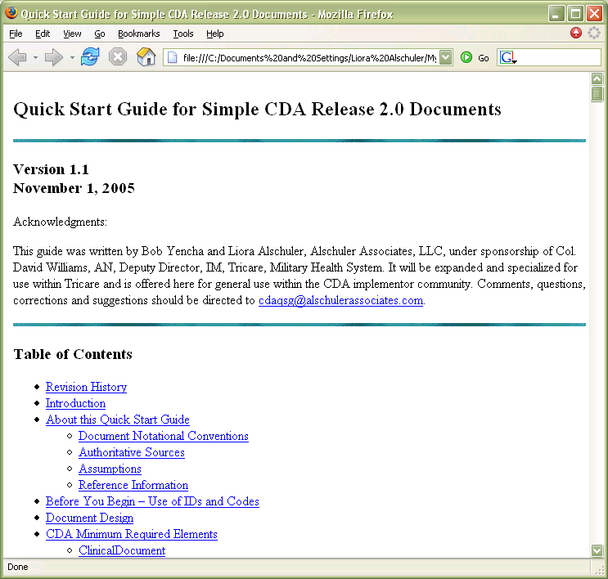
Quick Start Guides
CDA – available now
CCD – available now
Prose
Examples in text
Unpopulated sample

Slide 67
References
JAMIA
  Dolin RH, Alschuler L, Boyer S, Beebe C, Behlen FM, Biron PV, Shabo A. HL7 Clinical Document Architecture, Release 2. J Am Med Inform Assoc. 2006;13:30–39.
  http://www.jamia.org/cgi/reprint/13/1/30
CDA Release 2.0 Normative Edition: see HL7.org
CCD: see HL7.org
V3 Normative Edition
http://www.hl7.org/v3ballot/html/welcome/environment/index.htm
XML
http://www.w3.org/TR/xml
XSLT
http://www.w3.org/TR/xslt
XHTML
http://www.w3.org/TR/xhtml-modularization/
Schematron
http://www.schematron.com/
http://xml.ascc.net/resource/schematron/schematron.html
AlschulerAssociates.com
  Quick Start Guides
  CDA Validator
  CDA Gallery
  liora@alschulerassociates.com
  brett@alschulerassociates.com

Slide 68

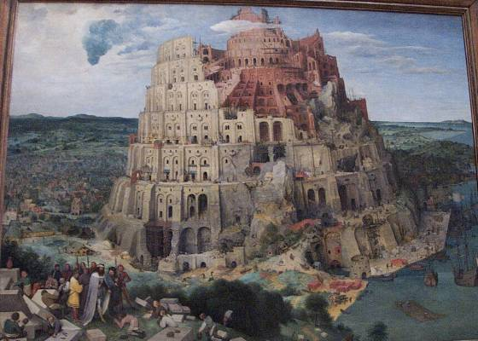
Thank you!
Questions?

