Slide 1
Converting Image Types
图像类型转换
Fresh business general template
Applicable to enterprise introduction, summary report, sales marketing, chart data
组员：王昊飞 汪会 韩仲明 秦楷
汇报人：优品PPT

Slide 2
the meaning of converting image types
01
图像类型转换的意义
目录
CONTENT
02
Relationship of converting image types
图像类型转换关系
03
the image conversion functions
图像类型转换函数

Slide 3
first part
the meaning of converting Image Types

Slide 4
the meaning of converting image types
For certain operations, it is helpful to convert an image to a different image type. For example, if you want to filter a color image that is stored as an indexed image, you should first convert it to RGB format. When you apply the filter to the RGB image, MATLAB filters the intensity values in the image, as is appropriate. If you attempt to filter the indexed image, MATLAB simply applies the filter to the indices in the indexed image matrix, and the results may not be meaningful.
A B

Slide 5
Second part
Relationship of converting image types

Slide 6
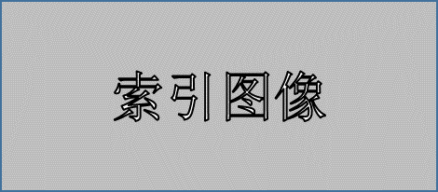
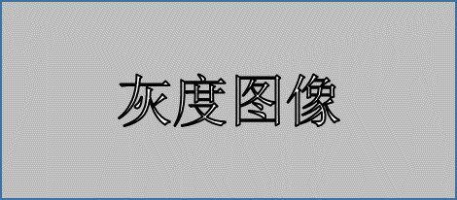
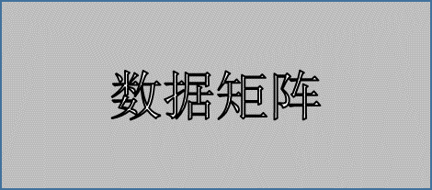
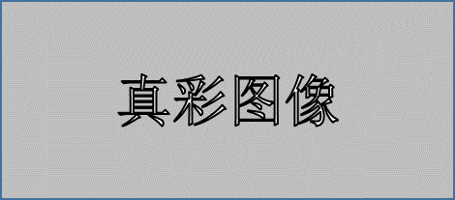
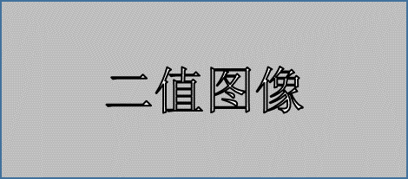
Relationship of converting image types

Slide 7
Third part
the image conversion functions

Slide 8

dither funcion
Function:Image dithering(图像抖动)
grayscale intensity image
（灰度图像）
RGB image indexed image
（真彩图像） （索引图像）
Format:
Bw=dither(I)
X=dither(RGB,map)
binary image
（二值图像）

Slide 9
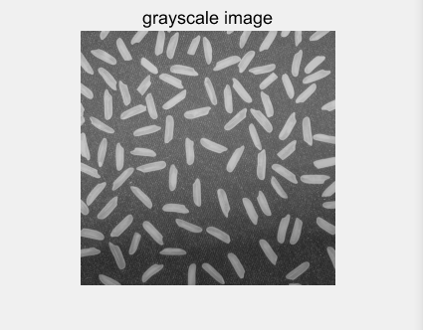
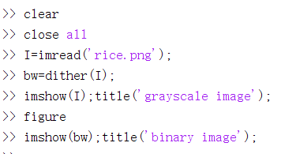
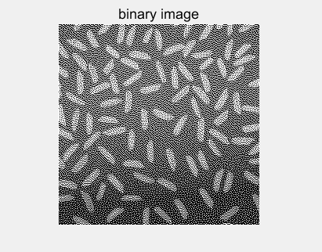
（1）grayscale image binary image

Slide 10
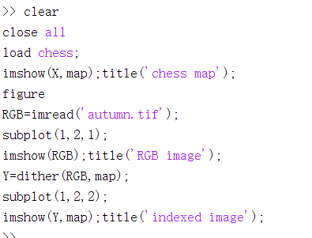
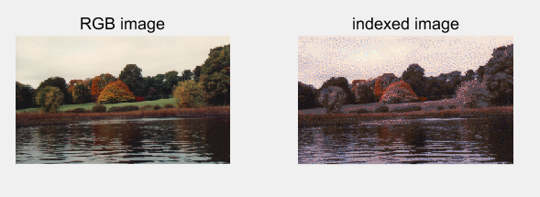
（2）RGB image indexed image
Problem description:Use the color map of the index image(chess.met), By dithering the colors in the map, an approximate index image of the RGB image(autumn.tif)

Slide 11
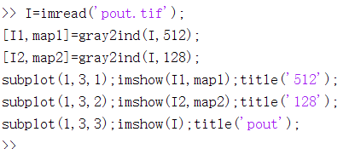
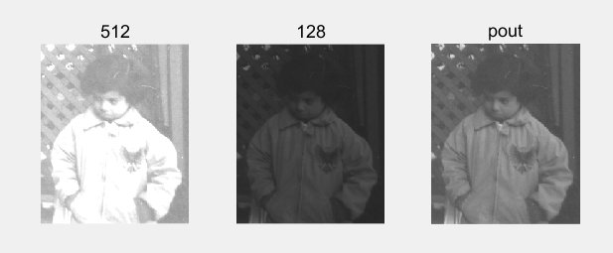
gray2ind function
Function: grayscale intensity image indexed image
(灰度图像) （索引图像）
Format:
[X,map]=gray2ind(I,n)
Problem description: Converting grayscale image into index image,the map are,gray(512)、gray(128)

Slide 12
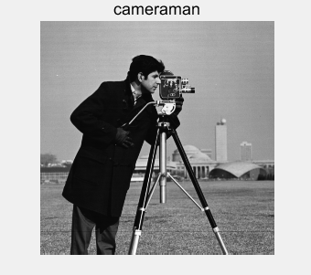
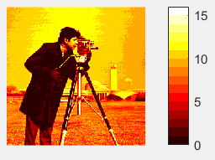
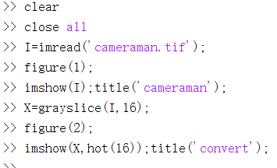
grayslice funcion
Function:By setting thresholds
grayscale intensity image indexed image
（灰度图像） （索引图像）
Format:
X=grayslice(I,n)

Slide 13
im2bw funcion
Function:By the thresholding method
grayscale intensity image
（灰度图像）
RGB image
（真彩图像）
indexed image
（索引图像）
Format:
Bw=im2bw(I,level)
Bw=im2bw(X,map,level)
BW=im2bw(RGB,level)
binary image
（二值图像）

Slide 14
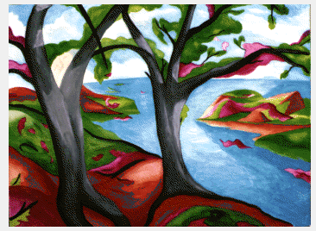
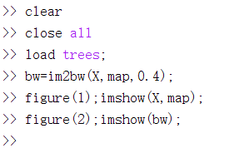
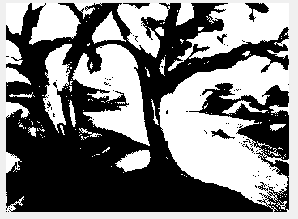
Problem description:
By the thresholding method,Converts the index image(tree.mat) to a binary image, the threshold is 0.4

Slide 15
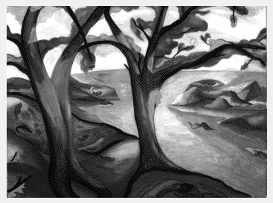
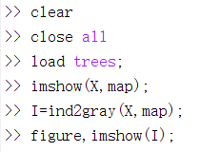
ind2gray funcion
Function:
indexed image grayscale intensity image
（索引图像） （灰度图像）
Format:
I=ind2gray(X,map)

Slide 16
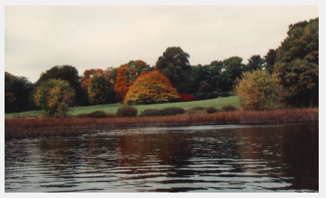
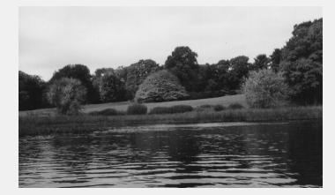
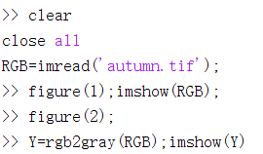
rgb2gray funcion
Function:
RGB image grayscale image
（真彩图像） （灰度图像）
Format:
I=rgb2gray(RGB)

Slide 17
ind2rgb funcion
Function:
indexed image RGB image
（索引图像） （真彩图像）
Format:
RGB=ind2rgb(X,map)

Slide 18
rgb2ind funcion
Function:
RGB image indexed image
（真彩图像） （索引图像）
Format:
[X,map]=rgb2ind(RGB)
[X,map]=rgb2ind(RGB,tol)
[X,map]=rgb2ind(RGB,n)
X=rgb2ind(RGB,map)

Slide 19
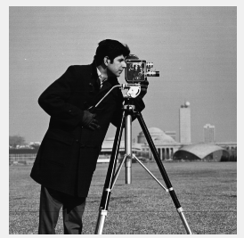
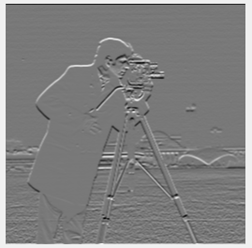
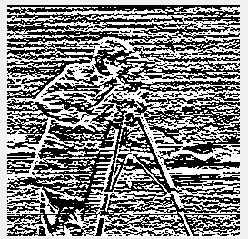
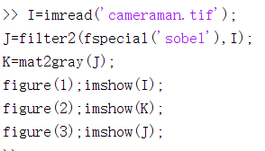
mat2gray funcion
Function:
matrix grayscale image
（ 矩阵） （灰度图像）
Format:
RGB=ind2rgb(A,[amin,amax])

Slide 20
Thanks for watching

