Slide 1
Berries_Slides
Haoyu Wang

Slide 2
Introduction
As discussed in class, we’re going to wrap up Unit 1 by doing the “berries” dataset. What we need is to combine data cleaning, data organization, and EDA. Also, we need to visualize the data.
These data were collected from the USDA database selector: https://quickstats.nass.usda.gov
The data were stored online and then downloaded as a CSV file.

Slide 3
Data cleaning and organizing
Main Steps: - Load and select meaningful data, find the columns that can be eliminated.
Choose “STRAWBERRIES” for the futher steps.
Separate columns
Organize the data

Slide 4
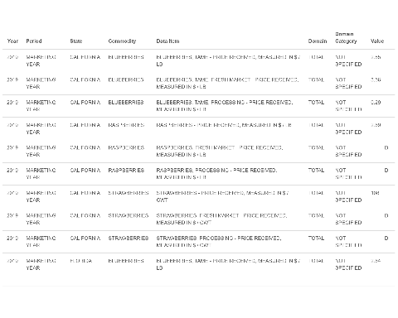
Outpus for these steps

Slide 5
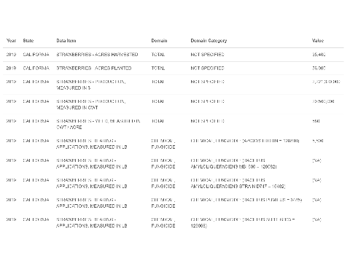

Slide 6
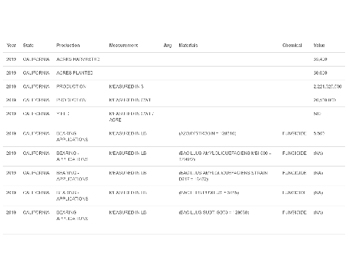

Slide 7
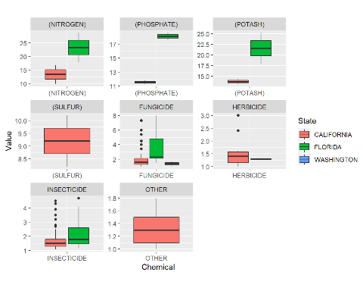
EDA(Exploratory Data Analysis)

