Slide 1
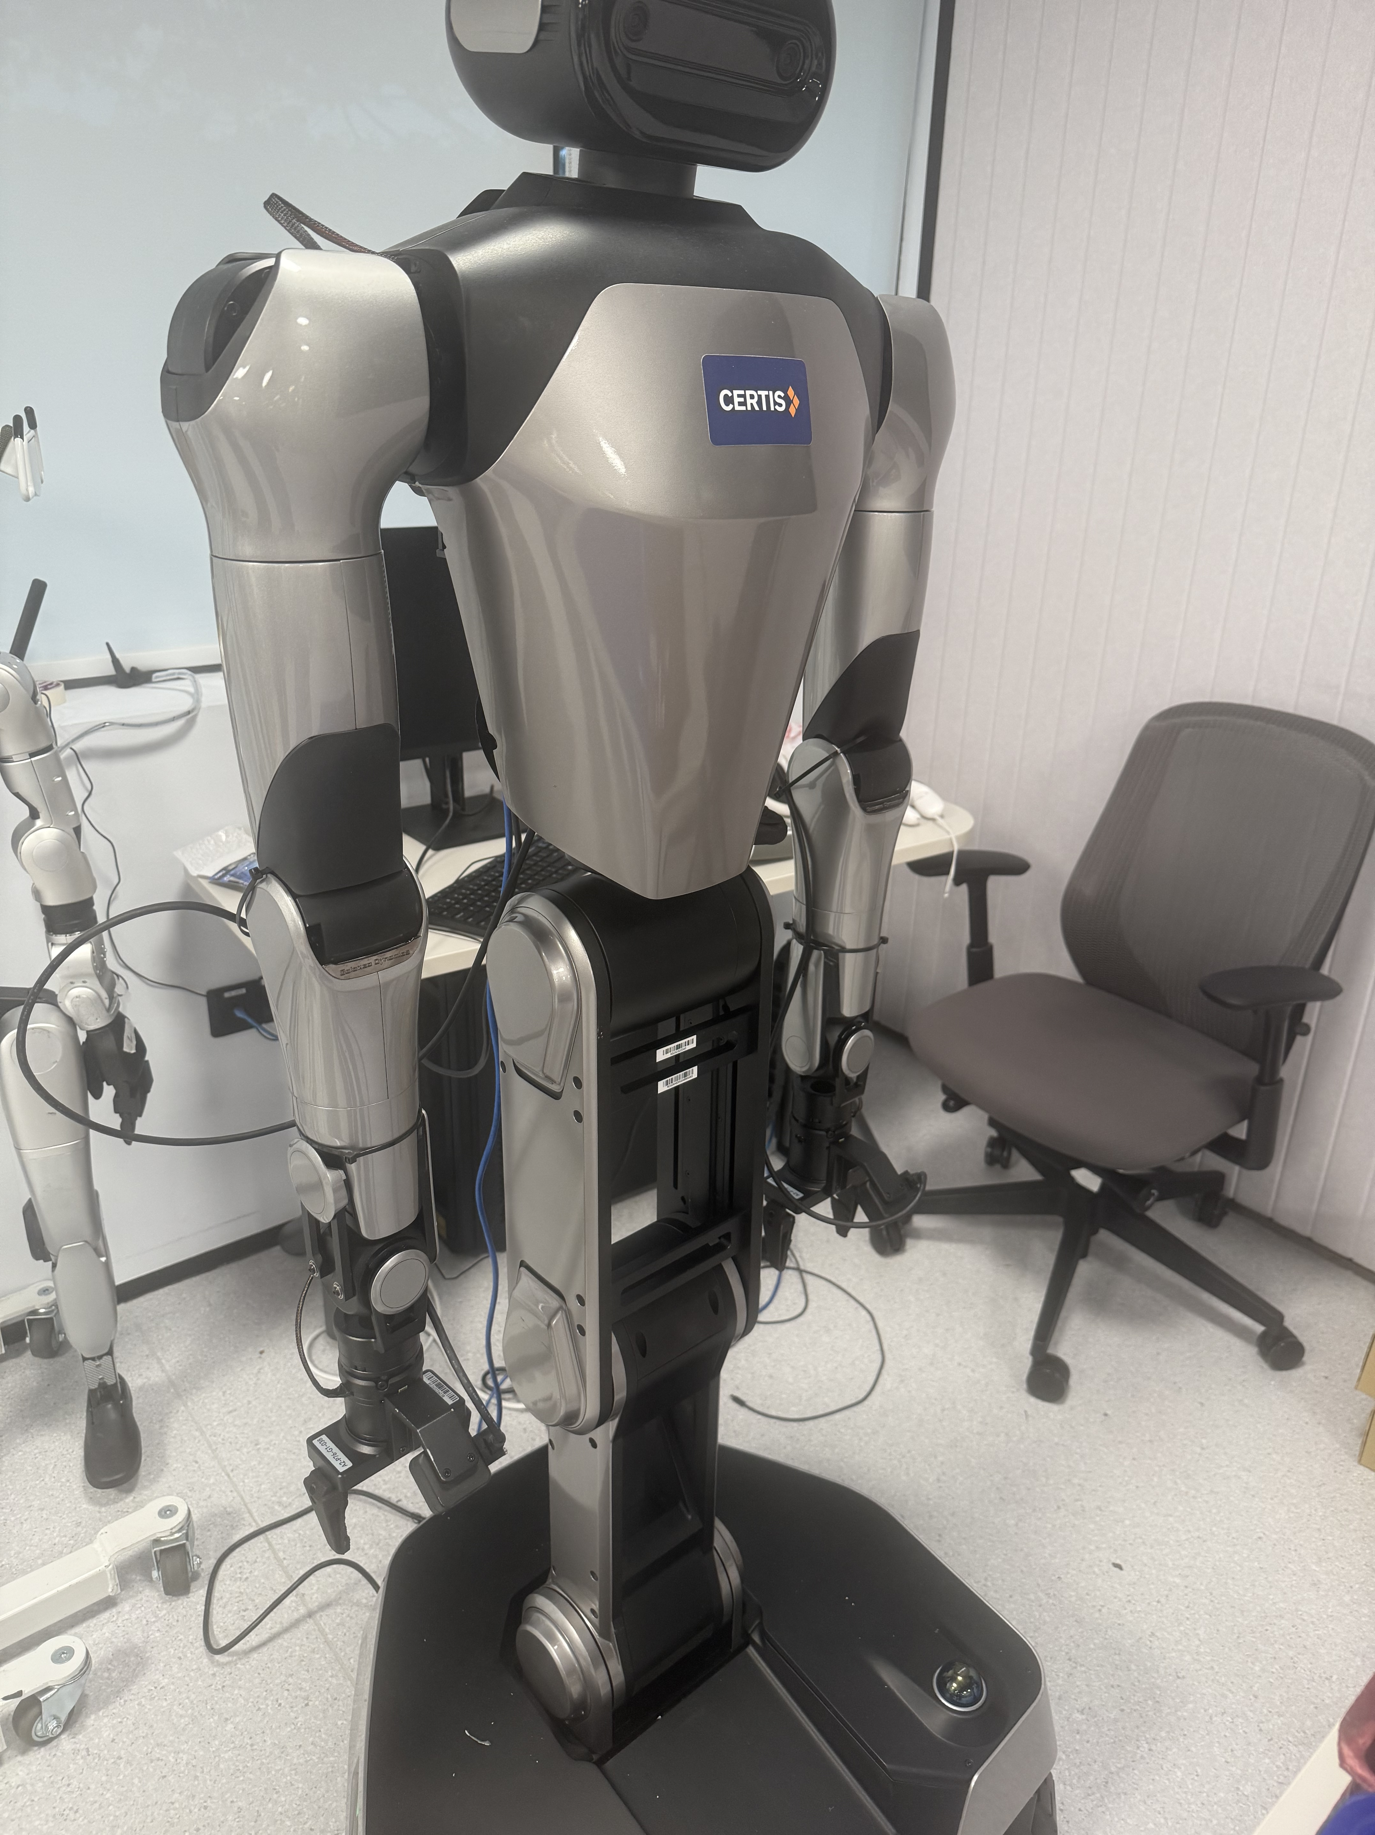
R1 Pro: From Lab to Policy
π0.5 adaptation
Real2Sim and Sim2Real
Mixed-data training
Technical report · Updated 19 October 2026
Evidence snapshot: 18:29 SGT
01
Notes:
Project technical report. Sources: project task contract, server evidence collected on 19 October 2026, and original laboratory reference photography. The cover photograph identifies the platform, not an evaluated checkpoint.

Slide 2
π0.5 connects perception to robot actions
Current observations and a task instruction condition an action chunk.
Vision
Language + state
Action chunk
Multiple RGB views
Scene and object context
Task instruction
Robot proprioception
Continuous joint targets
Repeated prediction
Heterogeneous co-training connects robotic and semantic supervision.
This project adapts the low-level action policy to the R1 Pro tray task.
02
Notes:
Sources: https://arxiv.org/abs/2504.16054 and https://www.pi.website/blog/pi05 . The original paper reports open-world generalization using heterogeneous co-training. Those paper-level findings are not measurements from this R1 Pro project.

Slide 3
π0.5 generates actions with flow matching
Context encoder
Action expert
Robot interface
Images, instruction
and robot state
Flow matching converts
noise into an action chunk
Decode targets
Act, then observe again
Implementation scope
OpenPI provides the low-level policy. The task controller supplies the instruction and maps model outputs to the robot.
Project configuration: 20-step horizon at 20 Hz. This differs from the original default horizon.
03
Notes:
Sources: https://github.com/Physical-Intelligence/openpi and https://github.com/Physical-Intelligence/openpi/blob/main/src/openpi/models/pi0_config.py . OpenPI currently exposes the flow-matching action head. The paper also describes high-level semantic inference. This project supplies explicit task text rather than implementing that complete hierarchy.

Slide 4
Observation and action interfaces
Interface | R1 Pro configuration | Consistency requirement
Vision | Head + two wrists, 224 × 224 | Native camera orientation
State / action | 14 joints + 2 grippers + 3 base | Joints in rad, grippers in m
Action chunk | Horizon 20, sampled at 20 Hz | Common time base
Closed-loop execution | Reobserve after up to 5 steps | Explicit fixed-base mask
Keep raw model outputs and record the fixed-base execution mask explicitly.
04
Notes:
Sources: r1pro_teleop/vla/real_sim_data.py, scripts/studio_mse.py and r1pro_teleop/real2sim/isaac_policy_pickplace.py. Raw channel order: left arm 7, left gripper, right arm 7, right gripper, base 3. The model pads 19 dimensions to 32.

Slide 5
The project pipeline
Real lab
Real2Sim
Simulation
Training
Evaluation
Photos, CAD and
real demonstrations
Geometry, joints
and camera mapping
32 rooms collect
physical trajectories
Frozen sources
and mixed sampling
Real-data MSE
and policy rollouts
Scene Studio connects hosted access and an offline workstation to GPU jobs.
Hosted Sites and workstation releases differ; the newest runtime comparison is on the workstation.
05
Notes:
Sources: docs/SCENE_TASK_SPEC.md, apps/scene-agent/PROJECT.md and scripts/studio_prepare_training.py. All diagram nodes remain editable.

Slide 6
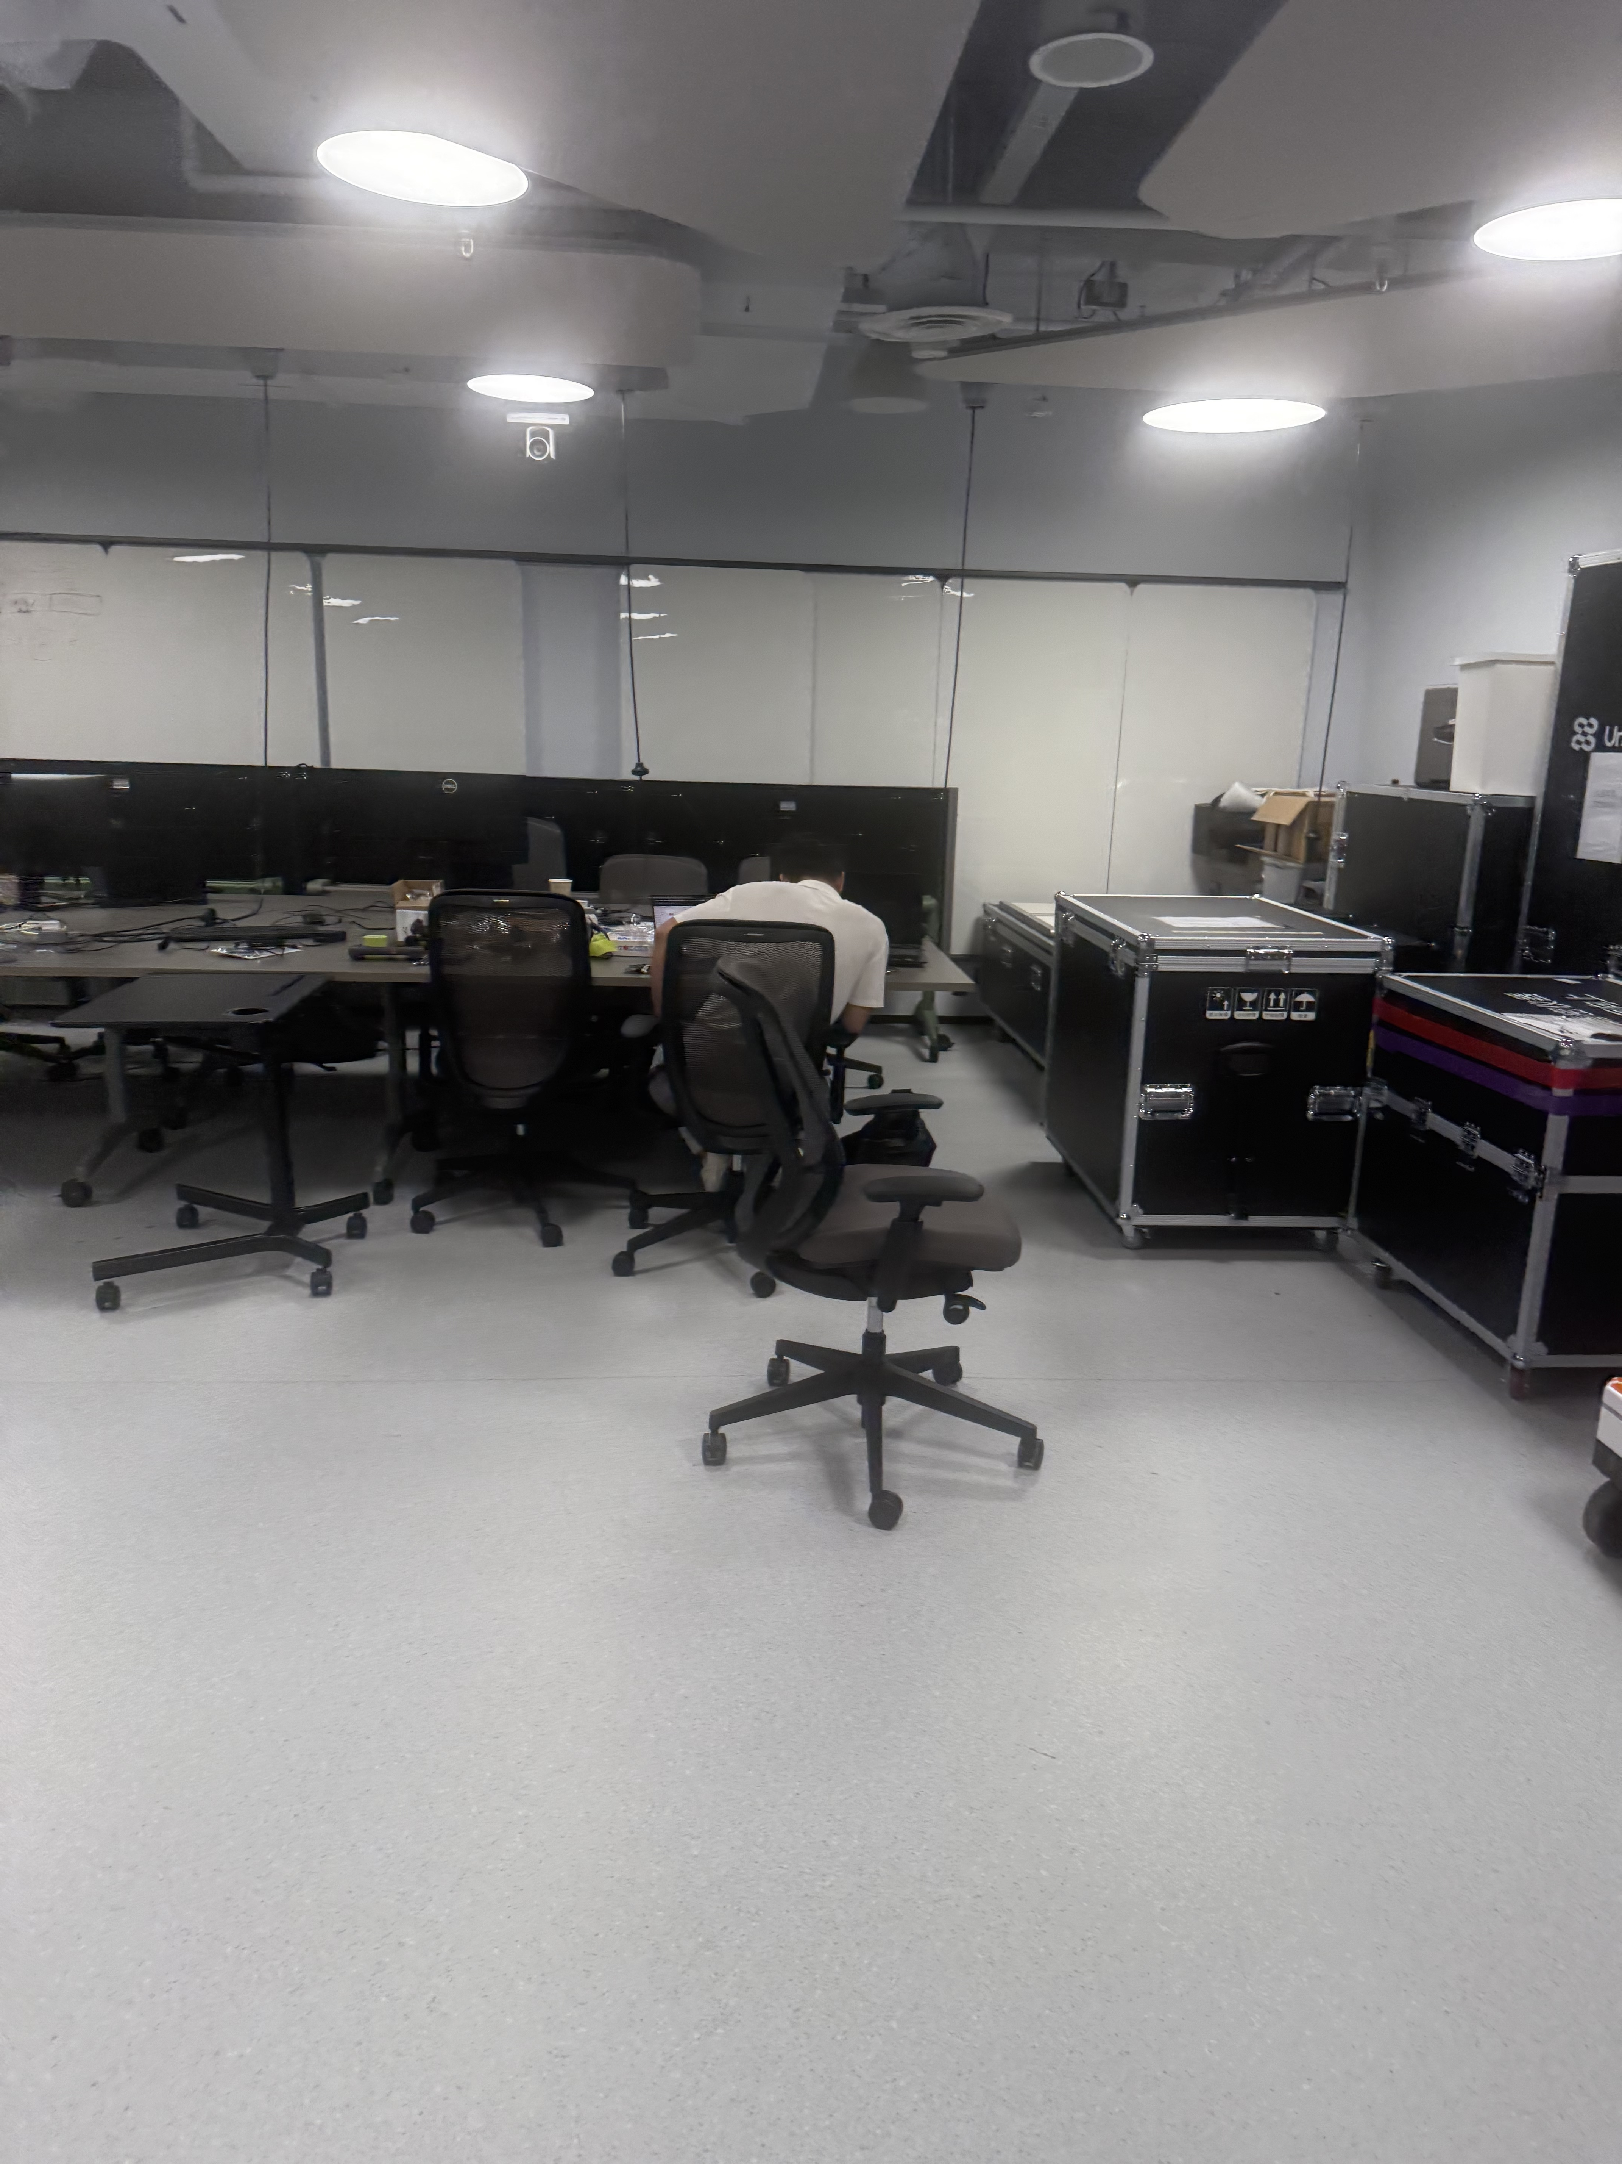
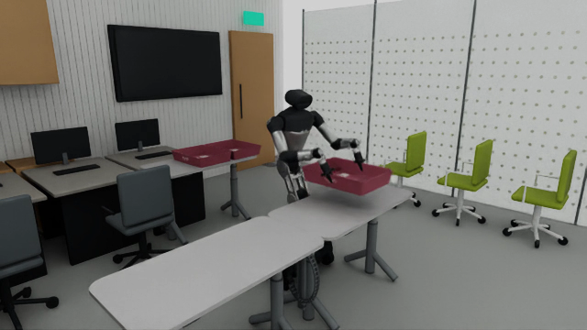
Real2Sim reconstructs the laboratory
Real laboratory reference
Native Isaac scene with R1 Pro
Preserve the desk layout, robot appearance and tray markings. Check physical alignment separately.
06
Notes:
Sources: resources/single_tray_lab_v1/reference_photos/room_desks.jpg and runs/isaacsim_reachable_fixedbase_20261016_v1/case_000/presentation.mp4. These are project source assets. The slide does not claim pixel-equivalent reconstruction.

Slide 7
Alignment makes simulation data usable
Geometry and control
Use a common coordinate system, joint order and units. Record the tray and base initial states for each source.
Contact and support
Keep physical collision and contact feedback. Grasp opposite long edges and carry the actual Pick end state into Place.
Vision and time
Keep native camera directions and original-speed recordings. Each 20 Hz frame advances 25 physics substeps of 2 ms.
07
Notes:
Sources: docs/SCENE_TASK_SPEC.md, scripts/run_isaac_parallel_pickplace.py and r1pro_teleop/vla/parallel_pickplace_training.py.

Slide 8
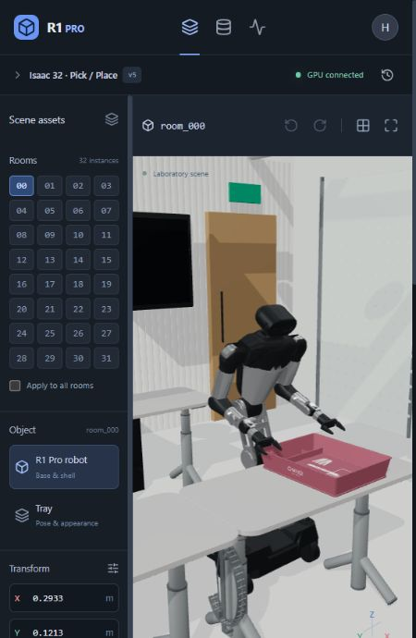
Website: select and edit a scene
1. Select a room and object
Choose room_000–031, then select the robot or tray.
2. Edit through dialogue or controls
For example: “Make the tray blue.” Check the pose, color and edit scope in the preview.
3. Save a version and submit
Synchronize the saved draft to the GPU. Native adaptation and physical qualification precede data collection.
08
Notes:
Source: production website screenshots and actual interaction on 19 October 2026. The current basic instruction parser handles color edits. GPT API configuration remains pending. The English screenshot shows the restored original material at version 5. The earlier color demonstration was restored and saved as a new version. No GPU synchronization or training input change occurred. This is the scene editing workspace. Policy evaluation separately displays measured PhysX poses.

Slide 9
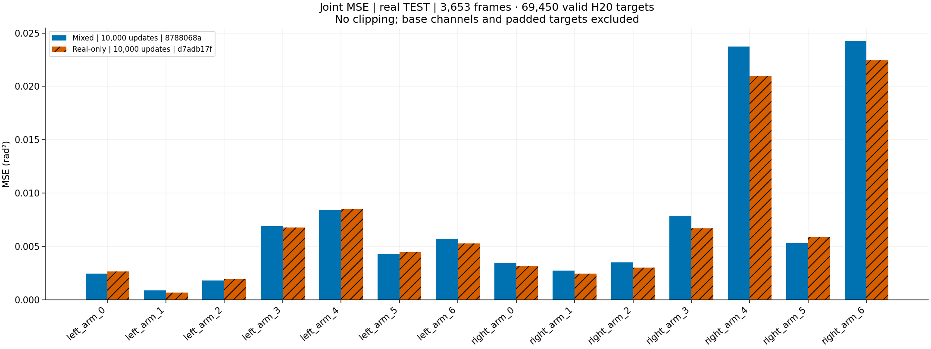
Website: train, evaluate and export results
Configure training
Choose registered data, real/sim sampling ratio and update budget. Track updates, checkpoints and stage-specific ETA.
Read and export MSE
Data & training → Evaluation & MSE → Real TEST MSE.
Use Figure to select joint bars or episode traces; download PNG, CSV or ZIP.
Final-checkpoint automatic evaluation
The latest 50/50 MSE and 32-room VLA jobs have finished. Their outcomes are reported separately.
09
Notes:
Sources: workstation bootstrap sampled 19 October 2026 18:29 SGT, automatic_evaluation.json, latest_figure_source.json, and docs/site/README.md. The figure is the completed latest 10000-update paired MSE job amse_c9c6f69c3fa6b0bd34dde0b2. Hosted Sites retains owner authentication for GPU operations; workstation mode uses local identity. GPT API remains unconfigured: dialogue is basic instruction parsing.

Slide 10
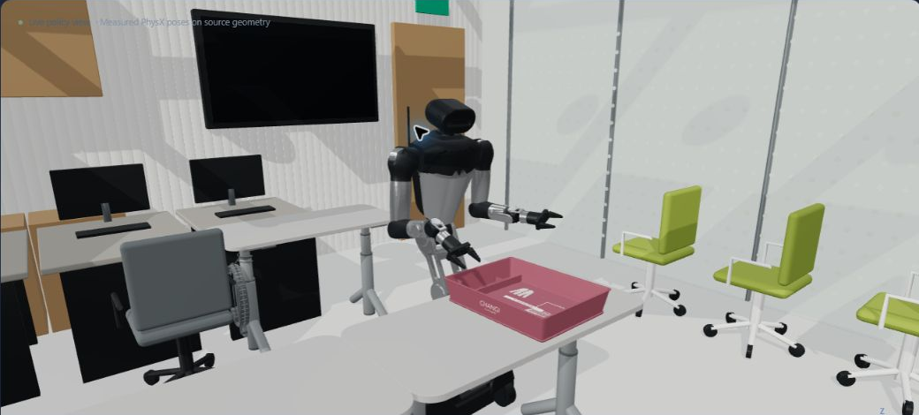
Website: run one policy and inspect its behavior
Select
Policy evaluation → room + checkpoint
Configure
1–120 s simulation budget; action handling
Observe
Measured 3D, four cameras and model latency
Measured PhysX poses on the website geometry
Inspect
Stop reason, executed frames and per-run files
Simulation time excludes inference waits. Wall time is reported independently.
Latest workstation default: Robot limits. Strict and limit-clipped modes remain explicit choices.
10
Notes:
Sources: docs/site/POLICY_EVALUATION.md; current workstation screenshot and bootstrap sampled 19 October 2026. The screenshot is the final measured state of protected run 02237d37, not a live successful Pick/Place. No job was submitted while preparing this presentation.

Slide 11
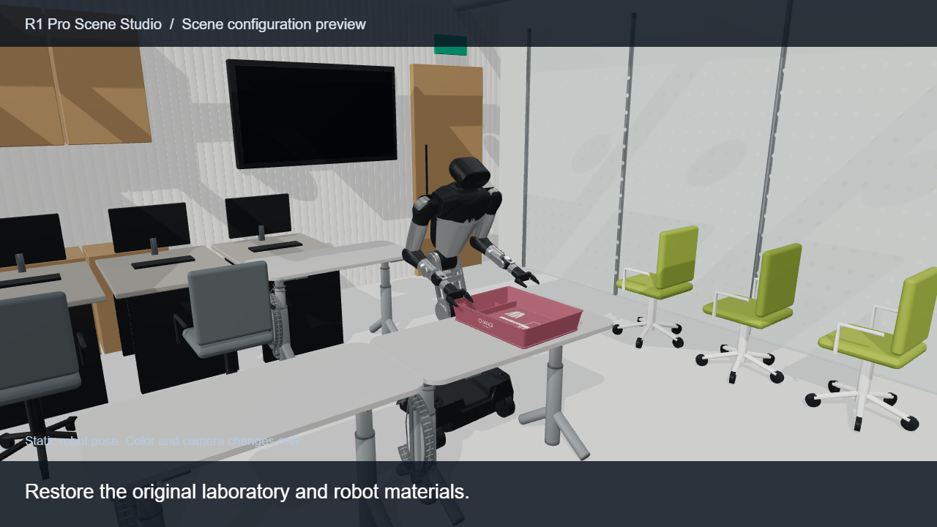
Demo: scene editing and physical Pick / Place
Click the video in Slide Show. English captions identify scene previews and expert-controlled physics.
11
Notes:
Embedded media: demo_english.mp4. Website screenshots show actual UI interactions. The camera/color segment records the original website GLB and material rules in a presentation viewer with a static pose. The native Isaac clip shows expert-controlled physics, not a successful VLA policy rollout. Physics footage remains at original speed. English captions identify each source.

Slide 12
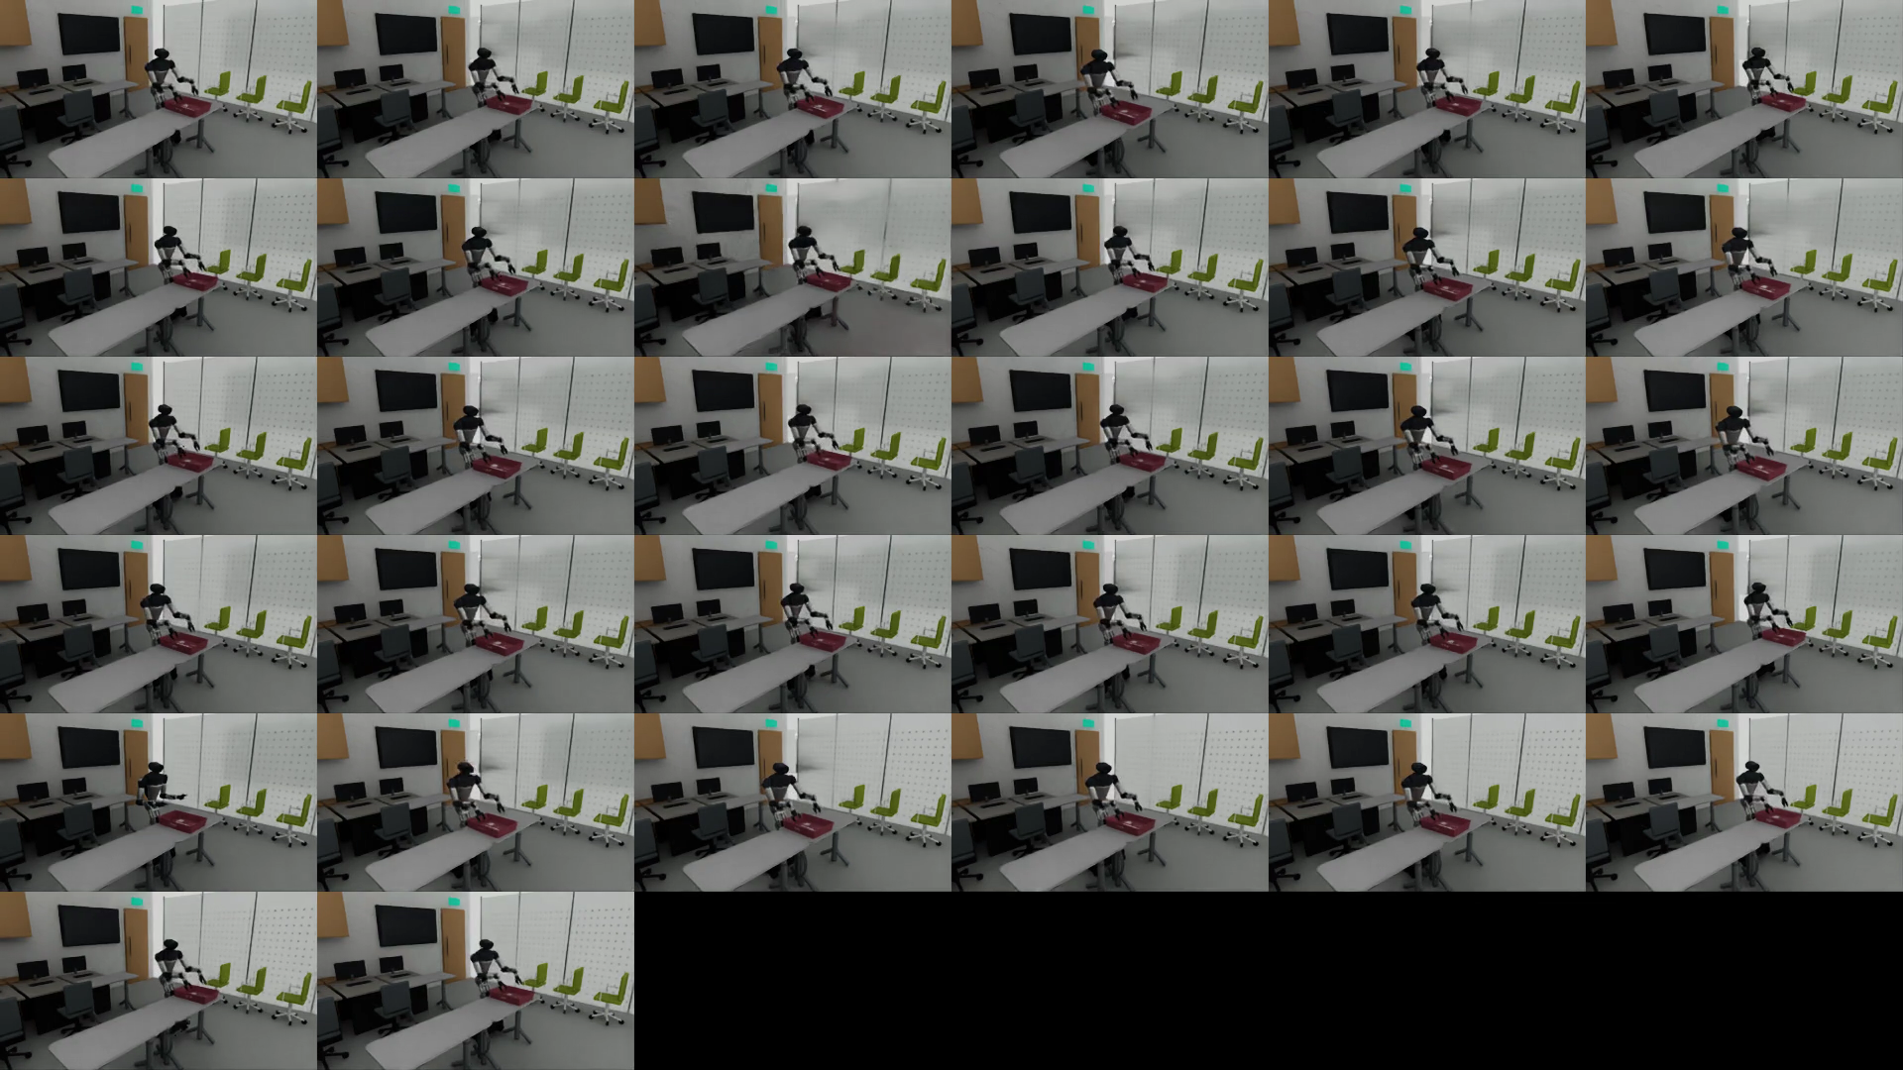
32 rooms share one physics clock
Initialize
Control
Advance
Qualify
Registered initial
states and seeds
Independent targets
for each room
One engine runs
25 shared substeps
Close trajectories
and media per room
Preserve completion and failure evidence.
Freeze only qualified complete sources.
32 room instances do not equal 32 independent training/test scenes.
12
Notes:
Sources: docs/SCENE_TASK_SPEC.md and runs/isaacsim_parallel_pickplace300_20261017_v1. One Isaac engine and one PhysicsScene advance all rooms together. These rooms share one training parent scene and do not establish held-out scene generalization.

Slide 13
Qualification preserves the physical evidence
Stage | Evidence retained
Pick | Opposite-edge bilateral contact, lift and table clearance
Place | Continuous end state, low release and stable support
Timing and media | N actions, N+1 states, native video and actual exit status
Provenance | Parent-scene split, camera identity and frozen manifest
Failed attempts | Original logs and media remain outside training
One complete Pick/Place source yields two action segments. Camera files are not additional sources.
13
Notes:
Source: the project task contract and independent native audit. Tolerances follow the user-authorized contract. No new acceptance thresholds are introduced by this presentation.

Slide 14
Data inventory and split isolation
Data domain | Train | Val | Test | Role
Real demonstrations | 102 episodes | 13 episodes | 19 episodes | Train + fixed evaluation
New Isaac data | 300 full pairs | 0 | 0 | 600 action segments
Earlier narrow / wide | 30 + 29 pairs | 0 | 0 | Separate selectable version
Additional production | 13 full pairs | — | — | Outside the frozen 300
Fit normalization and sampling weights using training data only.
14
Notes:
Sources: frozen 300-source manifest, preparation status and real-data cache. Production created 313 new complete pairs, but this training input froze exactly 300. Historical 59 pairs belong to a separate version.

Slide 15
Mixed training with duration-weighted BC
Domain sampling ratio p
Sample real data with probability p and simulation with 1−p. A domain at 0% contributes neither samples nor normalization data.
Action and source sampling
Balance Pick and Place within each domain. Weight sources by bounded inverse duration, then sample frames uniformly within a source.
w = clip(median(T) / T, 0.5, 2.0)
π0.5 LoRA Batch 8 Horizon 20 10,000 updates
Sampling weights change source probabilities. Recorded physical trajectories retain their original timing.
15
Notes:
Sources: parallel_pickplace_training.py, train_pi05_parallel_real_mix.py and decisions DEC-055 / DEC-WEB-004. This is behavior cloning with LoRA, not RL or DAgger. Duration weighting applies to the new 50/50 run. Historical recipes differ.

Slide 16
Sim2Real validation uses three evidence levels
Offline real-data test
Isaac policy rollout
Real-robot validation
Recorded observations
Per-joint / gripper MSE
Prediction error analysis
Model drives physics
No teacher or IK fallback
Independent task audit
Consistent interface
Controlled deployment
Successes / attempts
Prediction accuracy, closed-loop behavior and real task outcomes answer different questions.
16
Notes:
Sources: studio_mse.py, studio_vla_evaluate.py and project handoff documents. Offline analysis of recorded real data does not operate the physical robot. No physical robot control was performed for this report.

Slide 17
The workstation closes the camera-to-action loop
Isaac observation
ROS 2 transport
Checkpoint service
Physical execution
Head + wrist RGB
Measured joint state
Request / room / model IDs
Explicit units and horizon
π0.5 action prediction
Raw outputs preserved
Declared action handling
25 substeps per frame
Model readiness
Model | Measured state | Remaining limitation
π0.5 | Loaded; native closed-loop actions executed | Strict joint-limit failures
Galaxea G0.5 | Weights loaded; image-based inference observed | Missing gripper outputs; 30/20 Hz mismatch
GR00T | Joint-space adapter contract available | Compatible weights not supplied
Robot-limited diagnostics preserve raw outputs and are excluded from pure-model success rates.
17
Notes:
Sources: docs/site/WORKSTATION.md, docs/site/LIVE_INFERENCE.md, docs/SCENE_TASK_SPEC.md v1.181 and runtime audit. The newest performance changes are deployed on the workstation; they were not republished to the hosted frontend. No hardware control was performed. G0.5 completed actual model loading/inference but lacks a complete gripper action contract; GR00T compatible weights remain unavailable.

Slide 18
A common MSE evaluation protocol
Dimension | Common evaluation setting
Real test set | 19 episodes: 11 Pick and 8 Place
Observation / prediction | All 3,653 frames, 20 Hz, horizon 20
Valid targets | 69,450 window timesteps, excluding tail padding
Noise | Frame seed = 42000 + global frame index
Metrics | 14 joints in rad², 2 grippers in mm², base excluded
Overlapping windows are not independent samples. Offline MSE does not measure task success.
18
Notes:
Sources: paired evaluation dated 12 October and full-frame evaluation dated 19 October 2026. Real-only and historical 90/10 models use the archived paired results. The new 50/50 model uses a separate evaluation run with the same protocol. Each checkpoint retains its own normalization. Initialization, simulated sources and training recipes differ.

Slide 19
Left arm: error for every joint
Frozen three-model comparison. All use 10,000 updates; initialization and simulation recipes differ.
19
Notes:
Sources: comparison_metrics.json and the new full-frame report. Archived order: L1–L7, R1–R7, GL, GR. New report order: L1–L7, GL, R1–R7, GR. The builder explicitly reorders channels. Chart workbooks retain 12 significant digits for Excel compatibility. The companion CSV preserves the original report values.

Slide 20
Right arm: error for every joint
Frozen three-model comparison. Joint-level tradeoffs remain visible; lower is better.
20
Notes:
Sources and channel mapping match the previous slide. All joints remain visible, including R5 and R7 with larger errors. Numerical values accompany the deck as CSV.

Slide 21
Gripper error and aggregate joint MSE
Mean across 14 joints
Real 100%
0.006769 rad²
Real 90% / Sim 10%
0.006496 rad²
Real 50% / Sim 50%
0.007230 rad²
Frozen comparison from the earlier report. The next slide shows the new paired baseline separately.
21
Notes:
Source: fixed real Test19. Convert gripper m² to mm² by multiplying by 10^6. Joint and gripper values have different units and are never averaged together.

Slide 22
Simulation helps some metrics, not every outcome
Earlier paired result: 90% real / 10% simulation
Joint MSE −4.04% · Gripper MSE −7.86% · 9 / 14 arm joints improve
Latest paired result: 50% real / 50% simulation
Model · 10,000 updates | Joint MSE (rad²) | Gripper MSE (mm²)
Real 100% | 0.006772 | 405.98
Real 50% / Sim 50% | 0.007230 | 356.80
Change vs paired baseline | +6.77% | −12.11%
Different initializations and data recipes prevent causal attribution to ratio alone. MSE is not task success.
22
Notes:
Sources: archived 12 October paired real100 vs real90/sim10; latest automatic paired MSE amse_c9c6f69c3fa6b0bd34dde0b2. The previous three charts intentionally retain their original frozen values. Latest real100 arm0.006771753502435589 and gripper405.97845179832854 differ slightly from archived0.0067694845045005265 and406.36878144081703; the source of this rerun discrepancy has not been isolated. No cross-run baseline substitution is performed. Initializations and simulation sources/weighting differ, preventing a causal ratio-only claim.

Slide 23
Strict closed-loop evaluation exposes joint-limit failures
0 / 32
All runs stopped at the joint-range guard
qualified Pick / Place pairs
Left arm joint 4: 29 rooms
Right arm joint 4: 3 rooms
32 model failures
0 infrastructure failures
100% evaluation coverage
Protected diagnostics now make continued behavior observable, but do not repair the model or establish strict-policy success.
Scope: registered training-scene rooms. Explicit clipping or robot limits are excluded from this success score.
23
Notes:
Source: completed automatic native VLA report avla_c9c6f69c3fa6b0bd34dde0b2, retrieved in workstation_bootstrap.json at 18:29 SGT on 19 October 2026. Checkpoint cp_8788068a6984a796aed42ef1, real50/sim50,10000 updates. 32 training-parent rooms,200 frames per action, no teacher/IK fallback, fixed base. All32 model failures: left_arm_joint4=29,right_arm_joint4=3; infrastructureFailures=0, coverage100%. This supersedes v2 queued/unverified wording. It is not a held-out-scene generalization score.

Slide 24
Runtime optimization cuts rollout time by 3.34×
15.87 s → 4.74 s
2 simulated seconds
40 action frames
1,000 physics substeps
0.126× → 0.422×
Real-time factor remains below 1.0×.
Single short paired benchmark with robot limits enabled. Both runs ended at the duration limit.
24
Notes:
Source: runs/web_realtime_optimization_20261019/comparison.json and audit.json. Same room000,real90/sim10 checkpoint cp_d0c1ec449340c22c344ee87c,40 frames,2 simulated seconds,actionSafetyMode robot_limits. Baseline GPU PhysX+synchronous; optimized CPU PhysX+one in-flight asynchronous prediction+Fabric. Both use warmup and25 substeps at0.002s. Three displayed timing values overlap: physics and model waiting are components of total rollout, not additive categories. Initialization/warmup and media finalization are excluded from rollout. CPU/GPU and asynchronous observations produce different trajectories; one short pair does not establish long-run stability.

Slide 25
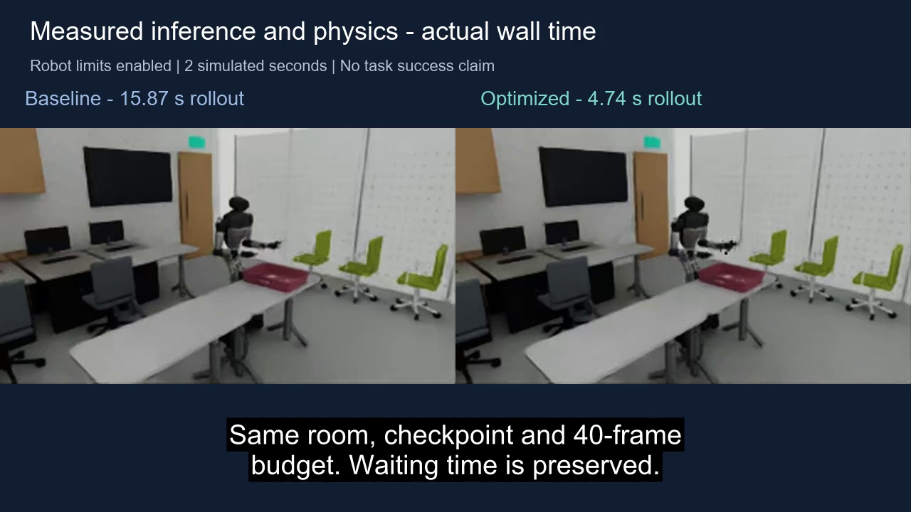
Watch the measured runtime difference
Actual wall time is preserved. After the optimized run ends, its final frame is explicitly held.
25
Notes:
Embedded runtime_comparison_english.mp4. Original wall-clock videos were downloaded from the current workstation artifact API and SHA-verified against comparison.json. Both begin together with original waiting time preserved. The optimized final frame is explicitly held after4.8s while baseline continues; both end cards hold until17.92s. Original recordings are320x180; no new motion is generated. Source encoder rounding produces15.92s and4.80s videos versus measured15.8707s and4.7446s rollout. This protected diagnostic is not task success.

Slide 26
What is delivered, and what must improve next
Area | Delivered evidence | Next validation
Scene and data | Lab editing; 313 qualified / 300 frozen pairs | Hold out independent parent scenes
Training and evaluation | 10k model; paired MSE; 32-room strict VLA | Match initialization for ratio ablations
Policy execution | Measured 3D / cameras; explicit robot limits | Resolve joint-range and gripper contracts
Runtime | 3.34× faster in a 2 s paired diagnostic | Sustain ≥1× and test longer rollouts
Real-robot transfer | User video: real10/sim90,10k updates | Bind exact checkpoint; count attempts
Engineering workflow is demonstrated. General task success and causal simulation-data gains remain open.
26
Notes:
Sources: current workstation API snapshot at18:29SGT, project release evidence and the measured reports cited throughout. Recommendations are next research steps, not completed experiments or authorization to run them. No new training or simulation job was submitted for this revision.

Slide 27
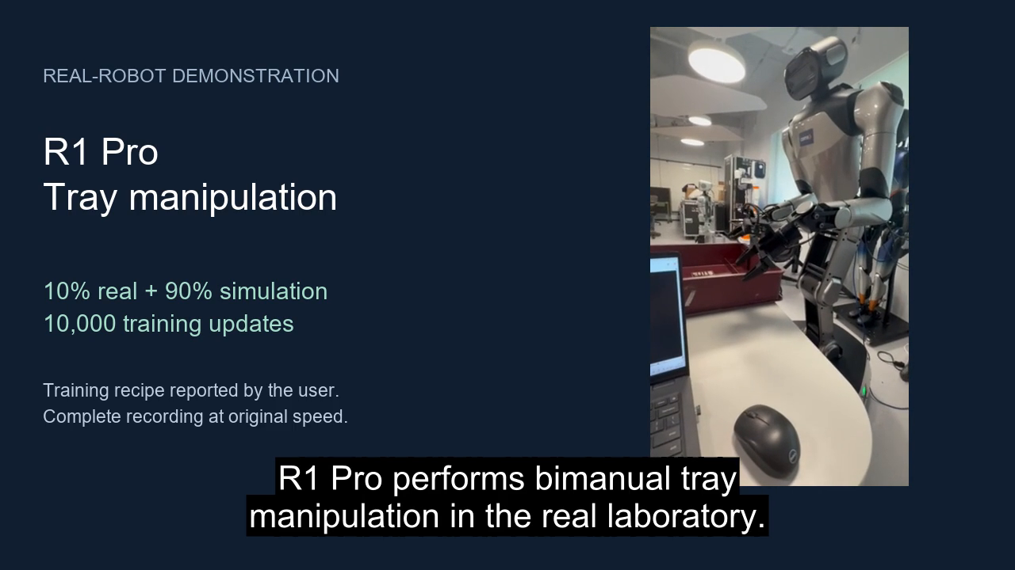
Real-robot demonstration
Original speed. User-reported recipe: 10% real + 90% simulation, 10,000 updates.
27
Notes:
Embedded media: real_robot_english.mp4. The user supplied the original 72.93-second recording. The presentation preserves its speed and full visual sequence, adds descriptive English captions, and strips location metadata. The user identifies the recipe as 10% real + 90% simulation at 10,000 updates. The exact checkpoint hash and execution mode remain unverified. This is a different recipe from the archived 90% real / 10% simulation MSE model. No task success rate or causal training claim is derived from this single video.

