Slide 1
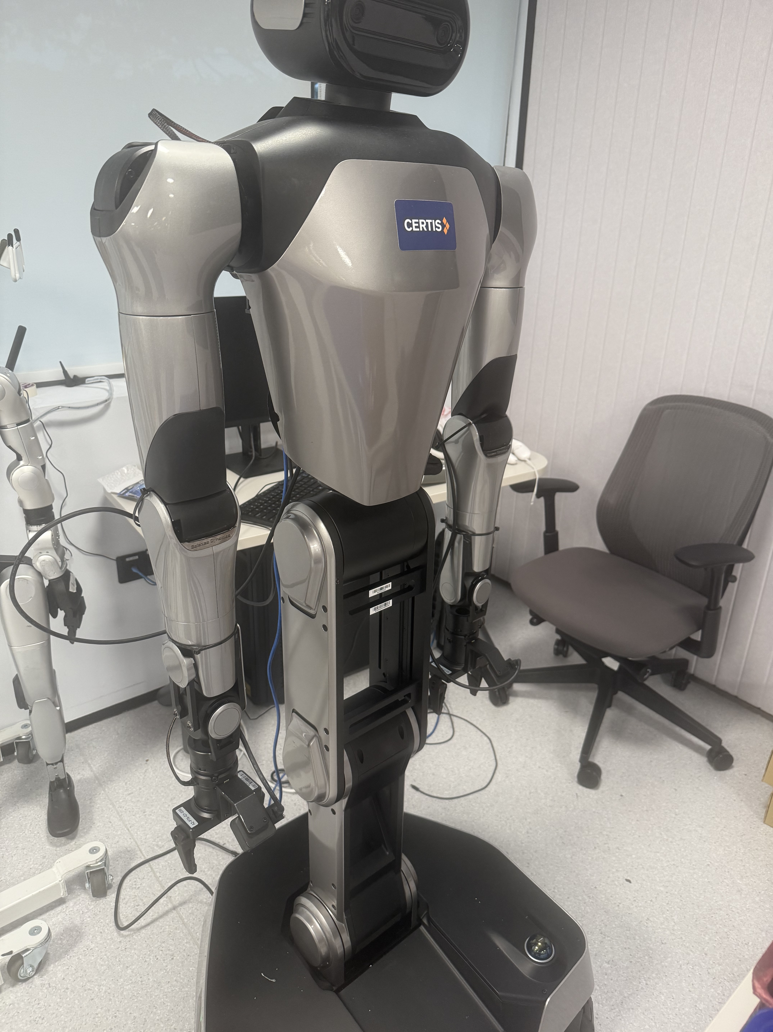
R1 Pro: From Lab to Policy
π0.5 adaptation
Real2Sim and Sim2Real
Mixed-data training
Technical report
19 October 2026
01
Notes:
Project technical report. Sources: project task contract, server evidence collected on 19 October 2026, and original laboratory reference photography. The cover photograph identifies the platform, not an evaluated checkpoint.

Slide 2
π0.5 connects perception to robot actions
Current observations and a task instruction condition an action chunk.
Vision
Language + state
Action chunk
Multiple RGB views
Scene and object context
Task instruction
Robot proprioception
Continuous joint targets
Repeated prediction
Heterogeneous co-training connects robotic and semantic supervision.
This project adapts the low-level action policy to the R1 Pro tray task.
02
Notes:
Sources: https://arxiv.org/abs/2504.16054 and https://www.pi.website/blog/pi05 . The original paper reports open-world generalization using heterogeneous co-training. Those paper-level findings are not measurements from this R1 Pro project.

Slide 3
π0.5 generates actions with flow matching
Context encoder
Action expert
Robot interface
Images, instruction
and robot state
Flow matching converts
noise into an action chunk
Decode targets
Act, then observe again
Implementation scope
OpenPI provides the low-level policy. The task controller supplies the instruction and maps model outputs to the robot.
Project configuration: 20-step horizon at 20 Hz. This differs from the original default horizon.
03
Notes:
Sources: https://github.com/Physical-Intelligence/openpi and https://github.com/Physical-Intelligence/openpi/blob/main/src/openpi/models/pi0_config.py . OpenPI currently exposes the flow-matching action head. The paper also describes high-level semantic inference. This project supplies explicit task text rather than implementing that complete hierarchy.

Slide 4
Observation and action interfaces
Interface | R1 Pro configuration | Consistency requirement
Vision | Head + two wrists, 224 × 224 | Native camera orientation
State / action | 14 joints + 2 grippers + 3 base | Joints in rad, grippers in m
Action chunk | Horizon 20, sampled at 20 Hz | Common time base
Closed-loop execution | Reobserve after up to 5 steps | Explicit fixed-base mask
Keep raw model outputs and record the fixed-base execution mask explicitly.
04
Notes:
Sources: r1pro_teleop/vla/real_sim_data.py, scripts/studio_mse.py and r1pro_teleop/real2sim/isaac_policy_pickplace.py. Raw channel order: left arm 7, left gripper, right arm 7, right gripper, base 3. The model pads 19 dimensions to 32.

Slide 5
The project pipeline
Real lab
Real2Sim
Simulation
Training
Evaluation
Photos, CAD and
real demonstrations
Geometry, joints
and camera mapping
32 rooms collect
physical trajectories
Frozen sources
and mixed sampling
Real-data MSE
and policy rollouts
The website configures scenes and tracks GPU jobs and results.
Data qualification, prediction error and task completion use separate acceptance evidence.
05
Notes:
Sources: docs/SCENE_TASK_SPEC.md, apps/scene-agent/PROJECT.md and scripts/studio_prepare_training.py. All diagram nodes remain editable.

Slide 6
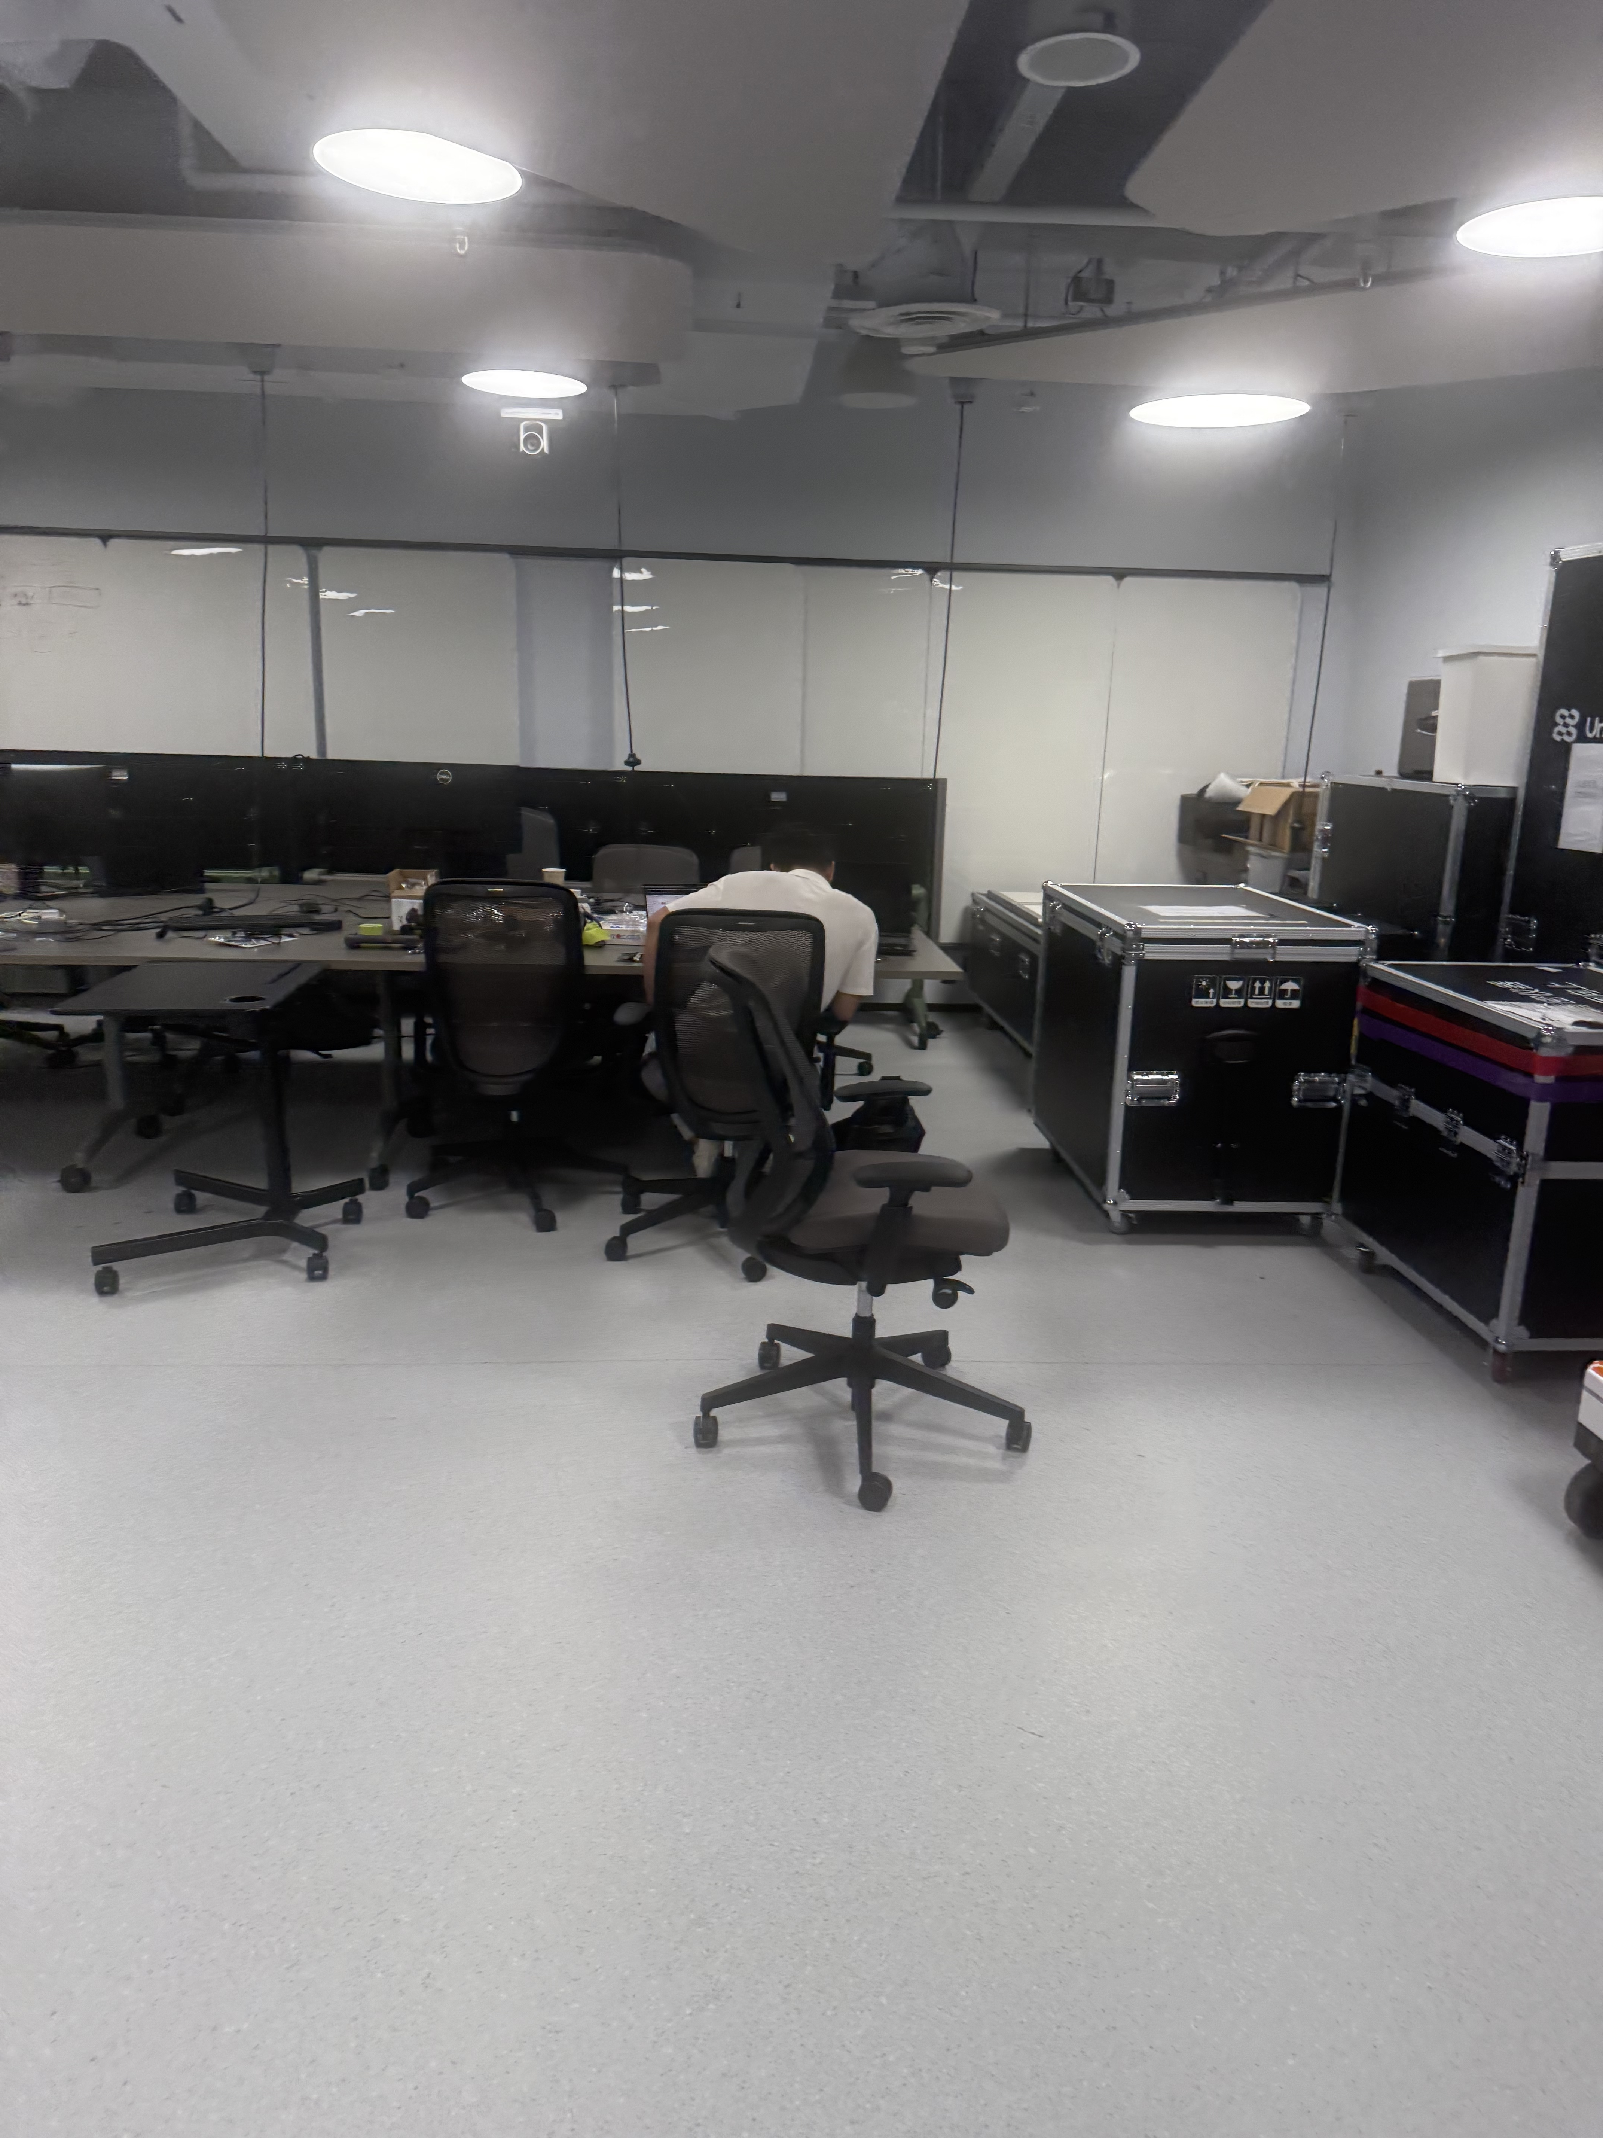
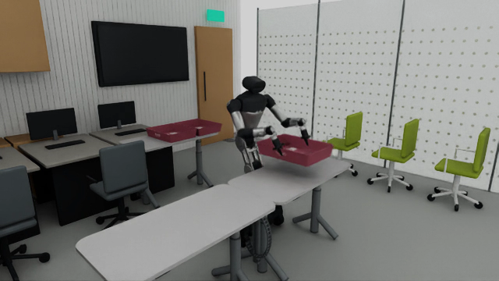
Real2Sim reconstructs the laboratory
Real laboratory reference
Native Isaac scene with R1 Pro
Preserve the desk layout, robot appearance and tray markings. Check physical alignment separately.
06
Notes:
Sources: resources/single_tray_lab_v1/reference_photos/room_desks.jpg and runs/isaacsim_reachable_fixedbase_20261016_v1/case_000/presentation.mp4. These are project source assets. The slide does not claim pixel-equivalent reconstruction.

Slide 7
Alignment makes simulation data usable
Geometry and control
Use a common coordinate system, joint order and units. Record the tray and base initial states for each source.
Contact and support
Keep physical collision and contact feedback. Grasp opposite long edges and carry the actual Pick end state into Place.
Vision and time
Keep native camera directions and original-speed recordings. Each 20 Hz frame advances 25 physics substeps of 2 ms.
07
Notes:
Sources: docs/SCENE_TASK_SPEC.md, scripts/run_isaac_parallel_pickplace.py and r1pro_teleop/vla/parallel_pickplace_training.py.

Slide 8
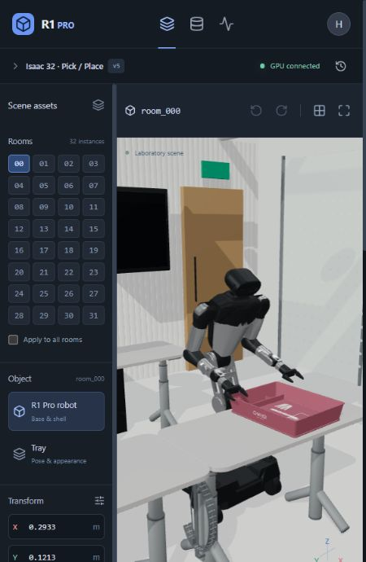
Website: select and edit a scene
1. Select a room and object
Choose room_000–031, then select the robot or tray.
2. Edit through dialogue or controls
For example: “Make the tray blue.” Check the pose, color and edit scope in the preview.
3. Save a version and submit
Synchronize the saved draft to the GPU. Native adaptation and physical qualification precede data collection.
08
Notes:
Source: production website screenshots and actual interaction on 19 October 2026. The current basic instruction parser handles color edits. GPT API configuration remains pending. The English screenshot shows the restored original material at version 5. The earlier color demonstration was restored and saved as a new version. No GPU synchronization or training input change occurred.

Slide 9
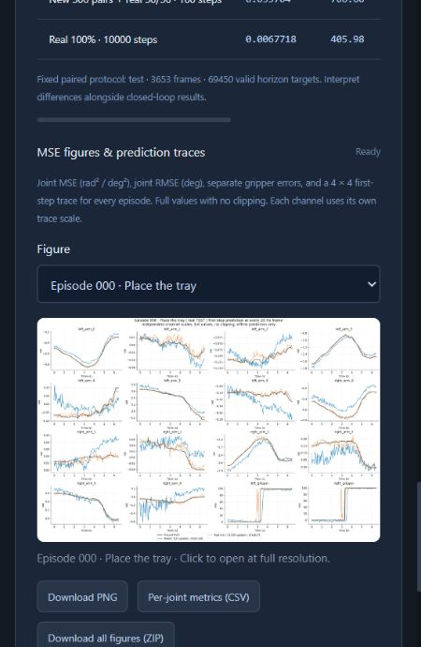
Website: configure runs and inspect results
1. Configure a training run
Choose registered datasets, a 0-100% real/sim ratio, update budget and automatic evaluation.
2. Track progress and ETA
Data & training shows updates, loss, saved checkpoints and the current-stage estimate.
3. Open the MSE results
Data & training > Evaluation & MSE > Real TEST MSE. Run history shows job status.
4. Inspect and download figures
Choose MSE/RMSE bars or episode 4x4 traces. Download PNG, per-joint CSV or the full ZIP.
Screenshot: historical evaluation UI. Its training budgets differ; the comparison later uses 10,000 updates.
09
Notes:
Sources: production website, runs/web_english_autoeval_20261019_v1/production_mse_ready.png and user-shared update https://chatgpt.com/s/cx_6ad5ad23e2c88191b724e1988089716e . Read on 19 October 2026. The screenshot shows the historical 100-update mixed vs 10,000-update real-only job; this is a UI example, not the equal-budget comparison in slides 17-20. The latest final-checkpoint automatic VLA and paired MSE were queued in that record. The completed full-frame evaluation in this report is a separate job.

Slide 10
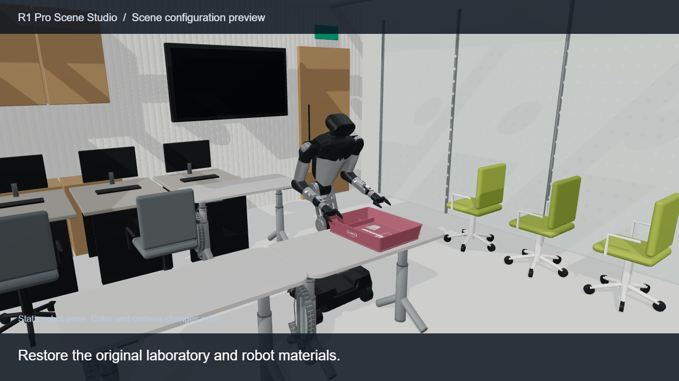
Demo: scene editing and physical Pick / Place
Click the video in Slide Show. English captions identify scene previews and expert-controlled physics.
10
Notes:
Embedded media: demo_english.mp4. Website screenshots show actual UI interactions. The camera/color segment records the original website GLB and material rules in a presentation viewer with a static pose. The native Isaac clip shows expert-controlled physics, not a successful VLA policy rollout. Physics footage remains at original speed. English captions identify each source.

Slide 11
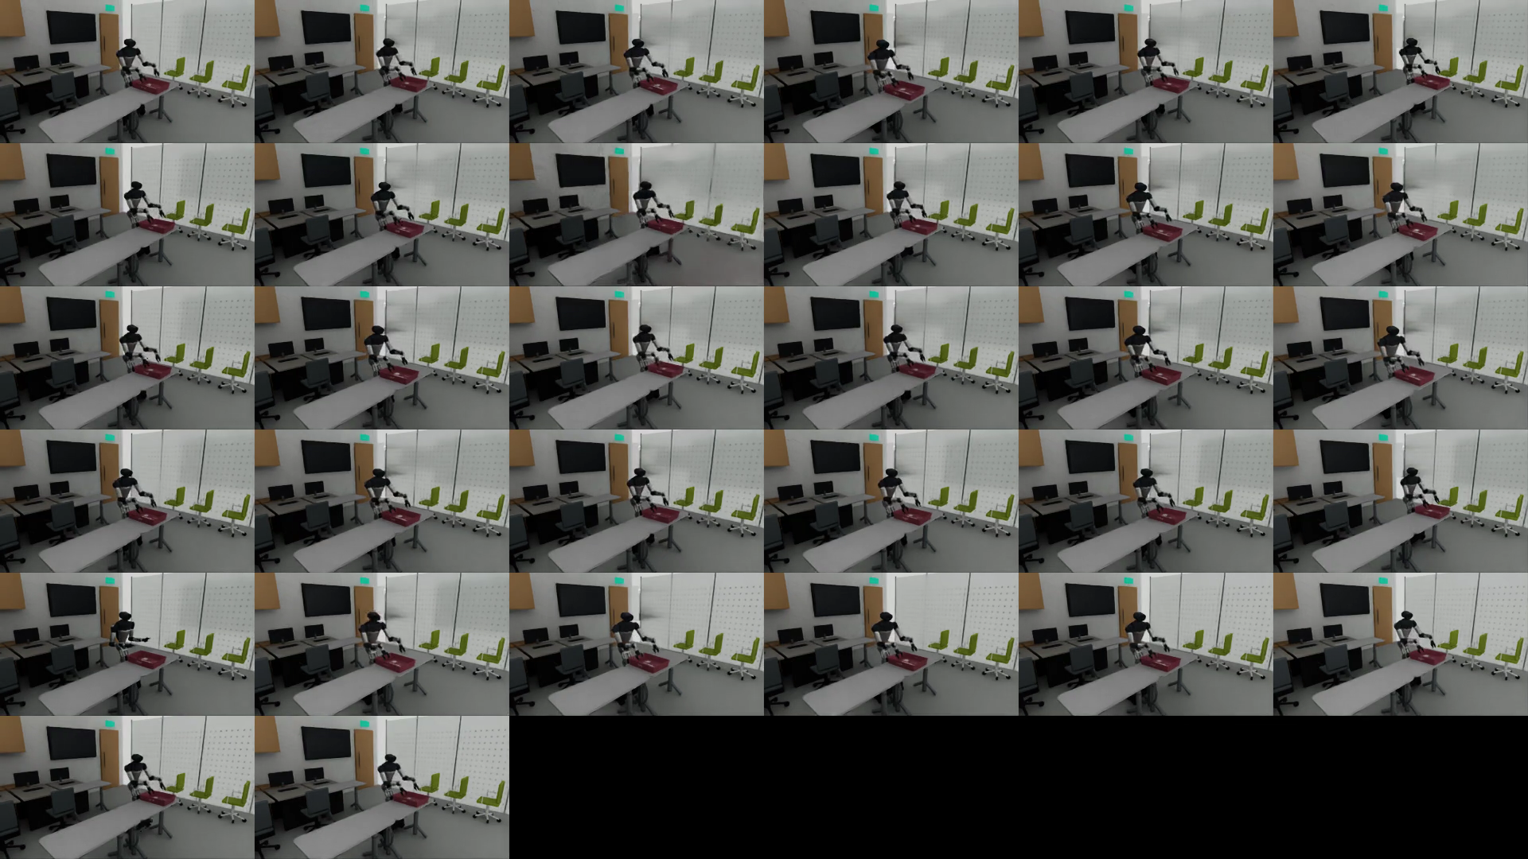
32 rooms share one physics clock
Initialize
Control
Advance
Qualify
Registered initial
states and seeds
Independent targets
for each room
One engine runs
25 shared substeps
Close trajectories
and media per room
Preserve completion and failure evidence.
Freeze only qualified complete sources.
32 room instances do not equal 32 independent training/test scenes.
11
Notes:
Sources: docs/SCENE_TASK_SPEC.md and runs/isaacsim_parallel_pickplace300_20261017_v1. One Isaac engine and one PhysicsScene advance all rooms together. These rooms share one training parent scene and do not establish held-out scene generalization.

Slide 12
Qualification preserves the physical evidence
Stage | Evidence retained
Pick | Opposite-edge bilateral contact, lift and table clearance
Place | Continuous end state, low release and stable support
Timing and media | N actions, N+1 states, native video and actual exit status
Provenance | Parent-scene split, camera identity and frozen manifest
Failed attempts | Original logs and media remain outside training
One complete Pick/Place source yields two action segments. Camera files are not additional sources.
12
Notes:
Source: the project task contract and independent native audit. Tolerances follow the user-authorized contract. No new acceptance thresholds are introduced by this presentation.

Slide 13
Data inventory and split isolation
Data domain | Train | Val | Test | Role
Real demonstrations | 102 episodes | 13 episodes | 19 episodes | Train + fixed evaluation
New Isaac data | 300 full pairs | 0 | 0 | 600 action segments
Earlier narrow / wide | 30 + 29 pairs | 0 | 0 | Separate selectable version
Additional production | 13 full pairs | — | — | Outside the frozen 300
Fit normalization and sampling weights using training data only.
13
Notes:
Sources: frozen 300-source manifest, preparation status and real-data cache. Production created 313 new complete pairs, but this training input froze exactly 300. Historical 59 pairs belong to a separate version.

Slide 14
Mixed training with duration-weighted BC
Domain sampling ratio p
Sample real data with probability p and simulation with 1−p. A domain at 0% contributes neither samples nor normalization data.
Action and source sampling
Balance Pick and Place within each domain. Weight sources by bounded inverse duration, then sample frames uniformly within a source.
w = clip(median(T) / T, 0.5, 2.0)
π0.5 LoRA Batch 8 Horizon 20 10,000 updates
Sampling weights change source probabilities. Recorded physical trajectories retain their original timing.
14
Notes:
Sources: parallel_pickplace_training.py, train_pi05_parallel_real_mix.py and decisions DEC-055 / DEC-WEB-004. This is behavior cloning with LoRA, not RL or DAgger. Duration weighting applies to the new 50/50 run. Historical recipes differ.

Slide 15
Sim2Real validation uses three evidence levels
Offline real-data test
Isaac policy rollout
Real-robot validation
Recorded observations
Per-joint / gripper MSE
Prediction error analysis
Model drives physics
No teacher or IK fallback
Independent task audit
Consistent interface
Controlled deployment
Successes / attempts
Prediction accuracy, closed-loop behavior and real task outcomes answer different questions.
15
Notes:
Sources: studio_mse.py, studio_vla_evaluate.py and project handoff documents. Offline analysis of recorded real data does not operate the physical robot. No physical robot control was performed for this report.

Slide 16
A common MSE evaluation protocol
Dimension | Common evaluation setting
Real test set | 19 episodes: 11 Pick and 8 Place
Observation / prediction | All 3,653 frames, 20 Hz, horizon 20
Valid targets | 69,450 window timesteps, excluding tail padding
Noise | Frame seed = 42000 + global frame index
Metrics | 14 joints in rad², 2 grippers in mm², base excluded
Overlapping windows are not independent samples. Offline MSE does not measure task success.
16
Notes:
Sources: paired evaluation dated 12 October and full-frame evaluation dated 19 October 2026. Real-only and historical 90/10 models use the archived paired results. The new 50/50 model uses a separate evaluation run with the same protocol. Each checkpoint retains its own normalization. Initialization, simulated sources and training recipes differ.

Slide 17
Left arm: error for every joint
Lower is better. Each model has 10,000 updates. Initialization, simulated data and recipes differ.
17
Notes:
Sources: comparison_metrics.json and the new full-frame report. Archived order: L1–L7, R1–R7, GL, GR. New report order: L1–L7, GL, R1–R7, GR. The builder explicitly reorders channels. Chart workbooks retain 12 significant digits for Excel compatibility. The companion CSV preserves the original report values.

Slide 18
Right arm: error for every joint
Lower is better. Read all channels and action groups before interpreting the aggregate.
18
Notes:
Sources and channel mapping match the previous slide. All joints remain visible, including R5 and R7 with larger errors. Numerical values accompany the deck as CSV.

Slide 19
Gripper error and aggregate joint MSE
Mean across 14 joints
Real 100%
0.006769 rad²
Real 90% / Sim 10%
0.006496 rad²
Real 50% / Sim 50%
0.007230 rad²
Report joints and grippers separately. The companion CSV also includes Pick / Place breakdowns.
19
Notes:
Source: fixed real Test19. Convert gripper m² to mm² by multiplying by 10^6. Joint and gripper values have different units and are never averaged together.

Slide 20
What the measurements support
The 10% simulation model improves aggregate MSE
Relative to real-only: joint MSE decreases 4.04% and gripper MSE decreases 7.86%. Nine of 14 arm joints improve.
The 50% simulation model has mixed results
Joint MSE rises 6.80% to 0.007230 rad². Gripper MSE falls 12.20% to 356.80 mm², relative to real-only.
Controlled ablations are needed for causal attribution
Existing models differ in initialization and simulated data. A ratio-only study must hold these fixed and measure real-robot completion rates.
20
Notes:
Source: archived paired measurements, checkpoint identities and the fresh full-frame evaluation. Existing model comparisons do not isolate sampling ratio as the sole cause. Real-only starts from official pi05_base. Mixed models start from a project simulation-finetuned parent. The new 50/50 model also changes the simulation dataset and duration weighting.

Slide 21
Current evidence and remaining validation
Workstream | Evidence available
Scene and website | English UI, scene editing, job queue and downloadable MSE figures
Data and model | 300 frozen pairs and a 10,000-update 50/50 checkpoint
Offline evaluation | Per-joint comparison using fixed real observations
Policy rollout | Interface implemented, successful rollout still unverified
Real-robot footage | User reports 10% real + 90% sim, 10,000 updates
The expert-controlled simulation demo does not establish VLA closed-loop success.
21
Notes:
Source: server evidence collected on 19 October 2026. The new 50/50 model saved the 10,000-update checkpoint. The shared website update reports 24 historical figures online and final-checkpoint automatic jobs queued. The independent full-frame MSE in this presentation has now completed with actual exit 0. The earlier 100-update VLA job exited during Isaac bootstrap because EULA input was unavailable. It produced no native policy rollout and counts as an infrastructure failure, not a model outcome.

Slide 22
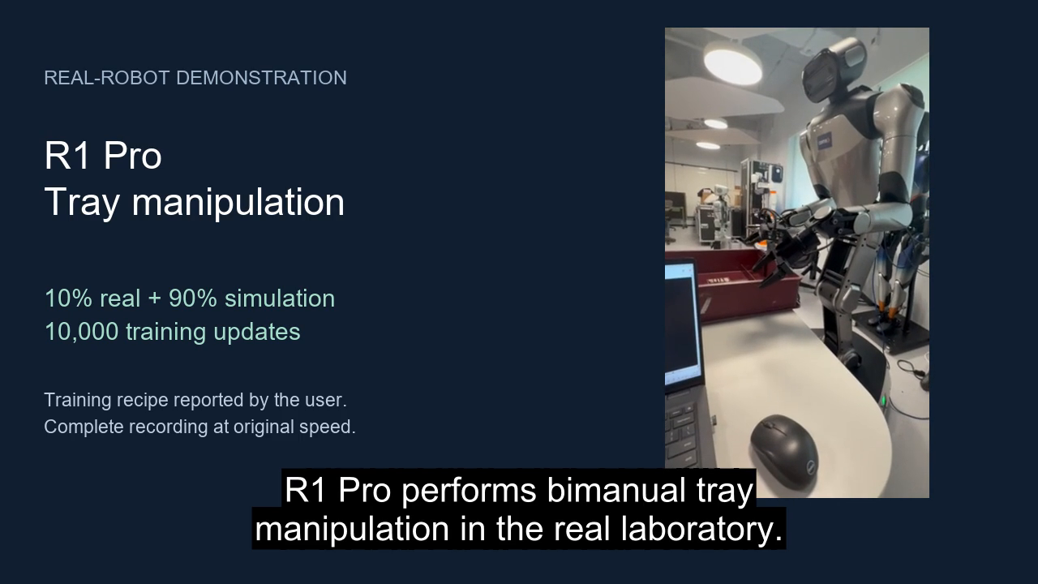
Real-robot demonstration
Original speed. User-reported recipe: 10% real + 90% simulation, 10,000 updates.
22
Notes:
Embedded media: real_robot_english.mp4. The user supplied the original 72.93-second recording. The presentation preserves its speed and full visual sequence, adds descriptive English captions, and strips location metadata. The user identifies the recipe as 10% real + 90% simulation at 10,000 updates. The exact checkpoint hash and execution mode remain unverified. This is a different recipe from the archived 90% real / 10% simulation MSE model. No task success rate or causal training claim is derived from this single video.

