Slide 1
Client run on Windows
Jason Wang SW QA
Jul 2024

Slide 2
Agenda
Environment setup
Launch with CMD mode
Launch with GUI mode
Available EIT suites
Q&A

Slide 3

Goal and Expectation
Goal:
Help SW DEV functional groups run SW QA EIT cases(All/partial) with TMP client on their local/remote machines before code check-in.
Expectation :
SW DEV can easily run EIT suite on local machine with special build.
SW DEV start to run EIT suite before code check in.

Slide 4
Environment setup
Python Setup:
Source:
\\lsh-smb04\sw\qa\qa_store\TMP_tools\depend_software\python_and_packages (LSH win access)
/disks/swrd_archive/sqa_lsv/test_management_platform/depend_software/python_and_packages (LSV lin access)
Install Python:
Double click: python-3.8.7-amd64.exe (Windows) or unzip Python-3.8.7.tar.xz(Linux)
Put Python install path into environment ‘PATH’ variable
Install Python Packages:
cd ‘offline’ folder
Run following commands in console(dos):
python -m pip install --no-index --find-links . psutil==5.8.0
python -m pip install --no-index --find-links . JIRA==2.0.0
python -m pip install --no-index --find-links . openpyxl==3.0.7
python -m pip install --no-index --find-links . pymysql==1.0.2
Verify:
Run following commands in console(dos):
python -- Python should be run with a correct version
import psutil -- Python package imported, no crash
import jira -- Python package imported, no crash
import openpyxl -- Python package imported, no crash
import pymysql -- Python package imported, no crash

Slide 5
Environment setup
SVN Setup:
Source:
/disks/swrd_archive/sqa_lsv/test_management_platform/depend_software/Setup-Subversion-1.6.6.msi
Install SVN:
Double click: Setup-Subversion-1.6.6.msi
Put SVN install path into environment ‘PATH’ variable
Verify:
Run following commands in console (dos):
svn --version -- SVN should report correct version
Client Setup:
Source:
\\lsh-smb04\sw\qa\qa_store\TMP_tools\client_software (LSH win access)
/disks/swrd_archive/sqa_lsv/test_management_platform/client_build (LSV lin access)
Install Client With Wizard:
Double click: tmp_client_<version>_installer_bin_windows.exe
Select ‘Installation Folder’
Put Client bin path(<install_path>/bin) into environment ‘PATH’ variable (Optional)
Verify:
Run following commands in console (dos):
Clientc.exe -h -- Client will display current version and simple usage

Slide 6
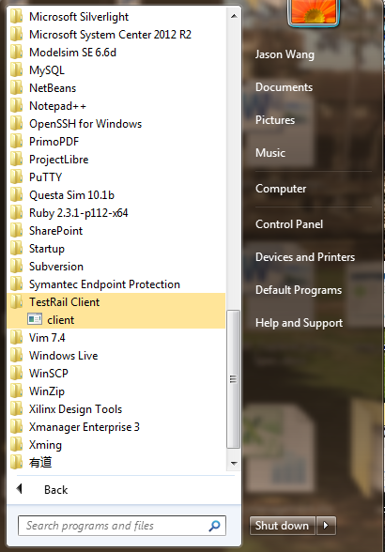
Environment setup
Launch Client:
Launch from Start Menu (Windows):
On Windows platform we can launch TMP client from start menu.
Please click “Start Menu” → “All Programs” → “TestRail Client” → “client”
Launch from command line(dos):
Please use following command lines to launch client:
<client_install_path>/bin/clientc.exe –c (console mode)
<client_install_path>/bin/client.exe (GUI mode)

Slide 7
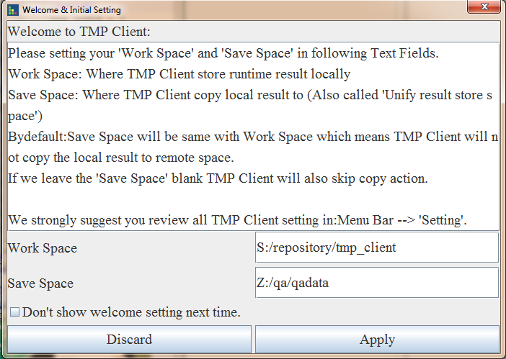
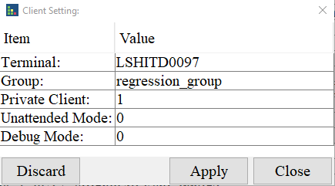
Environment setup
GUI Initial Setting 1:
Welcome setting:
You will be prompted a welcome setting dialog like following. You can specify ‘Work Space’, ‘Save Space’ and click ‘Apply’ button to finish the setting.
‘Work Space’ : location/space for test case run
‘Save Space’ : client make a copy of test case here(Work with TMP platform, leave it open for personal use)
See ‘Appendix – Case work flow’ for more details.
Client setting:
Click “Setting” → “Client…”:
Terminal -- Client name
Group -- Setting the client group name
Private -- value can be “0” or “1”, the default name is “1”
“0”: public client will run assigned and matched task.
“1”: private client will run assigned task only.
Unattended -- value can be “0” or “1”, the default name is “1”
“0”: Attended Mode. SW do some special work (i.e. SW update) under user’s operation.
“1”: Unattended Mode. SW do some special work (i.e. SW update) automatically.

Slide 8
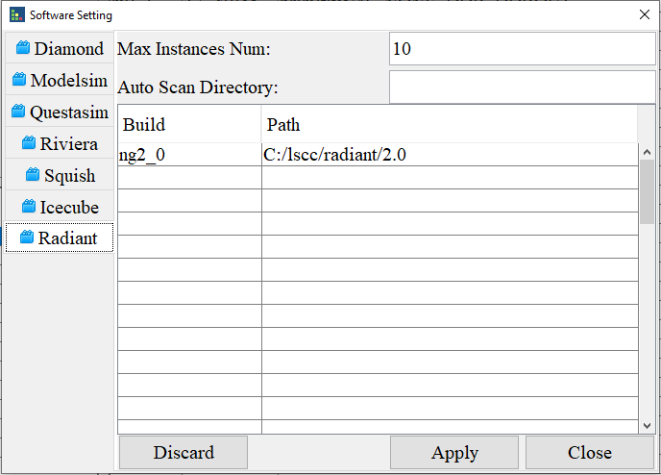
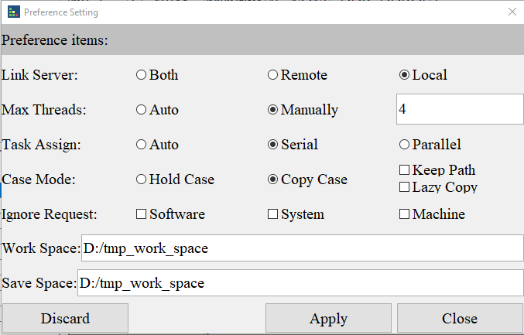
Environment setup
GUI Initial Setting 2:
Software setting:
Click “Setting” → “Software…”. Set current host machine available Software and Maximum instances can be launched for this Software.
‘Build <--> Path’ : Build name and real installation path
‘Max Instances Num’ : Maximum instances can be launched for this Software
Preference setting:
Link_mode: value can be “both”, “remote” and “local”. Client linked server select.
Max_threads: Maximum threads (test case) can be launched.
Thread_mode: value can be “auto” and “manual”
Task_mode: auto, serial and parallel.
Auto: client will take top priority level tasks and run parallel these tasks.
Serial: client will run task one by one according the task priority
Parallel: client will run tasks in parallel mode
Work_space: client work space, client will download and run case in this folder.
Save_space: client result save space. If doesn’t present client will skip copy case runtime results.

Slide 9
Environment setup
Initial Setting for Console mode(Optional):
Actually, GUI dialogs are wrappers for the Client core engine, All the GUI settings were saved to following file, so for Console mode we can update this file directly：
Config file: <user_home_path>/client_conf/<machine_name>.ini
This xxx.ini file contains two kinds of sections:
Section without “tmp_” : Client software setting section
Section with “tmp_” : Client setting section.
You can update the software, client and preference setting in this file directly.

Slide 10
Environment setup
Initial Setting for local EIT run(Suggestion):
GUI Software setting (or <software name> in xxx.ini file):
NA
GUI Client setting (or tmp_machine in xxx.ini file):
group = regression_group
private = 1 -- Private mode, remote task will not use this client
GUI Preference setting (or tmp_preference in xxx.ini file):
link_mode = local -- Do not link to remote server
ignore_request = software -- Do not care client have requested software or not (ENV, RTF used)
max_threads = 3 -- Client can launch 3 case parallelly
work_space = D:/tmp_work -- Your prefer path for case run
python = C:/Python38/python.exe -- Python bin path
*: Please keep other setting as default.

Slide 11
Launch with CMD mode(dos)
Environment setting:
set EXTERNAL_RADIANT_PATH=C:/lscc/radiant/3.2
or
setenv ENV /home/rel/ng3_2.168/env
Launch Command:
clientc.exe/client -c -l -i software -f $unit_path/demo.xlsx
*[-w <your prefer path>]
*:Only for first time launch
Use \$unit_path in Linux
-e <env1=value1, env2=value2>, to add environment in command line
-t <number>, to specify how many threads to use
-w work space, where to run your cases, it’s better to assign a place with 5g+ space

Slide 12
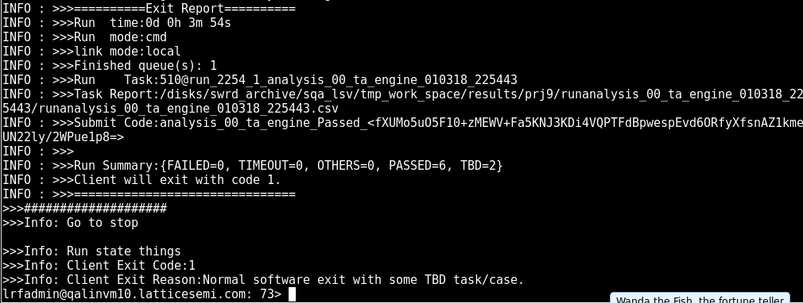
Result check – suite run
Report Path
Summary
Run ID
Final Result
File opened with report path:

Slide 13
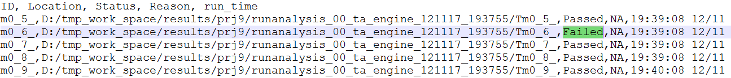
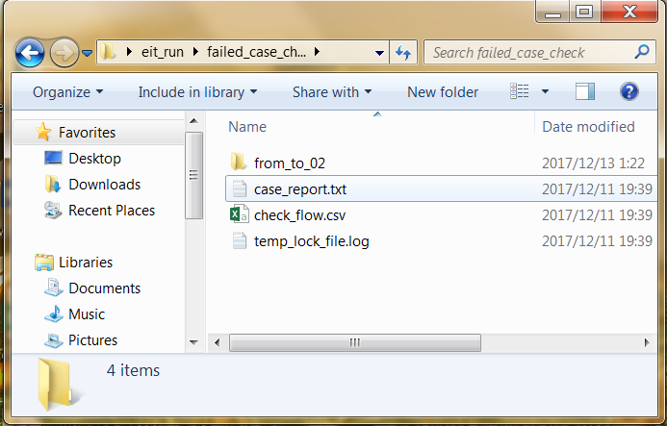
Result check – Filed case check steps
Steps:
Open the report file
Open failed case directory
Open ‘case_report.txt’ to see which check failed
Open ‘*.conf’ file in design to see what is the failed check doing
Manually check again
Demo

Slide 14
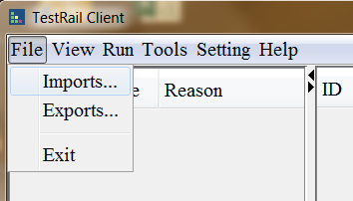
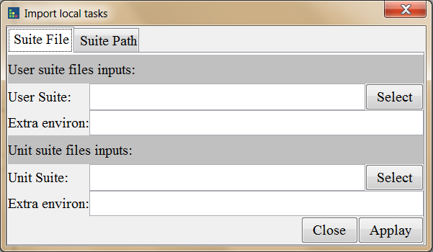
Launch with GUI mode
1. Run client.exe on Windows
2. Client “imports…” on top left
3. Select ‘Suite File’ tab
4. Give the value of ‘Unit Suite’
5. Give the extra environments: ENV=xxx, RTF=xxx
6. Click ‘Apply’

Slide 15
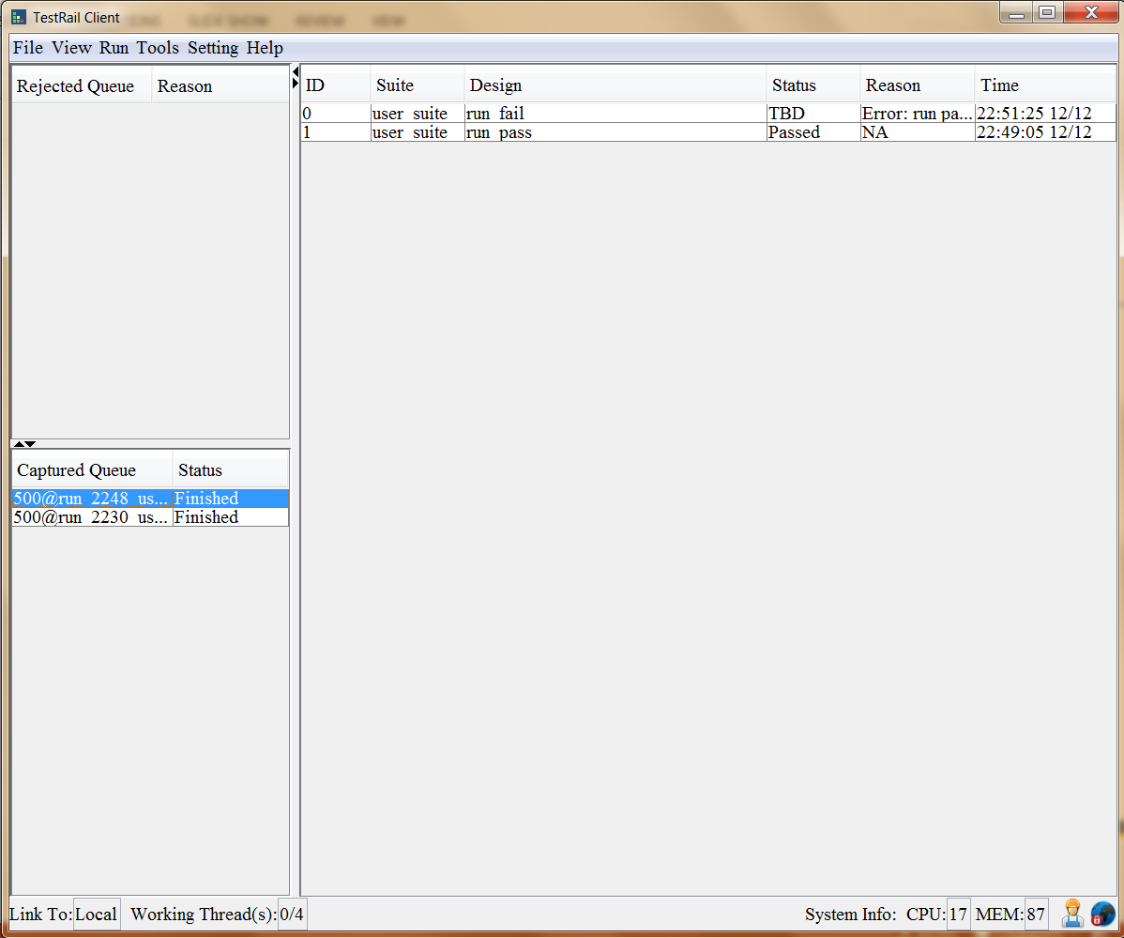
Launch with GUI mode
Result Show
Double click the finished run
In GUI test you can retest the failed case

Slide 16
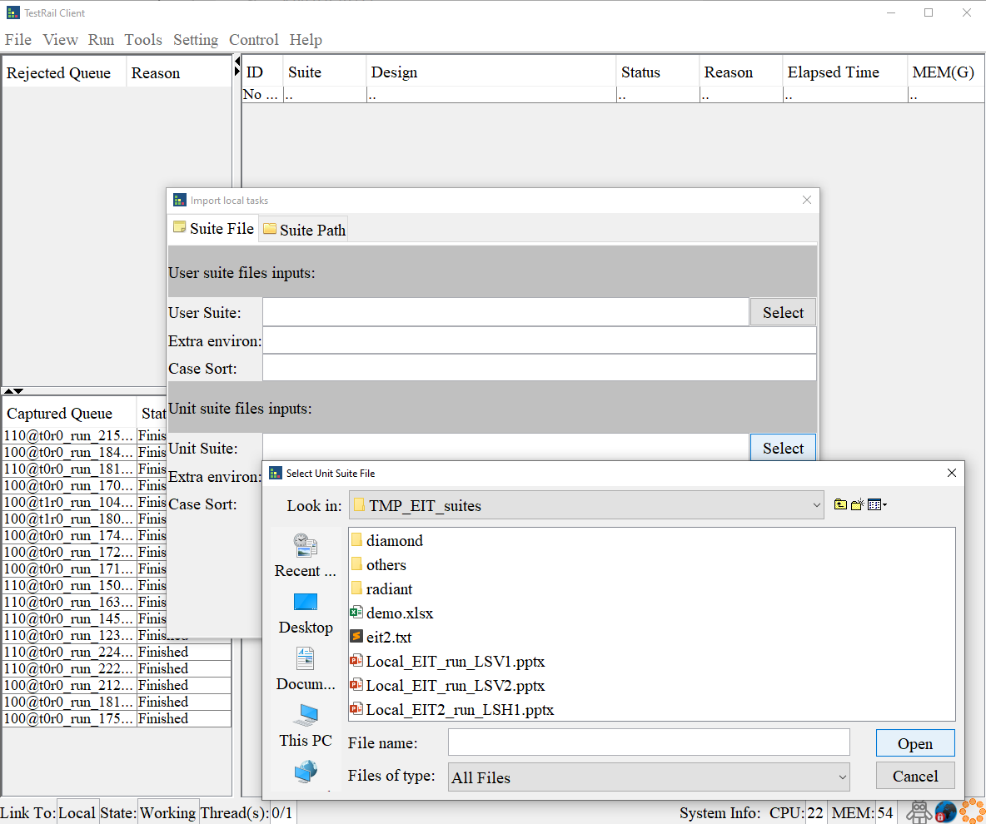
Available EIT suites
EIT test suite files:
Suite files can be found here:<Install path>/doc/TMP_EIT_suites
EIT suite launch in GUI:
Client ‘File’ → ‘Imports…’ → ‘Unit suite file inputs:’ → ‘Select’ (like right picture)
Select the suite file(component) as you prefer.
Radiant EIT test suites:
<Install path>/doc/TMP_EIT_suites/radiant
Scope: PN GUI, simulaiton, constraint, device basic cover
Diamond EIT test suites:
<Install path>/doc/TMP_EIT_suites/diamond
Scope: PN GUI, simulaiton, constraint, device basic cover

Slide 17
THANKS
Q&A

Slide 18
Appendix – Case work flow
Client will read the case info from Suite file and download the case to ‘work Space’ and run it then copy the run result to ‘Save Space’ if needed.
-w to set client work space
-s to client save space, if don’t need give the same value as -w
* Client will remember your setting, only first time need.
Suite File
Optional
depot
Work Space
Save Space

Slide 19
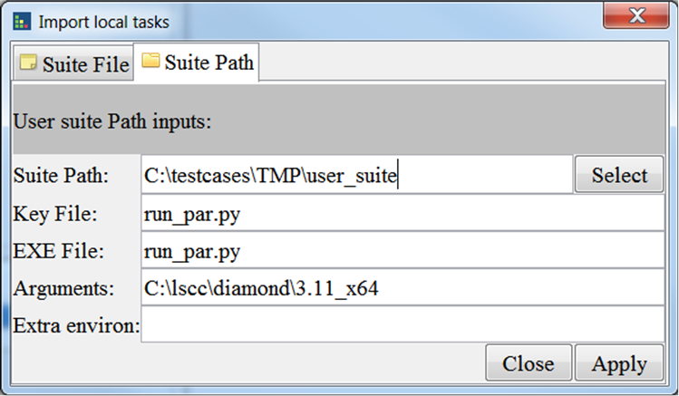
Appendix - Run user case
Format:
There is a run file in every case folder.
Run file exit code: 0: pass, 1:tbd, others: fail
Demo
Launch CMD:
Clientc.exe/client -c -l -p <suite_path> -k <key_file> -x <execute file> -a <arguments> -e <environments>
-k key file to make client consider the path is a case
-x execute file, support: py, pl, sh
-a arguments for the execute file
Launch GUI:

Slide 20
Appendix - Ready for integration:
Client will exit with:
0 : All test case passed or with .
1 : Some case failed with known issues.(QA filed CR already)
2 : Any case failed with unknown issues
#python
exit_sts = os.system(‘clientc.exe -c -l -i software -f $unit_path/radiant/analysis_00_ta_engine.xlsx’)
sys.exit(exit_sts)
#perl
exit exit_sts
#java
System.exit(exit_sts)

Slide 21
Appendix – Know issues
NA

