Slide 1
CR Reporting and Fixing Appointments
Jason Wang SW QA
Nov 2018

Slide 2
Agenda
SW QA EIT suites introduction
Command line launch for EIT case
Result check
Available EIT suites
Q&A

Slide 3

Goal and Expectation
Goal:
Help LSV SW DEV functional groups run SW QA EIT cases(All/partial) with TMP client on their local/remote machines before code check-in.
Expectation :
LSV SW DEV can easily run EIT suite on local machine with special build.
LSV SW DEV start to run EIT suite before code check in.

Slide 4
SW QA EIT suites introduction
Key Points:
Case information collection (where is the case and how to launch it)
Filed by QA focus on maximum coverage with minimum case number
Recognized and can be run by Client
Could be updated by Client
Real case located in LSH and maintained by QA
Same with webpage: http://linux-d50553/testrail/index.php?/plans/view/28871
Location:
<Client_install_path>/doc/TMP_EIT_suites
*we use $unit_path to represent this path in TMP client

Slide 5
Command line launch for EIT case
Environment setting:
set EXTERNAL_RADIANT_PATH=C:/lscc/radiant/1.2
or
setenv ENV /home/rel/ng1_1p.96/env
setenv RTF /home/rel/ng1_1p.96/rtf
Launch Command:
clientc.exe/client -c -l -i software -f $unit_path/demo.xlsx
*[-w <your prefer path>]
*:Just for first time launch
Use \$unit_path in Linux
-e <env1=value1, env2=value2>, to add environment in command line
-t <number>, to specify how many threads to use
-w work space, where to run your cases, it’s better to assign a place with 5g+ space

Slide 6
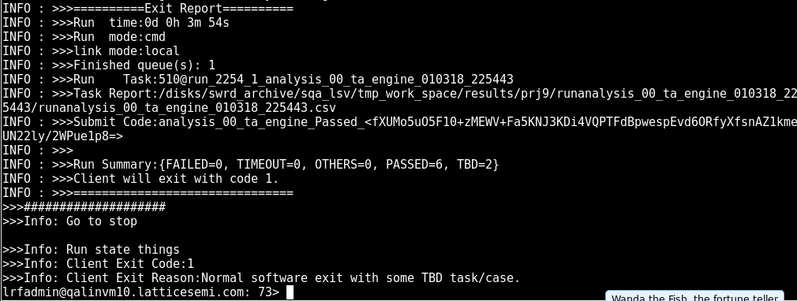
Result check – suite run
Report Path
Summary
Run ID
Final Result
File opened with report path:

Slide 7
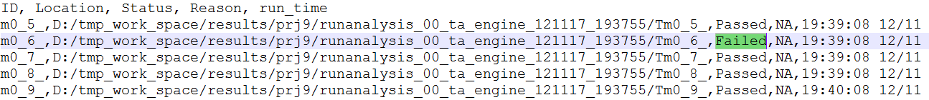
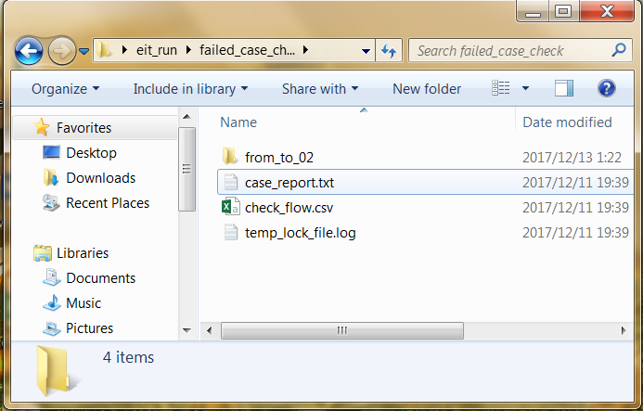
Result check – Filed case check steps
Steps:
Open the report file
Open failed case directory
Open ‘case_report.txt’ to see which check failed
Open ‘*.conf’ file in design to see what is the failed check doing
Manually check again
Demo

Slide 8
TMP client run demo
Linux:
Client Installed in: /disks/swrd_archive/sqa_lsv/test_management_platform/TMP_Client
Steps:
Copy /disks/swrd_archive/sqa_lsv/test_management_platform/launch_eit to your owned directory.
Go into launch_eit folder and find launch.demo file
View this file (this file is for your environment setting and launch command)
Run this file

Slide 9
Available EIT suites
Brian’s team:
analysis_00_ta_engine_all.xlsx --TA engine feature cover
flow_00_design_entry_all.xlsx --Over design flow: synthesis, map, par
impl_00_LSE_engine_lin.xlsx --LSE engine flow, attribute, option support
impl_00_LSE_engine_win.xlsx --LSE engine flow, attribute, option and functional support
Chih-Chung’s team:
constriant_10_flow_all.xlsx --Physical constraint cover for map, par
impl_01_mapar_engine_all.xlsx --Map, Par flow, option, report cover
Cindy’s team:
analysis_01_simulation_win.xlsx --simulation library cover
impl_02_bit_generate_all.xlsx --bitgen flow and option cover
silicon_02_thunderplus_all.xlsx --device primitive flow, sta cover
Dave’s team
impl_00_Synplify_engine_lin.xlsx --Synplify engine flow, fdc2ldc cover
impl_00_Synplify_engine_win.xlsx --Synplify engine flow, fdc2ldc and functional support
debug_10_reveal_inserter_all.xlsx --Reveal inserter flow support
Overall
misc_radiant_design_pool_all.xlsx --customer design general flow cover

Slide 10
Available EIT2 suites
Suite Name | Case Number | Typical Run Time | Run Threads | Available For
analysis_00_ta_engine_all.xlsx | 82 | 17min | 4 | Both
constriant_10_flow_all.xlsx | 42 | 10min | 4 | Both
debug_10_reveal_inserter_all.xlsx | 40 | 8min | 4 | Both
flow_00_design_entry_all.xlsx | 45 | 10min | 4 | Both
impl_00_LSE_engine_lin.xlsx | 189 | 50min | 4 | Linux
impl_00_Synplify_engine_lin.xlsx | 156 | 23min | 4 | Linux
impl_01_mapar_engine_all.xlsx | 23 | 7min | 4 | Both
impl_02_bit_generate_all.xlsx | 20 | 5min | 4 | Both
misc_radiant_design_pool_all.xlsx | 145 | 57min | 4 | Both
silicon_02_thunderplus_all.xlsx | 68 | 12min | 4 | Both
analysis_01_simulation_win.xlsx | 61 | 22min | 4 | Windows
impl_00_LSE_engine_win.xlsx | 136 | 40min | 4 | Windows
impl_00_Synplify_engine_win.xlsx | 136 | 40min | 4 | Windows

Slide 11
THANKS
Q&A

Slide 12
Appendix - Client Install on Windows
Install depend SW
SW location: /disks/swrd_archive/sqa_lsv/test_management_platform/depend_software
a) Python 2.7 and packages:
Install: python-2.7.16.msi and add Python install path in system environment ‘PATH’
Run: python registry.py (add python related info into system registry
Install: psutil-5.0.0.win32-py2.7.exe
Install: MySQL-python-1.2.5.win32-py2.7.exe
b) SVN 1.6
Install: Setup-Subversion-1.6.6.msi
2. Testing these install:
Type ‘python --version’ in console , it should be ‘2.7.x’
Type ‘svn --version’ in console, it should be ‘1.6.x’

Slide 13
Appendix - Client Install on Windows
3. Install Client:
SW location: /disks/swrd_archive/sqa_lsv/test_management_platform/client_build
Pick up different version:
.exe for Windows,
.run for Linux,
.tar.gz for all(unzip it will be ok)
4. Launch Client:
Go to your install path:
Double click ‘client.exe’ – will open TMP client without Console.
Double click ‘clientc.exe’ -- will open TMP client with Console for more debug info.

Slide 14
Appendix – Case work flow
Client will read the case info from Suite file and download the case to ‘work Space’ and run it then copy the run result to ‘Save Space’ if needed.
-w to set client work space
-s to client save space, if don’t need give the same value as -w
* Client will remember your setting, only first time need.
Suite File
Optional
depot
Work Space
Save Space

Slide 15
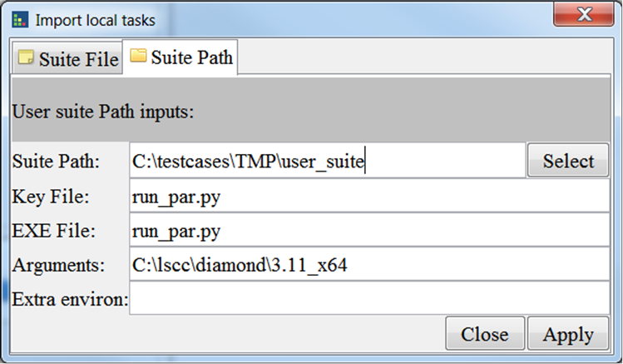
Appendix - Run user case
Format:
There is a run file in every case folder.
Run file exit code: 0: pass, 1:tbd, others: fail
Demo
Launch CMD:
Clientc.exe/client -c -l -p <suite_path> -k <key_file> -x <execute file> -a <arguments> -e <environments>
-k key file to make client consider the path is a case
-x execute file, support: py, pl, sh
-a arguments for the execute file
Launch GUI:

Slide 16
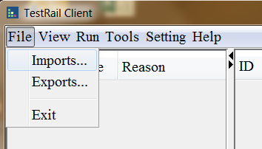
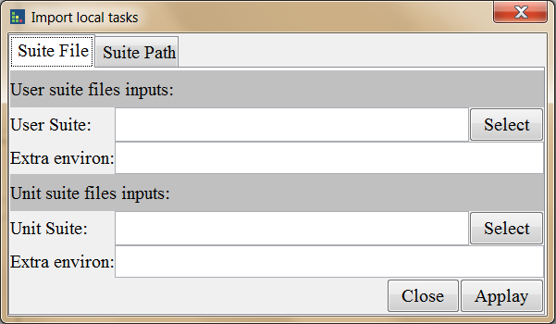
Appendix – Run EIT with GUI
1. Run client.exe on Windows and run client on Linux
2. Client “imports…” on top left
3. Select ‘Suite File’ tab
4. Give the value of ‘Unit Suite’
5. Give the extra environments: ENV=xxx, RTF=xxx
6. Click ‘Apply’

Slide 17
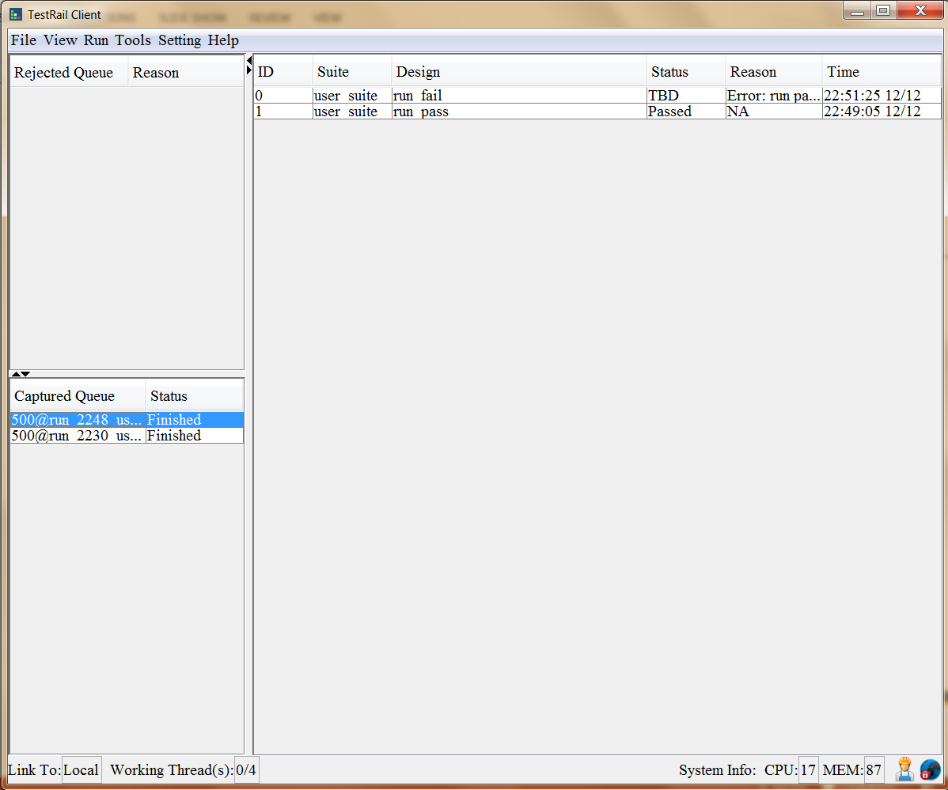
Appendix – Run EIT with GUI
Result Show
Double click the finished run
In GUI test you can retest the failed case

Slide 18
Appendix - Ready for integration:
Client will exit with:
0 : All test case passed or with .
1 : Some case failed with known issues.(QA filed CR already)
2 : Any case failed with unknown issues
#python
exit_sts = os.system(‘clientc.exe -c -l -i software -f $unit_path/radiant/analysis_00_ta_engine.xlsx’)
sys.exit(exit_sts)
#perl
exit exit_sts
#java
System.exit(exit_sts)

Slide 19
Appendix – Know issues
1. Currently EIT Case run with ENV/RTF not support Synplify and simulation flow.
-- we will contact with build team to find a solution

