Slide 1
TMP CLIENT LOCAL RUN
Jason Wang SW QA
Dec 2019

Slide 2
Agenda
SW EIT run updates
Command line launch for EIT suite
Run R&D Regression Suite on TMP Client
TMP client run demo
Q&A

Slide 3

Goal and Expectation
Goal:
Help SW DEV functional groups run R&D regression suites (All/partial) with TMP client on their local/remote machines before code check-in.
Expectation :
SW DEV can edit (add, delete and update) R&D regression suites and run them on local machine with TMP client

Slide 4
SW QA EIT run updates introduction
Previous issues:
EIT2 test case located in LSH server, developer cannot modify it.
EIT2 test case always run the whole impl flow, design flow could stop at synthesis while PAR developer don’t care it.
New updates:
TMP client support command line flow which allow us run individual engine test, such as LSE, timing, map or par
TMP client run with suite paths
TMP client run with P4 local path
TMP client run with case selection support

Slide 5
Command line launch <Prepare> <Win only>
Install depend SW
SW location: /disks/swrd_archive/sqa_lsv/test_management_platform/depend_software
a) Python 2.7 and packages:
Install: python-2.7.16.msi and add Python install path in system environment ‘PATH’
Run: python registry.py (add python related info into system registry
Install: psutil-5.0.0.win32-py2.7.exe
Install: MySQL-python-1.2.5.win32-py2.7.exe
b) SVN 1.6
Install: Setup-Subversion-1.6.6.msi
2. Testing the installation:
Type ‘python --version’ in console , it should be ‘2.7.x’
Type ‘svn --version’ in console, it should be ‘1.6.x’

Slide 6
Command line launch <Prepare> <Win only>
3. Install Client:
SW location:/disks/swrd_archive/sqa_lsv/test_management_platform/client_build
Pick up different version:
.exe for Windows,
.run for Linux,
.tar.gz for all(unzip it will be ok)
4. Launch Client:
Launch with Console:
open a console
type: ‘<TMP client install path>/bin/client
launch with GUI:
Go to your installation path
Double click ‘client.exe’ – will open TMP client without Console.
Double click ‘clientc.exe’ -- will open TMP client with Console for more debug info.

Slide 7
Command line launch <Win>
Test Environment:
set EXTERNAL_RADIANT_PATH=C:\lscc\radiant\2.0
or
set ENV=xxx
set RADIANT_RTF=xxx
set SYNPLIFY_PATH=xxx
Launch Environment:
unset PYTHONHOME
set PATH=x:/xx/svn_1.8/bin:${PATH}
set PATH=x:/xx/python-2.7.14/bin:${PATH}
set PATH=x:/xx/java/jre1.8.0_51/bin:${PATH}
set PATH=x:/xx/TMP_Client/bin:${PATH}
Launch Commands:
[old] clientc.exe -c -l -i software -f $unit_path/demo.xlsx
[new] clientc.exe -c -l -p x:/xx/eit_demo/jedi_place_30k
[new] clientc.exe -c -l -L x:/xx/eit_demo/suite_list.txt
-k key pattern for test case identify, default value is ‘run\..*’
-d The data file to record test case detail info, json format, i.e. {"level": 1}, default value is ‘bqs.data’
-S Task case sorting, format option1=value1;option2=value1,value2, demo: level=1
-K Keep the original directory tree structure
-t <number>, to specify how many threads to use
-w work space, where to run your cases, it’s better to assign a place with 5g+ space, Just for first time launch

Slide 8
Command line launch <Lin>
Test Environment:
setenv EXTERNAL_RADIANT_PATH /home/rel/ng2_0p.64/eit/lin/install
or
setenv ENV /home/rel/ng2_0p.64/env/fpga
setenv RADIANT_RTF /home/rel/ng2_0p.64/rtf
setenv SYNPLIFY_PATH /home/rel/ng2_0p.64/rtf/tptools/synplify/linux
Launch Environment:
unsetenv PYTHONHOME
setenv PATH /tools/dist/subversion/svn_1.8/bin:${PATH}
setenv PATH /tools/python/python-2.7.14/bin:${PATH}
setenv PATH /tools/java/jre1.8.0_51/bin:${PATH}
setenv PATH /disks/swrd_archive/sqa_lsv/test_management_platform/TMP_Client/bin:${PATH}
Launch Commands:
[old] client -c -l -i software -f \$unit_path/demo.xlsx
[new] client -c -l -p /disks/swrd_archive/sqa_lsv/test_management_platform/eit_demo/jedi_place_30k
[new] client -c -l -L /disks/swrd_archive/sqa_lsv/test_management_platform/eit_demo/suite_list.txt
-k key pattern for test case identify, default value is ‘run\..*’
-d The data file to record test case detail info, json format, i.e. {"level": 1}, default value is ‘bqs.data’
-S Task case sorting, format option1=value1;option2=value1,value2, demo: level=1
-K Keep the original directory tree structure
-t <number>, to specify how many threads to use
-w work space, where to run your cases, it’s better to assign a place with 5g+ space, Just for first time launch

Slide 9
Run R&D Regression Suite on TMP Client
1. Case build
Case Requirement:
demo_case/
bqs.data --optional, test case detail description for future case selection, json format
run.bat --must have one exec file, execute detail inside
xxx.ldc --design file, optional based on run command
xxx.udb --design file, optional based on run command
xxx.sv --design file, optional based on run command
…
*exec file should have a name of ‘run.<xx>’, here xx can be: bat, cmd, py, pl, sh, csh, TMP client search this file to identify a case in a given suite path.
Support exec type:
Win: .bat, .cmd, .py, .pl
Lin: .bat, .cmd, .py, .pl, .sh, .csh
*bat and cmd will be executed with bash on Linux
** windows created execute file use ‘dos’ format, cannot correctly read by Linux.
Result Processing:
TMP client will catch the return value of ‘run.xx’ execution.
0 : TMP show PASS
non 0 : TMP show FAIL
Demo

Slide 10
Run R&D Regression Suite on TMP Client
2. Save your case/suite
R&D Regression Root Directory
To P4
Local
cases
JEDI
APOLLO
Full Flow
(syn->bitgen)
LSE
STA
PAR
Postsyn & Map & Backanno
Synp Flow
LSE Flow
Area Mode
Timing Mode
Logic
Physical
Place
Route
Postsyn
Backanno
Dflt Mode
Place & Route
Map

Slide 11
Run R&D Regression Suite on TMP Client
3. Launch regression
Steps:
Get latest version of your case/suite from P4 (to your local disk)
Go into launch_eit folder
Make a copy of launch.suite_path/suite_list file
Update the suite path in launch.suite_path/suite_list (point to your regression suite download from P4)
Set environment in your console, like ‘setenv EXTERNAL_RADIANT_PATH /home/rel/ng2_0p.64/eit/lin/install’
Launch with ‘source launch.suite_path’ or ‘source launch.suite_list’
‘launch.suite_path’ allow you put one regression suite inside
‘launch.suite_list’ allow you put lots of regression suites inside

Slide 12
TMP client run demo
Linux:
Client ready on Linux side no more SW install
Client Installed in: /disks/swrd_archive/sqa_lsv/test_management_platform/TMP_Client
Steps:
Copy /disks/swrd_archive/sqa_lsv/test_management_platform/launch_eit to your owned directory.
Go into launch_eit folder
Set environment in your console, like ‘setenv EXTERNAL_RADIANT_PATH /home/rel/ng2_0p.64/eit/lin/install’
Launch suite path demo with ‘source launch.suite_path’
Launch suite lists demo with ‘source launch.suite_list’
You will get run reports in the console outputs
Demo

Slide 13
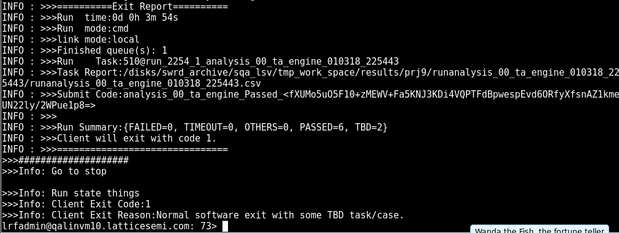
Result check – console report
After TMP Client completed the task it will output following report in console
Report Path
Summary
Run ID
Final Result
Details in report file:

Slide 14
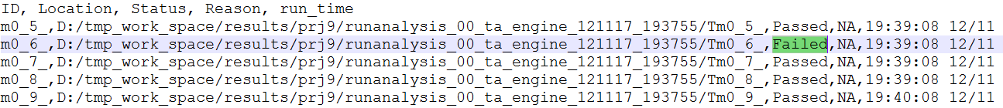
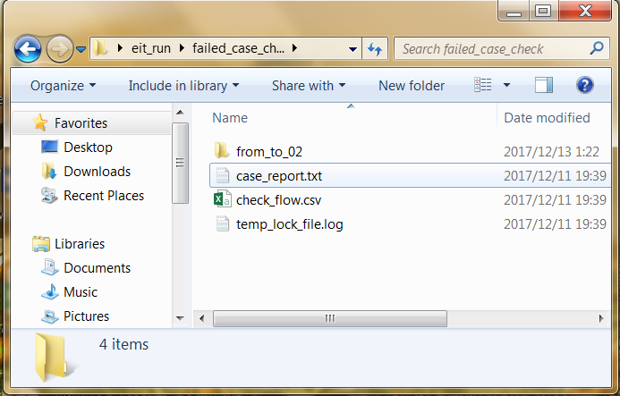
Result check – Filed case check steps
Steps:
Open the report file
Open failed case directory
Open ‘case_report.txt’ to see which check failed
Open ‘*.conf’ file in design to see what is the failed check doing
Manually check again

Slide 15
THANKS
Q&A

Slide 16
Appendix - EIT introduction
Key features:
Case information collection (where is the case and how to launch it)
Filed by QA focus on maximum coverage with minimum case number
Recognized and can be run by Client
Could be updated by Client
Real case located in LSH and maintained by QA
Same with webpage: http://linux-d50553/testrail/index.php?/plans/view/28871
Location:
<Client_install_path>/doc/TMP_EIT_suites
*we use $unit_path to represent this path in TMP client

Slide 17
Appendix - Available EIT suites
Brian’s team:
analysis_00_ta_engine.xlsx --TA engine feature cover
flow_00_design_entry.xlsx --Over design flow: synthesis, map, par
impl_00_LSE_engine.xlsx --LSE engine flow, attribute, option support
impl_00_LSE_engine.xlsx --LSE engine flow, attribute, option and functional support
Chih-Chung’s team:
constriant_10_flow.xlsx --Physical constraint cover for map, par
impl_01_mapar_engine.xlsx --Map, Par flow, option, report cover
Cindy’s team:
analysis_01_simulation.xlsx --simulation library cover
impl_02_bit_generate.xlsx --bitgen flow and option cover
silicon_02_thunderplus.xlsx --device primitive flow, sta cover
Dave’s team
impl_00_Synplify_engine.xlsx --Synplify engine flow, fdc2ldc cover
impl_00_Synplify_engine.xlsx --Synplify engine flow, fdc2ldc and functional support
debug_10_reveal_inserter.xlsx --Reveal inserter flow support
Overall
misc_radiant_design_pool.xlsx --customer design general flow cover

Slide 18
Appendix - Current EIT2 suite
Existing suites:
Suite Name | Case Number | Run Time | Comments
analysis_00_ta_engine.xlsx | 107 | 11 min | TA constraint cover, T+ and Jedi
analysis_01_simulation.xlsx | 59 | 12 min | Simulation flow cover, including Verilog and VHDL case, T+ and Jedi
constraint_10_flow.xlsx | 75 | 14 min | Constraint flow cover, T+ and Jedi
debug_10_reveal_inserter.xlsx | 81 | 10 min | Reveal flow cover, T+ and Jedi
flow_00_design_entry.xlsx | 56 | 10 min | Design entry cover, T+ and Jedi
impl_00_LSE_engine.xlsx | 86 | 16 min | LSE flow cover, post-syn simulation verification used. T+ and Jedi
impl_00_Synplify_engine.xlsx | 86 | 22 min | Synplify flow cover, post-syn simulation verification used. T+ and Jedi
impl_01_mapar_engine.xlsx | 33 | 7 min | MPAR flow and option cover, T+ and Jedi
impl_02_bit_generate.xlsx | 24 | 5 min | Bitgen flow and option cover, T+ and Jedi
impl_04_backanno.xlsx | 55 | 18 min | Post-syn, par backanno flow, simulation verification used. T+ and Jedi
impl_05_ibis.xlsx | 78 | 15 min | IBIS flow and output file verification, T+ and Jedi
misc_radiant_design_pool.xlsx | 84 | 30 min | Customer Case cover, limited device cover
pn_00_tcl_console.xlsx | 54 | 5 min | TCL flow cover, T+ and Jedi
silicon_01_softip.xlsx | 85 | 30 min | SoftIP cover, T+ and Jedi

Slide 19
Appendix - EIT2 suite update
New and Updated suites
Suite Name | Case Number | Run Time | Comments
silicon_02_thunderplus.xlsx | 42 | 12 min | Updated. Primitive flow and simulation cover
silicon_04_jedi.xlsx | 115 | 40 min | Updated. Primitive flow and simulation cover
silicon_05_Jedi_d2.xlsx | 96 | 50 min | New. Primitive flow and simulation cover
silicon_06_jedi_d1.xlsx | 56 | 30 min | New. Primitive flow and simulation cover
pn_20_project_navigator.xlsx | 7 | 7 min | New. PN GUI tools cover(open and no crash)
EIT2 Suites update summary:
Switch simulation tool from Active-HDL to Modelsim.
Apply same suite to both Windows and Linux.
Update Thunderplus and Jedi suites based on primitive cover.
Add Jedi-D1 and Jedi-D2 suites based on primitive cover.
Add PN suite for GUI tools cover.
Notes:
1. Run time updated based on 5 threads parallel run.

Slide 20
Appendix – Case work flow
Client will read the case info from Suite file and download the case to ‘work Space’ and run it then copy the run result to ‘Save Space’ if needed.
-w to set client work space
-s to client save space, if don’t need give the same value as -w
* Client will remember your setting, only first time need.
Suite File/Path
Optional
depot
Work Space
Save Space

Slide 21
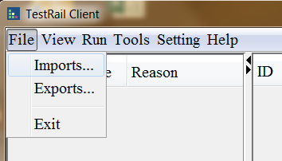
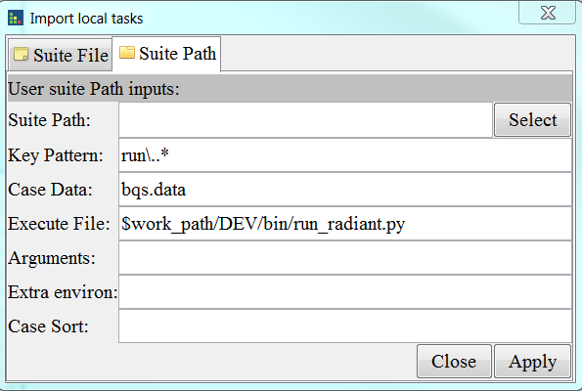
Appendix – Run with GUI
1. Run client.exe on Windows and run client on Linux
2. Client “imports…” on top left
3. Select ‘Suite File’ tab for suite file launch
4. Select ‘Suite Path’ tab for suite path launch
5. Give the value of ‘Suite Path’
6. Give the extra environments: ENV=xxx, RTF=xxx
7. Click ‘Apply’

Slide 22
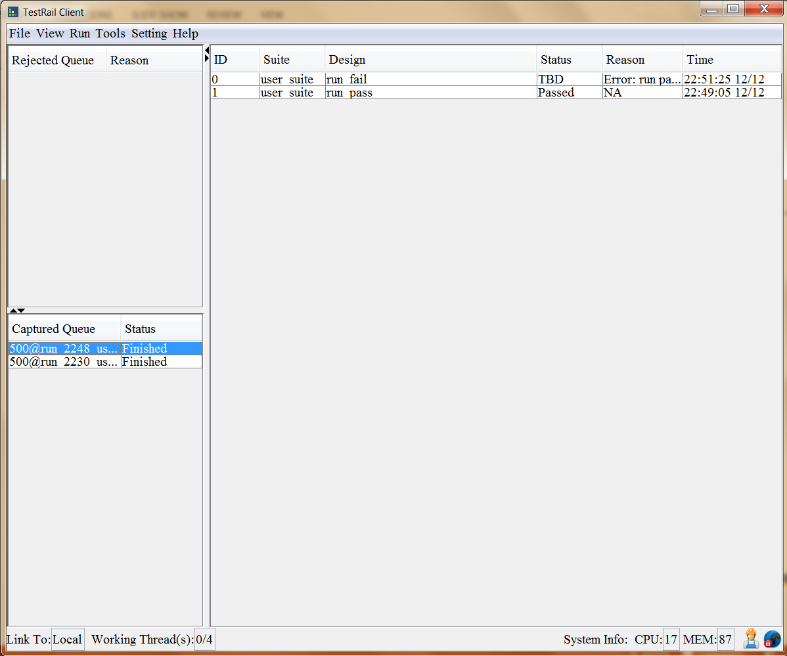
Appendix – Run EIT with GUI
Result Show
Double click the finished run
In GUI test you can retest the failed case

Slide 23
Appendix - Ready for integration:
Client will exit with:
0 : All test case passed or with .
1 : Some case failed with known issues.(QA filed CR already)
2 : Any case failed with unknown issues
#python
exit_sts = os.system(‘clientc.exe -c -l -i software -f $unit_path/analysis_00_ta_engine.xlsx’)
sys.exit(exit_sts)
#perl
exit exit_sts
#java
System.exit(exit_sts)

Slide 24
Appendix – Know issues
1. Currently EIT Case run with ENV/RTF not support simulation flow.

