Slide 1
QA QoR Implementation/Capability
Jason Wang SW QA
Mar 2024

Slide 2
Agenda
QA QoR implementation overview
Generic QoR
With iteration method
With pushbutton method
With fmax sweeping method
With seed sweeping method
Simulation QoR
Power QoR
Repeatability QoR
Q&A

Slide 3

QA QoR implementation overview
QA support QoR benchmarks:
Generic QoR -- General performance check for comparable Software or Devices
Simulation QoR -- Simulation performance check for comparable Simulators or modules
Power QoR -- General power consumption check for comparable Devices
Repeatability QoR -- Engine Stability check
QoR run location:
All QoR implementation are based on TMP platform, with the platform help we can run QoR designs with multiple machines and threads.
Standard machines: 10(win10)
Linux servers: 9 (Redhat/CentOS 7.9/8.8, Ubuntu20.04/22.04)
QoR existing resource:
Design/suite for implementation:
Avant: A26
Jedi & derivatives: E30, L26, S21
Jedi-D1: M29
Design/suite for simulation:
Avant: DDR/*, DSP/*, EBR/*, PLL/*, Slice/*
Jedi: DDR/*, DSP/*, EBR/*, PLL/*, Slice/*

Slide 4
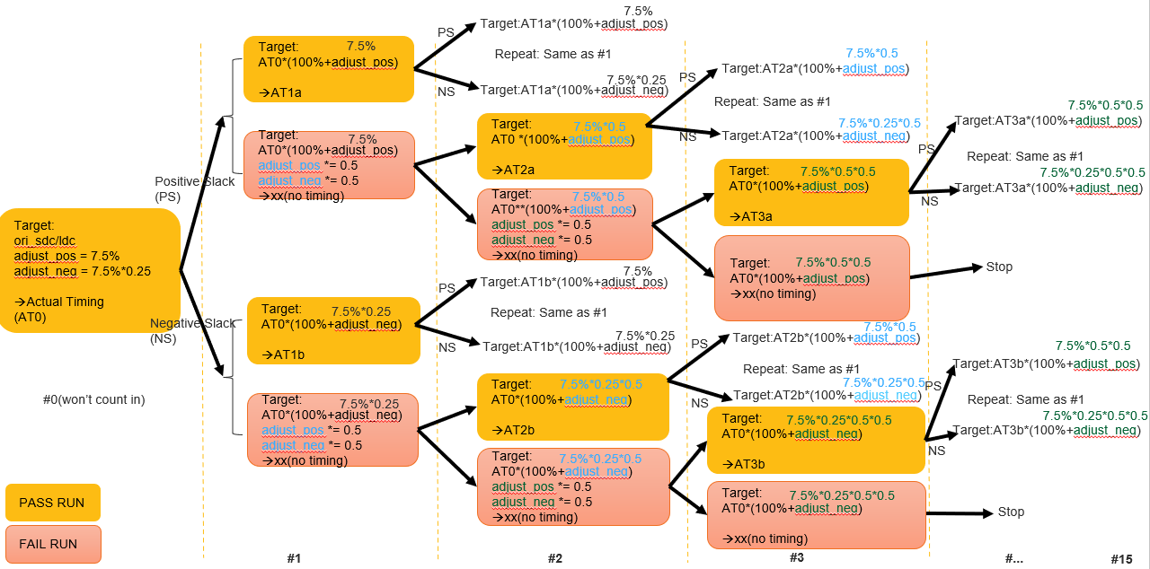
Generic QoR -- Iteration
Methods
“qor_iter” will run an initial result based on design constraint file and run following 15 additional ‘PAR-trace’(iterations) based on previous actual timing result plus adjustments
“qor_iter” is the default method for Avant Generic QoR
Details
Target areas:
Radiant version by version QoR benchmark for Avant
Standard runtime:
~50h (Suite:A26, Run both LSE and Syn, Run with TMP Linux machines)
Benchmark areas:
Performance: Geofmax
Resource: LUT4, Register, DSP, EBR
Runtime: Synthesis, Map, PAR runtime
Memory: Synthesis, Map, PAR memory usage
Notes:
Runtime reference: http://lsh-tmp/testrail/index.php?/runs/view/246719

Slide 5
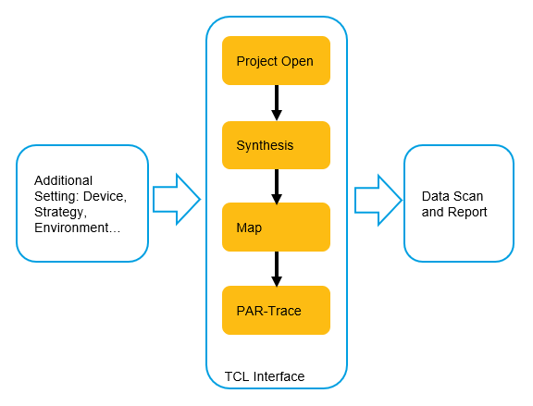
Generic QoR -- Pushbutton
Methods
For every test design(with constraints setted), platform will run design implementation flow and scan implementation results like area, performance, runtime, memory usage…
“qor_pushbutton” is the default method for non-Avant Generic QoR
Details
Target areas:
Radiant version by version QoR benchmark for Jedi related devices
Radiant synthesis tools LSE and Synplify QoR benchmark
Radiant engine wi/wo specific feature or environment QoR benchmark
Standard runtime:
~24h (Suite:Jedi: E30, L26, S21, Jedi-D1: M29, Run both LSE and Syn, Run with TMP Standard machines)
Benchmark areas:
Performance: Avgfmax
Resource: LUT4, Register, DSP, EBR
Runtime: Synthesis, Map, PAR runtime
Memory: Synthesis, Map, PAR memory usage
Notes:
Runtime reference: http://lsh-tmp/testrail/index.php?/runs/view/24221

Slide 6
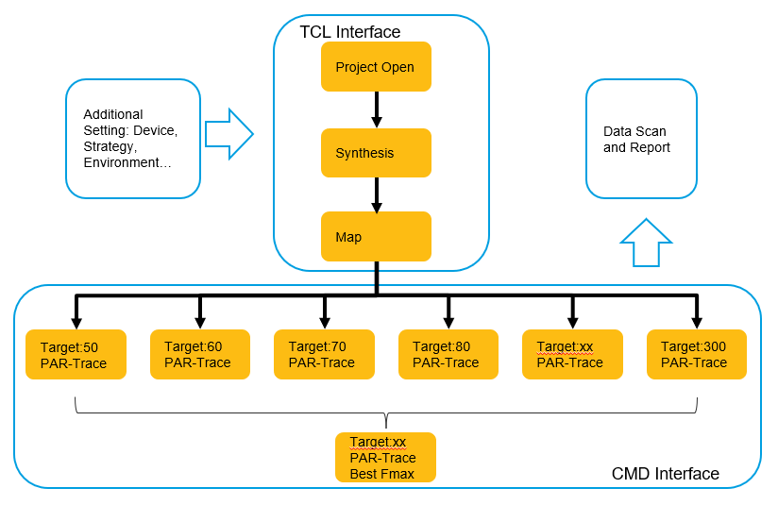
Generic QoR – Fmax Sweeping
Methods
For every test design(ignore timing constraints), platform will run design implementation flow to map, with this map result script launch a bunch of sweeping points with different target fmax and run PAR-trace. Usually, the sweeping point can be : 50,60,70,80,90,100,110,120,130,140,150,160,170,180,190,200,210,220,230,240,250,260,270,280,290,300. Total 26 points (run 26 PAR-trace).
Details
Target areas:
Radiant version by version QoR benchmark
Standard runtime:
No data
Benchmark areas:
Performance: Avgfmax
Resource: LUT4, Register, DSP, EBR
Runtime: Synthesis, Map, PAR runtime
Memory: Synthesis, Map, PAR memory usage

Slide 7
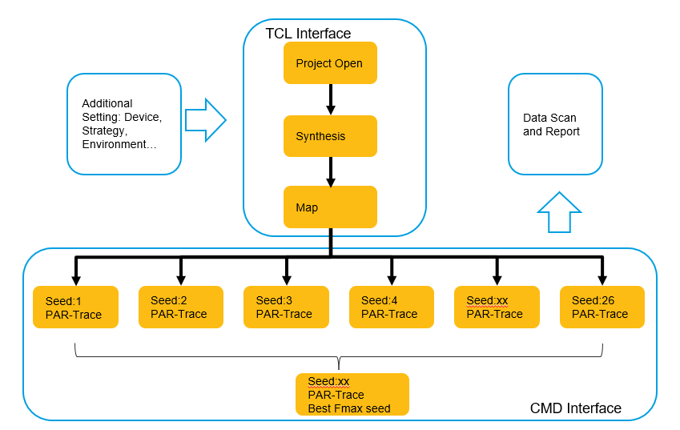
Generic QoR – Seed Sweeping
Methods
For every test design(ignore timing constraints), platform will run design implementation flow to map, with this map result script will launch a bunch of seed points with different start point for PAR-trace. Usually, the seed point can be: 1,2,3,4,5,6,7,8,9,10,11,12,13,14,15,16,17,18,19,20,21,22,23,24,25,26. Total 26 points (run 26 PAR-trace).
Details
Target areas:
Radiant version by version QoR benchmark
Standard runtime:
No data
Benchmark areas:
Performance: Avgfmax
Resource: LUT4, Register, DSP, EBR
Runtime: Synthesis, Map, PAR runtime
Memory: Synthesis, Map, PAR memory usage

Slide 8
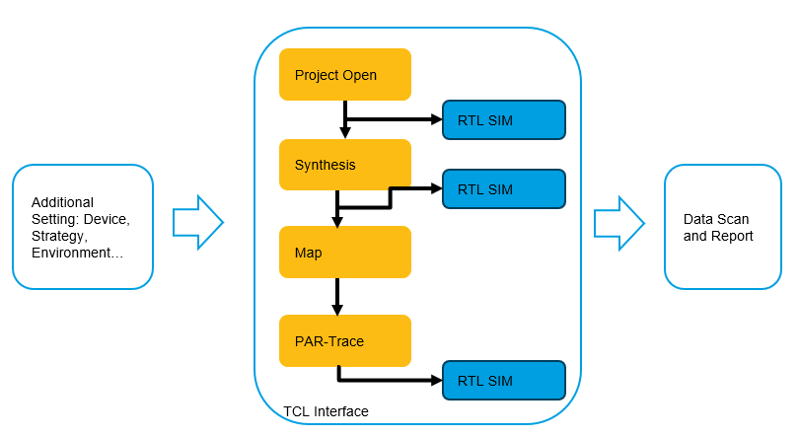
Simulation QoR
Methods
General simulation performance check for comparable simulator or modules.
A benchmark design will run RTL, Post-syn, Post-par simulation and extract data for comparison.
Details
Target areas:
Simulator version by version QoR benchmark
Simulation model version by version QoR benchmark
Different device simulation models QoR benchmark
Different simulators QoR benchmark
Standard runtime:
~8h(Jedi and Avant sim benchmark designs, Run with TMP Standard machines)
Benchmark areas:
Runtime: RTL, post-syn, post-par runtime
Notes:
Reference runtime: http://lsh-tmp/testrail/index.php?/runs/view/258123

Slide 9
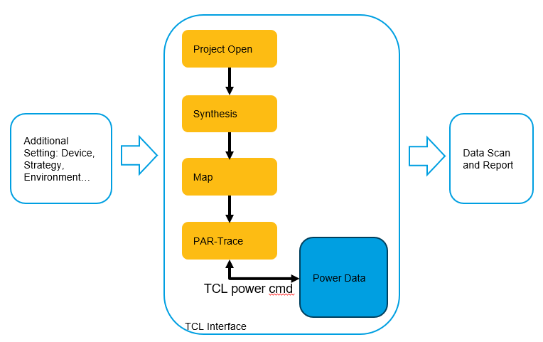
Power QoR
Methods
General power consumption check for comparable devices
A benchmark design will be run with fixed power setting and extract data for comparison.
Details
Target areas:
Power version by version QoR benchmark
Different tools and devices power QoR benchmark
Standard runtime:
~40h(Avant:A26, Run with TMP Standard machines)
Benchmark areas:
Power data: Dynamic, Static and Total Power
Power setting:
pwc_set_processtype "Typical"
pwc_set_ambienttemp 25
pwc_set_thetaja 4.25
pwc_set_af 12.5
pwc_set_freq -freq 0 -usefreqtwr 1 -freqtwropt pref
Notes:
Reference runtime: http://lsh-tmp/testrail/index.php?/runs/view/231031

Slide 10
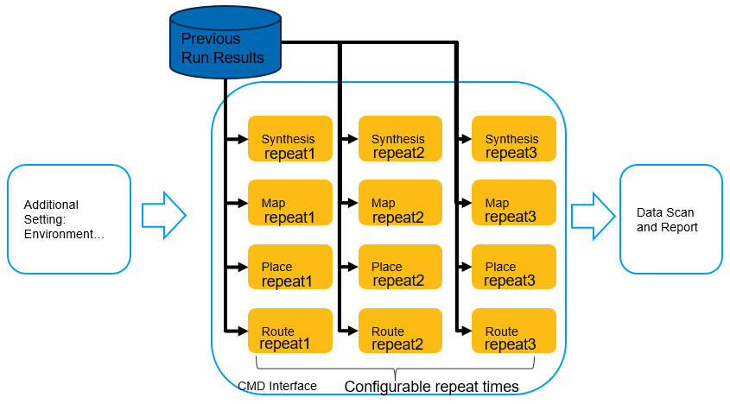
Repeatability QoR
Methods
This method can run one engine many times and dump the SHA1 code for engine's output file for future checking. To make sure the engine start from the same inputs, we prepared previous results(UDB file) for all stages(synthesis, map, place, route)
Details
Target areas:
Engine stability
Standard runtime:
Depends on the engine to be check
Benchmark areas:
Stability: hash data(SHA1) of generated file by engine.
Notes:
Reference runtime: http://lsh-tmp/testrail/index.php?/runs/view/231031

Slide 11
THANKS
Q&A

