Slide 1
Radiant EIT2 suites local run
Jason Wang SW QA
Nov 2018

Slide 2
Agenda
GUI test suites introduction
Run test suite
Result check
Q&A

Slide 3

Goal and Expectation
Goal:
Help LSH SW DEV functional groups run SW QA EIT2 cases(All/partial) with TMP client on their local/remote machines before code check-in.
Expectation :
LSH SW DEV can easily run EIT2 suite on local machine with special build.
LSH SW DEV start to run EIT2 suite before code check in.

Slide 4
LSH GUI test suites introduction
Test suite:
<Install_path>/doc/TMP_EIT_suites/pn_20_project_navigator_all.xlsx
Total run time:
About 8 minutes with one thread on Windows 10
Test case details:
Case | Info
tst_toolbar_new | click toolbar new button items (new file, new project)
tst_toolbar_open | click toolbar open button items(open file, open project, Open Archived Project)
tst_toolbar_tool | click toolbar tool buttons
tst_toolbar_view | click toolbar view buttons and detach/attach views
tst_Menu_view | click main menu View items
tst_example_counter | run example counter
tst_example_reveal | run example reveal

Slide 5
Software Preparation
1. Install dependence SW:
SW location: \\lsh-smb02\sw\qa\qa_store\TMP_tools\depend_software
a) Python 2.7 and packages:
Install: python-2.7.16.msi and add Python install path in system environment ‘PATH’
Run: python registry.py (add python related info into system registry
Install: psutil-5.0.0.win32-py2.7.exe
Install: MySQL-python-1.2.5.win32-py2.7.exe
b) SVN 1.6
Install: Setup-Subversion-1.6.6.msi
2. Test these installation:
Type ‘python --version’ in console , it should be ‘2.7.x’
Type ‘svn --version’ in console, it should be ‘1.6.x’
Open Squish IDE

Slide 6
Software Preparation
1. Install Client:
TMP Client: tmp_client_2xxxx_installer_bin_windows.exe
SW location: \\lsh-smb02\sw\qa\qa_store\TMP_tools\client_software
2. Launch Client:
Click ‘Windows menu’ -> ‘All Programs’ -> ‘TestRail Client’ -> ‘client’
Or
Go to your install path:
Double click ‘client.exe’ – will open TMP client without Console.
Double click ‘clientc.exe’ -- will open TMP client with Console for more debug info.

Slide 7
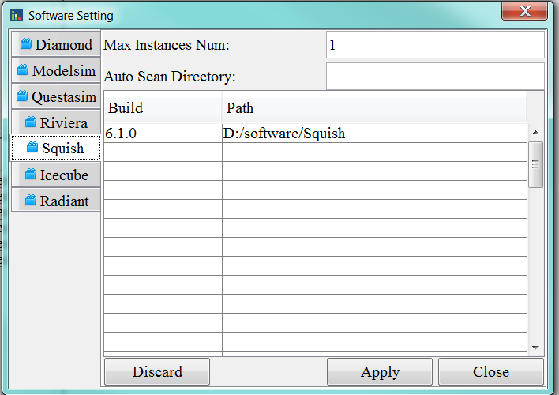
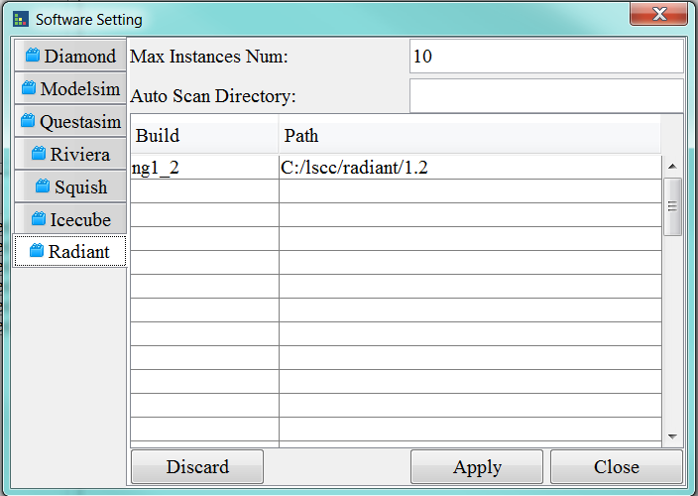
GUI - Client Software Setting
Set available Software by ‘Settings’ -> ‘Software…’
Radiant version: ng1_2 = <install_path>
Squish version:6.1.0 = <install_path>
*:Suite file has test case information and run requirements, TMP client check the available information and run matched tasks.

Slide 8
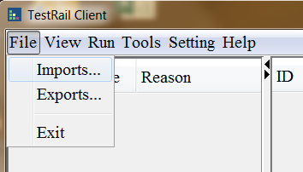
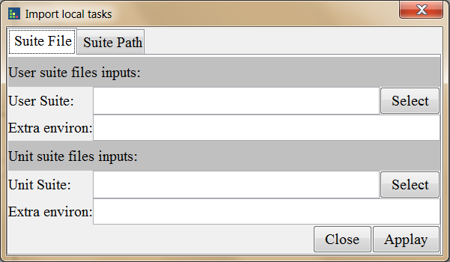
GUI - Launch EIT2 suites
Run client.exe on Windows
2. Client “imports…” on top left
3. Select ‘Suite File’ tab
4. Select “pn_20_project_navigator_all.xlsx”
for ‘Unit Suite’
5. Give the extra environments if need:
ENV=xxx, RTF=xxx
6. Click ‘Apply’

Slide 9
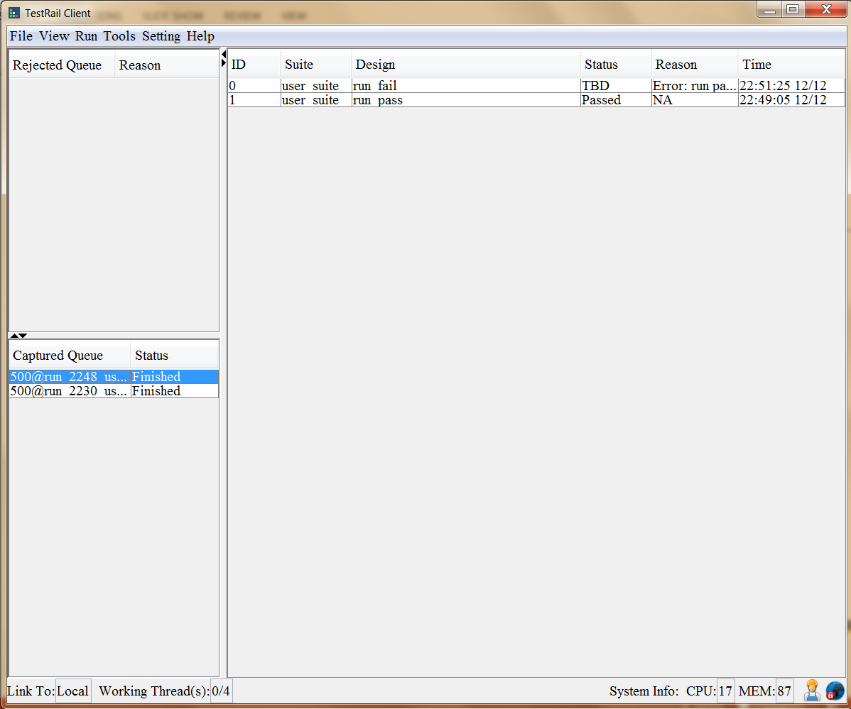
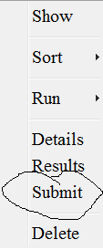
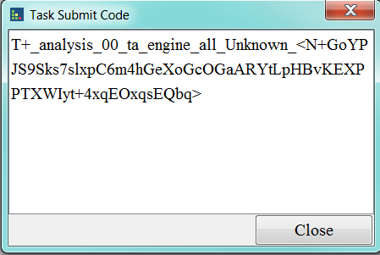
GUI – EIT2 suites running
Result Show
Double click the finished run
Right click to Get Submit
In GUI test you can retest the failed case

Slide 10
CMD – Launch EIT2 suites in console
Environment setting:
set EXTERNAL_RADIANT_PATH=C:/lscc/radiant/1.2
or
set ENV=/home/rel/ng1_1p.96/env
set RTF=/home/rel/ng1_1p.96/rtf
and
Set EXTERNAL_SQUISH_PATH= D:/software/Squish
Launch Command:
clientc.exe -c -l -i software -f $unit_path/pn_20_project_navigator_all.xlsx
*[-w <your prefer path>]
*:Just for first time launch
Use \$unit_path in Linux
-e <env1=value1, env2=value2>, to add environment in command line
-w work space, where to run your cases, it’s better to assign a place with 5g+ space

Slide 11
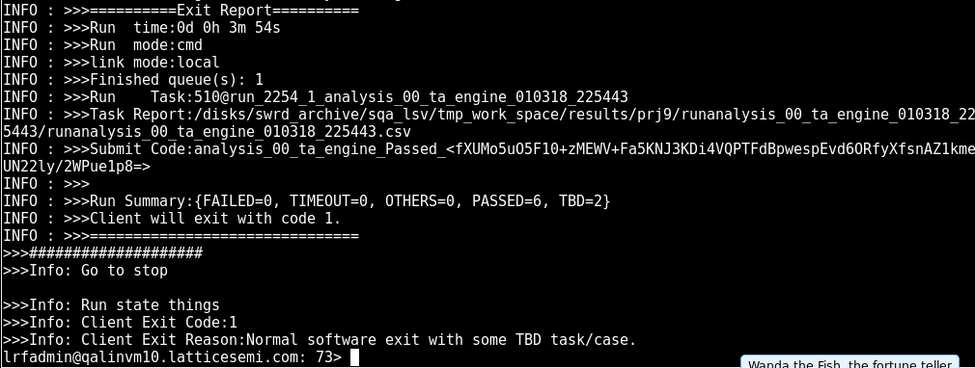
CMD – suite run in console
Report Path
Summary
Run ID
Final Result
File opened with report path:

Slide 12
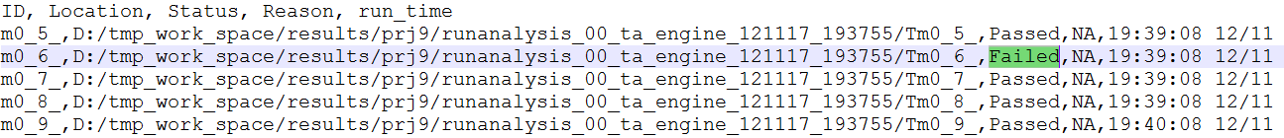
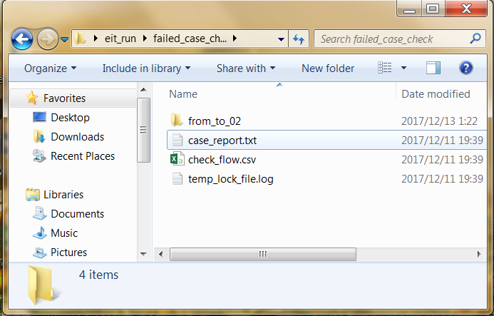
Result check – Filed case check steps
Steps:
Open the report file
Open failed case directory
Open ‘case_report.txt’ to see which check failed
Open ‘*.conf’ file in design to see what is the failed check doing
Manually check again
Demo

Slide 13
THANKS
Q&A

Slide 14
Appendix 1– Linux Software Prepare
1. Prepare environment:
Run command ‘source /lsh/sw/qa/lshqa/qa_home/qa_config/tmp.cshrc’
With this command you will get following things ready:
python linked to: /lsh/sw/qa/lshqa/qa_home/qa_tools/python27_64/bin/python
squish linked to: /lsh/sw/qa/lshqa/qa_home/qa_tools/squish6.1/squishide
‘tmp_client’ linked to: /lsh/sw/qa/lshqa/qa_home/qa_tools/TMP_Client/bin/client
Display setting: setenv DISPLAY XXXX:X.0
2. Open Squish GUI (Only for first time)
type ‘Squish’ in console and type the license into the GUI for the first time.(GGB-222K2-2SUJ3-26X)

Slide 15
Appendix 1– Linux EIT2 suite launch
Environment setting:
setenv EXTERNAL_RADIANT_PATH /home/rel/ng1_1p.96/eit/lin/install
or
setenv ENV /home/rel/ng1_1p.96/env
setenv RTF /home/rel/ng1_1p.96/rtf
and
setenv EXTERNAL_SQUISH_PATH /lsh/sw/qa/lshqa/qa_home/qa_tools/squish6.1
Launch Command:
tc -c -l -i software -f \$unit_path/pn_20_project_navigator_example.xlsx
*[-w <your prefer path>]
*:Just for first time launch
Use \$unit_path in Linux
-e <env1=value1, env2=value2>, to add environment in command line
-w work space, where to run your cases, it’s better to assign a place with 5g+ space
GUI suites:pn_20_project_navigator_example.xlsx, pn_20_project_navigator_menu.xlsx, pn_20_project_navigator_tool.xlsx

Slide 16
Appendix2 – Case work flow
Client will read the case info from Suite file and download the case to ‘work Space’ and run it then copy the run result to ‘Save Space’ if needed.
-w to set client work space
-s to client save space, if don’t need give the same value as -w
* Client will remember your setting, only first time need.
Suite File
Optional
depot
Work Space
Save Space

Slide 17
Appendix3 - Ready for integration:
Client will exit with:
0 : All test case passed or with .
1 : Some case failed with known issues.(QA filed CR already)
2 : Any case failed with unknown issues
#python
exit_sts = os.system(‘clientc.exe -c -l -i software -f $unit_path/analysis_00_ta_engine.xlsx’)
sys.exit(exit_sts)
#perl
exit exit_sts
#java
System.exit(exit_sts)

Slide 18
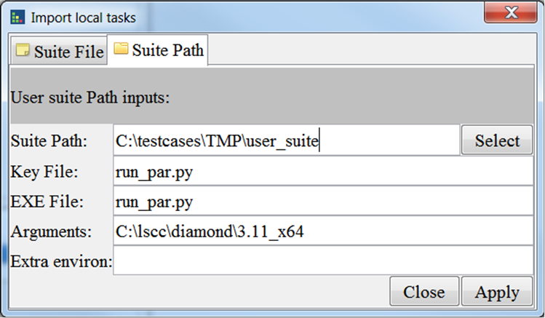
Appendix4 - Run user case
Format:
There is a run file in every case folder.
Run file exit code: 0: pass, 1:tbd, others: fail
Demo
Launch CMD:
Clientc.exe/client -c -l -p <suite_path> -k <key_file> -x <execute file> -a <arguments> -e <environments>
-k key file to make client consider the path is a case
-x execute file, support: py, pl, sh
-a arguments for the execute file
Launch GUI:

Slide 19
Appendix5 – Know issues
1. Currently EIT Case run with ENV/RTF not support Synplify and simulation flow.
-- we will contact with build team to find a solution

