Slide 1


Laboratory of Computational Soft Materials
Bonded Potentials of Coarse-Grained Polymer Models
Qiang (David) Wang
Department of Chemical and Biological Engineering
Colorado State University
q.wang@colostate.edu

Slide 2
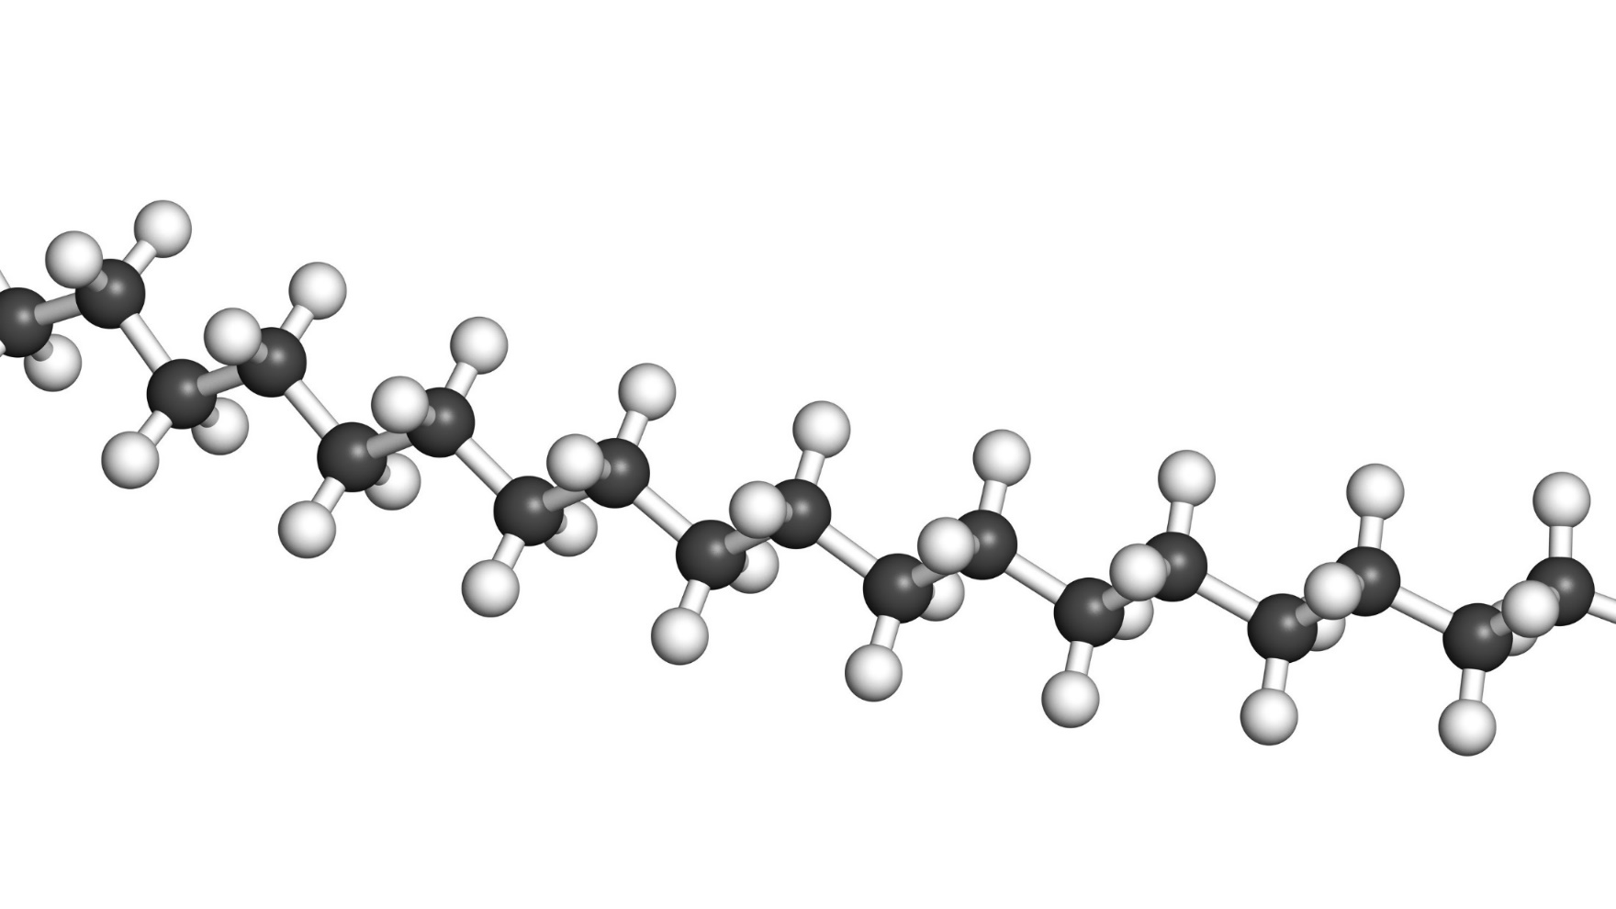
Introduction
Can we do better?
Analytical bonded potentials restricting the bond length, the bond angle, and the torsion angle among consecutive backbone atoms on the same chain are used in atomistic simulations.
Similar analytical bonded potentials are heuristically used in coarse-grained (CG) polymer models to reproduce, to some extent, only the local intrachain structures of CG segments.
Bonded and non-bonded CG potentials are usually determined sequentially, sometimes even independently.

Slide 3
Relative-Entropy-based Coarse Graining
of Homopolymer Melts*
*D. Yang and Q. Wang, Soft Matter 11, 7109 (2015).

Slide 4
Approach I
For simplicity, we use isotropic pair potentials v^{b}(r;λ^{b}) and v^{nb}(r;λ^{nb}) for the bonded and non-bond CG potentials, respectively, in a system of n chains at chain number density ρ_{c}, where each chain is coarse-grained as N segment.

Slide 5
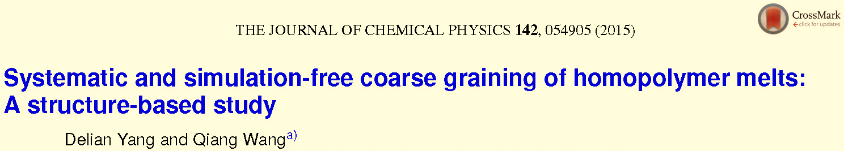
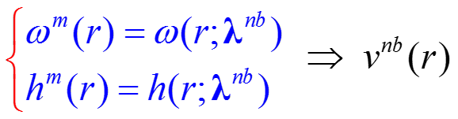
Approach I
For simplicity, we use isotropic pair potentials v^{b}(r;λ^{b}) and v^{nb}(r;λ^{nb}) for the bonded and non-bond CG potentials, respectively, in a system of n chains at chain number density ρ_{c}, where each chain is coarse-grained as N segment.
O(N²)
Structure-based coarse graining

Slide 6
Approach II
For simplicity, we use isotropic pair potentials v^{b}(r;λ^{b}) and v^{nb}(r;λ^{nb}) for the bonded and non-bond CG potentials, respectively, in a system of n chains at chain number density ρ_{c}, where each chain is coarse-grained as N segment.
{i^{b}} is a subset of m integers in [1,N−1]

Slide 7
Approach II
For simplicity, we use isotropic pair potentials v^{b}(r;λ^{b}) and v^{nb}(r;λ^{nb}) for the bonded and non-bond CG potentials, respectively, in a system of n chains at chain number density ρ_{c}, where each chain is coarse-grained as N segment.
m<N
Structure-based coarse graining

Slide 8
Approach II
For simplicity, we use isotropic pair potentials v^{b}(r;λ^{b}) and v^{nb}(r;λ^{nb}) for the bonded and non-bond CG potentials, respectively, in a system of n chains at chain number density ρ_{c}, where each chain is coarse-grained as N segment.
m<N
Structure-based coarse graining

Slide 9
An Example
9/14
−45/14
171/14
171/14
m=3
m<N
225/14
Structure-based coarse graining

Slide 10
An Example
9/14
−45/14
171/14
171/14
225/14

Slide 11
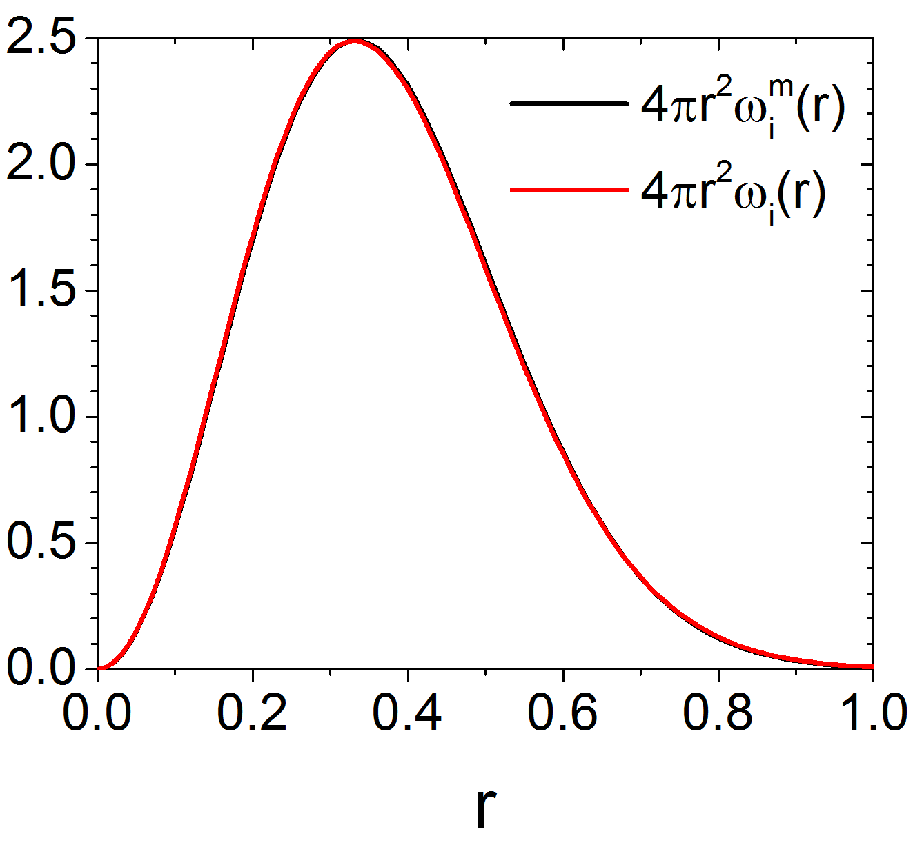
An Example
9/14
−45/14
171/14
171/14
225/14

Slide 12
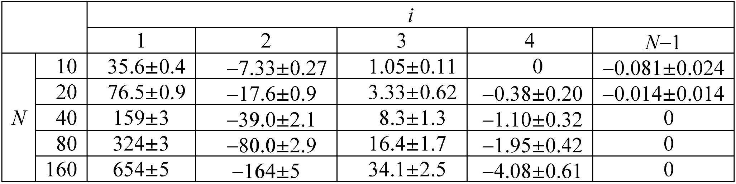
An Example

Slide 13
An Example

Slide 14
Summary
We have shown that the bonded coarse-grained potentials (taken to be isotropic pair potentials here), in the most commonly used structure-based coarse graining (which reproduces some distribution functions of the original system), need to reproduce the intrachain segment pair correlation functions at all length scales, and that the bonded and non-bonded coarse-grained potentials need to be determined simultaneously.
We have proposed several ways to achieve the above by combining theories and simulations, for the case where each coarse-grained segment represents the center-of-mass of a group of consecutive monomers on the same chain.

