Slide 1
How Multitasking Benefits QA Retrieval
F74096043 王駿杰
F74091035 黃念暉
指導教授 高宏宇

Slide 2
Wendy Lehnert [1] :
“ The ability to answer questions about a text is the strongest possible demonstration of text comprehension.”
---- The QA is a benchmark for Machine Comprehension.

Slide 3
Introduction
1.1 Outline and history
Decades ago, machine reading comprehension posed a significant challenge. However, in 2018, BERT[2] was introduced and revolutionized the field, becoming the state-of-the-art model in various tasks, including QA-retrieval.
Prior to the emergence of BERT, there were already several models designed for QA-retrieval, such as BiDAF[3], which was a significant milestone in the development of QA systems introduced in 2016.
In our approach, we refer to the paper "Question Answering on SQuAD 2.0 Dataset"[4], which proposes three model structures based on BERT embeddings and compares their performance with BiDAF. We adopt this reference to design our Multi-Task Learning structure, aiming to enhance the model's ability to classify whether the context contains the answer to a given question.

Slide 4
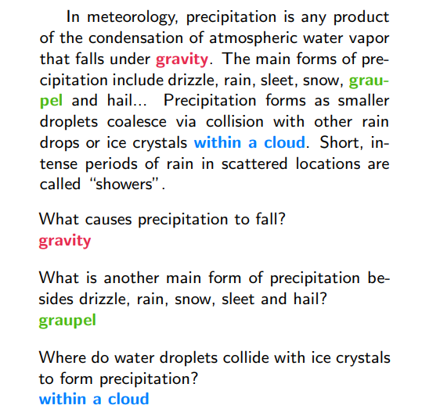
Introduction
1.2 Question answering retrieval
Given the context and question,
then retrieve the relevant answer for the question from the context.
Fig2, the example of QA-retrieval [7]

Slide 5
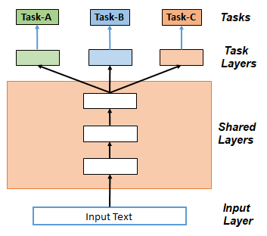
Introduction
1.3 Multi-Task Learning (MTL)
Leverage useful information on related tasks to achieve performance improvement on target tasks.
There are shared layers and task-specific layers in MTL.
Fig3, the concept of hard parameter sharing MTL

Slide 6
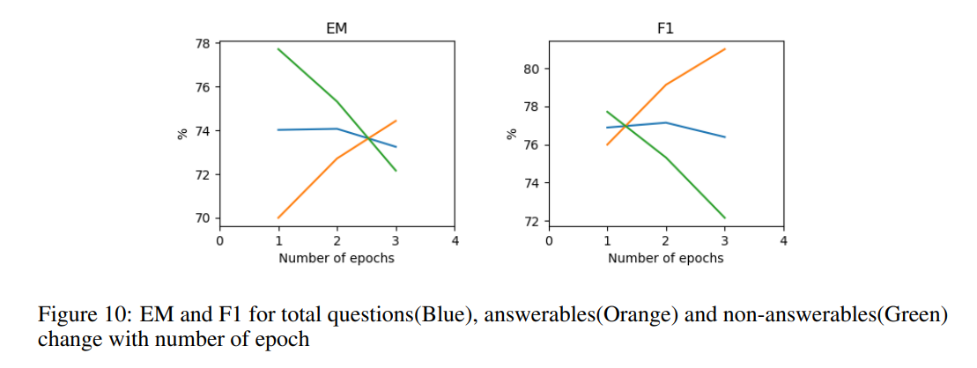
Improving Classifying (Un)answerable Q.
Fig1, Analysis in Question Answering on SQuAD 2.0 Dataset[4]
Goal: Increase the performance of classification in Squad 2.0
Answerable vs non-answerable questions[4], the analysis showed that the performance of the answerable question is improved while the performance for the unanswerable question dropped hugely. The research thought that it’s not an overfitting problem but a problem with weak [CLS] token to classify the unanswerable ones.
In the above, we tried some multitasking mechanism to help the model get more weight on the [CLS] token, also make sure that answerable questions work properly.

Slide 7
Improving Classifying (Un)answerable Q.
Main Method:
Inspired by BERT and the architecture in Multi-Task Learning in Natural Language Processing: An Overview[8], we tried to use self-attention to focus on [CLS] token
Self-attention allows the model to attend to relevant information and make accurate predictions for no-answer scenarios
Sub. Method (Abandoned):
Refer to Question Answering on SQuAD 2.0 Dataset[4] ,we built modeling layers for QA and supporting data while the classification of the answerable/unanswerable question was supported by the supporting data’s modeling layers.

Slide 8
Introduction
1.4 Dataset
Squad 2.0
In SQuAD 1.0, all questions are answerable, meaning there is a definite answer provided in the context passage. However, in SQuAD 2.0, the dataset includes both answerable and unanswerable questions. Unanswerable questions are accompanied by a placeholder answer, "no-answer," indicating that the answer is not present in the provided context passage.
GLUE Dataset
The text in the GLUE dataset is unprocessed and reflects real-world language use. It contains nuances, variations, and complexities that are representative of natural language. This realism helps models trained on GLUE to better generalize to real-world applications and perform well on unseen data.

Slide 9
Approach
CLF Modeling layer (Modeling layer for supporting data)
Original pooler output + Linear(the concatenation last 4 hidden states of BERT)
Highway Network with Bi-LSTM (Modeling layer for QA)
Captures contextual information and relationships between words
Allows bidirectional information flow
Inspired by Stanford research[4]
Self-Attention Structure
Addresses the defect in classifying no-answer data

Slide 10
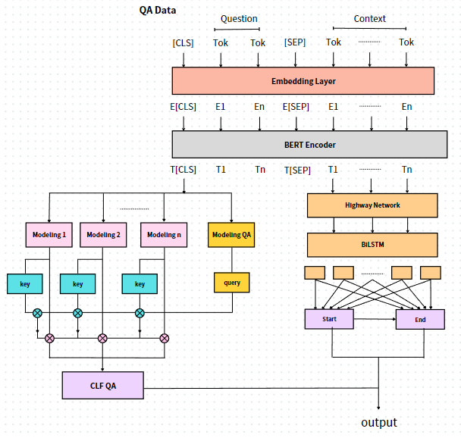
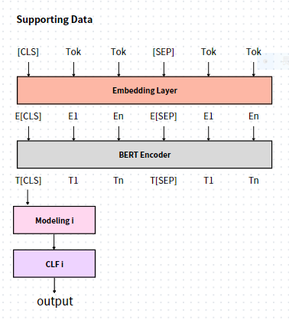
2.1 Training Framework
Two frameworks in Multi-Task learning process[5].
1: training supporting data
2: training target data
Fig4, training structure for supporting data
Fig5, training structure for target data

Slide 11
2.2 Supporting Data
Shared layer: Embedding, BERT Encoder
Specific layer: Modeling, Classifier
Input format : [CLS] sentence1 [SEP] sentence2
With the self-attention[6] in BERT Encoder, the model can find the relationship between two sentences.
The representation of the [CLS] token is extracted and combined with additional layers for further fine-tuning.
Fig4, training structure for supporting data

Slide 12
2.3 Target Data
Shared layer:
Embedding, BERT Encoder, Supporting Data Modeling
Specific layer: other
Input format: [CLS] question [SEP] context
Part1(left): identify if the context has the answer
Part2(right): determine the start and end position
Fig5, training structure for target data

Slide 13
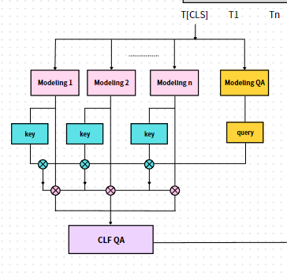
2.3.1 Target data Part1
N supporting data => N Modeling layers
=> N pairs of “key” and “value”
Using modeling QA to get the key, then do the
single-head self-attention to the N modeling results.
Ultimately, use the CLF QA to determine if the context has the answer.
2.3.2 Modeling Layer
Linear(Concatenate the last 4 hidden states in BERT Encoder)
+
BERT Pooler(T[CLS])
To get more information
Fig6, the part classify if the context has answer

Slide 14
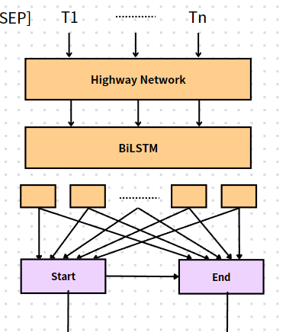
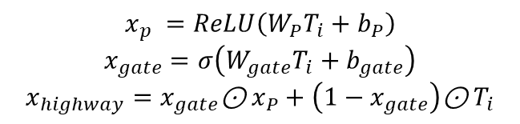

2.3.3 Target data Part2
Extract the representation of context $T_{i}$, fed into the Highway to refine the BERT-embedded representation and pass through the LSTM layer to get the new $T_{i}$.
$P_{i,start}=\frac{e^{ST_{i}}}{\sum_{j}{e^{ST_{j}}}}$ , $P_{i,end}=\frac{e^{ET_{i}}}{\sum_{j}{e^{ET_{j}}}}$
2.3.4 Highway Network + BiLSTM
Highway network :
$$x_{p} =ReLU\left(W_{P}T_{i}+b_{P}\right)$$
$$x_{gate}=σ\left(W_{gate}T_{i}+b_{gate}\right)$$
$$x_{highway}=x_{gate}\text{⊙}{ x}_{P}+\left(1−x_{gate}\right)\text{⊙}{ T}_{i}$$
BiLSTM :
Fig7, the part determines the answer’s start and end in context
{$b_{1}$, $b_{2}, ……,b_{L}$}$=BiLSTM(\{x_{1},x_{2}, ……x_{L}\})$

Slide 15
Experiment
3.1 Result of 70k SQuAD2.0 data training :
 | Has answer F1 score | No answer F1 score | Has answer accuracy | No answer accuracy
Vanilla | 0.6990 | 0.7695 | 0.8712 | 0.7610
MTL | 0.7031 | 0.7958 | 0.8818 | 0.7897
In our research, we have made multiple changes to the model structure and hyperparameters, and the table presented here is the results obtained under the final conditions.
Among all the experimental conditions we have tested, the performance of the Multi-Task Learning (MTL) approach consistently outperforms the Vanilla approach. However, it's important to note that we have only utilized 100,000 data points and trained 70,000 from the SQuAD dataset. The performance with larger training data is yet to be determined.

Slide 16
Experiment
3.2 Result of 7k SQuAD2.0 data training :
 | Has answer F1 score | No answer F1 score | Has answer accuracy | No answer accuracy
Vanilla | 0.5502 | 0.9772 | 0.8361 | 0.9715
MTL | 0.6980 | 0.7692 | 0.9229 | 0.7550
No answer recall
0.5581
0.6760
In this table, the results obtained using MTL are comparable to the results obtained from training with 70,000 data. This indicates that MTL enhances the model's understanding of the mutual relationship between two sentences, even though the support data only do the classification, it helps the model to retrieve text and get a higher f1 score.
On the other hand, the Vanilla model shows a significantly high score in No answer accuracy; however, its recall is considerably low. This is inconvenient if we expect the model to output relevant information in response to a question.

Slide 17
Experiment
3.3 example question comparison (70K training):
3.3.1 multi-hop question
context = "Sam walks into the kitchen. Sam picks up an apple.
Sam walks into the bedroom. Sam drops the apple."
question = "Where is the apple"
MTL: bedroom (has answer probabiliy: 0.9120)
Vanilla: sam picks up an apple. sam walks into the bedroom
(has answer probabiliy: 0.7799)

Slide 18
3.3.2 the punctuation effect
context = "After the 1980s, the use of the "Canadian Armed Forces" name gave way to "Canadian Forces";[citation needed] The "Canadian Armed Forces" name returned in 2013."
question = "What is the old name of the Canadian Forces?"
MTL: NO ANSWER (has answer probabiliy: 0.4855)
Vanilla: NO ANSWER (has answer probabiliy: 0.2459)
context = "After the 1980s, the use of the "Canadian Armed Forces" name gave way to "Canadian Forces“,[citation needed] The "Canadian Armed Forces" name returned in 2013."
question = "What is the old name of the Canadian Forces?"
MTL: “canadian armed forces” (has answer probabiliy: 0.5331)
Vanilla: NO ANSWER (has answer probabiliy: 0.2716)

Slide 19
The accurate response is "Canadian Armed Forces," while both models incorrectly output "NO ANSWER." However, the MTL model is closer to being correct because it has a higher probability of having an answer ("HA probability").
In addition to this example, we observe that when misclassifying questions that have an answer (meaning they are classified as having no answer), the MTL model typically has a higher probability of predicting HA. Conversely, when misclassifying questions that have no answer (meaning they are classified as having an answer), the MTL model usually has a lower probability of predicting HA. As a result, the MTL model performs the classification more accurately.
And in the above and below case, the below transfers the punctuation “;” to “,”, then the MTL predicts the question has the answer and outputs the answer correctly, implies punctuation can influence the prediction to some extent, but we cannot just replace all the “;” to “,” in data, in some condition, it may destroy the semantics.

Slide 20
3.3.3 hard question
context = "Snapshots usually become available more than six months after they are archived or, in some cases, even later; it can take twenty-four months or longer. The frequency of snapshots is variable, so not all tracked website updates are recorded. Sometimes there are intervals of several weeks or years between snapshots."
question = "What are the saved versions of a site called?"
MTL: NO ANSWER (has answer probabiliy: 0.2510)
Vanilla: NO ANSWER (has answer probabiliy: 0.2100)
This is too hard for the model to classify, if we want to improve the model’s ability to output the correct answer, we can consider employing a more powerful pre-trained model or training MTL utilizing a larger dataset.

Slide 21
Conclusion
In comparing the use of self-attention for multitasking in Squad 2.0 tasks with the absence of self-attention and multitasking, we observed a notable difference.
Specifically, the accuracy of the answerable and unanswerable questions in Squad 2.0 showed an increasing trend with each epoch in the former method, while the latter method exhibited a decrease or fluctuation in the accuracy of unanswerable questions.
This suggests that the presence of self-attention and multitasking in the model enhances the performance of the Squad 2.0 tasks, particularly in the classification between answerable and unanswerable questions, emphasizing the importance of the [CLS] token.

Slide 22
Reference
[1] WENDY LEHNER. Human and Computational Question Answering*. Yale University. 1977
[2] Jacob Devlin, Ming-Wei Chang, Kenton Lee, and Kristina Toutanova. Bert: Pre-training of deep bidirectional transformers for language understanding. 2018
[3] Jacob Devlin, Ming-Wei Chang, Kenton Lee, and Kristina Toutanova. Bert: Pre-training of deep bidirectional transformers for language understanding. 2018
[4] Yuanjun Li, Yuzhu Zhang. Question Answering on SQuAD 2.0 Dataset.
[5] Orion Weller*, Kevin Seppi, Matt Gardner. When to Use Multi-Task Learning vs Intermediate Fine-Tuning for Pre-Trained Encoder Transfer Learning. 2022
[6] Ashish Vaswani, Noam Shazeer, Niki Parmar, Jakob Uszkoreit, Llion Jones, Aidan N. Gomez, Lukasz Kaiser, Illia Polosukhin. Attention Is All You Need. 2017
[7] Pranav Rajpurkar, Jian Zhang, Konstantin Lopyrev, Percy Liang. SQuAD: 100,000+ Questions for Machine Comprehension of Text
[8] Shijie Chen, Yu Zhang, Qiang Yang. Multi-Task Learning in Natural Language Processing: An Overview. 2021

