Slide 1
How Multitasking Benefits QA Retrieval
F74096043 王駿杰
F74091035 黃念暉
指導教授 高宏宇

Slide 2
Wendy Lehnert [1] :
“ The ability to answer questions about a text is the strongest possible demonstration of text comprehension.”
---- The QA is a benchmark for Machine Comprehension.

Slide 3
Introduction
1.1 Outline and history
Decades ago, reading comprehension has been a challenging task for machines, then come in 2018, BERT[2] was born and revolutionized the landscape of it, became the state of the art in many tasks at that time, including the QA-retrieval.
But before the BERT appearance, there has been a variety of models to do the QA-retrieval task, BiDAF[3], was introduced in 2016 and served as a significant milestone in the development of QA systems.
The paper, “Question Answering on SQuAD 2.0 Dataset” [4], which proposed three self-designed model structures built on the BERT embeddings and compare its results with BiDAF, is taken as a reference to design our structure for Multi-Task learning to help the model improve the performance in classifying if the context has the answer for the question.

Slide 4
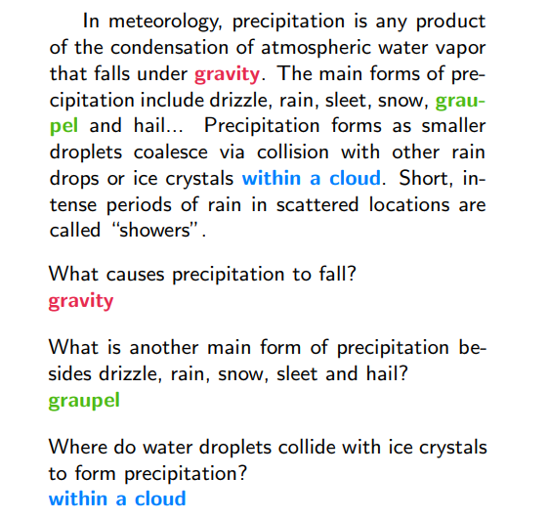
Introduction
1.2 Question answering retrieval
Given the context and question,
then retrieve the relevant answer for the question from the context.
Fig1, the example of QA-retrieval [7]

Slide 5
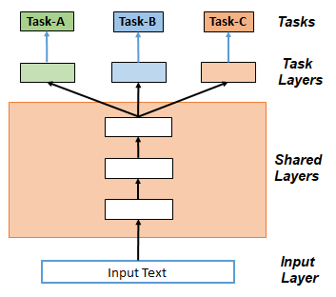
Introduction
1.3 Multi-Task Learning (MTL)
Leverage useful information on related tasks to achieve performance improvement on target tasks.
There are shared layers and task-specific layers in MTL.
Fig2, the concept of hard parameter sharing MTL

Slide 6
Introduction
1.4 Dataset
Squad 2.0
In SQuAD 1.0, all questions are answerable, meaning there is a definite answer provided in the context passage. However, in SQuAD 2.0, the dataset includes both answerable and unanswerable questions. Unanswerable questions are accompanied by a placeholder answer, "no-answer," indicating that the answer is not present in the provided context passage.
GLUE Dataset
The text in the GLUE dataset is unprocessed and reflects real-world language use. It contains nuances, variations, and complexities that are representative of natural language. This realism helps models trained on GLUE to better generalize to real-world applications and perform well on unseen data.

Slide 7
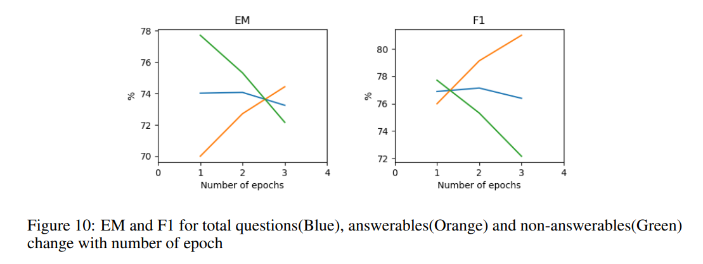
Improving Classifying (Un)answerable Q.
Fig3, Analysis in Question Answering on SQuAD 2.0 Dataset[4]
Goal: Increase the performance of classification in Squad 2.0
Answerable vs non-answerable questions[4], the analysis showed that the performance of the answerable question is improved while the performance for the unanswerable question dropped hugely. The research thought that it’s not an overfitting problem but a problem with weak [CLS] token to classify the unanswerable ones.
In the above, we tried some multitasking mechanism to help the model get more weight on the [CLS] token, also make sure that answerable questions work properly.

Slide 8
Improving Classifying (Un)answerable Q.
Main Method:
Inspired by BERT and the architecture in Multi-Task Learning in Natural Language Processing: An Overview[8], we tried to use self-attention to focus on [CLS] token
Self-attention allows the model to attend to relevant information and make accurate predictions for no-answer scenarios
Sub. Method (Abandoned):
Refer to Question Answering on SQuAD 2.0 Dataset[4] ,we built modeling layers for QA and supporting data while the classification of the answerable/unanswerable question was supported by the supporting data’s modeling layers.

Slide 9
Approach
CLF Modeling layer (Modeling layer for supporting data)
Original pooler output + Linear(the concatenation last 4 hidden states of BERT)
Highway Network with Bi-LSTM (Modeling layer for QA)
Captures contextual information and relationships between words
Allows bidirectional information flow
Inspired by Stanford research[4]
Self-Attention Structure
Addresses the defect in classifying no-answer data

Slide 10
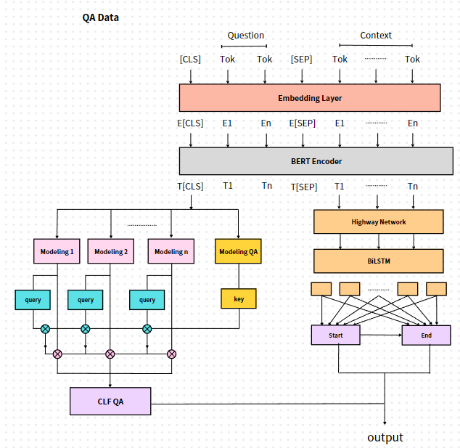
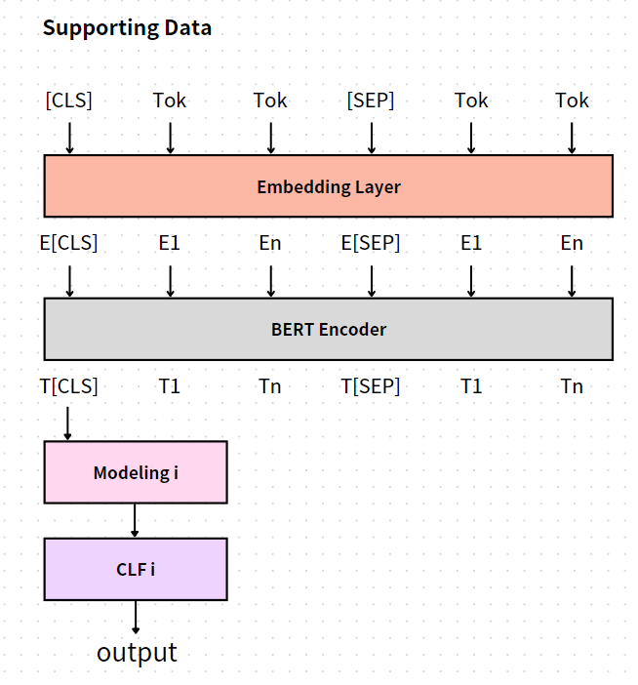
Approach
2.1 Training procedure
Two stages in the Multi-Task learning process[5].
1: training supporting data
2: training target data
Fig4, training structure for supporting data
Fig5, training structure for target data

Slide 11
Approach
2.2 Supporting Data
Shared layer: Embedding, BERT Encoder
Specific layer: Modeling, Classifier
Input format : [CLS] sentence1 [SEP] sentence2
With the self-attention[6] in BERT Encoder, the model can find the relationship between two sentences.
The representation of the [CLS] token is extracted and combined with additional layers for further fine-tuning.
Fig4, training structure for supporting data

Slide 12
Approach
2.3 Target Data
Shared layer:
Embedding, BERT Encoder, Supporting Data Modeling
Specific layer: other
Input format: [CLS] question [SEP] context
Part1(left): identify if the context has the answer
Part2(right): determine the start and end position
Fig5, training structure for target data

Slide 13
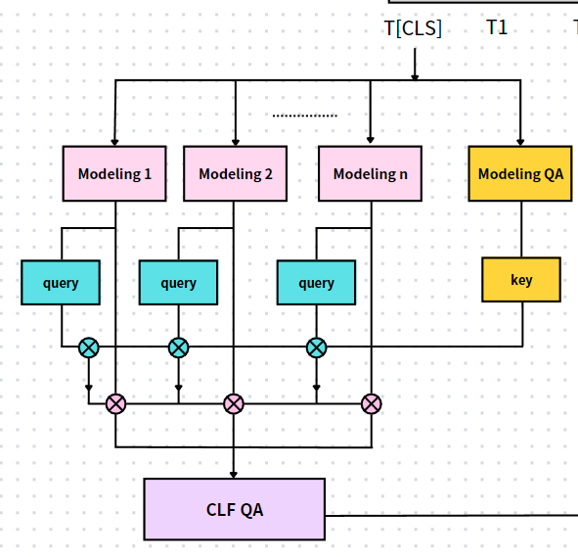
Approach
2.3.1 Target data Part1
N supporting data => N Modeling layers
=> N pairs of “query” and “value”
Using modeling QA to get the key, then do the
single-head self-attention to the N modeling results.
Ultimately, use the CLF QA to determine if the context has the answer.
2.3.2 Modeling Layer
Linear(Concatenate the last 4 hidden states in BERT Encoder)
+
BERT Pooler(T[CLS])
To get more information
Fig6, the part determine if the context has answer

Slide 14
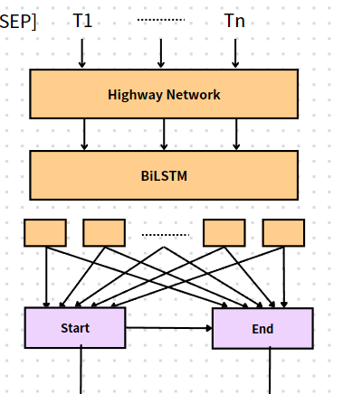
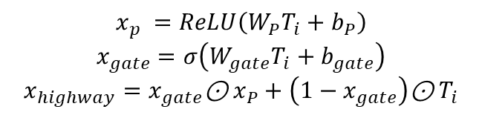

Approach
2.3.3 Target data Part2
Extract the representation of context $T_{i}$, fed into the Highway to refine the BERT-embedded representation and pass through the LSTM layer to get the new $T_{i}$.
$P_{i,start}=\frac{e^{ST_{i}}}{\sum_{j}{e^{ST_{j}}}}$ , $P_{i,end}=\frac{e^{ET_{i}}}{\sum_{j}{e^{ET_{j}}}}$
2.3.4 Highway Network + BiLSTM
Highway network :
$$x_{p} =ReLU\left(W_{P}T_{i}+b_{P}\right)$$
$$x_{gate}=σ\left(W_{gate}T_{i}+b_{gate}\right)$$
$$x_{highway}=x_{gate}\text{⊙}{ x}_{P}+\left(1−x_{gate}\right)\text{⊙}{ T}_{i}$$
BiLSTM :
Fig7, the part determines the answer’s start and end in context
{$b_{1}$, $b_{2}, ……,b_{L}$}$=BiLSTM(\{x_{1},x_{2}, ……x_{L}\})$

Slide 15
Results

Slide 16
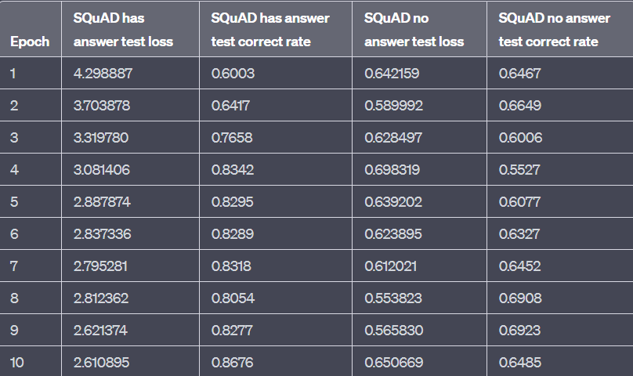
Compared with no-multitasking
From the chart, we can observe that the test correct rate fluctuates or worsens across all epochs.
The test loss for answerable questions consistently decreases, indicating that the model does not suffer from overfitting. However, the performance for unanswerable questions deteriorates.
Hence the Transformer may focus less on the attention associated with the [CLS] token.This observation aligns with the same analysis presented in the paper[4] ..
Fig8, test loss with answerable and unanswerable question without multitasking & self-attention

Slide 17
Conclusion
In comparing the use of self-attention for multitasking in Squad 2.0 tasks with the absence of self-attention and multitasking , we observed a notable difference. Specifically, the accuracy of the answerable and unanswerable questions in Squad 2.0 showed an increasing trend with each epoch in the former method, while the latter method exhibited a decrease or fluctuation in the accuracy of unanswerable questions.
This suggests that the presence of self-attention and multitasking in the model enhances the performance of the Squad 2.0 tasks, particularly in the classification between answerable and unanswerable questions, emphasizing the importance of the [CLS] token.

Slide 18
[1] WENDY LEHNER. Human and Computational Question Answering*. Yale University. 1977
[2] Jacob Devlin, Ming-Wei Chang, Kenton Lee, and Kristina Toutanova. Bert: Pre-training of deep bidirectional transformers for language understanding. 2018
[3] Jacob Devlin, Ming-Wei Chang, Kenton Lee, and Kristina Toutanova. Bert: Pre-training of deep bidirectional transformers for language understanding. 2018
[4] Yuanjun Li, Yuzhu Zhang. Question Answering on SQuAD 2.0 Dataset.
[5] Orion Weller*, Kevin Seppi, Matt Gardner. When to Use Multi-Task Learning vs Intermediate Fine-Tuning for Pre-Trained Encoder Transfer Learning. 2022
[6] Ashish Vaswani, Noam Shazeer, Niki Parmar, Jakob Uszkoreit, Llion Jones, Aidan N. Gomez, Lukasz Kaiser, Illia Polosukhin. Attention Is All You Need. 2017
[7] Pranav Rajpurkar, Jian Zhang, Konstantin Lopyrev, Percy Liang. SQuAD: 100,000+ Questions for Machine Comprehension of Text
[8] Shijie Chen, Yu Zhang, Qiang Yang. Multi-Task Learning in Natural Language Processing: An Overview. 2021

