Slide 1
Daito Manabe Presentation
Jiayi Wang

Slide 2
Who is Daito Manabe?
Japan's new media artist, also a software engineer, currently serves as Chairman of Rhizomatiks.

Slide 3
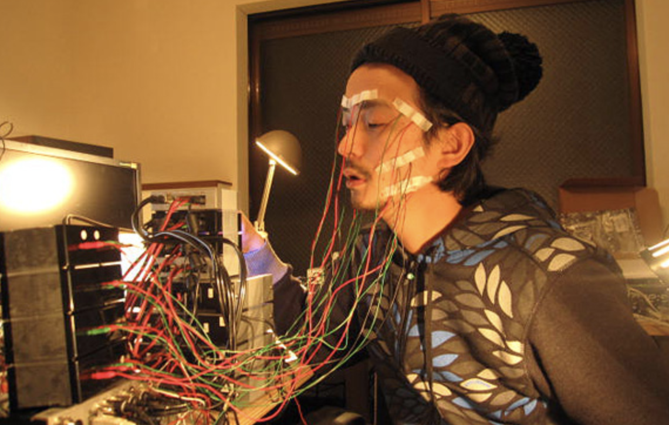
First achievements：Face Visualizer
Face Visualizer is facial muscles interact with the sound.
This is through the facial muscles covered with electromyographic sensors, recording facial muscles when the current stimulation of the different reactions, and then record the reaction, the electronic music.
https://www.youtube.com/watch?v=pLAma-lrJRM

Slide 4
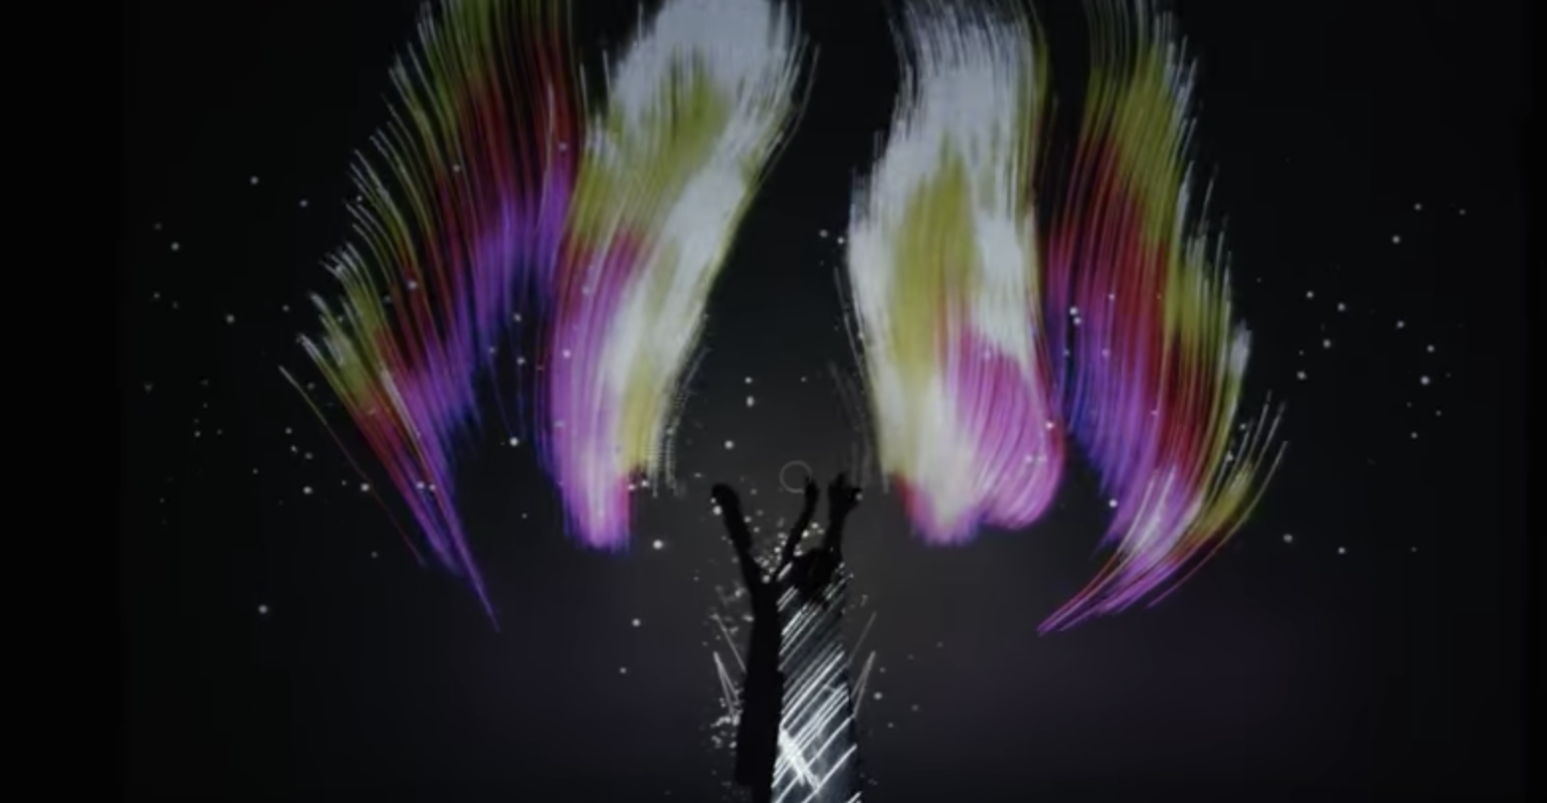
Second achievements： Audiovisual
https://www.youtube.com/watch?v=_woNBiIyOKI
He and his company use art to give audiences a great deal of audiovisual satisfaction, a feeling that is very different from that of traditional art.

Slide 5
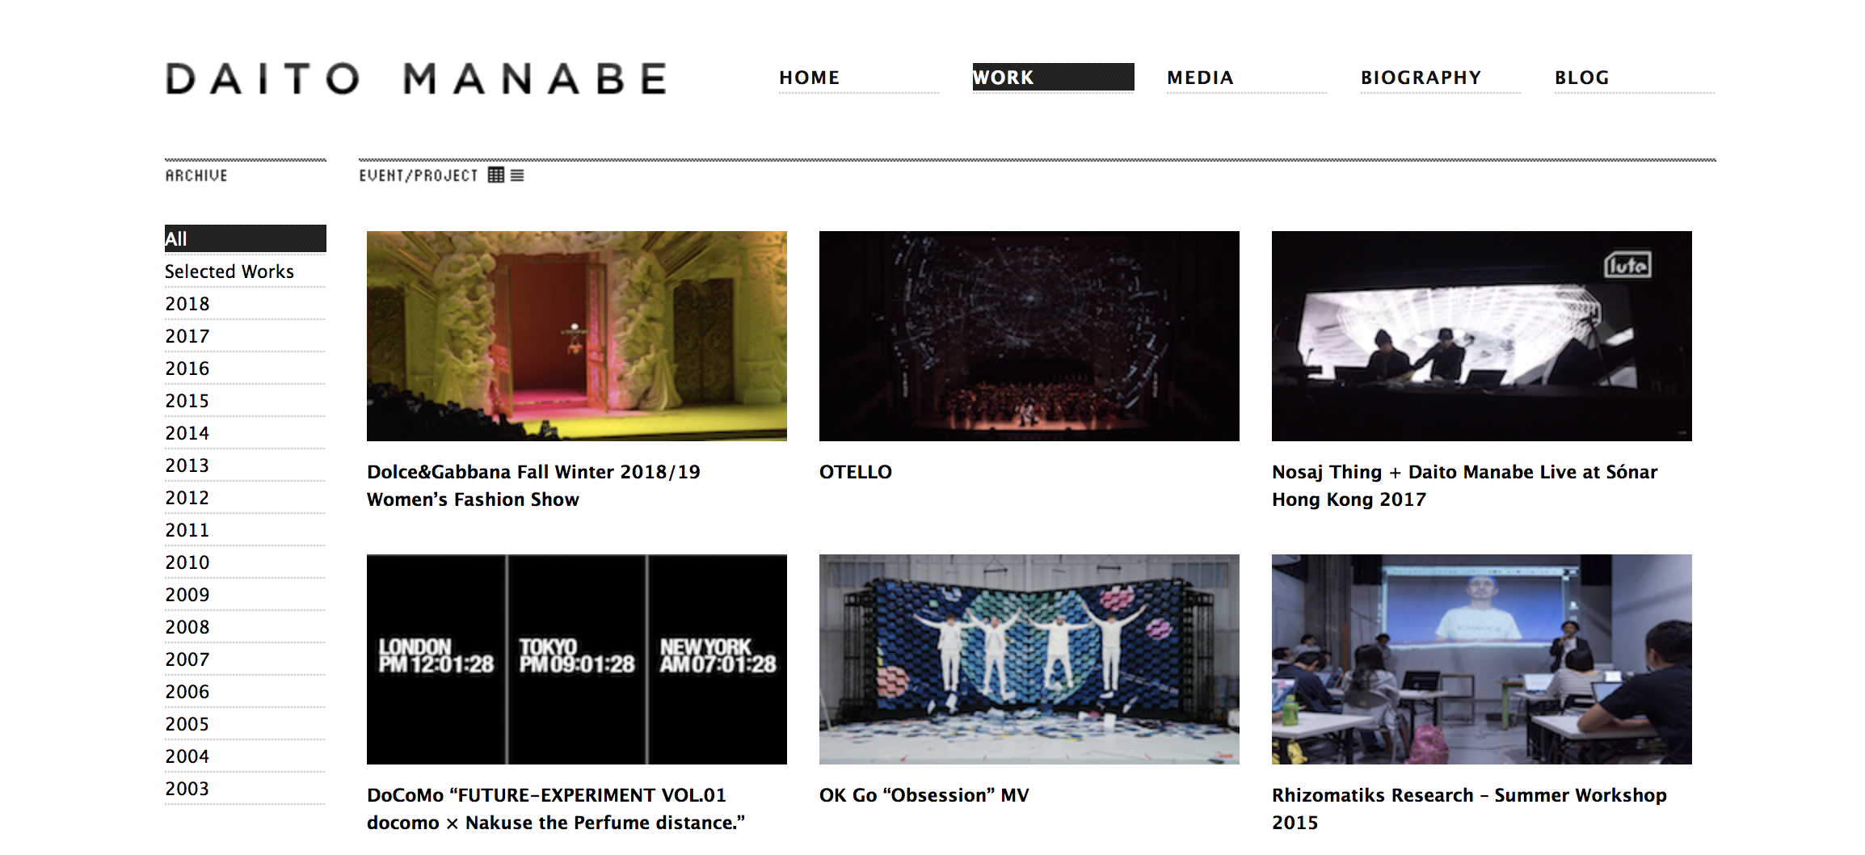
Daito Manabe‘s Website
He is good at using the phenomenon of the surrounding and different angles to observe the world. Then achieve his own works.
http://www.daito.ws/en/work/

Slide 6

Thank you

