Slide 1


Advanced Computer Network
Dr. Jin Wang
2024/8/21

Slide 2
Lectural
Tel: 13308859600
E-mail: wangjin@ynu.edu.cn
Github:
https://github.com/wangjin0818/Advanced_Computer_Network_2024
王津 教授

Slide 3
Welcome to this course
This project-based course will explore research topics in computer networking, primarily at the IP layer and above.
You will gain exposure to burgeoning areas of computer networking and learn how to use the tools commonly used for networking research today.
Thinking and doing.
All material can be

Slide 4
Syllabus
Chapter 1: Computer Networks and the Internet
Chapter 2: Application Layer
Chapter 3: Transport Layer
Chapter 4: The Network Layer
Chapter 5: The Link Layer: Links, Access Networks and LAN
Chapter 6: Wireless and Mobile Networks
Chapter 7: Multimedia Networking
Chapter 8: Security in Computer Networks

Slide 5
Knowledge you will learn
K1: Wireless Networks and 5G
K2: Encryption and Blockchain
K3: Multimedia Networking
K4: Distributed Hash Table and P2P Streaming
K5: Congestion Management
K6: Reliable Data Transfer
K7: Bellman-Ford Equation and RIP protocol
K8: Dijkstra Algorithm and OSPF protocol
K9: Software Defined Network （SDN）

Slide 6


Teaching material - Primary
Computer Networking: A Top-Down Approach
计算机网络： 自顶向下方法
8th edition，Jim Kurose, Keith Ross

Slide 7
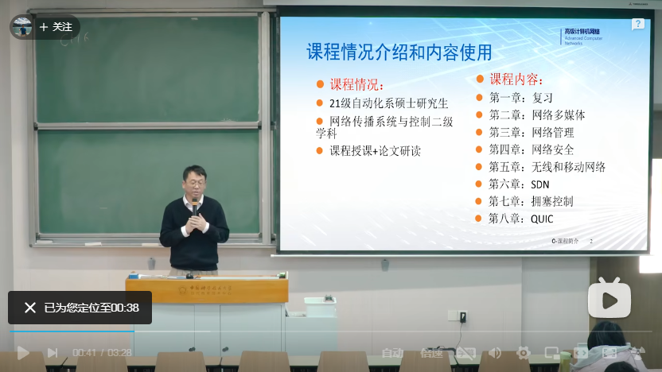
Teaching material - Supplement
高级计算机网络
中科大郑烇、杨坚
https://www.bilibili.com/video/BV1BL4y1J7vh/

Slide 8
Grading
Algorithm Implementation (20%)
Network Basics
Raw Sockets and Sniffing
Pretty Good Privacy (PGP) – How to implement a secure system online
Bellman-Ford Equation and RIP
Dijkstra Algorithm and OSPF
Course Project （Campus network simulation） (20%)
Final Exam (60%)
Attendence

Slide 9
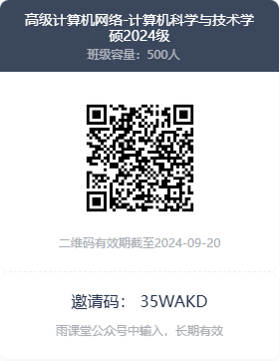
Code Submission
雨课堂提交
All codes are required to be written in Python.
Plagiarism is strictly prohibited
Both persons involved in plagiarism will have their grades cancelled

Slide 10
Tips
The PPT will be put on GitHub for every class, and the course progress will be very fast. It is necessary to preview and read relevant content in advance.
You are ALLOWED, and even ENCOURAGED to bring either laptop or tablet into the class.
It is strictly prohibited to use any type of mobile phone during class. Once discovered, the class will be marked as ABSENT.
One absence will result in a deduction 30% of the regular grade.

Slide 11
Environment Settings
Anaconda (https://www.anaconda.com/download/success)
Miniconda (https://docs.anaconda.com/miniconda/)
with virtual environment

Slide 12
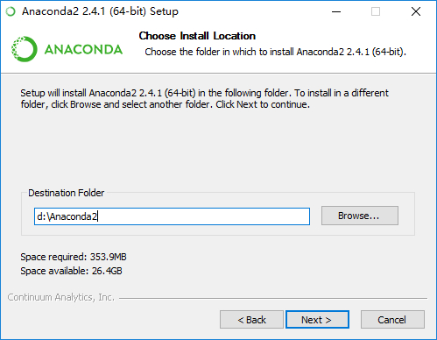
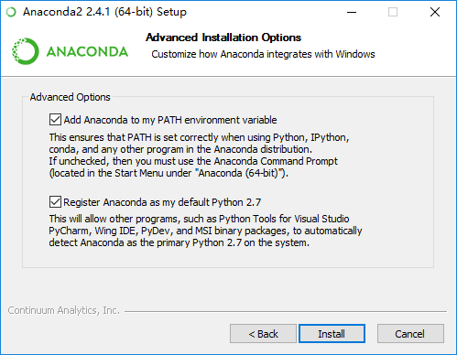
Environment Settings
Installation

Slide 13
Environment Settings
Create a virtual environment
Press “Win + R” and Run “miniconda”
Run “conda create –n network”

Slide 14
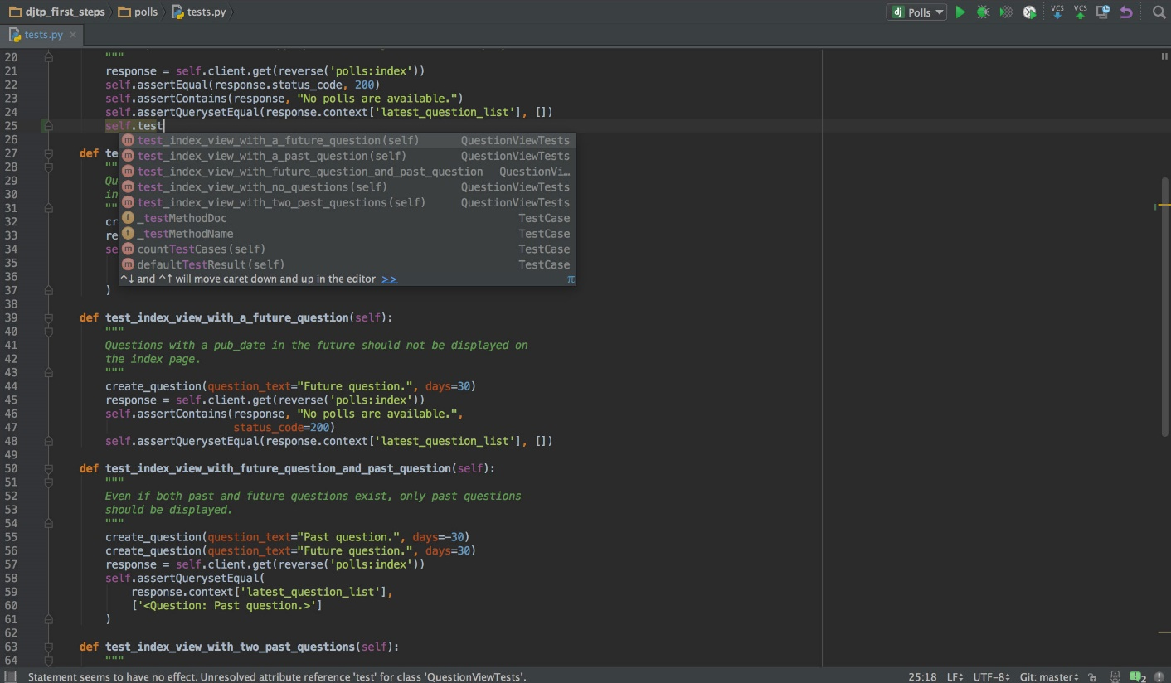
Integrated Development Environment
Pycharm (https://www.jetbrains.com/pycharm/)
通过企业微信注册云大邮箱，并申请免费License

Slide 15
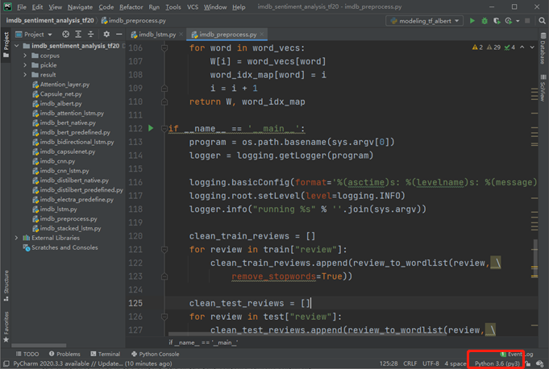
Integrated Development Environment
选择interpreter settings

Slide 16
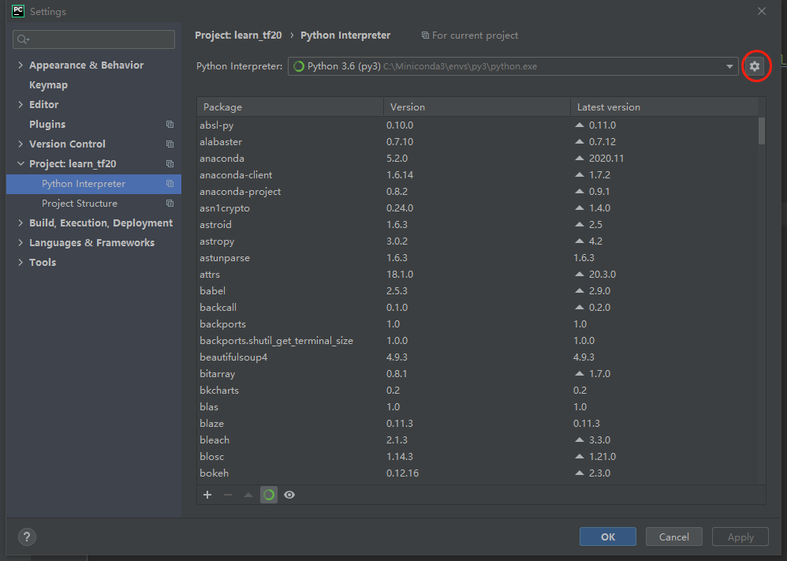
Integrated Development Environment
点击右侧齿轮符号，选择“Add…”

Slide 17
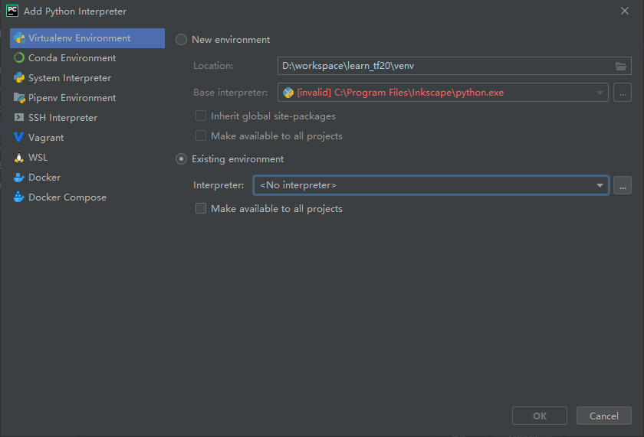
Integrated Development Environment
点击“Existing environment”
点击“…”，选择安装了anaconda的文件夹下的python.exe

