Slide 1
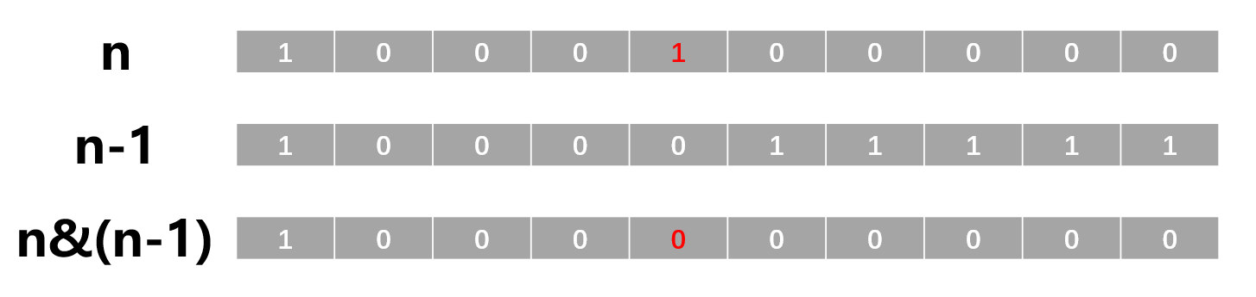
n
1 | 0 | 0 | 0 | 1 | 0 | 0 | 0 | 0 | 0
n-1
1 | 0 | 0 | 0 | 0 | 1 | 1 | 1 | 1 | 1
n&(n-1)
1 | 0 | 0 | 0 | 0 | 0 | 0 | 0 | 0 | 0

