Slide 1
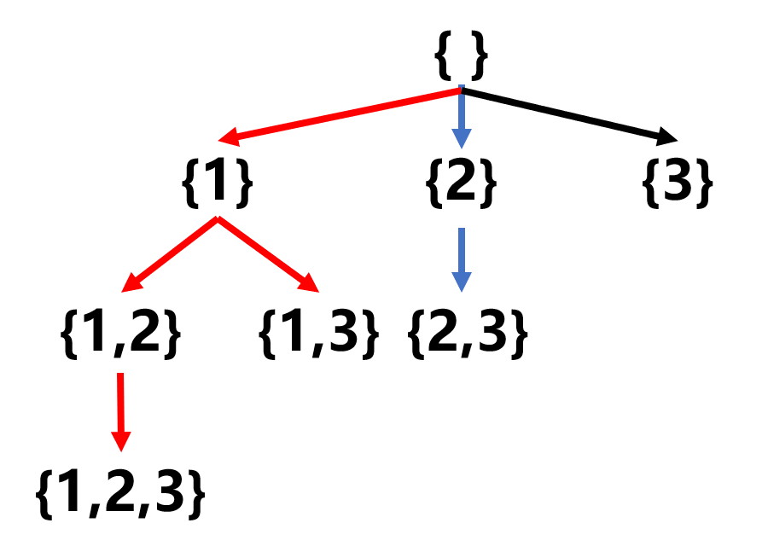
{ }
{1}
{2}
{3}
{1,2}
{1,3}
{2,3}
{1,2,3}

