Slide 1
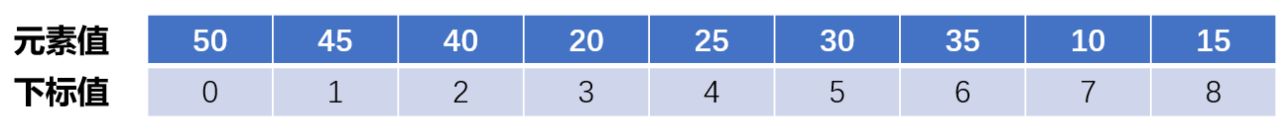
元素值
50 | 45 | 40 | 20 | 25 | 30 | 35 | 10 | 15
0 | 1 | 2 | 3 | 4 | 5 | 6 | 7 | 8
下标值

