Slide 1
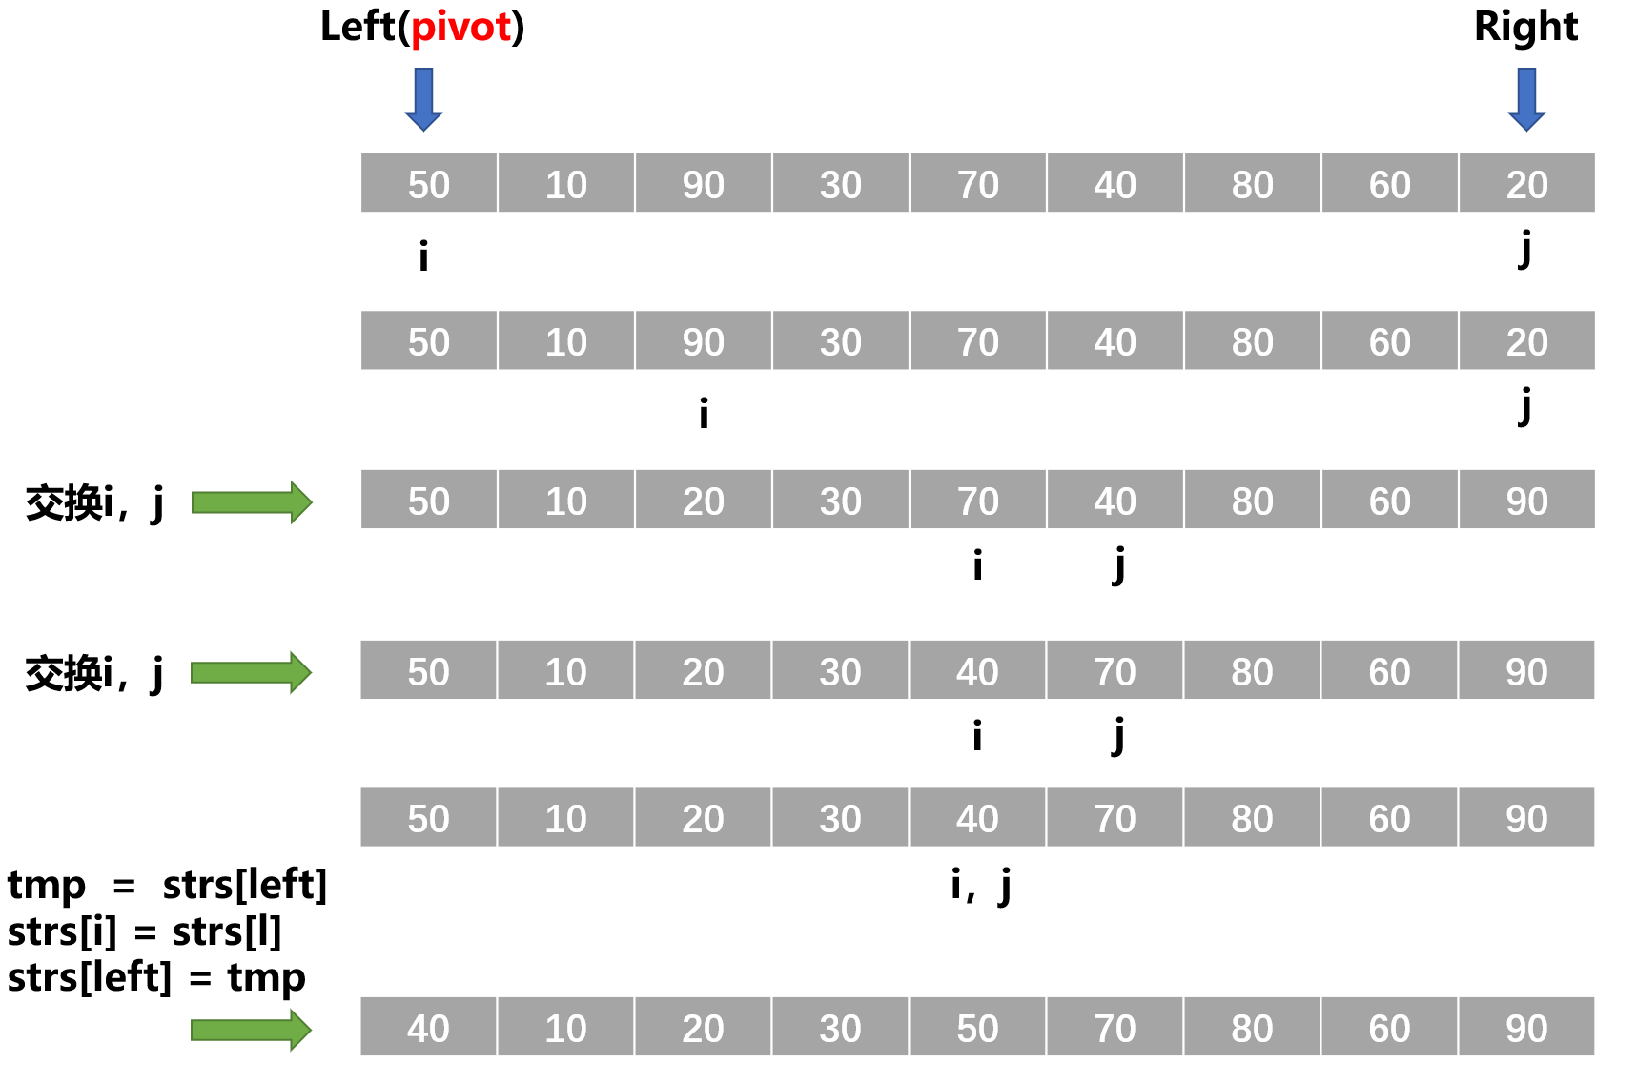
Left(pivot)
Right
50 | 10 | 90 | 30 | 70 | 40 | 80 | 60 | 20
i
j
50 | 10 | 90 | 30 | 70 | 40 | 80 | 60 | 20
i
j
交换i，j
50 | 10 | 20 | 30 | 70 | 40 | 80 | 60 | 90
i
j
交换i，j
50 | 10 | 20 | 30 | 40 | 70 | 80 | 60 | 90
i
j
50 | 10 | 20 | 30 | 40 | 70 | 80 | 60 | 90
tmp = strs[left]
strs[i] = strs[l]
strs[left] = tmp
i，j
40 | 10 | 20 | 30 | 50 | 70 | 80 | 60 | 90

