Slide 1
Beyond Monte Carlo Tree Search: Playing Go with Deep Alternative Neural Network and Long-Term Evaluation
Jinzhuo Wang, WenminWang, Ronggang Wang, Wen Gao
School of Electronics and Computer Engineering, Peking University
Proceedings of the Thirtieth AAAI Conference on Artificial Intelligence (AAAI-17)

Slide 2
Outline
Introduction of Computer Go
Motivation
Monte Carlo Tree Search
How Experts Play
Standard CNNs for Computer Go
The Proposed System
Evaluation
Discussion

Slide 3
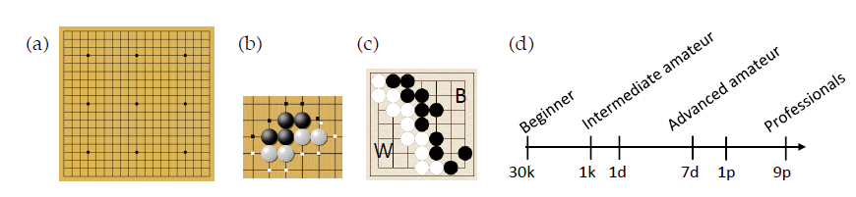
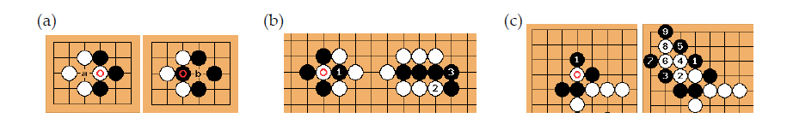
Introduction of Computer Go
Solution evolutions
Human knowledge + Rules -> only Rules

Slide 4
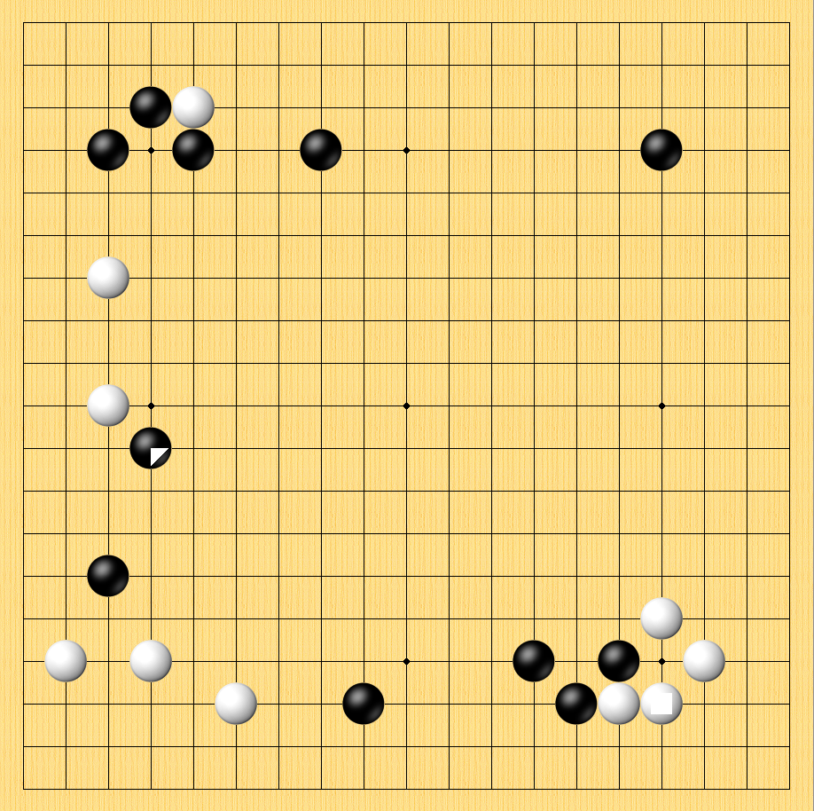
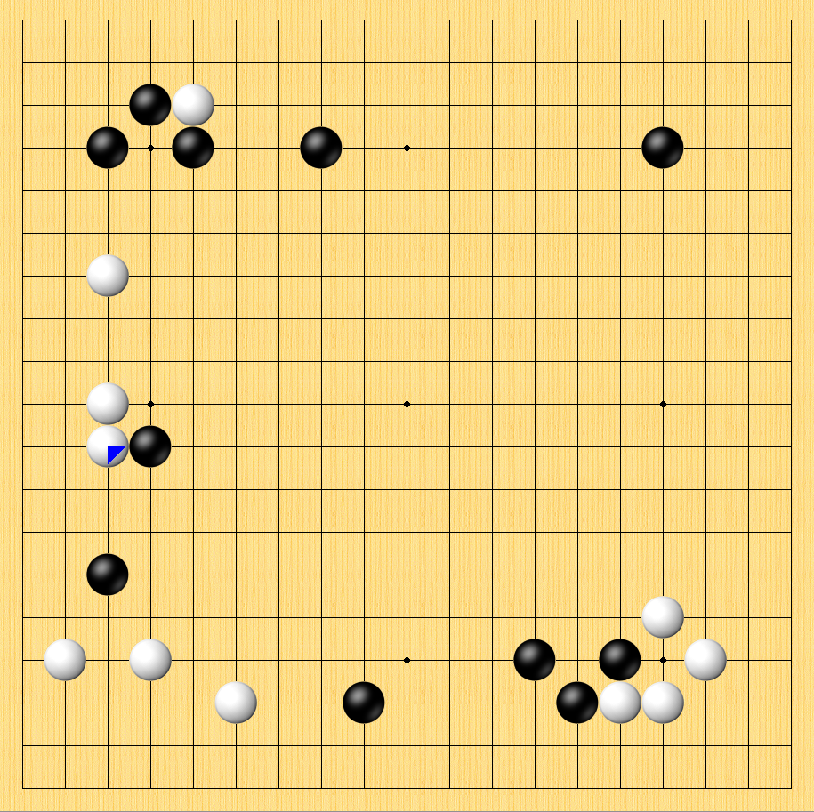
Introduction of Computer Go
The key problem is Move Prediction
How to transfer move prediction problem to machine learning setting?

Slide 5
Introduction of Computer Go
Transfer move prediction to machine learning algorithm
Define {x, y} data set
Establish mapping function
Learning
A match with n steps has n-1 training data
x
y

Slide 6
Introduction of Computer Go
Win-rate against open source engines
[1] Gelly, S., and Silver, D. 2011. Monte-carlo tree search and rapid action value estimation in computer go. Artificial Intelligence 175(11):1856–1875.
[2] Enzenberger, M.; M¨uller, M.; Arneson, B.; and Segal, R. 2010. Fuego- an open-source framework for board games and go engine based on monte carlo tree search. Computational Intelligence and AI in Games, IEEE Transactions on 2(4):259–270.
[3] Baudiˇs, P., and Gailly, J.-l. 2011. Pachi: State of the art open source go program. In Advances in Computer Games. 24–38.

Slide 7
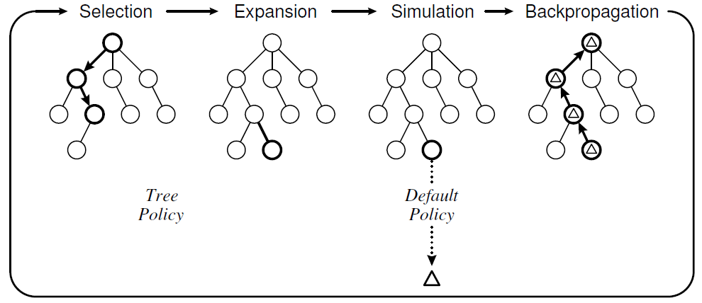
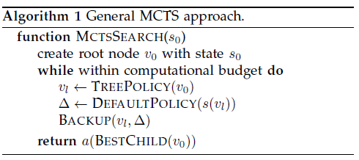
Motivation
Most existing algorithms are based on Monte Carlo Tree Search (MCTS)
Browne, C. B.; Powley, E.; Whitehouse, D.; Lucas, S. M.; Cowling, P. I.; Rohlfshagen, P.; Tavener, S.; Perez, D.; Samothrakis, S.; and Colton, S. 2012. A survey of monte carlo tree search methods. Computational Intelligence and AI in Games, IEEE Transactions on 4(1):1–43.

Slide 8
Motivation
Limitation of MCTS
MCTS will fail in many situations
e.g. simultaneous fights including two-safe-group problem; coexistence in seki
MCTS considers large proportion of meaningless moves
This situation is severe especially in the opening
Huang, S.-C., and M¨uller, M. 2013. Investigating the limits of monte-carlo tree search methods in computer go. In Computers and Games. 39–48.

Slide 9
Motivation
How Experts Play
Experts often consider next move with a long-term consideration
They barely use naïve violent search like MTCS
Sutskever, I., and Nair, V. 2008. Mimicking go experts with convolutional neural networks. In International Conference on Artificial Neural Networks. 101–110.

Slide 10
Motivation
Limitation of Standard CNNs for Computer Go
They often need more than 10 layers to achieve competitive results
Compared with popular image-based tasks, Go board has a much smaller size of 19*19
Contexts are important, especially for local fights
[1] Clark, C., and Storkey, A. 2015. Training deep convolutional neural networks to play go. In ICML, 1766–1774.
[2] Maddison, C. J.; Huang, A.; Sutskever, I.; and Silver, D. 2015. Move evaluation in go using deep convolutional neural networks. In ICLR
[3] Tian, Y., and Zhu, Y. 2016. Better computer go player with neural network and long-term prediction. In ICLR

Slide 11
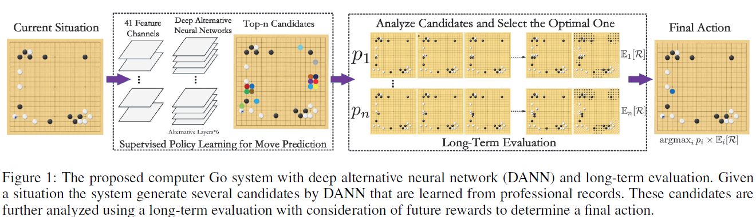
The Proposed System
The proposed system mainly contains two parts
Deep alternative neural network for move prediction
Long-term evaluation for comprehensive consideration

Slide 12
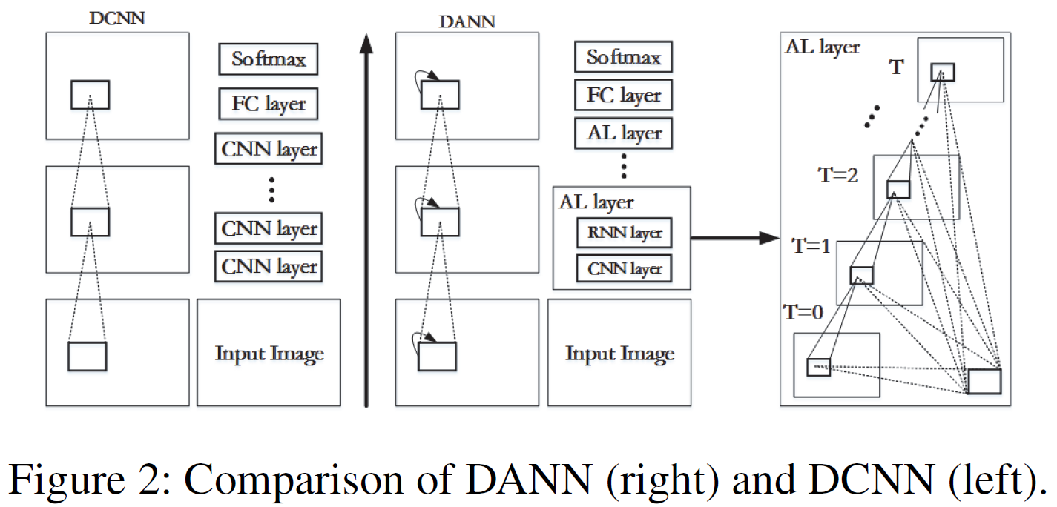


The Proposed System
Deep alternative neural network for move prediction
Jinzhuo Wang, Wenmin Wang, Xiongtao Chen, Ronggang Wang, Wen Gao: Deep Alternative Neural Network: Exploring Contexts as Early as Possible for Action Recognition. NIPS 2016: 811-819

Slide 13
The Proposed System
Deep alternative neural network for move prediction
Advantages over standard CNNs [1][2][3]
Context collection (1) in early layer (2) rich hierarchies
Increasing depth while consuming only additional constantly parameters
Multiple path in the feed-forward propagation
[1] Clark, C., and Storkey, A. 2015. Training deep convolutional neural networks to play go. In ICML, 1766–1774.
[2] Maddison, C. J.; Huang, A.; Sutskever, I.; and Silver, D. 2015. Move evaluation in go using deep convolutional neural networks. In ICLR
[3] Tian, Y., and Zhu, Y. 2016. Better computer go player with neural network and long-term prediction. In ICLR

Slide 14
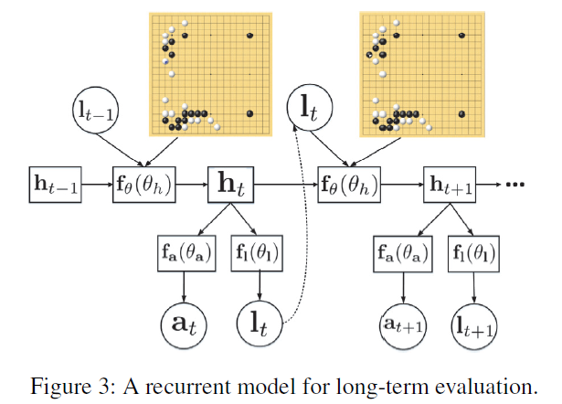

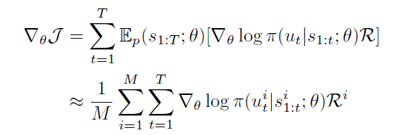
The Proposed System
Long-term evaluation for comprehensive consideration
Mnih, Volodymyr, Nicolas Heess, and Alex Graves. "Recurrent models of visual attention." In NIPS, pp. 2204-2212. 2014.

Slide 15

The Proposed System
Final decision for next move
We define the final score for each candidate using the criteria of both DANN and long-term evaluation. We select the action of the highest score of S as the final choice of our system, where p is the probability produced by the softmax layer of DANN.

Slide 16
Evaluation
Evaluation metric contains two parts
Accuracy (top-n) of next move prediction
Win rate against open source engines

Slide 17
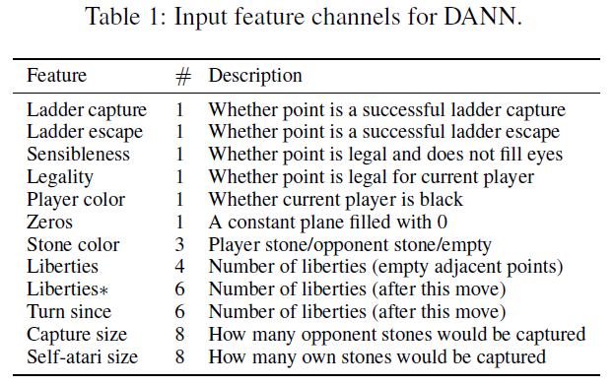
Evaluation
Setup and dataset
GoGoD (82k prof)
PGD (253k prof proposed)
KGS is not used (amateur)

Slide 18
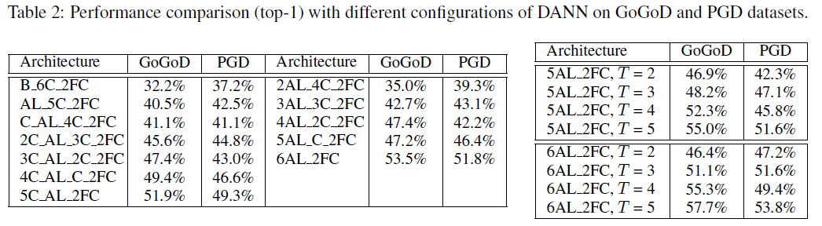
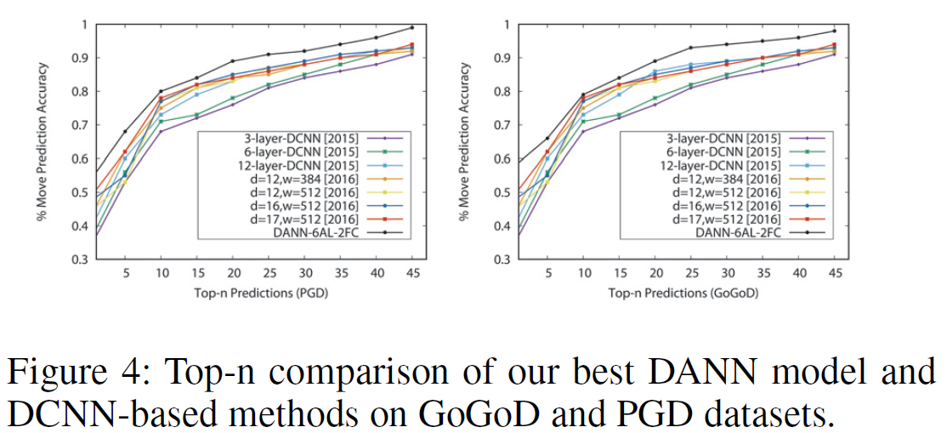
Evaluation
Model investigation (move prediction)
Ablation experiments of DANN
Comparison with standard DCNN

Slide 19
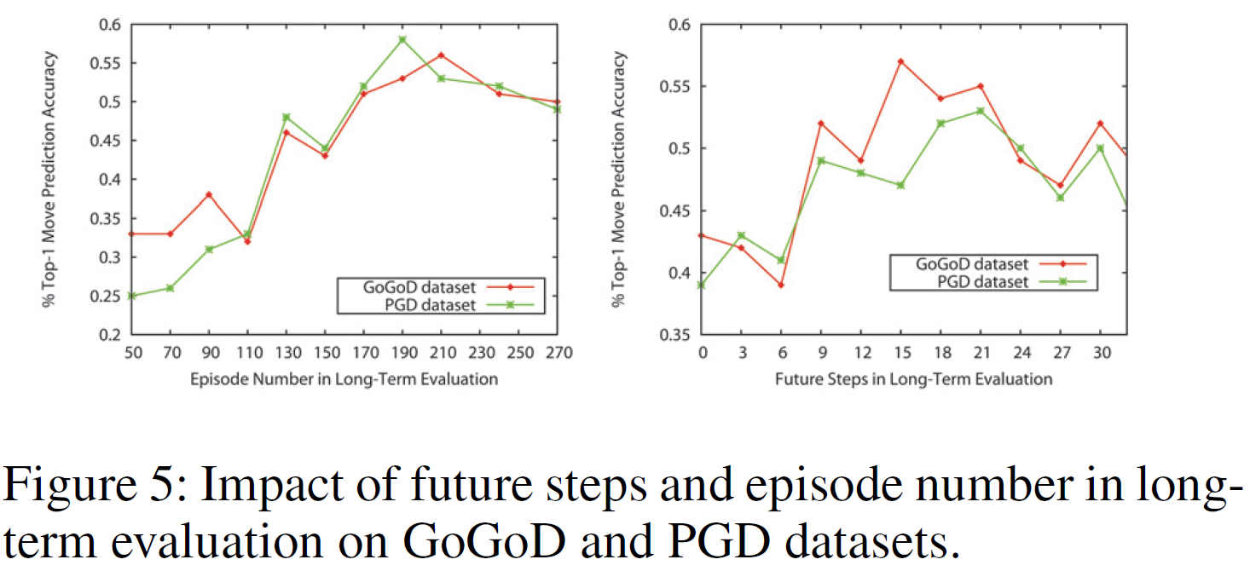
Evaluation
Model investigation (move prediction)
Impact of long-term evaluation
Top-1 Accuracy | GoGoD | PGD
DANN+LTE | 53.6 | 51.4
DANN+MCTS | 48.9 | 49.3
DCNN[1]+LTE | 51.2 | 53.5
DCNN[1]+MCTS | 45.7 | 46.2
[1] Clark, C., and Storkey, A. 2015. Training deep convolutional neural networks to play go. In ICML, 1766–1774.

Slide 20
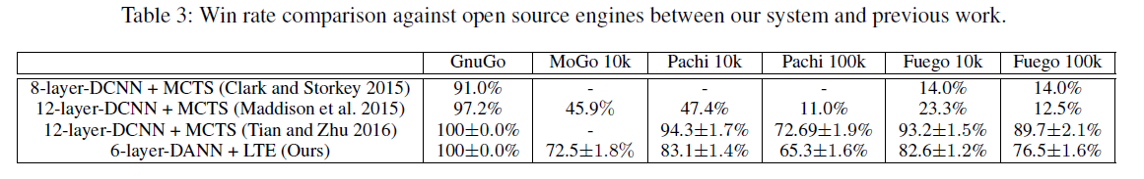
Evaluation
Win-rate against open source engines and comparison
[1] Clark, C., and Storkey, A. 2015. Training deep convolutional neural networks to play go. In ICML, 1766–1774.
[2] Maddison, C. J.; Huang, A.; Sutskever, I.; and Silver, D. 2015. Move evaluation in go using deep convolutional neural networks. In ICLR
[3] Tian, Y., and Zhu, Y. 2016. Better computer go player with neural network and long-term prediction. In ICLR

Slide 21
Discussion
While this work is doing, AlphaGo beaten Fan Hui with a 5-0, but has not played with Lee Sedol
At that time, we believe human experts can provide guidance
Lee Sedol and Ke Ji are defeated …
We need to re-think what human experts can provide when writing Go programs
I still believe human experts can provide something somehow

Slide 22
Thank you !

