Slide 1

Learning Class-Specific Pooling Shapes for Image Classification
School of Electronic and Computer Engineering, Peking University
Jinzhuo Wang, Wenmin Wang, Ronggang Wang, Wen Gao
Notes:
1

Slide 2
Outline
Introduction
Related Work
Class-Specific Pooling Shapes (CSPS)
Experiments
Conclusion

Slide 3
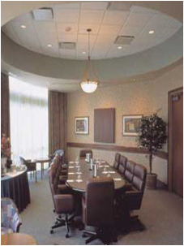
Introduction
Image Classification
?
Basketball
Cake
Grapes
Meeting room
Flashlight
Eyeglasses
People
Popular pipeline
Train
Images
Feature
Extraction
Feature
Coding
Feature
Pooling
Universal Representation
Classifier
Design
Image Understanding
Test
Images
Image Understanding
Universal Representation
Class
Prediction

Slide 4
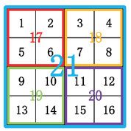
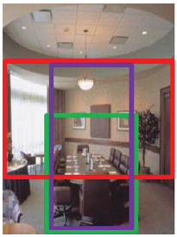
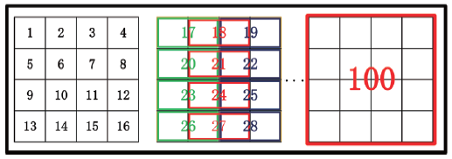
Introduction
Motivation and Contribution
1
2
Spatial Pyramid Representation (SPR)
…
…
21
1
1
Class-Specific Pooling Shapes (CSPS)
2
2
…
…
…
…
…
100
100

Slide 5
Outline
Introduction
Related Work
Class-Specific Pooling Shapes (CSPS)
Experiments
Conclusion

Slide 6
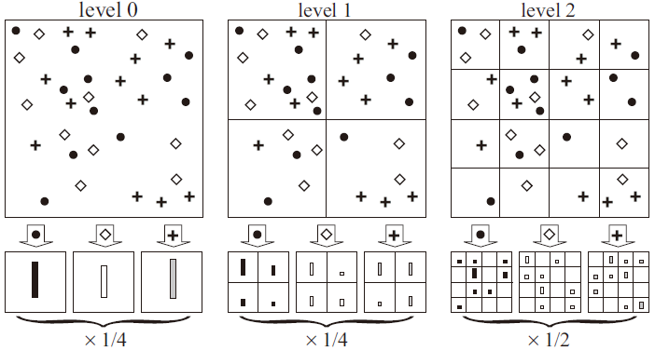
Related Work
Spatial Pyramid Representation (SPR)
Why SPR ?
SPR’s Limitation
ad-hoc segmentation
Recent Effort
Beyond Bags of Features: Spatial Pyramid Matching
for Recognizing Natural Scene Categories (CVPR,2006)
Object-Centric Spatial Pooling (ECCV,2012)
Receptive Field Learning (CVPR,2012)
Adaptive Pooling with Relative Features (ICME,2014)

Slide 7
Outline
Introduction
Related Work
Class-Specific Pooling Shapes (CSPS)
Experiments
Conclusion

Slide 8
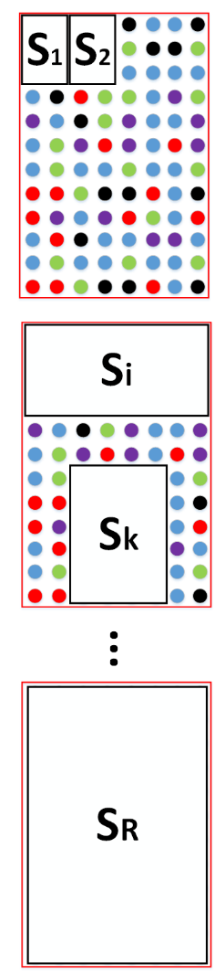
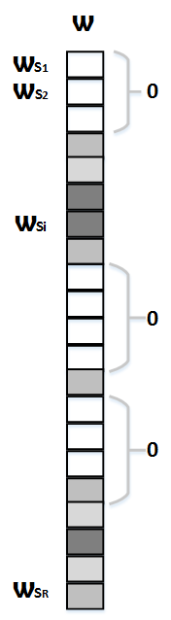
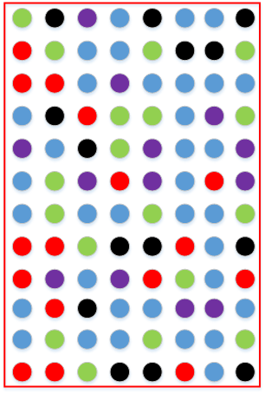
Class-Specific Pooling Shapes (CSPS)
Toy Overview
S1
S2
Si
…
…
…
SR

Slide 9

Class-Specific Pooling Shapes (CSPS)
Over-complete shape set
4*4 grids
VS
R =
NO
YES
Abundant
24
Redundant

Slide 10
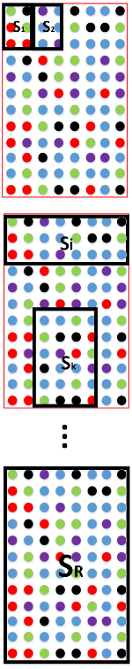

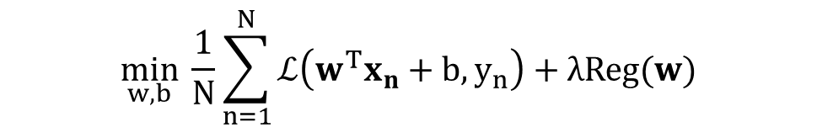
Class-Specific Pooling Shapes (CSPS)
CSPS learning formulation
S1
S2
Si
…
…
…
SR
$$\min_{w, b}{ \frac{1}{N}\sum_{n=1}^{N}{ℒ\left(w^{T}x_{n}+b,y_{n}\right)+λReg(w)}}$$
$$ℒ\left(w^{T}x_{n}+b,y_{n}\right)=\ln{(1+e^{(−y_{n}(w^{T}x_{n}+b))})}$$

Slide 11
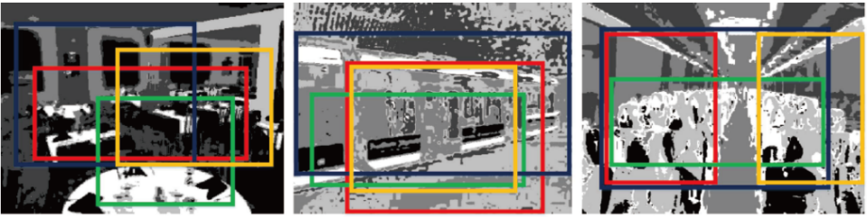

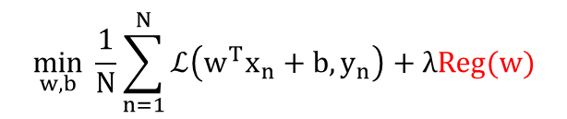







Class-Specific Pooling Shapes (CSPS)
CSPS learning formulation
--- Parameter Regularization
$$\min_{w, b}{ \frac{1}{N}\sum_{n=1}^{N}{ℒ\left(w^{T}x_{n}+b,y_{n}\right)+λReg(w)}}$$
$$Reg\left(w\right){=Reg}_{c}\left(w\right)+{Reg}_{s} (w)$$
Color Cues
Sparsity Constraints
$$\frac{N(c,i)}{N(c)}$$
$$=\sum_{i=1}^{R}{{\left\|w_{s_{i}}\right\|}_{2}}$$
$$\sum_{i=1}^{R}{\max_{j} }$$
$$\frac{N(c,i)}{P(j)}$$
$$j=\{1,2,⋯,k\}$$
$${Reg}_{s} \left(w\right)={\left\|w\right\|}_{2,1}$$
$$\text{primal}\text{−}\text{dual} \text{algorithm}$$
Rodolphe Jenatton et.al. “Proximal methods for sparse hierarchical dictionary learning,” (ICML-2010)

Slide 12
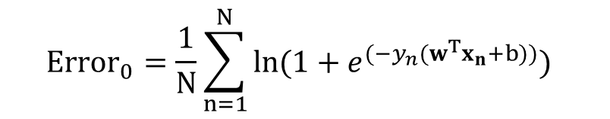
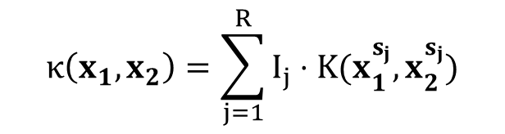
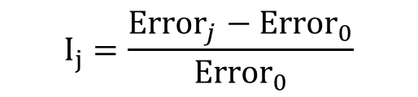
Class-Specific Pooling Shapes (CSPS)
Representation compression
$${Error}_{0}=\frac{1}{N}\sum_{n=1}^{N}{\ln{(1+e^{(−y_{n}(w^{T}x_{n}+b))})} }$$
S1
Leave-one-out
S2
$$I_{j}=\frac{{Error}_{j}−{Error}_{0}}{{Error}_{0}}$$
Si
$$κ\left(x_{1},x_{2}\right)=\sum_{j=1}^{R}{I_{j}⋅Κ(x_{1}^{s_{j}},x_{2}^{s_{j}})}$$
…
Multi-shape matching kernel
SR

Slide 13
Outline
Introduction
Related Work
Class-Specific Pooling Shapes (CSPS)
Experiments
Conclusion

Slide 14

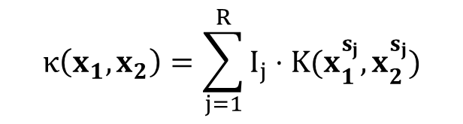
Experiments
Setup
Caltech-256, Scene-15, Indoor-67
Dense SIFT with LLC coding (codebook size 2048, k = 5)
max pooling for each region
$χ^{2}$ kernel for $Κ$
$$κ\left(x_{1},x_{2}\right)=\sum_{j=1}^{R}{I_{j}⋅Κ(x_{1}^{s_{j}},x_{2}^{s_{j}})}$$

Slide 15
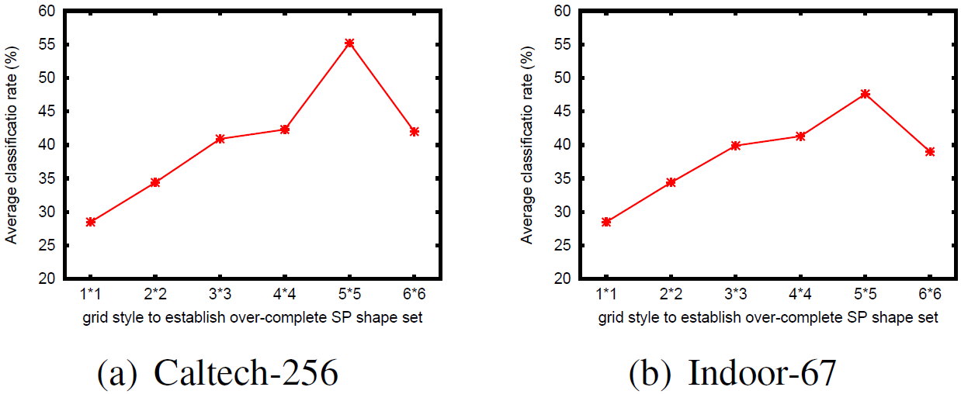
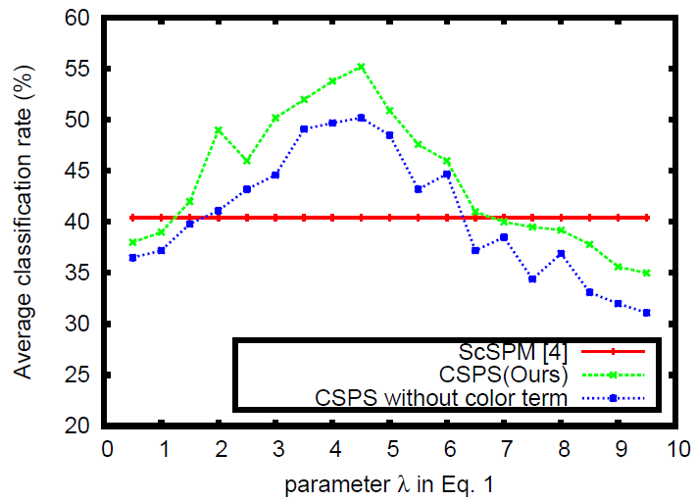
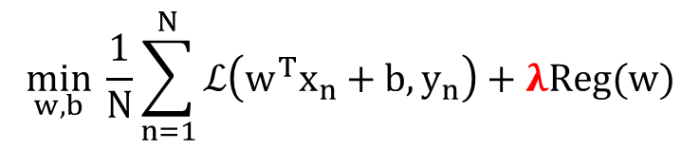
Experiments
Model analysis
Over-complete shape set
$$\min_{w, b}{ \frac{1}{N}\sum_{n=1}^{N}{ℒ\left(w^{T}x_{n}+b,y_{n}\right)+λReg(w)}}$$

Slide 16
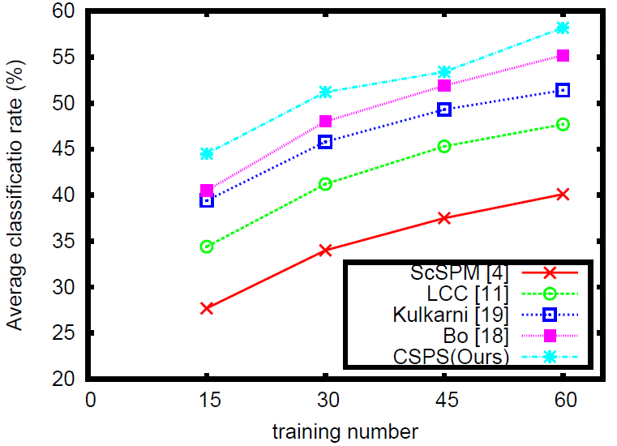
Experiments
Quantitive results --- Caltech-256
Ours

Slide 17
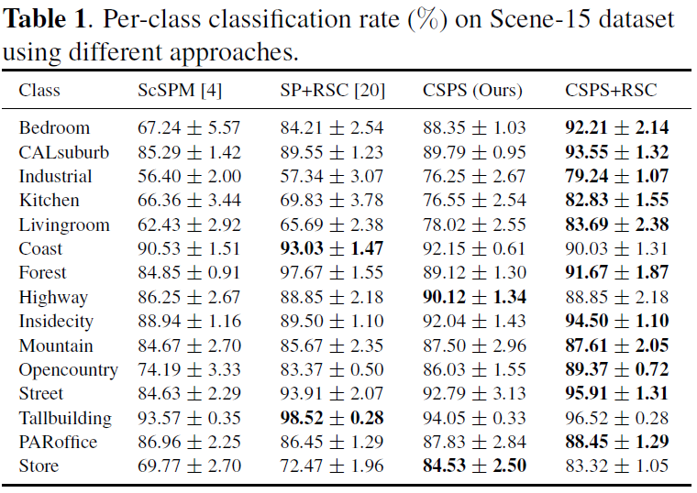
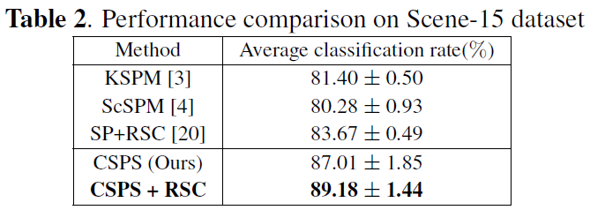
Experiments
Quantitive results --- Scene-15
100 test images per class

Slide 18
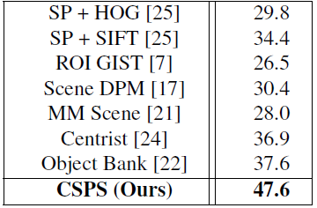
Experiments
Quantitive results --- Indoor-67
Further Gains with GIST (GIST-color) ?
Liefeng Bo et.al. “Multipath sparse coding using hierarchical matching pursuit,” (CVPR-2013)
Jianxin Wu et.al. “Centrist: A visual descriptor for scene categorization,” (TPAMI-2013)
20 test images per class

Slide 19
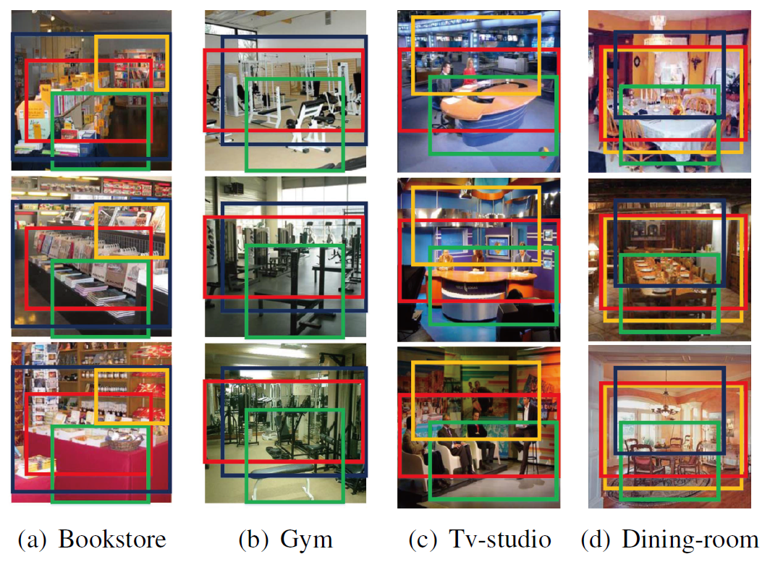
Experiments
Samples with learned pooling shapes

Slide 20
Outline
Introduction
Related Work
Class-Specific Pooling Shapes (CSPS)
Experiments
Conclusion

Slide 21
Conclusion
Class-Specific Pooling Shapes (CSPS) framework
A novel pooling shape learner
Competitive results
Image classification on popular datasets
Important step towards better image understanding
Better pooling → Better statistical information → Better representation
Future work
Alternative shapes (circles / polygon)
Object localization

Slide 22
Q&A
Notes:
22

