Slide 1
Parallel Implementation of DBSCAN Algorithm
Based on Spark
MSBD5003 Final Project
Hong Kong University of Science and Technology
Notes:
亮亮图文旗舰店https://liangliangtuwen.tmall.com

Slide 2
CONTENTS
Introduction
1
4
Parallelization & Merging
Techniques
2
5
Result
DBSCAN
3
6
Future Work

Slide 3
1
Introduction

Slide 4
1
Introduction
Spark DBSCAN
Spark DBSCAN is an implementation of the DBSCAN clustering algorithm on top of Apache Spark .When we do the traditional dbscan algorithm , if the sample set is large, the clustering convergence time of DBSCAN is too long.
In this case, we use SPARK to alleviate this problem and make the program more efficient.

Slide 5








2
Techniques

Slide 6
3
Procedures of DBSCAN

Slide 7
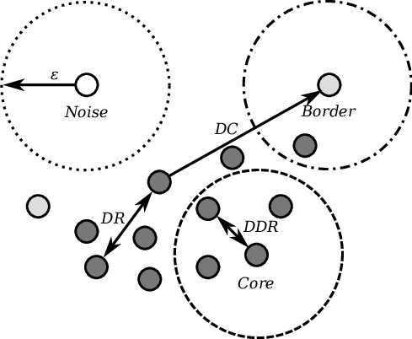
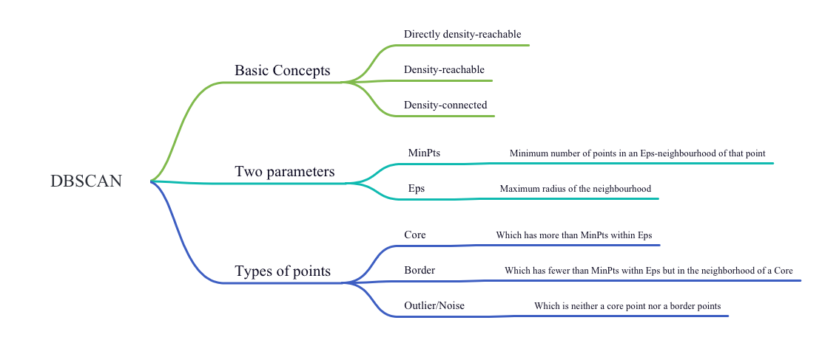
3
Procedures of DBSCAN
Density-Based Spatial Clustering of Applications with Noise
论文就是用来进行科学研究和描述科研成果的文章

Slide 8
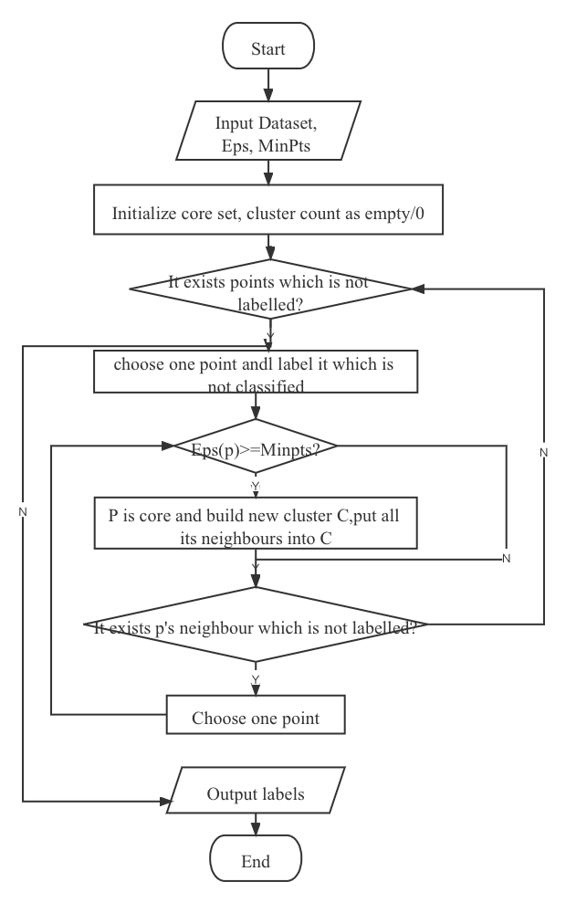
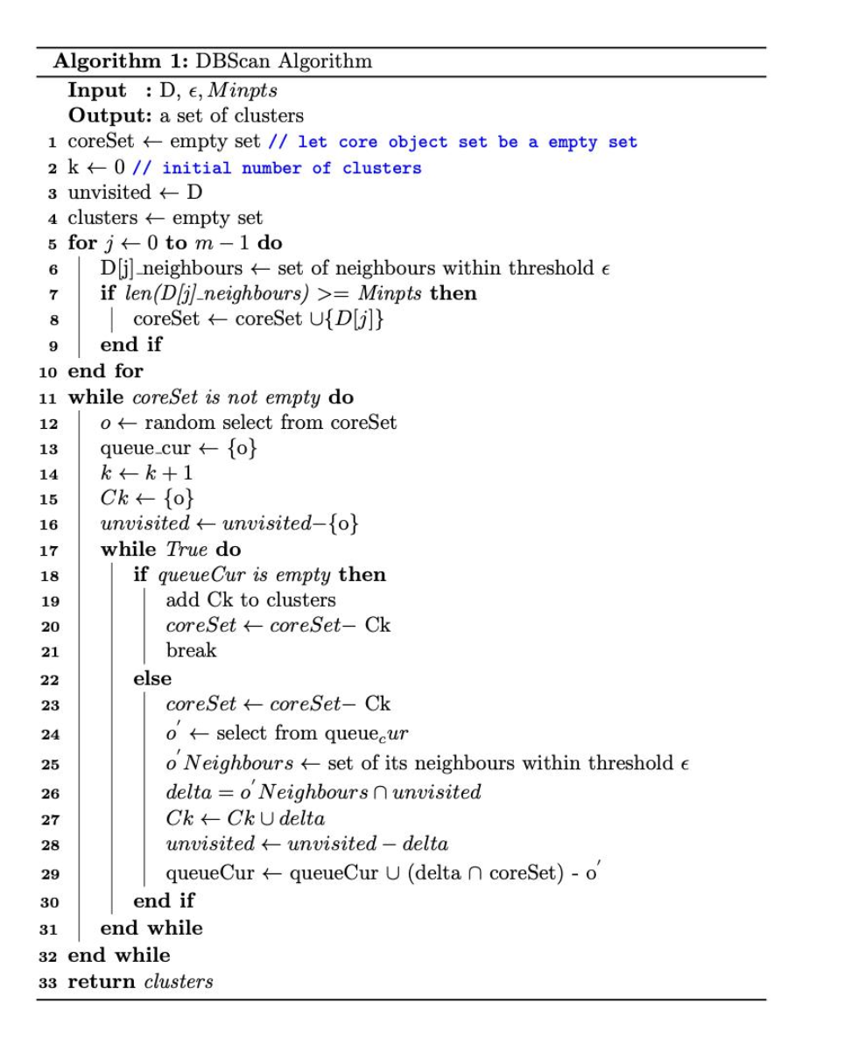
3
Procedures of DBSCAN

Slide 9
4
Parallelization of Implementation

Slide 10
4
Parallelization of Implementation
Implementation Steps
Step 1:
1
separating dataset into several parts
Step 2:
executing DBSCAN for each part individually
2
Step 3:
3
merging the result of each part together.

Slide 11
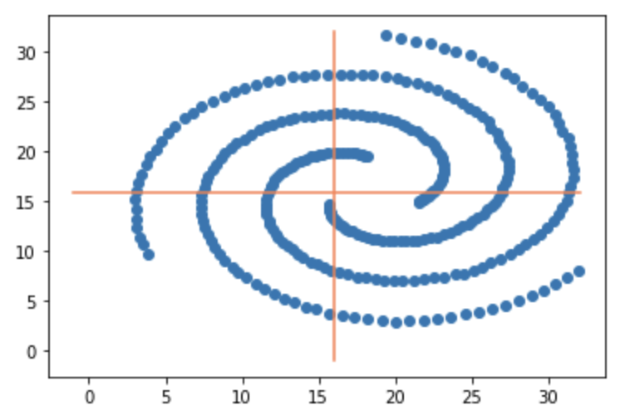
4
Parallelization of Implementation
Datasets separation
Analyze and separate the datasets
Each part of datasets is considered as a partition
Problem: how to combine results ?
Notes:
First, how to separate dataset is what we considered, for the example of 2-dimensional datasets, we analyze the dataset and separate the dataset into 4 parts according to the coordinates of features showing below. Each part of datasets is considered as a partition, and then we can execute local dbscan for each partition and get the following result.
For this stage, another problem is merging the result, since the output we can see some points should be in one cluster but clustered into two different clusters because they are in different partition. To solve this problem, we changed the way we split data a little bit to let some partitions will share some common data points.

Slide 12
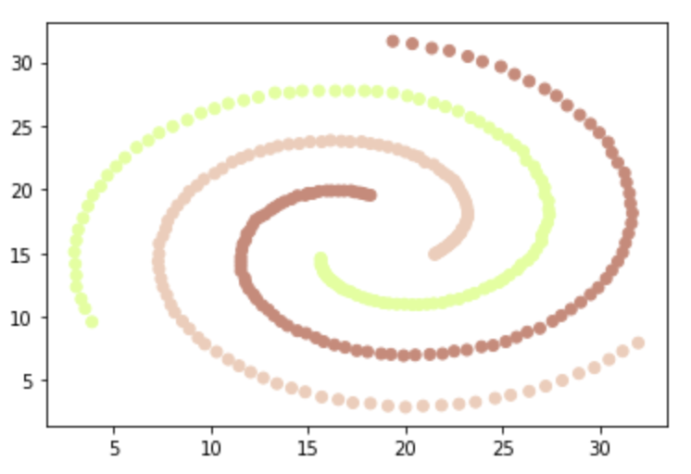
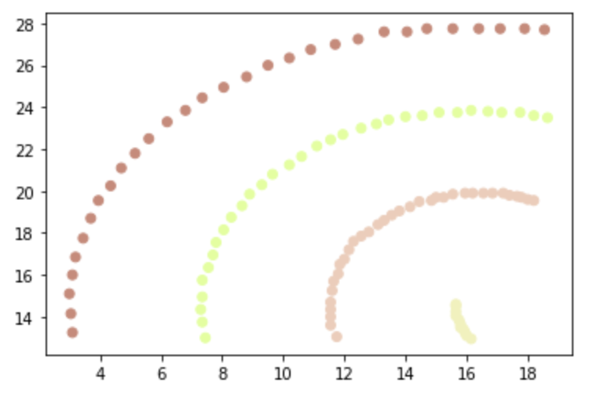
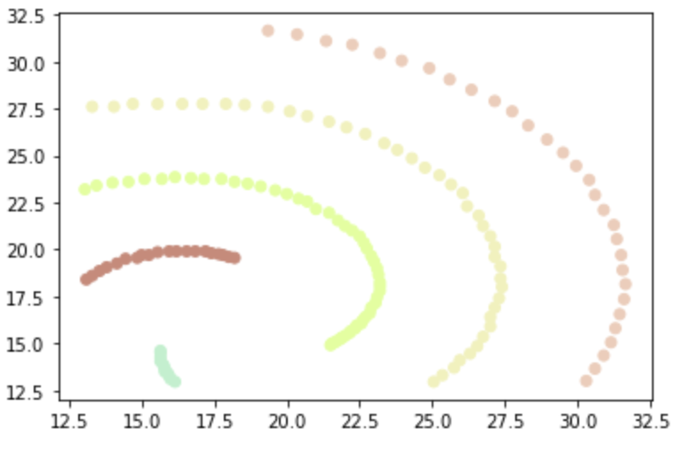
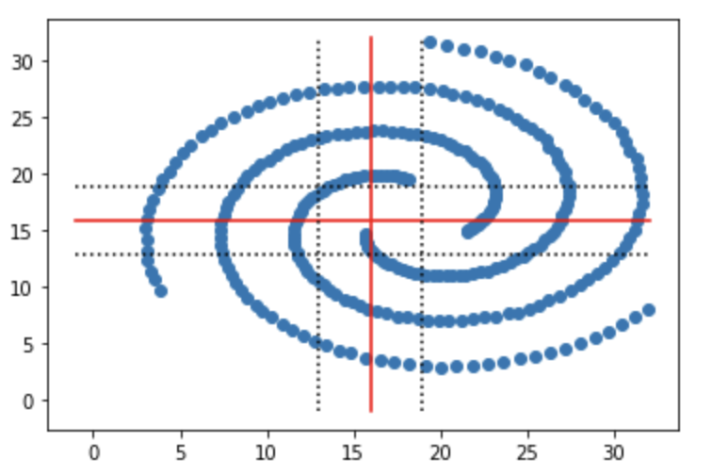
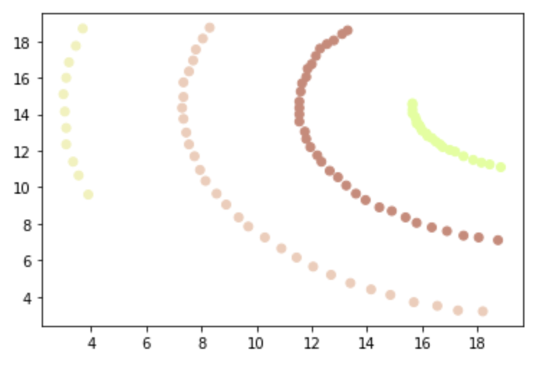
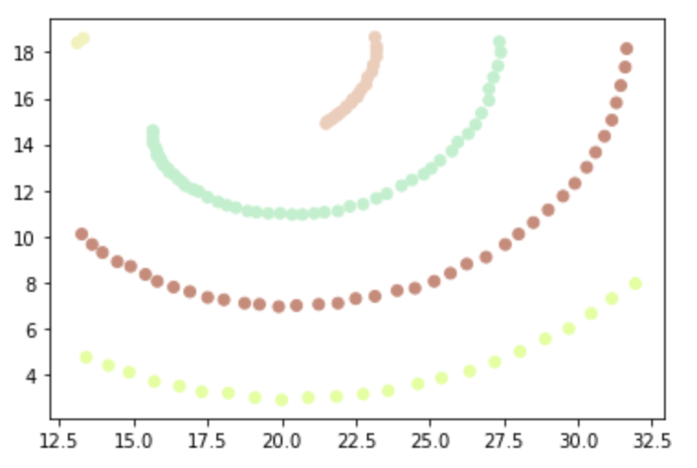
4
Parallelization of Implementation
Change the way to partition data points
Introduce a interim area to make partitions share common data points
Notes:
Merging:
For this stage, another problem is merging the result, since the output we can see some points should be in one cluster but clustered into two different clusters because they are in different partition. To solve this problem, we changed the way we split data a little bit to let some partitions will share some common data points. Under this situation, we can combine the clusters assigned to same data points into one cluster.

Slide 13
5
RESULT

Slide 14
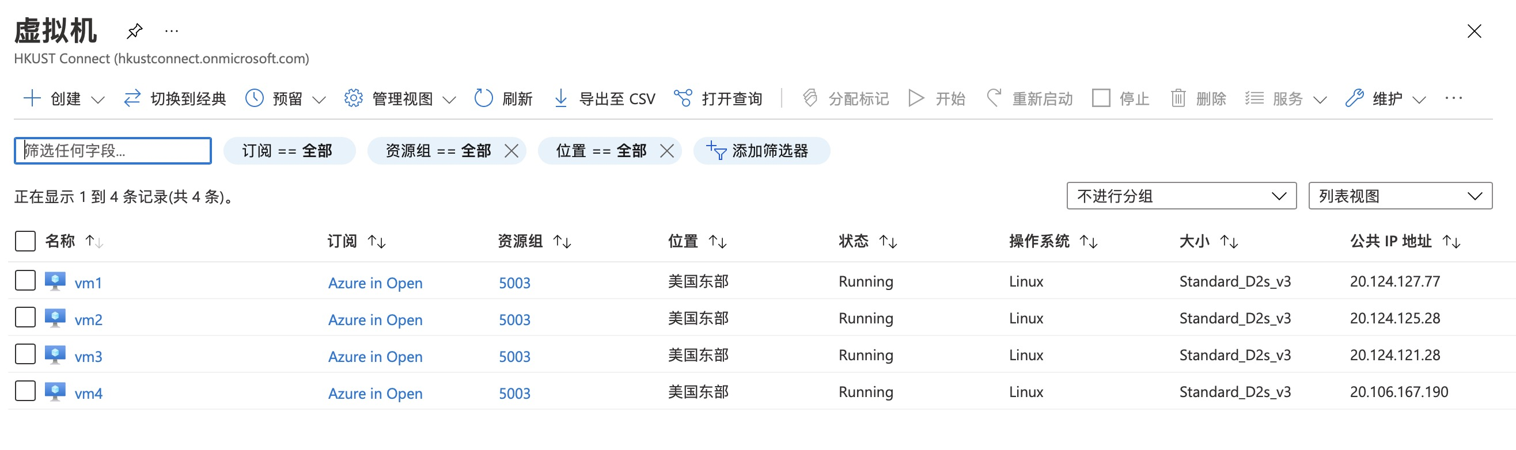
5
RESULT
Microsofte Azure
4 virtual machines
one master and 3 slaves

Slide 15
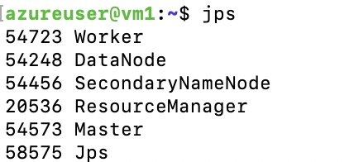
5
RESULT
Virtual machine process
we use the SKlearn to generate
the cluster data for getting the
following results.

Slide 16
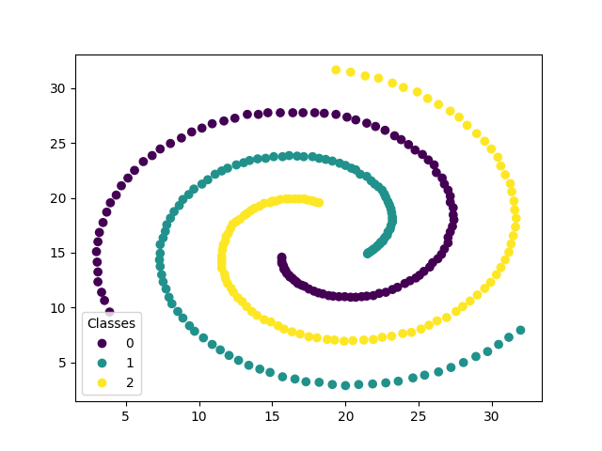
5
RESULT
the data size :500
Use the spark dbscan ,spent
9 seconds get the result.
Using the traditional dbscan, we spent 40 seconds.
So the spark dbscan is efficient.

Slide 17
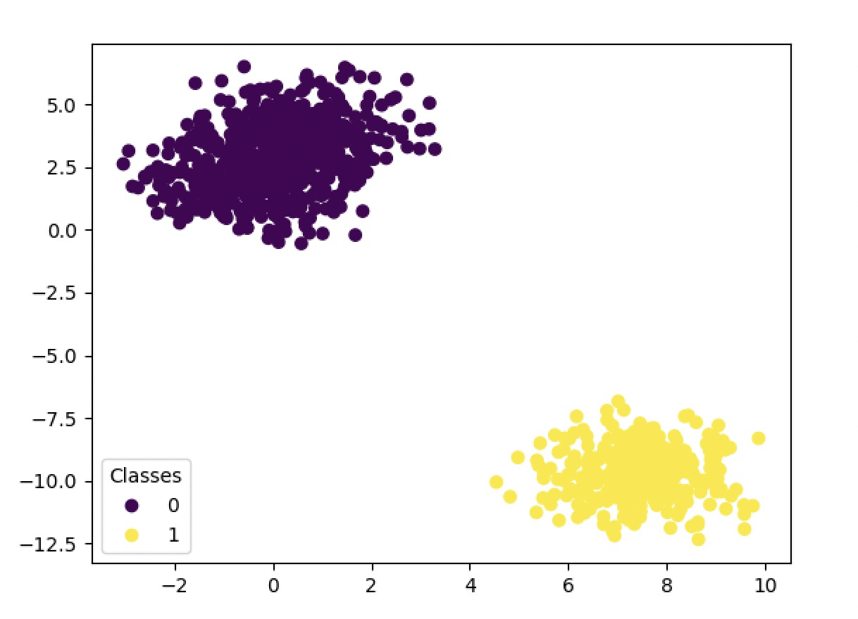
5
RESULT
the data size :1000
Use the spark dbscan ,spent
40 seconds get the result.
Using the traditional dbscan, we spent 109 seconds.
So the spark dbscan is efficient.

Slide 18
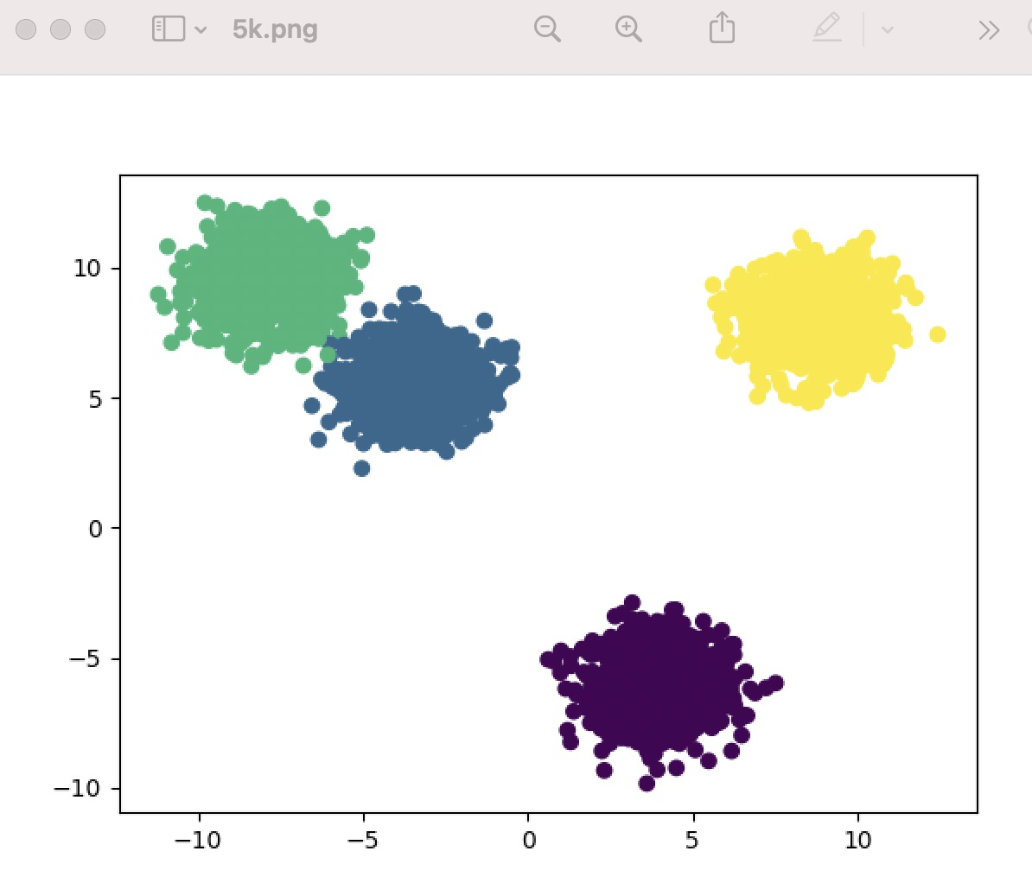
5
RESULT
the data size :5000
Use the spark dbscan ,spend
790 seconds get the showing result.
However,Using the traditional dbscan,we cannot get the result. Maybe the memory is not adequate loading all the data set.
So the spark dbscan is suitble for the large data set.

Slide 19
6
Future Work

Slide 20
6
Future Work
We tried the bigger data set ,the size like 60000,but the virtual machines memory and preformance is the bottleneck for the big data task.We will figure out the more optimal way to solve the problem.

Slide 21
Thanks

