Slide 1
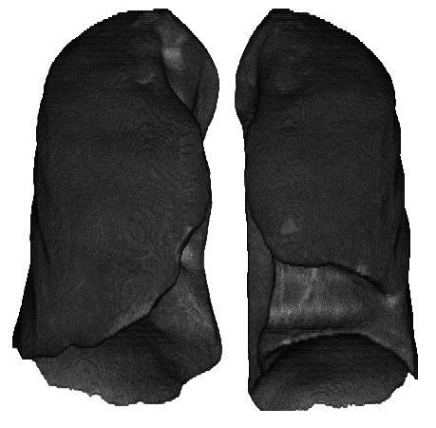

































Output 1: Severity grading
…
Selected treatment scheme
…
256
512
512
256
$$0$$
$$1$$
0
$$0$$
$$1$$
0
Softmax
…
$$τ_{1}$$
$$τ_{2}$$
$$τ_{C}$$
$$1$$
$$C_{1}^{1}$$
$$1$$
$$0$$
0
Treatments
48x48x48x16
$$S_{1}$$
24x24x24x32
$$0$$
$$C_{1}^{2}$$
12x12x12x64
6x6x6x128
1x1x1x256
…
…
…
…
Cross-entropy Classification loss
3x3x3x256
…
GAP
$$0$$
$$C_{N}^{1}$$
$$S_{2}$$
$$1$$
$$C_{N}^{2}$$
VGG16:3D Convolutional features
CT images
C
…
…
…
256
Softmax
$$σ_{1}$$
$$\vec{x}$$
$$1$$
Covariates with CNN feature
$$P_{1}$$
…
…
…
…
…
$$t_{1}$$
$$P_{2}$$
8
Feature Significance Ranking (FSR)
…
…
…
…
…
Multi-event regression loss
…
$$P_{t}$$
$$2$$
$$σ_{N}$$
…
Clinical features
$$P_{T}$$
12
$$t_{N}$$
…
…
…
…
…
Minibatch inputs
$${\vec{x}}^{′}$$
Weighted covariates with CNN feature
Hidden layers
Output 2: Recovery-time estimation
3D Conv + Relu
3D Max-pooling
GAP
Global Average Pooling
C
Concatenation
Fully-connected layer
$$S_{∗}$$
Probability for Low-risk ($S_{1}:$mild & moderate) and High-risk ($S_{2}:$severe & critical)
$$P_{t}$$
Probability of recovery in $t_{th}$day

