Slide 1
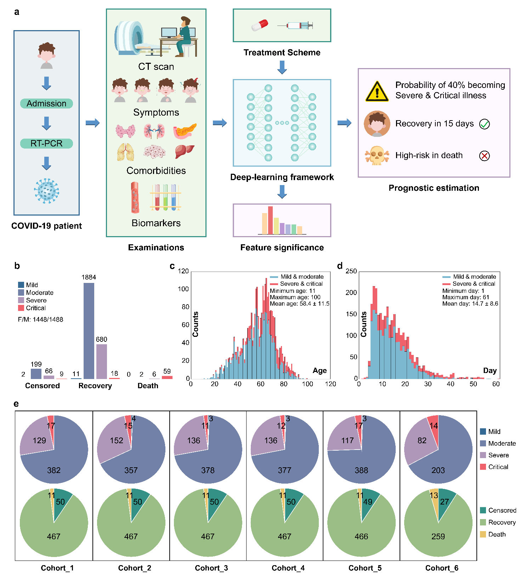

Slide 2
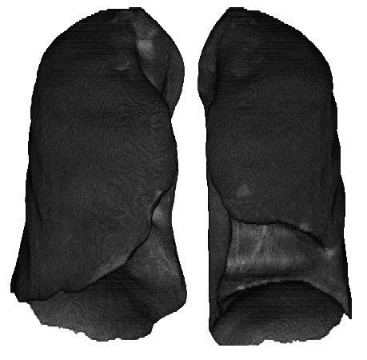



































Output 1: Severity-level grading
…
Treatment scheme
…
256
512
512
256
Softmax
$$0$$
$$1$$
…
0
$$0$$
$$1$$
0
$$1$$
$$0$$
0
$$τ_{1}$$
$$τ_{2}$$
$$τ_{C}$$
$$1$$
$$C_{1}^{1}$$
$$τ_{1}$$
$$τ_{2}$$
$$τ_{C}$$
$$S_{1}$$
Treatments
48x48x48x16
$$C_{1}^{2}$$
24x24x24x32
$$0$$
12x12x12x64
6x6x6x128
1x1x1x256
…
…
…
…
Cross-entropy classification loss
…
3x3x3x256
GAP
…
$$C_{N}^{1}$$
$$0$$
$$S_{2}$$
$$1$$
$$C_{N}^{2}$$
VGG16: 3D Convolutional features
…
…
…
Lung-only CT images
C
256
Softmax
Append CT-based score
$$σ_{1}$$
$$P_{1}$$
$$1$$
$$P_{2}$$
8
$$t_{1}$$
Sub-network for
Feature Significance Ranking (FSR)
…
…
…
…
…
…
Multi-event regression loss
…
…
$$P_{t}$$
…
$$2$$
$$σ_{N}$$
$$P_{T}$$
12
$$t_{N}$$
Clinical features
$$\vec{x}$$
$${\vec{x}}^{′}$$
Original covariates
Weighted covariates
Mini-batch inputs
Information combination
Hidden layers
Output 2: Recovery-time prediction
3D Conv + Relu
3D Max-pooling
GAP
Global Average Pooling
C
Concatenation
Fully-connected layer
$$S_{∗}$$
Probability for Low-risk ($S_{1}:$mild & moderate) and High-risk ($S_{2}:$ severe & critical)
$$P_{t}$$
Probability of recovery on $t_{th}$day

