Slide 2
Deep reinforcement learning control for deformable object manipulation
Project Motivation
State of Art
Methods
Results
Future Challenges

Slide 3
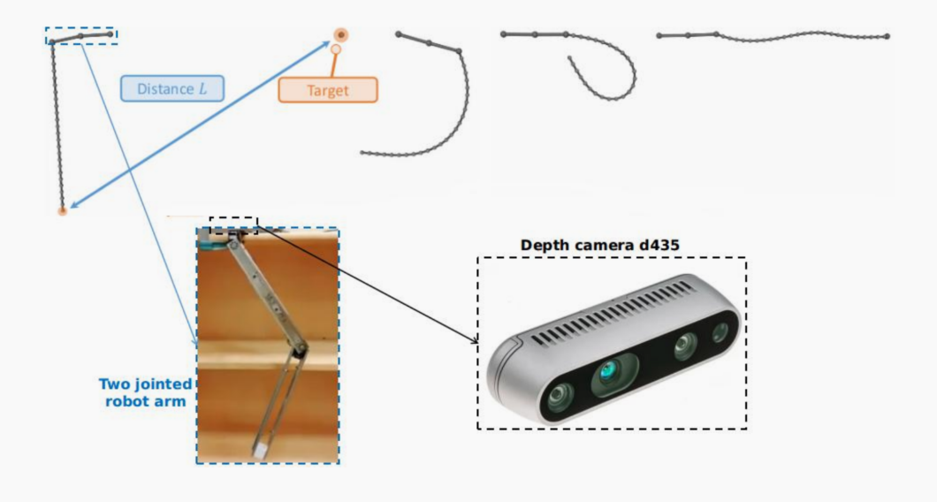
Deep reinforcement learning control for deformable object manipulation
Project Motivation
Depends on different positions of targets, controlling the deformable things to hit them through the two-jointed arm

Slide 4
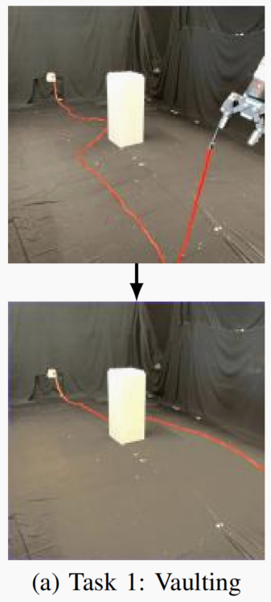
Deep reinforcement learning control for deformable object manipulation
State of Art
For the Harry Zhang research(Self-Supervised Learning to Dynamically Manipulate
Fixed-Endpoint Cables), using deep learning to train his policy can get 81.7% accurancy in vaulting movement

Slide 5
Deep reinforcement learning control for deformable object manipulation
Methods
HOWEVER, the training period of RL is so long! Can we add physical based control into RL to shorten the training time?
Reinforcement Learning
+
Online Impedance
Adaption Controller

Slide 6
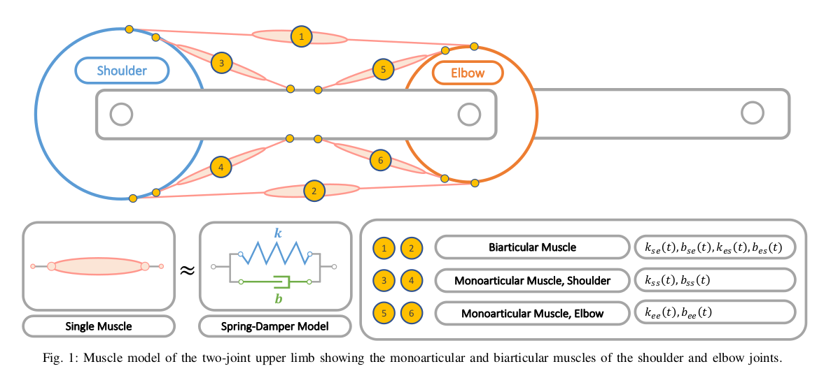
Deep reinforcement learning control for deformable object manipulation
Methods
K: Stiffness
B: Damping
Bionic muscle model [1]
[1] Xiong, X., Nah, M. C., Krotov, A., & Sternad, D. (Accept). Online Impedance Adaptation Facilitates Manipulating a Whip. IROS 2021, IEEE.

Slide 7

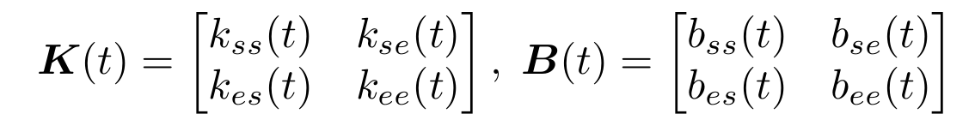
Deep reinforcement learning control for deformable object manipulation
Methods
Online Impedance Adaption Controller
Torque is from the errors of joint position and velocity:
OIAC adjusts K(t) and B (t) online

Slide 8
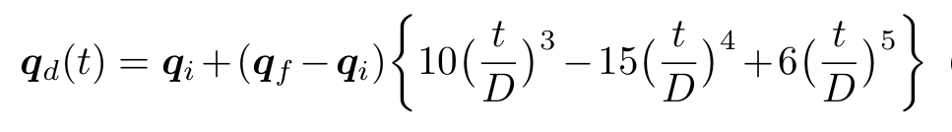

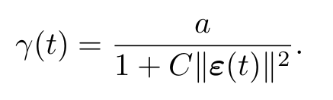
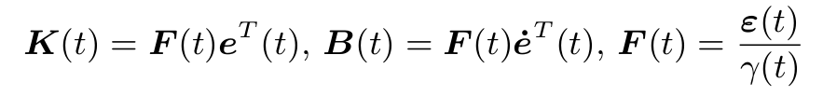
Deep reinforcement learning control for deformable object manipulation
Methods
Online Impedance Adaption Controller
How to adjust K(t) and B (t) online? [1]
Where, α, β, C are fixed constants;
(1) is from minimum-jerk trajectory ;
(2) calculates the errors;
(3) generates scaling factor;
(4) adjusts K(t) B(t) online;
More detailed illustration could be found in the paper.[1]
(1)
(2)
(3)
(4)
[1] Xiong, X., Nah, M. C., Krotov, A., & Sternad, D. (Accept). Online Impedance Adaptation Facilitates Manipulating a Whip. IROS 2021, IEEE.

Slide 9
Deep reinforcement learning control for deformable object manipulation
Methods
Reinforcement Learning
Popular continuous control algorithm:
SAC, TD3, DDPG, PPO, etc.
Observation Space: (1D)
distance between the whip tip to the target
Action Space: (5D)
initial joint0 position, initial joint1 position, final joint0 position, final joint1 position, duration time
Reward & Penalty:
if the target is hit (distance<0.1), reward = 50;
if distance<0.5 reward = -0.5 * distance;
else reward = -1 * distance;

Slide 10
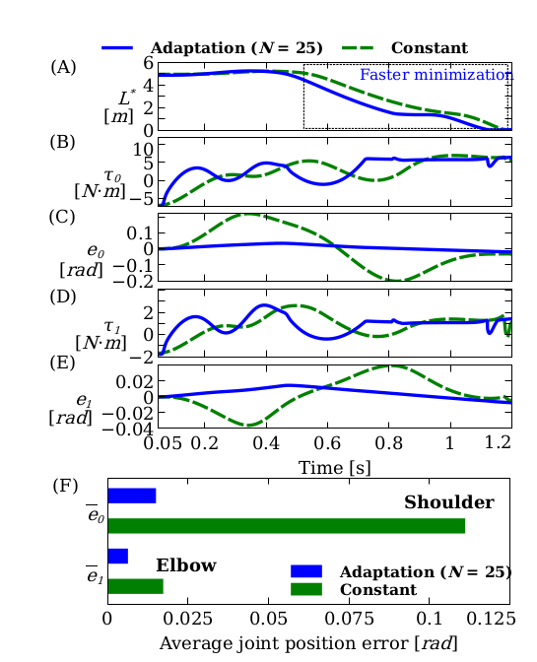

Deep reinforcement learning control for deformable object manipulation
Results
The figure shows the differences about torque and errors between the fixed gain control method and OIAC: [1]
(constant control matrix)
From it, we could find the performance of OIAC is more accurate than constant control.
[1] Xiong, X., Nah, M. C., Krotov, A., & Sternad, D. (Accept). Online Impedance Adaptation Facilitates Manipulating a Whip. IROS 2021, IEEE.

Slide 11
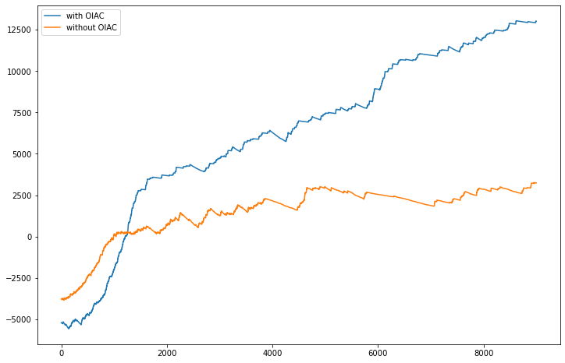
Deep reinforcement learning control for deformable object manipulation
Results
The figure shows the rewards comparison between the fixed gain control method and OIAC after 9000 SAC training steps:
In this simulation, we set the same random seed to make sure the same random targets order. And if the target is hit, it would be moved. In the end, OIAC hits 531 times while the constant one hits 487 times.

Slide 12
Deep reinforcement learning control for deformable object manipulation
Results
Before training
After training

Slide 13
Deep reinforcement learning control for deformable object manipulation
Future Challenges
Performance of combining with more RL methods
Sensitive fine-tuning hyper parameters
HPC GPU configuration
Physical experiment with real ropes

Slide 14
Thanks!

