Slide 1
ColorWorld – a Color-based Image Indexing and Retrieval System
Group No. 3
Ke Wang 903058889
Qichao Chu 903060535

Slide 2
Goal and Idea
Use color attributes and keywords to retrieve images
Use color histogram and color coherence vector
Compare the distance to get related images
Idea
Different color space
Different distance measurements
B+ Tree and Keyword-Tree
Dataset from Washington University
Images with different topics
Images with description files
Need to combine different format for our use

Slide 3
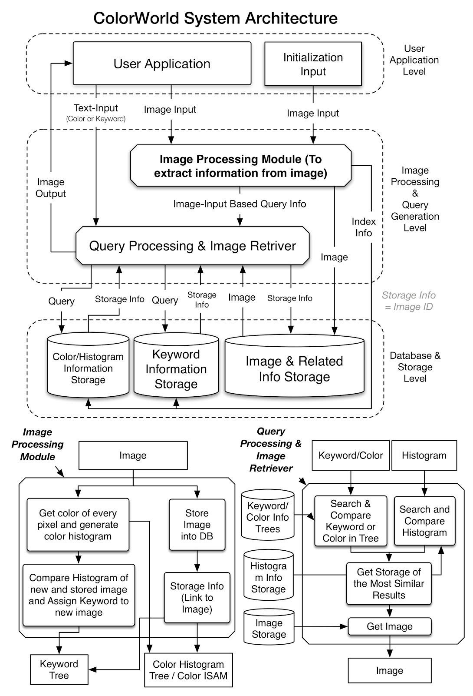
Architecture
Main components:
Hash Table
Color -> Image ID
B+ Tree
Image iD -> Image Desc
Keyword Tree
Keyword -> Image ID,
Confidence
Color Histogram
Color Coherence Vector

Slide 4
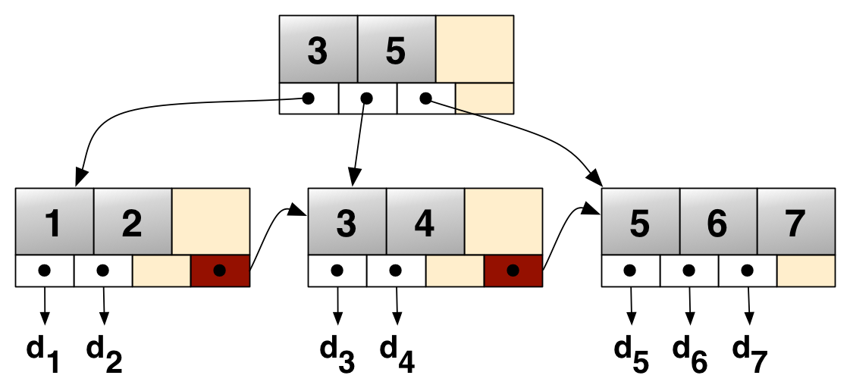
Data Structure - B+ Tree
Leaves:
Image ID and its description

Slide 5
Data Structure - Keyword Tree
Root
a
t
MAP:
Image ID -> Confidence

Slide 6
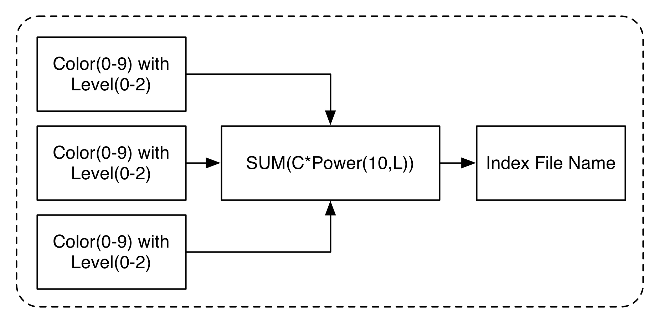
Data Structure - Color Hash Table
MAP: Color Info -> Image ID
￼

Slide 7
Color Histogram and CCV
Color Histogram
Choose color space and divide the space
RGB -> [8,8,8]
HSV -> [16,3,3]
int[ ][ ][ ] histogram
Denotes how many pixels are in this divided space
Compute the distance between two histograms to find relativity
Euclidean, Intersection, Quadratic
CCV Color Coherence Vector
Take into consideration coherent pixels and incoherent ones
Each bucket -> (a,b)

Slide 8
Accomplishments and TODO
Accomplishments:
Basic indexing (color attributes, keywords) and retrieval (related images, keywords)
ColorWorld supports:
Search by keyword
Search by image
Vote up or down keyword for an image
TODO
Serialization and deserialization
Add new images
Assign keyword to new images

Slide 9
Real-World Example

