Slide 1


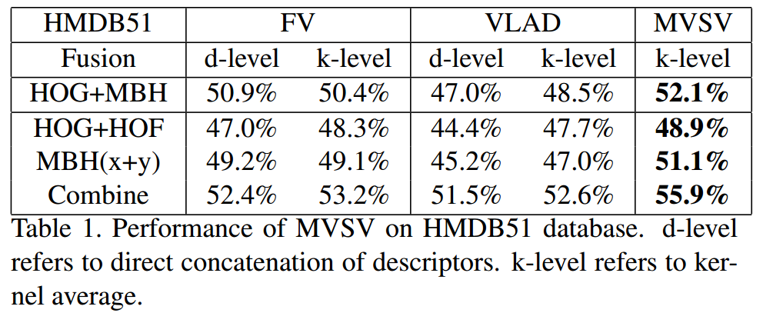
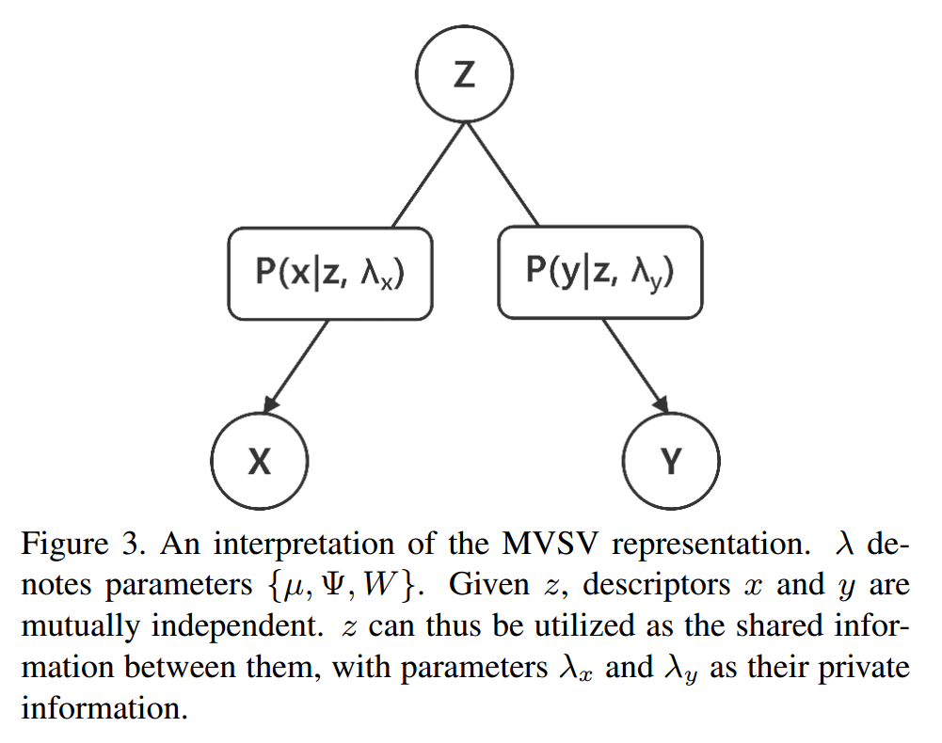
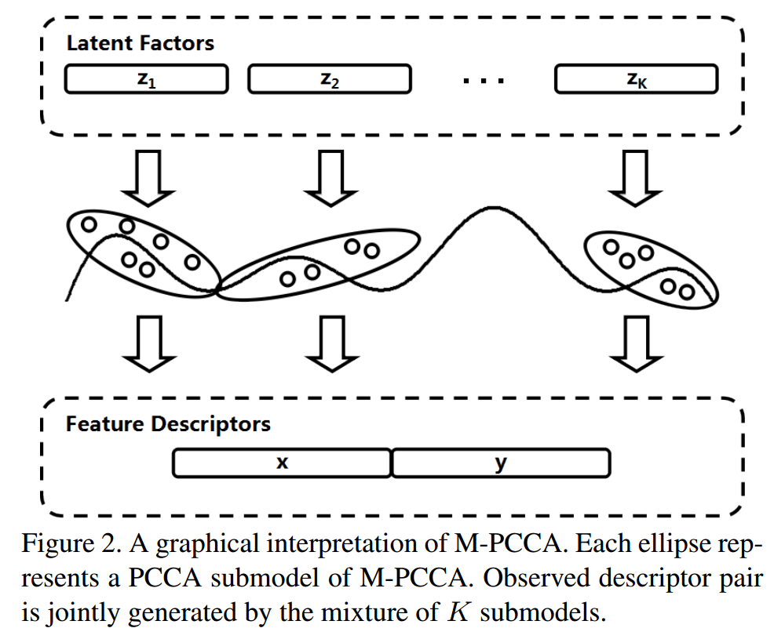
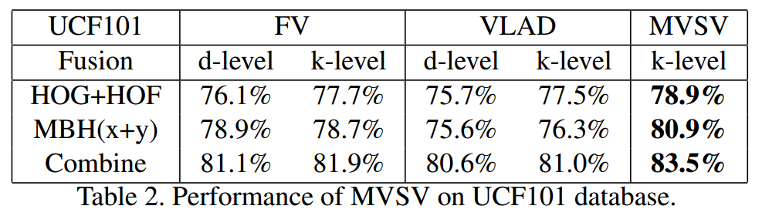
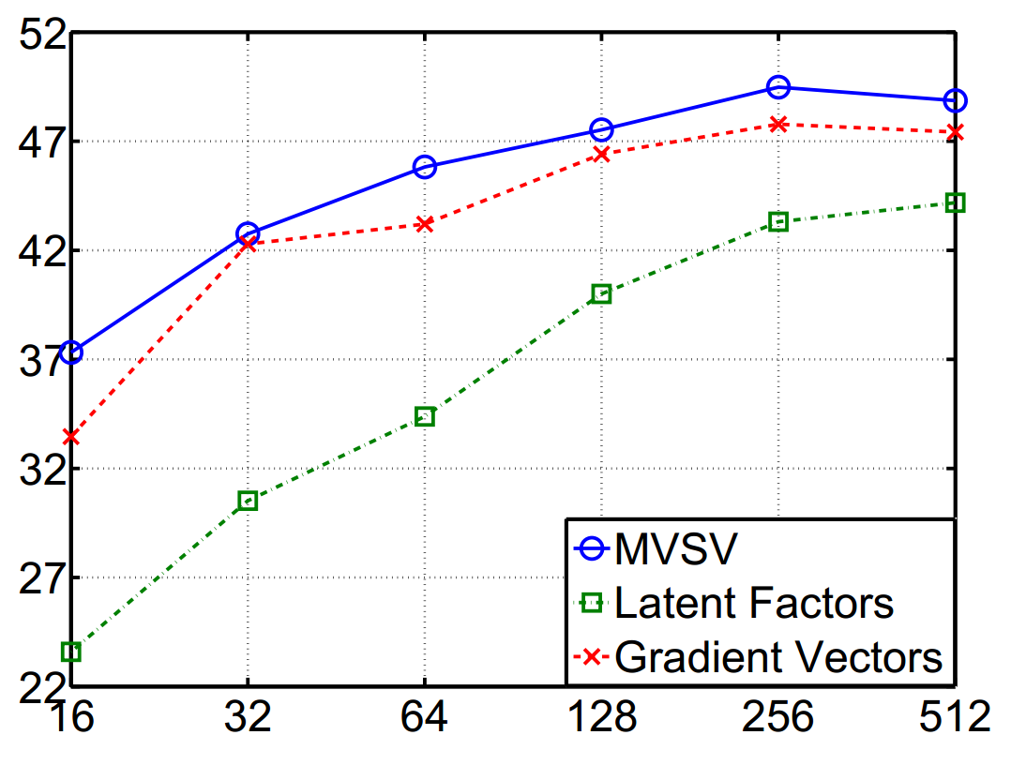
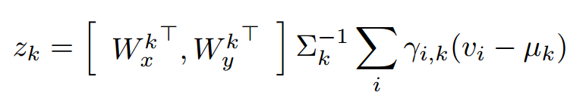
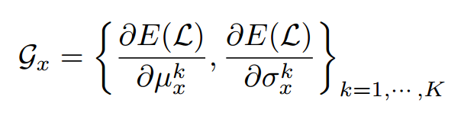
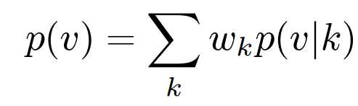
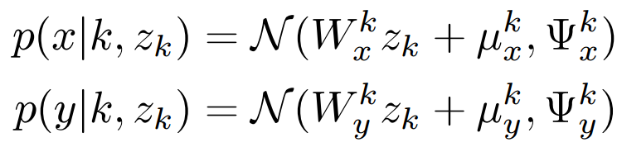
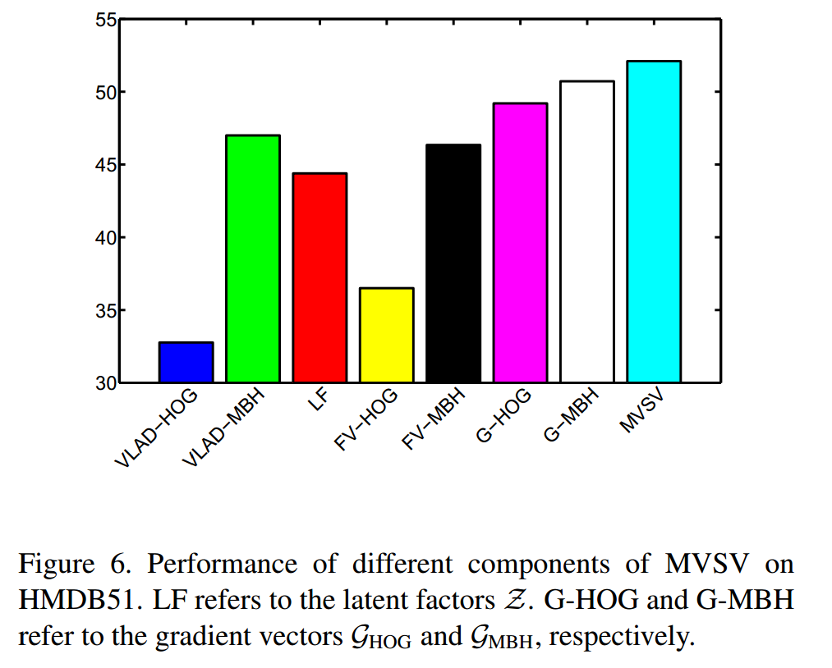
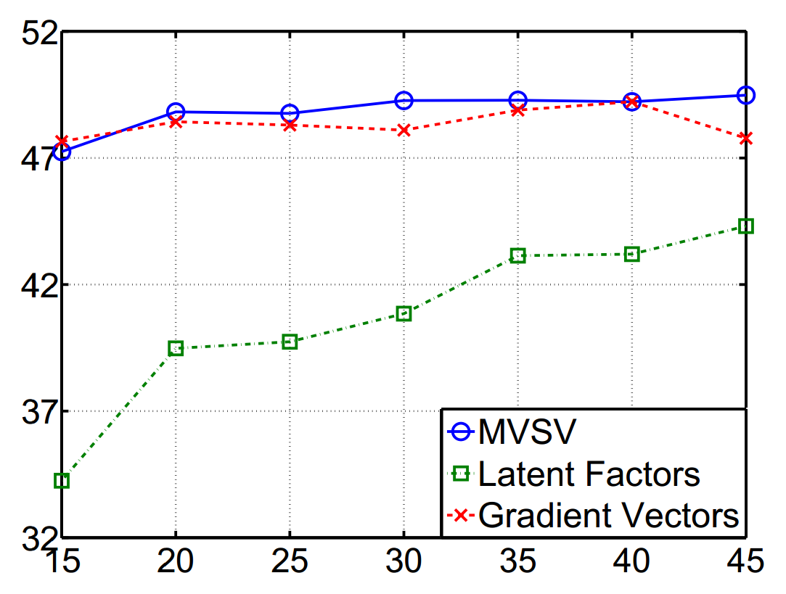
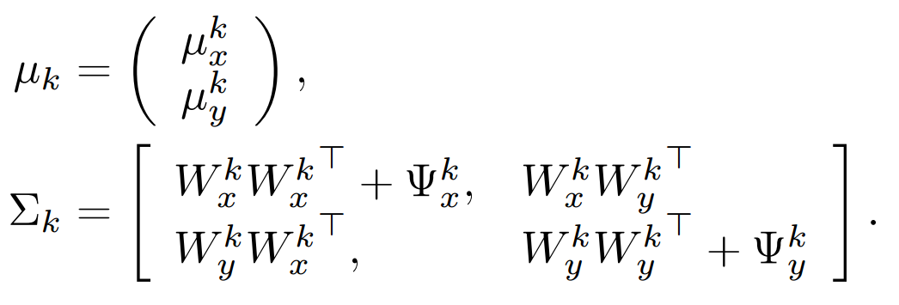
Multi-View Super Vector for Action Recognition
Zhuowei Cai¹, Limin Wang^{1,2}, Xiaojiang Peng¹, Yu Qiao^{1,2}
¹Shenzhen Institutes of Advanced Technology
²The Chinese University of Hong Kong
Motivation
Mixture model of Probabilistic CCA
Multi-View Super Vector
Experimental Results
Challenges in Action Recognition
  Different feature descriptors capture different aspects of object feature.
  Current fusion pipelines presume different properties between feature descriptors.
    Direct concatenation presumes strong correlation between fusion descriptors.
    Kernel average and score fusion prefer mutual independence between fusion descriptors.
    Typical fusion pipelines:
We utilize the Mixture of Probabilistic Canonical Correlation Analyzers to model a pair of feature descriptors.
  M-PCCA factorize descriptors from two sources into a share part between them and two parts specific to each of them.
These parts construct the super vector representation for subsequent classification.
Non-linear Distribution of Descriptors
  Descriptors are non-linearly distributed.
  Observed descriptor pair share common information.
Mixture model of Probabilistic CCA
  Tackle non-linearity with mixture model
  Encode shared information by specifying latent variable
Mathematical Formulation
  Let v = (x, y),
  x, y satisfy
  p(v | k) is Gaussian with
In each local Probabilistic CCA, shared information Z and private information λ jointly generate the observed descriptors
Shared information Z is extracted via concatenating latent information z_{k} for each local PCCA
Private information g_{x} is extracted by taking the gradients of the expected loglikelihood with respect to λ_{x} (and λ_{y})
Z, g_{x} and g_{y} form the final MVSV.
Comparison of performance on HMDB51.
Comparison of performance on UCF101.
Influence of Parameters
  Number of Components
  Latent Dimension
X
Fusion
GMM
Descriptor-level
SVM
Score
Y
X
GMM
Fusion
(linear) Kernel-level
Y
GMM
SVM
Score
X
GMM
SVM
Score
Fusion
Score-level
Y
GMM
SVM
Score
Score
Our Approach
Performance of Different Components
X
M-PCCA
Fusion
SVM
MVSV
Y
Score

