Slide 1
Action Recognition and Detection by Combining Motion and Appearance Features
Limin Wang, Yu Qiao, and Xiaoou Tang
The Chinese University of Hong Kong, Hong Kong
Shenzhen Institutes of Advanced Technology, CAS, China

Slide 2
Outline
Introduction
Method
Result
Conclusion

Slide 3
I. Introduction

Slide 4
Introduction
Action recognition from short clips has been widely studied recently (e.g. HMDB51, UCF101)
Action recognition and detection from temporally untrimmed videos received less attention.
THUMOS 14 challenge focuses on this more difficult problem.
State of the art results
UCF 101 Recognition | THUMOS 14 Recognition | THUMOS 14 Detection
87.9% | 71.0% | 33.6%

Slide 5
Introduction
There are two key problems in this challenge:
How to conduct temporal segmentation of continuous video sequence.
How to represent the video clips for action recognition.
In our current method, we only try a simple segmentation method.
We mainly focus on how to extract effective visual representation.

Slide 6
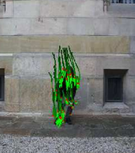
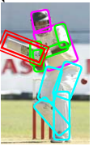
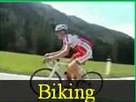
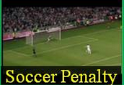
Introduction
What kinds of information are important for action understanding from video.
Motion trajectory
Pose
Interacting object
Scene category
Dynamic motion cue
Static appearance cue
Notes:
In video data, there are many cues for understanding human actions. Motion is an important feature as the humon move in a similar way as they conduct the same action. Pose is another imporntant cue. Human usually exihibit the same pose configuration when they perform the same action. In addition to motion and pose, some other context information such as object, and scene category can alos provide extra information to help action reconigiton.

Slide 7
Related Works
Dynamic motion cues:
Low-level features: STIPs [Laptev 05], Improved Trajectories [Wang13] etc.
Mid-level representation: Motionlet [Wang 13], Discriminative patches [Jain etc 13], Motion atoms and phrases[Wang13] etc.
High-level representation: Action Bank [Sadanand12] etc.
From THUMOS 13, it is known that Fisher vector of improved dense trajectories is very effective.
From our experience, the mid-level representation is complementary to FV of IDT.

Slide 8
Related Works
Pose: Poselet [Bourdev09], Mixture of parts [Yang13] etc.
Object: Deformable part model [Felzenszwalb10] etc.
Scene: Gist [Oliva01], Discriminative Patches [Singh12] etc.
Recently, deep CNN obtains much better results with theses tasks.
Deep CNN will need a large number of training samples with supervised labels.

Slide 9
II. Method

Slide 10
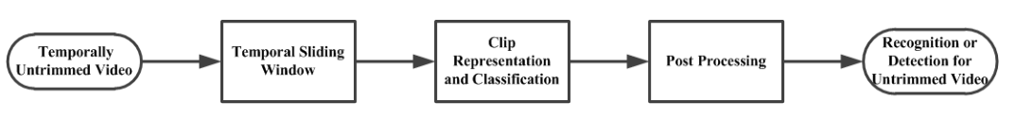
Overview of Our Method
We propose a simple pipeline for action recognition and detection from temporally untrimmed videos
It is composed of three steps: temporal segmentation, clip representation and recognition, post-processing

Slide 11
Temporal Segmentation
We use the simple temporal sliding window method.
In current implementation, we just a single temporal scale for sliding window (duration =150 frames, step = 100 frames)
Window duration
Sliding step

Slide 12
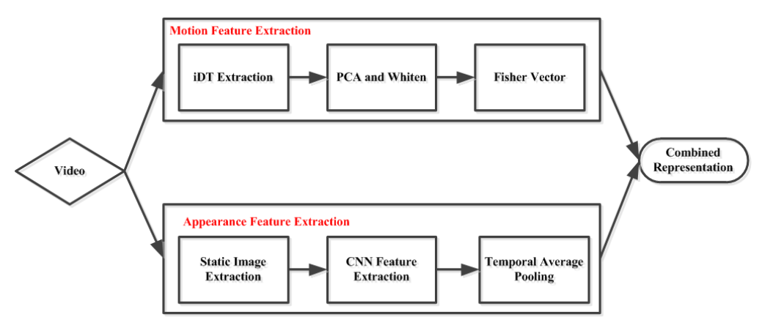
Clip Representation

Slide 13
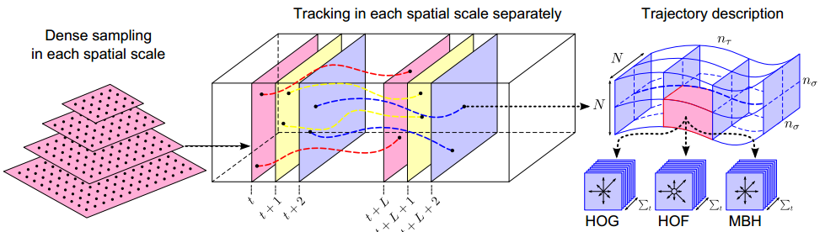
Improved Dense Trajectories
Improved dense trajectories extract: HOG, HOF, MBHx, MBHy
Improved dense trajectories firstly estimate camera motion and compensate it.
[1] Heng Wang and Cordelia Schmid, Action Recognition with Improved Trajectories, in ICCV 2013.

Slide 14
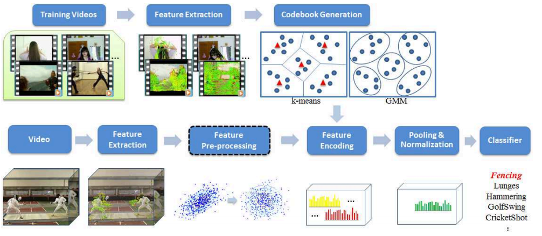
Bag of Visual Words
There many choices in each step of BoVW and implementation details are important.
Super vector encoding outperforms others.
[1] X. Peng, L. Wang, X. Wang, Y. Qiao, Bag of Visual Words and Fusion Methods for Action Recognition: Comprehensive Study and Good Practice. CoRR abs/1405.4506, 2014

Slide 15
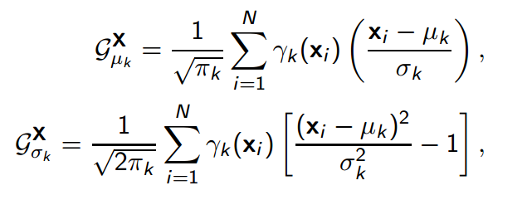

Fisher Vector
Given a set of descriptors: , we learn a generative GMM:
Given the descriptors from video clip, we derive the Fisher vector:
In our current implementation, we choose power ℓ2-normalization (α = 0.5) to obtain final representation S :

Slide 16
CNN Activation
Conv1
Conv2
Conv3
Conv4
Conv5
Full6
Full7
Soft
Max
We firstly resize frame as 256*256 and then crop a region as 227*227
We use the Caffe implementation of the CNN described by [Krizhevsky et al.]
We extract the activation of Full7 as CNN features (4096 dimensions) and conduct average pooling over different crops.
[1] Jia, Y.: Caffe: An open source convolutional architecture for fast feature embedding. (2013)
[2] Krizhevsky, A., Sutskever, I., Hinton, G.E.: Imagenet classification with deep convolutional neural networks. In: NIPS. pp. 1106–1114 (2012)

Slide 17
CNN Fine-tuning
We fine tune the parameters of CNN using the UCF101 dataset through 50,000 iterations.
We extract 10 frames from each video and use the video label as frame label to fine tune the ImageNet training result
The batch size is set as 256, drop out ratio as 0.5, iteration: 50,000.
Results of Split 1 on UCF 101
Without fine tuning | With fine tuning
65.3% | 70.5%

Slide 18
Feature Fusion
For appearance feature, we extract CNN activations on 15 frames and perform average pooling to get the representation of video clip.
For motion feature, we use FV for each descriptor of IDT features independently.
Both appearance and motion features are firstly normalized and then concatenated as a hybrid representation.
The fusion weight: appearance (0.4), motion (1.0).

Slide 19
Classifier
We choose linear SVM classifier for action recognition and detection using Training dataset and Background dataset.
For multi-class classification, we use the one vs. all training scheme.
To void false detections, we randomly select 4,000 clips from the background dataset as negative examples when training SVM for each action class.

Slide 20
Post Processing
To obtain the action recognition result for the whole video sequence, we conduct max pooling over the recognition result of video clip.
To avoid false positive recognition and detection, we simply use three thresholds:
Clip level threshold t₁: for each clip, there are at most t₁ action instances.
Sequence level threshold t₂: for each sequence, there are at most t₂ action instances.
SVM score threshold t₃: elimination of detection instance with confidence score lower than t₃.

Slide 21
III. Experimental Results

Slide 22
Experiment Results 1
Action recognition result of Split1 on UCF 101
Motion Feature | Appearance Feature | Fused Feature
85.3% | 70.5% | 89.1%
Action recognition result on validation dataset of THUMOS 14
Motion Feature | Appearance Feature | Fused Feature
57.1% | 48.2% | 65.3%

Slide 23
Experiment Results 2
Action recognition result on test dataset of THUMOS 14
(t₁,t₂) | (1,10) | (1,20) | (5,10) | (5,20) | (101,101)
Result | 0.617 | 0.6177 | 0.6196 | 0.6174 | 0.6201
Action detection result on test dataset of THUMOS 14
(t₁,t₂) | (1,0.5) | (1,0) | (1,-0.5) | (1,-1)
Overlap=0.1 | 0.1080 | 0.1373 | 0.1701 | 0.1818
Overlap=0.2 | 0.1042 | 0.1319 | 0.1591 | 0.1700
Overlap=0.3 | 0.0891 | 0.1137 | 0.1306 | 0.1405
Overlap=0.4 | 0.0765 | 0.0975 | 0.1090 | 0.1174
Overlap=0.5 | 0.0563 | 0.0695 | 0.0775 | 0.0834

Slide 24
IV. Conclusions

Slide 25
Conclusions
We prove that motion features (IDT) and appearance features (CNN) are complimentary to each other.
For FV of IDT, implementation detail such as descriptor pre-processing, normalization operation has a great influence on final performance.
For CNN feature, fine-tuning on UCF101 dataset helps to improve recognition performance.
In the future, we may consider designing more effective segmentation algorithm or performing both tasks simultaneously.

Slide 26
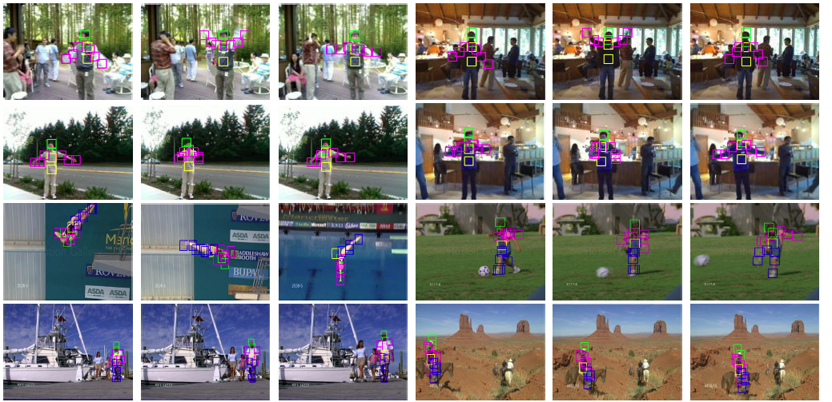
Another Work on Action Detection
We design a method unifying action detection and pose estimation in ECCV 2014:

Slide 27
Thank You! lmwang.nju@gmail.com
Welcome to our ECCV poster presentation:
Video Action Detection with Relational Dynamic-Poselets (Session 3B).
Action Recognition with Stacked Fisher Vectors (Session 3B).
Boosting VLAD with Supervised Dictionary Learning and High-Order Statistics (Session 2B).

