Slide 1
Session 3A: Thursday Morning, June 27th
Motionlets: Mid-Level 3D Parts for Human Recognition
LiMin Wang^{1,2}, Yu Qiao², Xiaoou Tang^{1,2}
1. The Chinese University of Hong Kong
2.Shenzhen Institutes of Advanced Technology, CAS

Slide 2
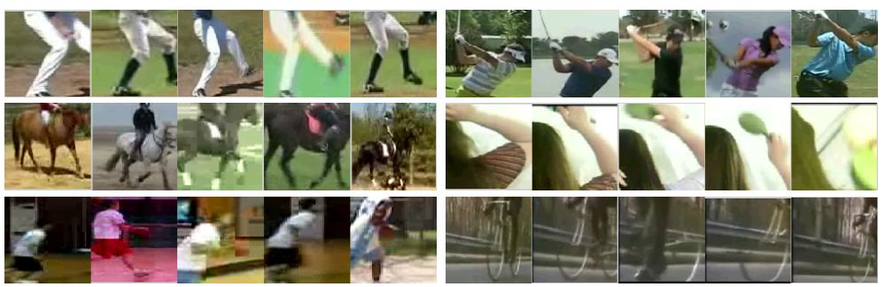
Motionlets: Mid-Level 3D Parts for Human Motion Recognition
P3A-18
Motionlet is a mid-level 3D (spatio-temporal) part of motion, which describes the moving process of parts, objects, visual phrases.
The motionlet has three key properties: high-motion saliency, multiple scales, representative & discriminative ability.
The construction of motionlet consists of three steps:
Extracting motion salient regions
Finding motoionlet candidates
Ranking
motionlets
Examples of
motionlets

