Slide 1
Poster Spotlights
Session 3B: Thursday Afternoon, December 5th
Mining Motion Atoms and Phrases for Complex Action Recognition
LiMin Wang, Yu Qiao, and Xiaoou Tang

Slide 2
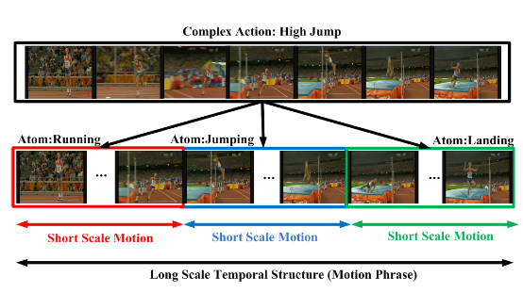
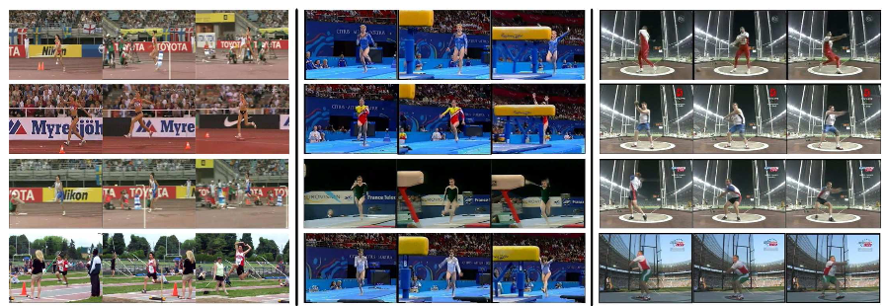
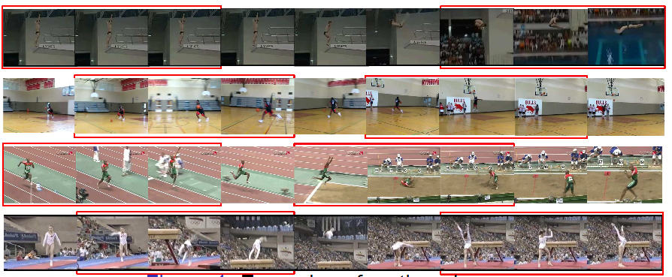
Mining Motion Atoms and Phrases for Complex Action Recognition
P3B-43
Mine motion atom and phrase from action videos, which act as temporal parts of action.
  Motion atoms describe patterns of short temporal duration
  Motion phrases capture longer temporal structure
Method (Olympic) | Performance
Niebels(ECCV 2010) | 62.5%
Liu(CVPR 2011) | 74.4%
Tang(CVPR 2012) | 66.8%
Wang(IJCV 2013) | 74.1%
Our Best | 84.9%
Examples of motion atoms
Method (UCF50) | Performance
Sadanand(CVPR 2012) | 57.9%
Kliper-Gross(ECCV 2012) | 72.6%
Wang (CVPR 2013) | 73.9%
Wang (IJCV 2013) | 84.5%
Our Best | 85.7%
Examples of motion phrases

