Slide 1
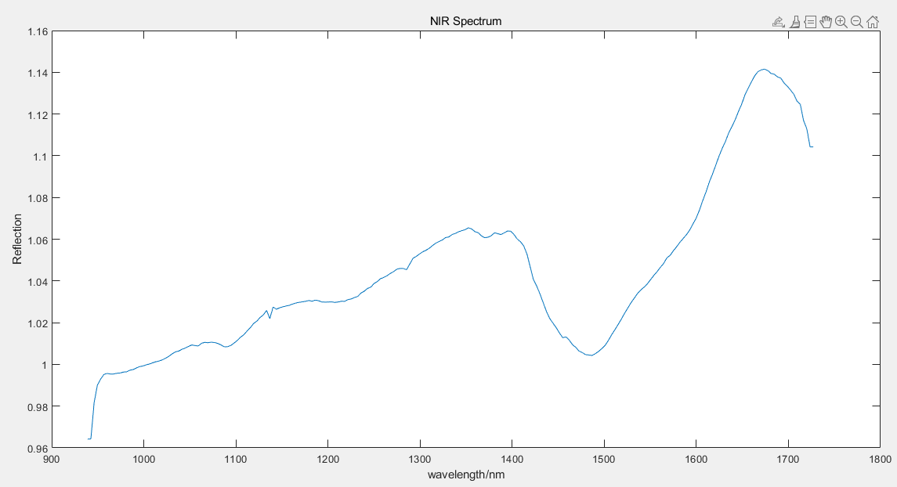
Spectrum Feature Extraction
NIR (Near-infrared spectroscopy）Basic Introduction:
Y axis: Reflection
X axis: Wavelength
OH-Bond Absorption
Notes:
于改了标题，与上一个对应

Slide 2
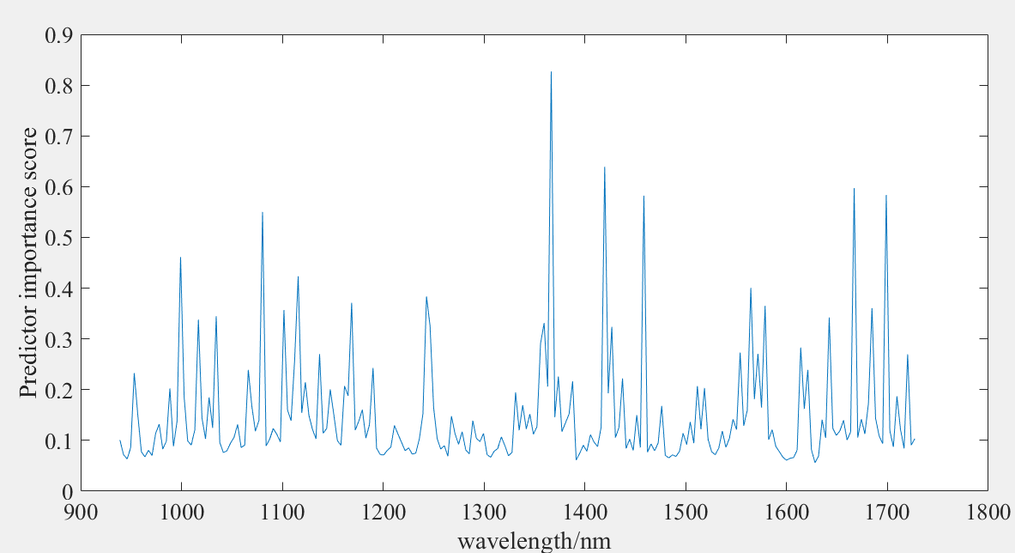
Feature Extraction by Matlab
Wavelength/nm | 1370 | 1423 | 1670 | 1701 | 1461 | 1084
Score | 0.827 | 0.639 | 0.597 | 0.584 | 0.582 | 0.55
Notes:
Wavelength index在之前或者这一页需要解释一下

Slide 3
Classification only based on NIR
 | Decision Trees | SVM Second Order | KNN
Only LDA | 94.0% | 96.9% | 95.6%
Only Matlab Function | 83.6% | 90.8% | 89.6%
Combination | 94.6% | 98.0% | 97.2%
Feature from dimensionality reduction(6) with LDA and feature selection with MRMR(6)
Split the data randomly: 70% for training, 30% for validation.

Slide 4
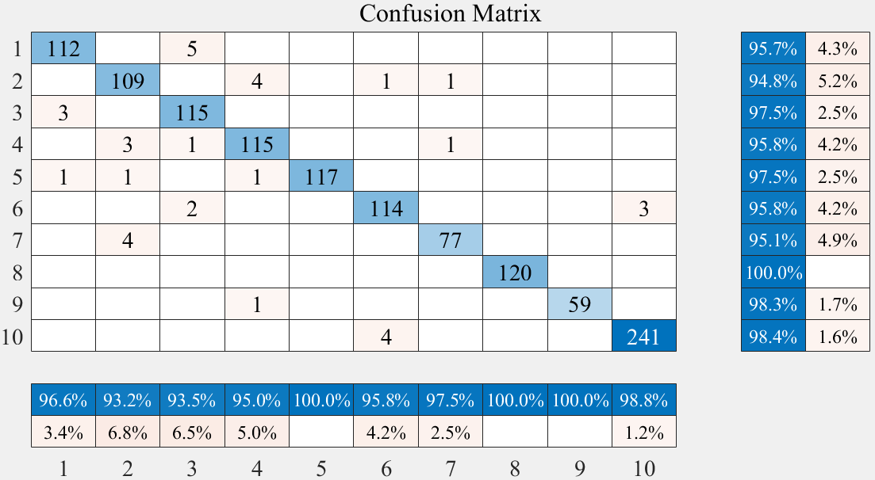
Result of Classification: NIR
Durchgefärbt
gKarton
gPapier
Magzine
Wellpappe
Werberhefte
wKarton
wPapier
wWellpappe
Zeitung
Real
Prediction
Success prediction rate: 97%

