Slide 1
Social Apps by Shalini Toopran
© Shalini Toopran

Slide 2
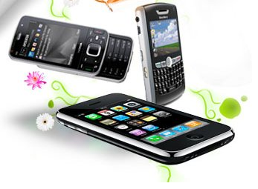
What is it?
A social networking app focuses on building online communities of people who share interests and/or activities, or who are interested in exploring the interests and activities of others.
Most social network services are web-based.

Slide 3
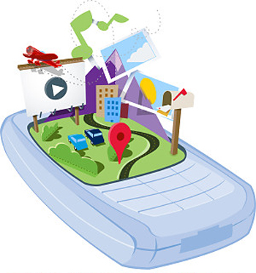
Various fields using social apps:
There are currently 200,000 active social networks right now!!
Government
Business
Education
Medical
Friends

Slide 4
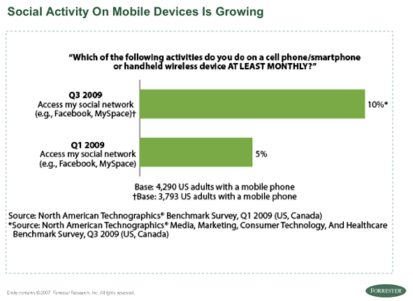
Social Activity on mobile devices is growing
Social Networking via mobile phones has doubled in the last 6 months

Slide 5
Some interesting apps:
Palringo
Beejive
Google wave
Centrl

Slide 6
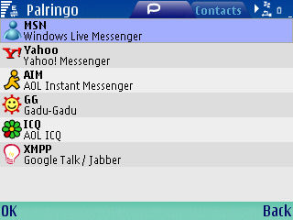
Palringo
What is Palringo?
It is the ultimate Instant Messaging client for mobile phones and computers.
Features:
One Universal Instant Messenger
Voice Message at the click of a button
Photo sharing
View location
Create groups and broadcast
Automatically update status on social networking sites

Slide 7
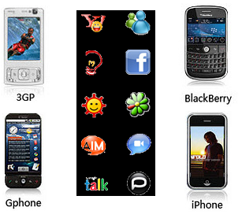
Palringo is free to download. It works on just about every phone. Some of the mobile devices supported include:
Android
Apple iPhone and iPod Touch
Blackberry
Java
Symbian and S60
Windows Mobile

Slide 8
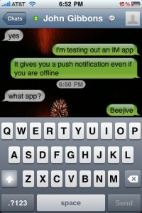
Beejive
Beejive contains all major instant messaging applications. The interface is pretty easy to navigate between one or multiple accounts. It has the ability to send an SMS through 3G, EDGE or Wi-Fi without incurring any messaging fees

Slide 9
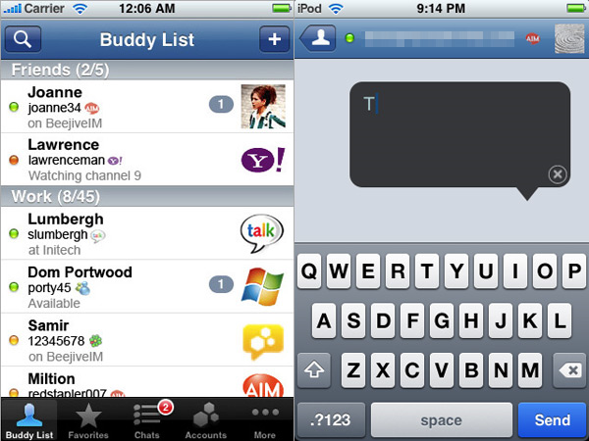
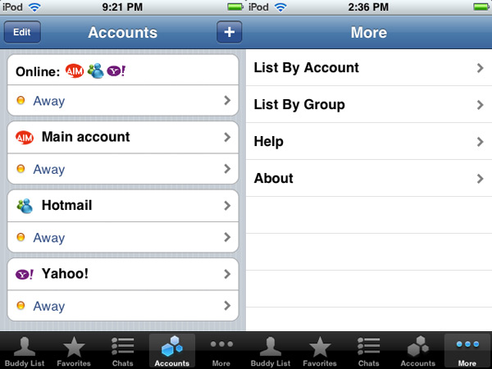
A list of current accounts, each with its own status bar, letting the user set online/offline status independently for each service.
Users can access their buddies listed by account or by group

Slide 10

Google wave
Merges e-mail, instant messaging, wikis, and social networking
Has extensions that can provide, real-time focus, spelling/grammar checking, automated translation among 40 languages and more

Slide 11
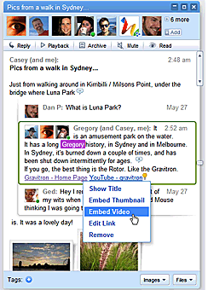
Features:
Shared. Any participant can reply anywhere in the message, edit the content and add participants at any point in the process. Then playback lets anyone rewind the wave to see who said what and when.
Live. With live transmission as you type, participants on a wave can have faster conversations, see edits and interact with extensions in real-time.

Slide 12
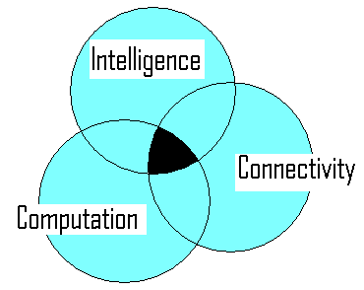
An app that has the three behaviors known:

Slide 13
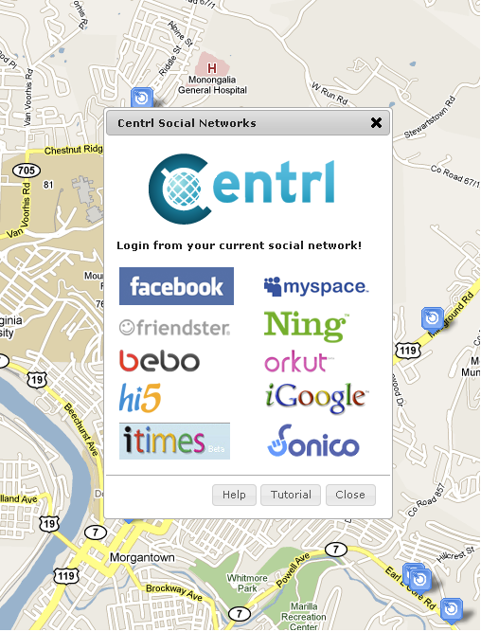
Centrl
Centrl is a location-based social network that helps you connect with your friends, share your favorite locations, discover new places and meet new people
You and your friends can use Centrl through your existing social networking account.

Slide 14
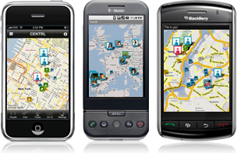
Centrl can be accessed directly from the web, or it could be downloaded as a free application to an iPhone, Blackberry or g-phone
It is free to join and free to use

Slide 15
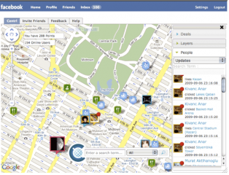
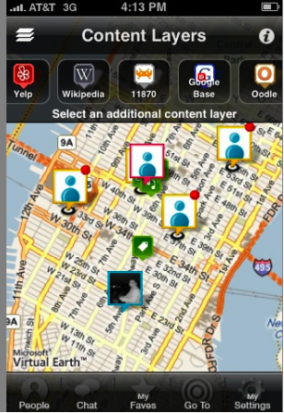
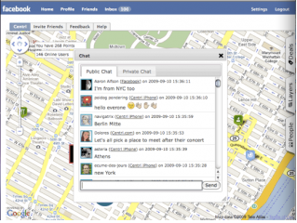

Slide 16
Cons:
Breach of privacy and data theft
Viruses and spam
Health risk
Reduced interpersonal relations
According to a recent study, the amount of time an average Briton spends interacting directly with other people has plunged dramatically - from 6 hours a day in 1987 to 2 hours 20 years later

Slide 17

Enhancements:
Users have various accounts such as Facebook, MySpace, LinkedIn, Orkut, Twitter,Digg , Google, Yahoo, Windows Live, AOL, Amazon, ebay.......
Most of them often tend to forget usernames or passwords
How about using fingerprints to login?

Slide 18
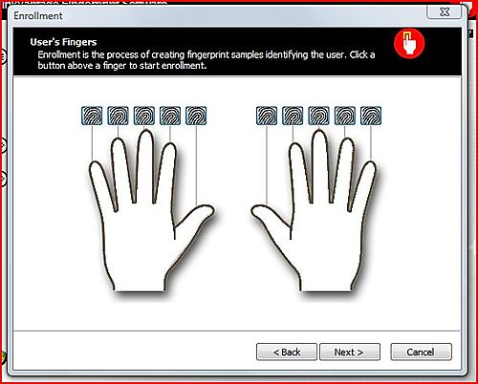
Enroll your fingerprints:

Slide 19
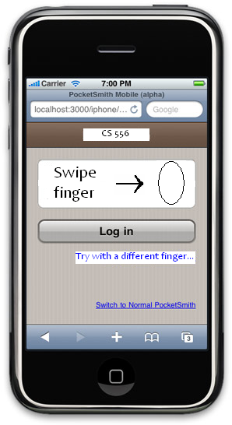
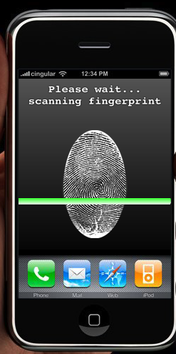

Slide 20
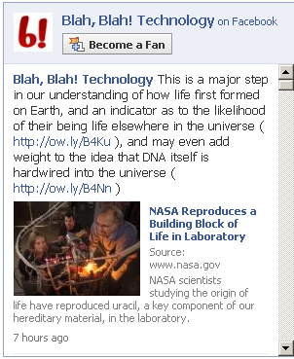
Irrelevant suggestions from friends:
We often fall victim to being sent irrelevant content suggestions by people we’ve added as friends
An intelligent app should be able to filter unwanted data

Slide 21
References:
http://en.wikipedia.org/wiki/Social_network_service
http://www.technologyreview.com/
http://wave.google.com/help/wave/about.html
http://www.ilounge.com/index.php/articles/comments/iphone-gems-the-best-instant-messaging-apps
http://woork.blogspot.com/2009/03/10-interesting-social-applications-for.html

Slide 22

Thank you….
Questions / Comments

