Slide 1
Text Mining Algorithms
Methods for Efficient JAN Comparison

Slide 2

What is text mining?
http://www.dashboardinsight.com/CMS/e01d472c-862e-4e13-8b23-591f8938889a/text_mining340x220.png
“Text mining refers generally to the process of extracting interesting information and knowledge from unstructured text.”
(Hotho, Nurnberger, and Paab)

Slide 3


There are different methods of text mining...
What we used: TFIDF - “Term Frequency Times Document Frequency”
(images from Wikipedia article on TFIDF)

Slide 4
Linear Time Document Clustering
Fast and Effective Text Mining Using Linear-time
Document Clustering
Excerpt from abstract:
“Clustering is a powerful technique for large-scale topic discovery
from text. It involves two phases: first, feature extraction maps
each document or record to a point in high-dimensional space,
then clustering algorithms automatically group the points into a
hierarchy of clusters. We describe an unsupervised, near-linear
time text clustering system that offers a number of algorithm
choices for each phase.”
(Larsen, and Aone)

Slide 5
Larsen and Aone – Text Mining Tool
“In this paper, we first describe our fast, scalable document
clustering system. This text mining tool is designed to discover topic hierarchies in gigabytes of documents per day”

Slide 6
Basic Runthrough
Feature Extraction (mapping documents → topics) – actually used tfidf
Clustering (using k-means, Scatter/Gather, to gather documents into “clusters”, refinement, etc)
Evaluation: What is the “quality” of the clusters? (compared to human evaluations)

Slide 7
Bottom line
Efficiency: “Current throughput using the default near-linear algorithms, including all pre-processing (e.g., for building a term frequency baseline) and feature-extraction, is 1.5 hours for 1 gigabyte of text (-200,000 documents) on a Sun ULTRA 1 with 256MB RAM.”
Results: “Our results support two feature extraction techniques. First, weighting extracted terms using tfidf produces better results than using term frequency alone for all corpora but those with the smallest number of documents. Second, truncating feature vectors saves time (clustering time and vector length appear to be very roughly proportional), at the expense of cluster quality.”

Slide 8
Revisiting TFIDF...
Improved Feature Selection Approach TFIDF In Text Mining
Feature Selection - “Feature selection also helps people to acquire better understanding about their data by telling them which are the important features and how they are related with each other.” - Wikipedia article on Feature Selection
...Sound familiar?

Slide 9
Improved Feature Selection Approach TFIDF In Text Mining
"The document frequency DF(t) is the number of documents in which the word t occurs at least once. The inverse document frequency IDF(t) can be calculated from the document frequency." (Jing, Huang, and Hong-Bo)
That is, divide the total number of documents by the DF in order to get the IDF.

Slide 10
TFIDF
Multiply by DF by IDF, and we acquire TFIDF. This is not necessarily enough, however.

Slide 11
Intermediary steps
"Before applying feature selection to documents, we use the following two steps on the data source: pruning of infrequent words and pruning of high frequency words."
(Jing, Huang, and Hong-Bo)
In their specific experiments, words had to occur at least 3 times in the training set.

Slide 12
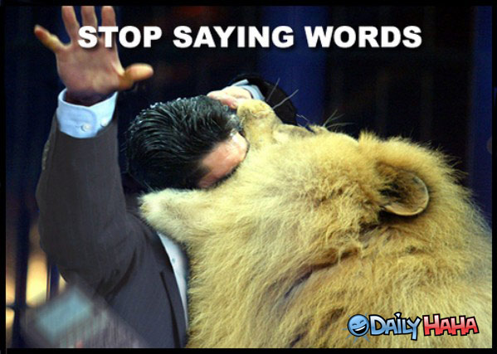
Why remove high frequency terms?
http://www.dailyhaha.com/_pics/stop_saying_words_lion.jpg
These are otherwise known as “stop words.” This came up in GKAV.

Slide 13
Bottom line
“To our surprise, the final classification precision is up to 88% with the same classifying method: Naive Bayes classifier, which is very exciting.” (Jing, Huang, and Hong-Bo)
I.E.: TFIDF is very effective when used properly.

Slide 14
How does this all tie together?
Text mining is an important aspect of determining relatedness for a knowledge advantage machine
There are various methods of text mining
These methods are viable in different ways, suited for different tasks
TFIDF, through my own group's experimentation, anecdotally appears to work appropriately for a knowledge advantage machine

Slide 15
Bibliography/Citations
Hotho, Andreas, Andreas Nurnberger, and Gerhard Paab. "A Brief Survey of Text Mining." Print.
Larsen, Bjornar, and Chinatsu Aone. "Fast and Effective Text Mining Using Linear-time Document Clustering." Print.
Jing, Li-Ping, Hou-Kuan Huang, and Shi Hong-Bo. "Improved Feature Selection Approach TFIDF In Text Mining." Print.

Slide 16

Any questions?
http://www.canberra.edu.au/__data/assets/image/0009/686070/questions.jpg

