Slide 1
Tutorial:
Intro to Scanning Tunneling Microscopy
UT Austin, Wang Materials Group

Slide 2
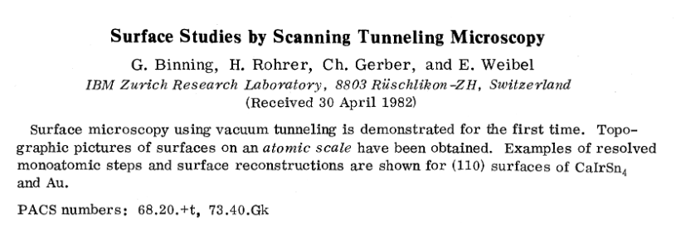
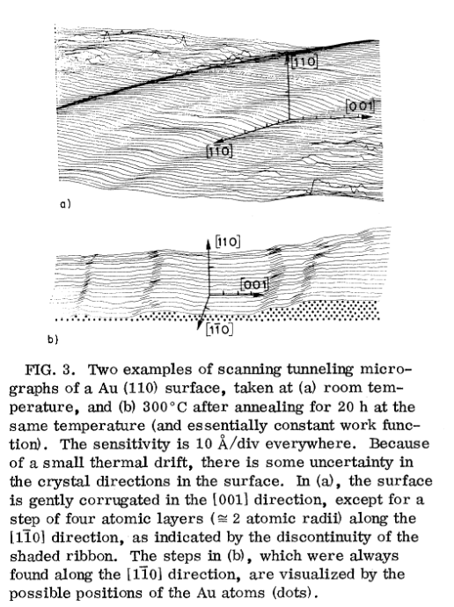
https://dx.doi.org/10.1103/PhysRevLett.49.57
2 modes of operation: imaging and spectroscopy
Imaging: constant current, constant height
Spectroscopy: sweep V_{bias} or vary tip height from sample to obtain I-V

Slide 3
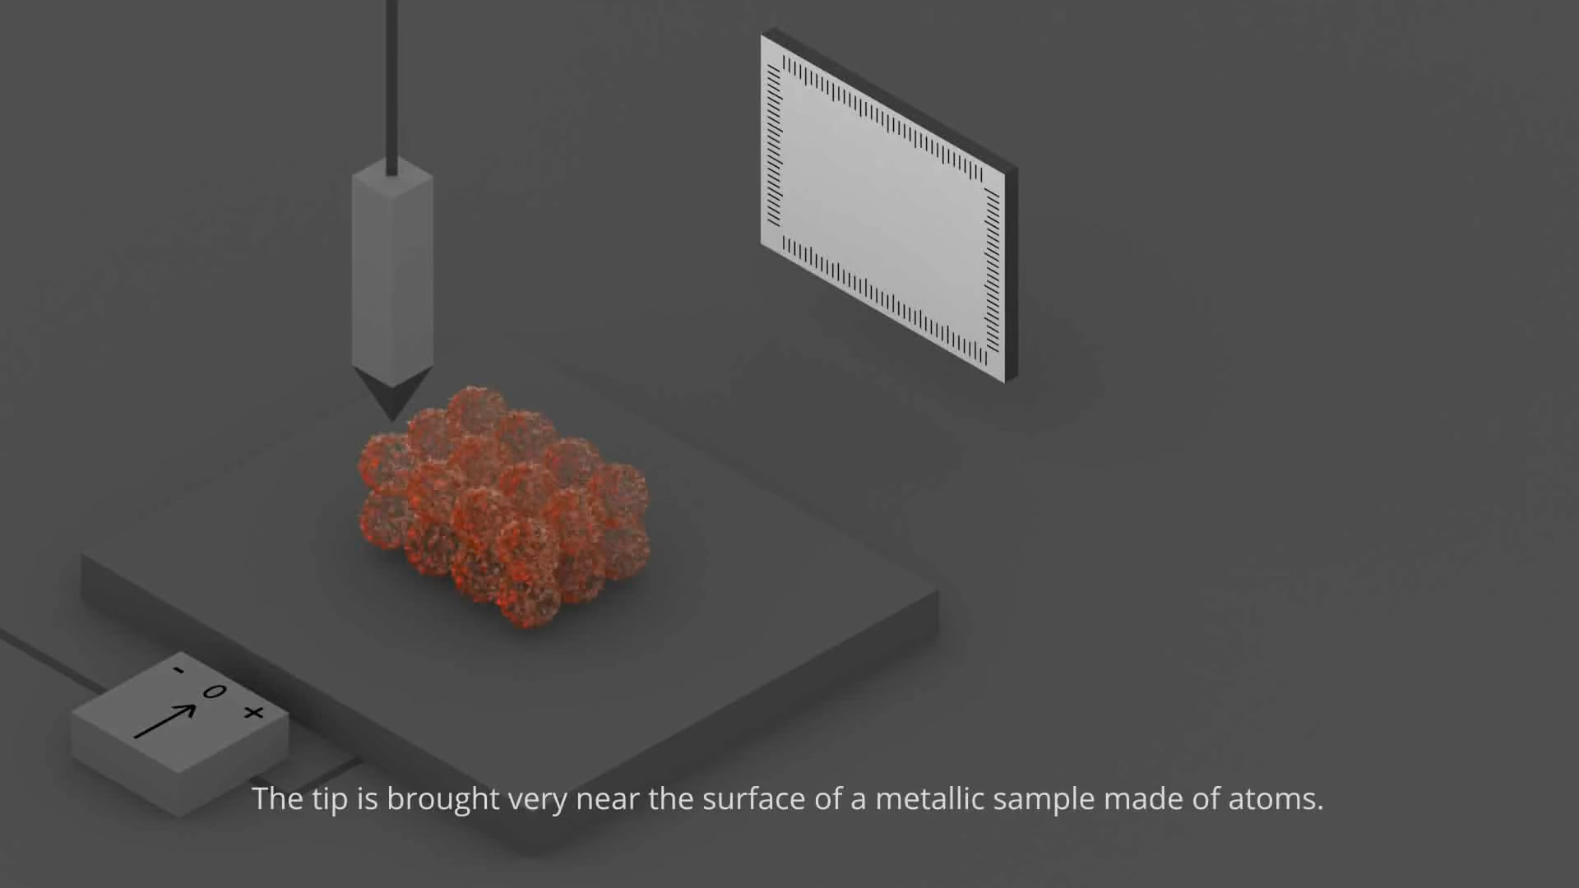
https://en.wikipedia.org/wiki/File:Scanning_Tunneling_Microscope.ogv

Slide 4
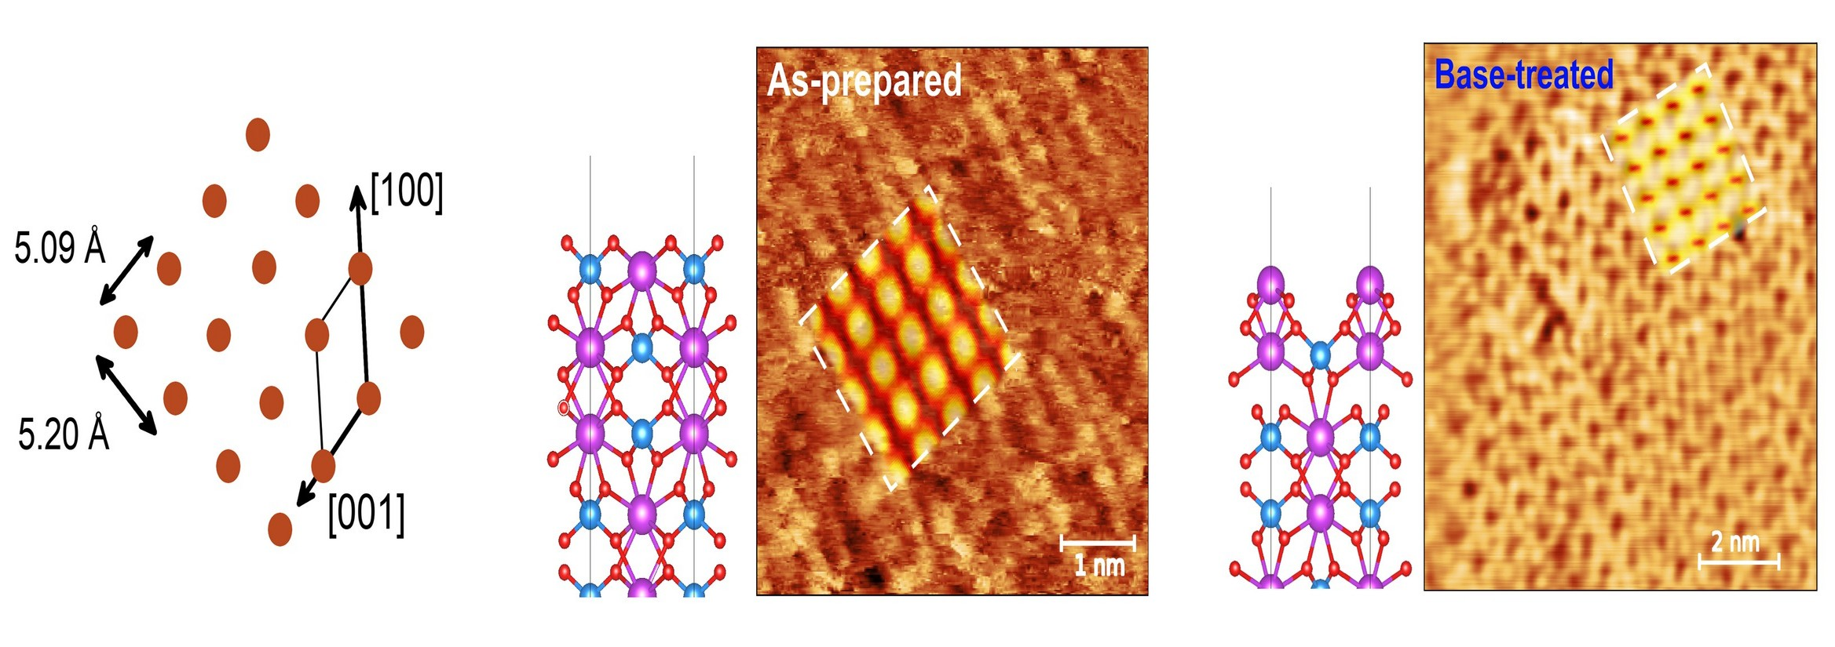
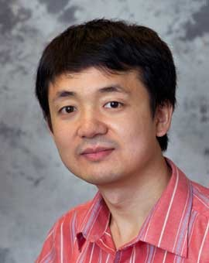


Surface termination impacts photocurrent
We prepared experimental and computational samples with two different surface terminations: as-grown and base-treated (010) surface.
aka “Stoichiometric” surface
aka “Bi-rich” surface
D. Lee, W. Wang, C. Zhou, X. Tong, M. Liu, G. Galli, K.S. Choi.
Nature Energy. 6, 287–294 (2021) 10.1038/s41560-021-00777-x
Analyzed with
Gwyddion
10

Slide 5
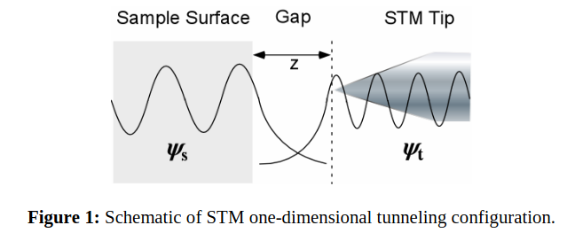
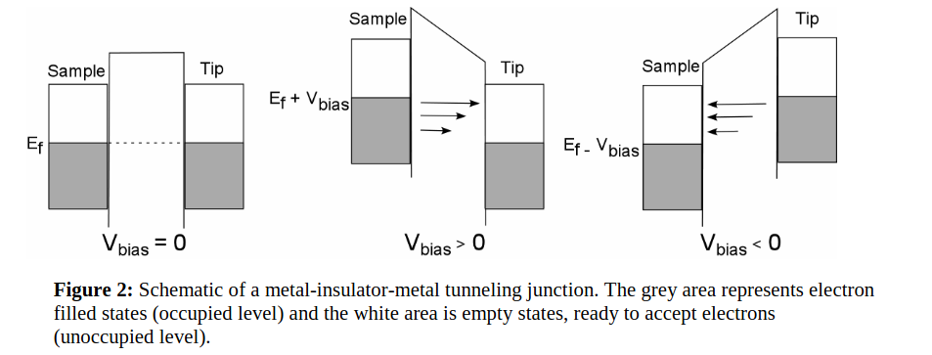
http://depts.washington.edu/nanolab/NUE_UNIQUE/Background/AFM.pdf

Slide 6
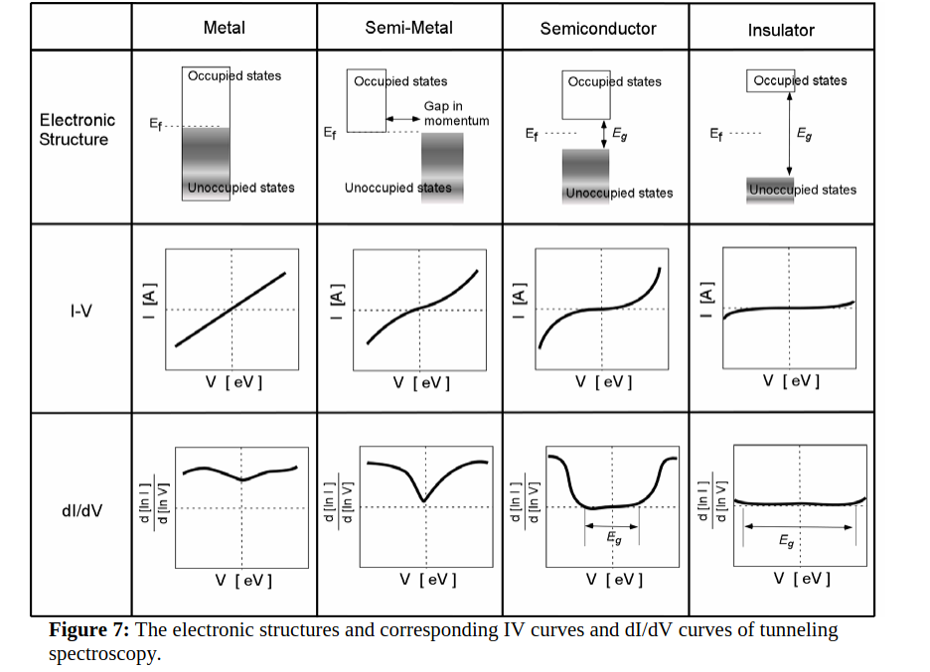
http://depts.washington.edu/nanolab/NUE_UNIQUE/Background/AFM.pdf

Slide 7

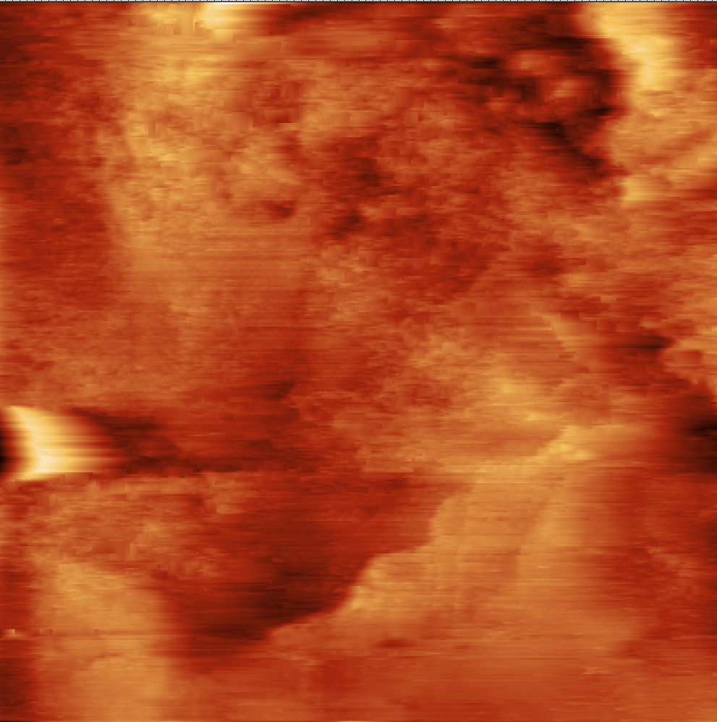
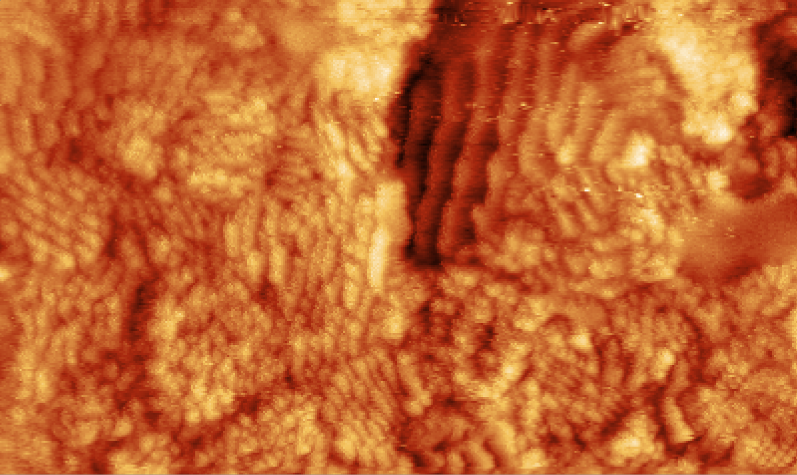
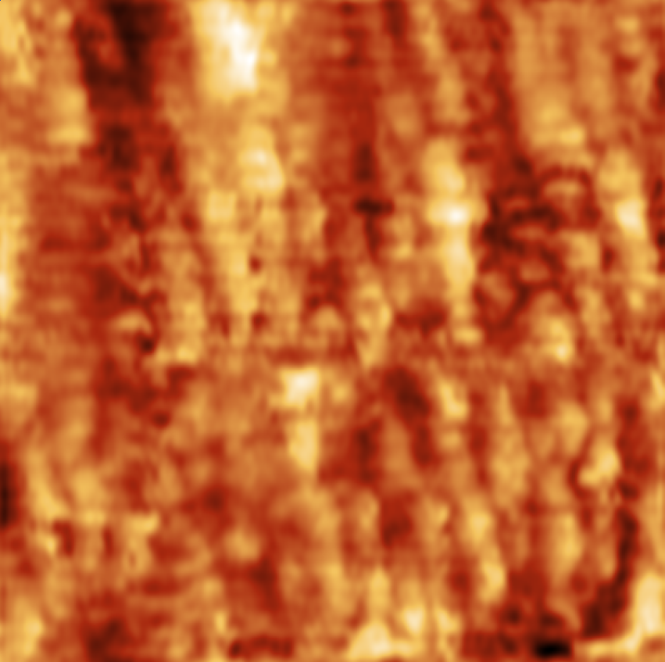
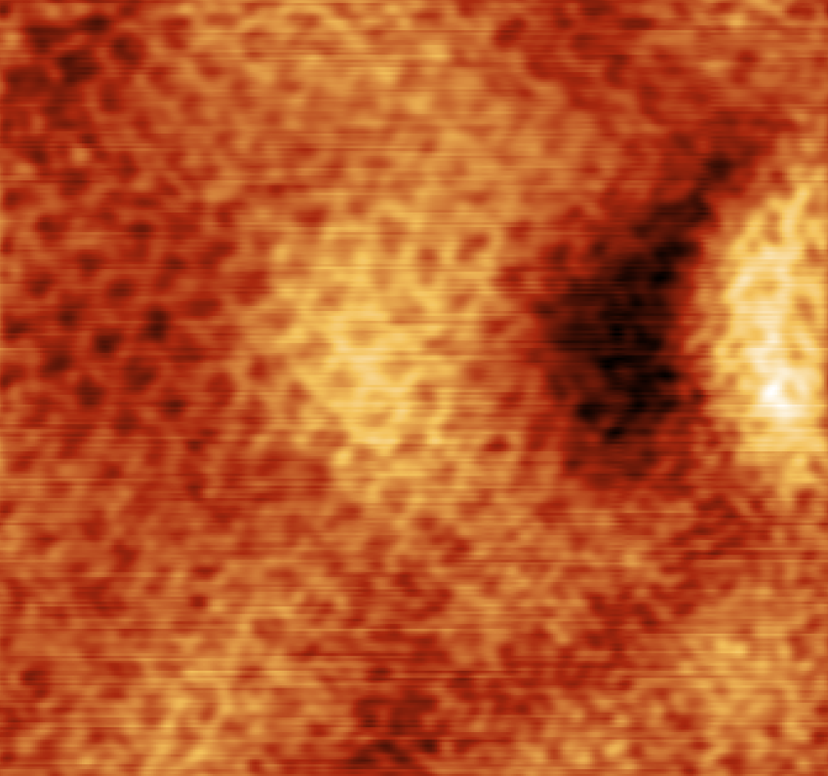
Sampling other areas with STM
As-grown Epitaxial
Bi-rich surface
46_3 (~500 x 500 nm)
61_1 cropped (~100 x 55 nm)
51_4 (~15 x 15 nm)

Slide 8
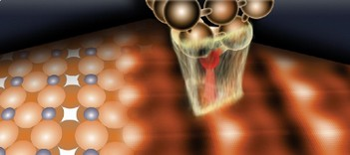
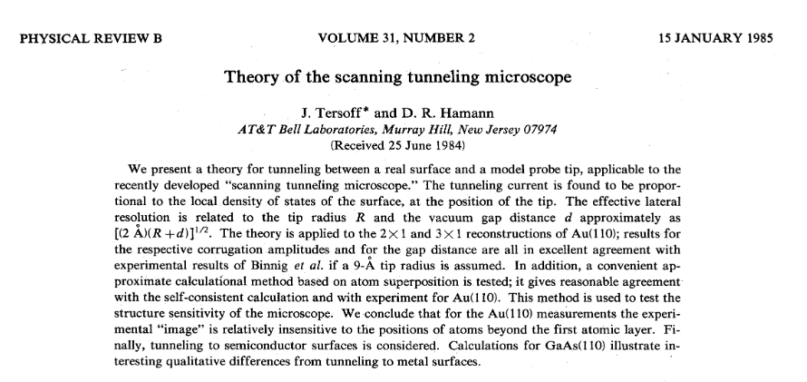
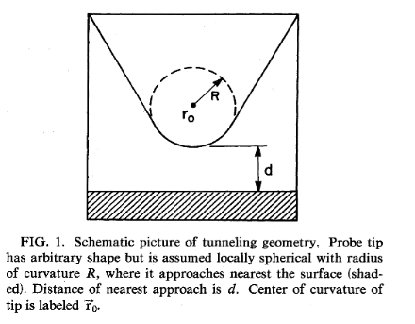
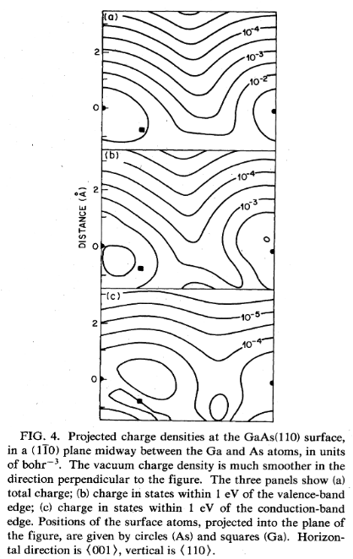

Simulated STM scans with DFT+U
Determination of surface morphology
Mönig et al. ACS Nano. 7, 10233 (2013).
> Effects of the tip
Quantum ESPRESSO implements:
Tersoff-Haman
> LDOS@surf
Tersoff & Haman. Phys. Rev. B. 31, 805 (1985)
Notes:
Dominanant LDOS to STM:
From analysis of surface atom LDOS contributions
Bi-rich:
VB: Bi (s, p; 2nd layer) + Bi (p; 1st layer) + V (d; 2nd layer)
CB: V (d; 2nd layer); Bi (p; 1st layer)
Stoich:
VB: Bi (s,p) + V (s)
CB: Bi (p) + V (d) (most from second layer- so shifted)

Slide 9
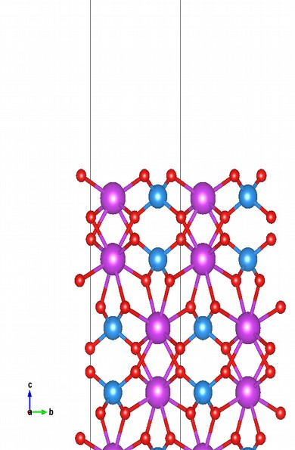
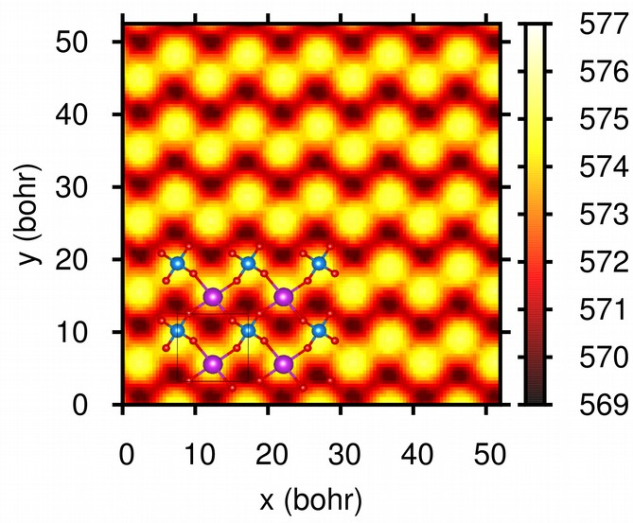
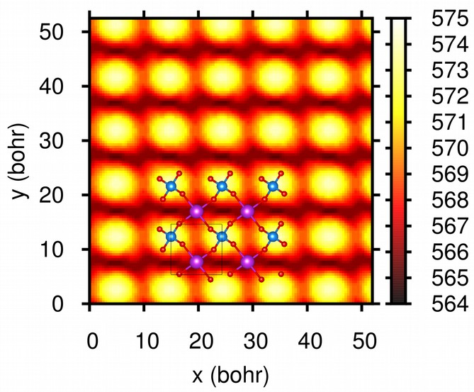
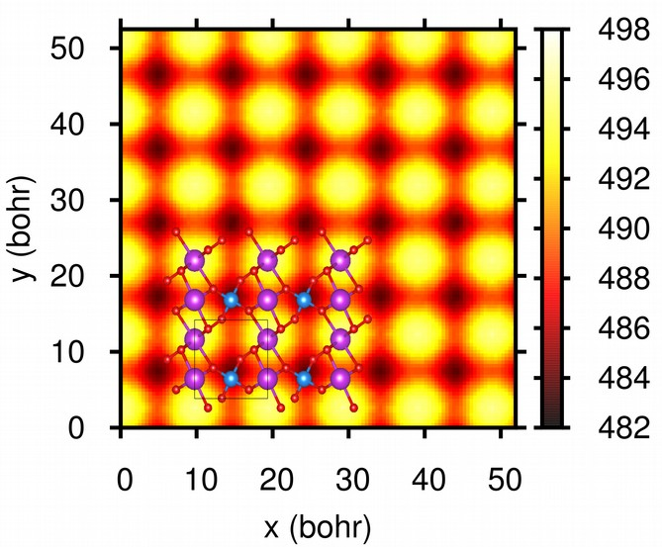
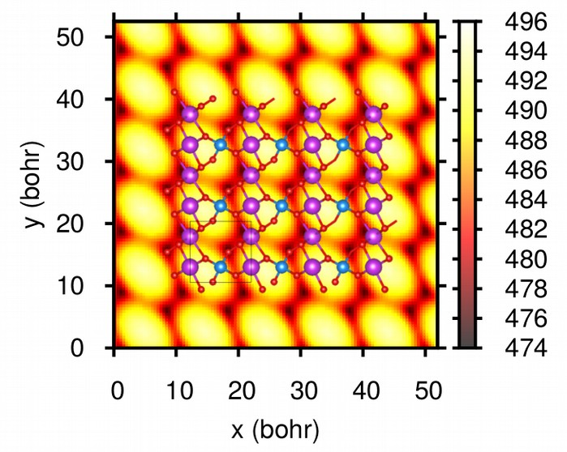
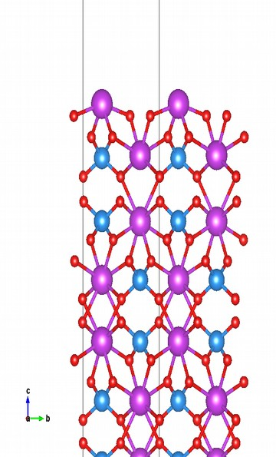
Simulated STM scans with DFT+U
Determination of surface morphology
Surface | VBs (-) | CBs (+)
Stoich.
Bi-rich
Mönig et al. ACS Nano. 7, 10233 (2013).
> Effects of the tip
(-2eV)
(+2eV)
Tersoff-Haman
> LDOS@surf
Quantum ESPRESSO implements:
Tersoff & Haman. Phys. Rev. B. 31, 805 (1985)
(-2eV)
(+2eV)
Notes:
Dominanant LDOS to STM:
From analysis of surface atom LDOS contributions
Bi-rich:
VB: Bi (s, p; 2nd layer) + Bi (p; 1st layer) + V (d; 2nd layer)
CB: V (d; 2nd layer); Bi (p; 1st layer)
Stoich:
VB: Bi (s,p) + V (s)
CB: Bi (p) + V (d) (most from second layer- so shifted)

Slide 10
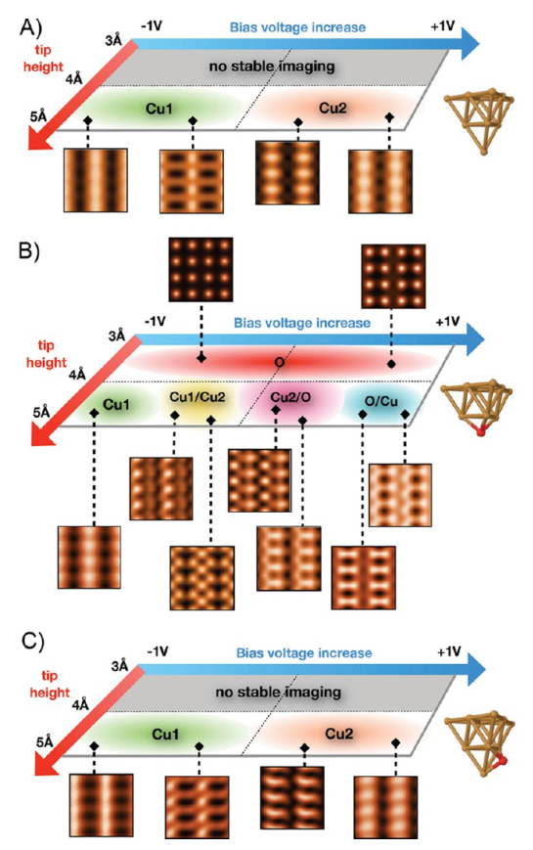
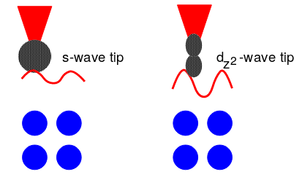
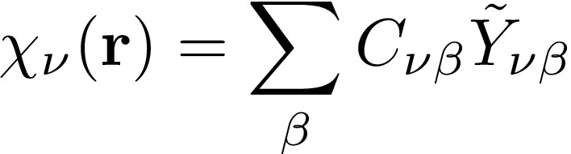
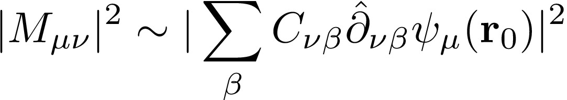
STM measurements considerations
Beyond Tersoff-Haman method:
Chen’s derivative rules:
Non-equilibrium Green’s functions
Influence of tip & measurement conditions on STM images
Cu/Cu-O tips over Cu (111) surfaces
Mönig et al. ACS Nano. 7, 10233 (2013).
Notes:
Chen’s extension to Tersoff-Haman:
Expand tip apex in spherical harmonics; matrix elements acquire a derivative operator that gives different orbital symmetries, e.g., p_i’s and d_i’s

Slide 11
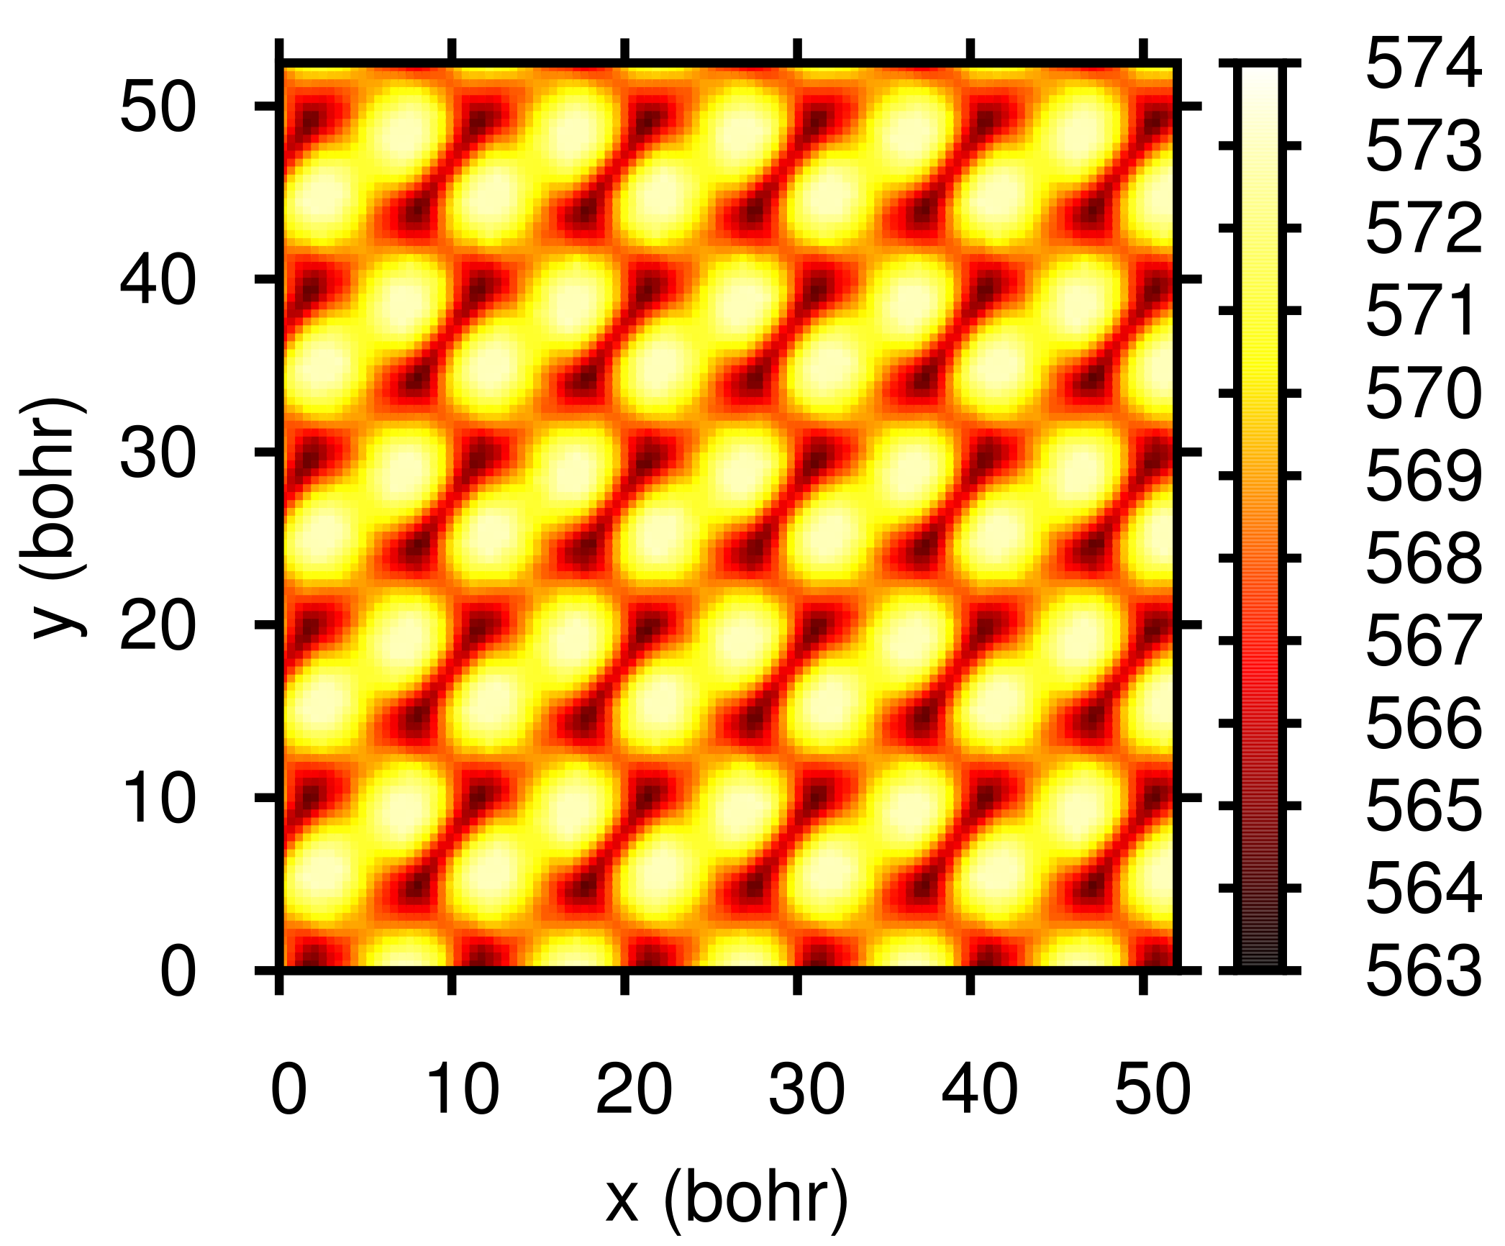
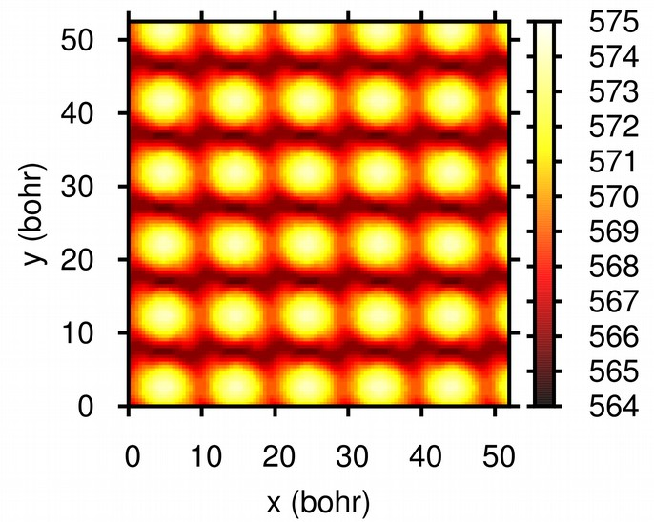
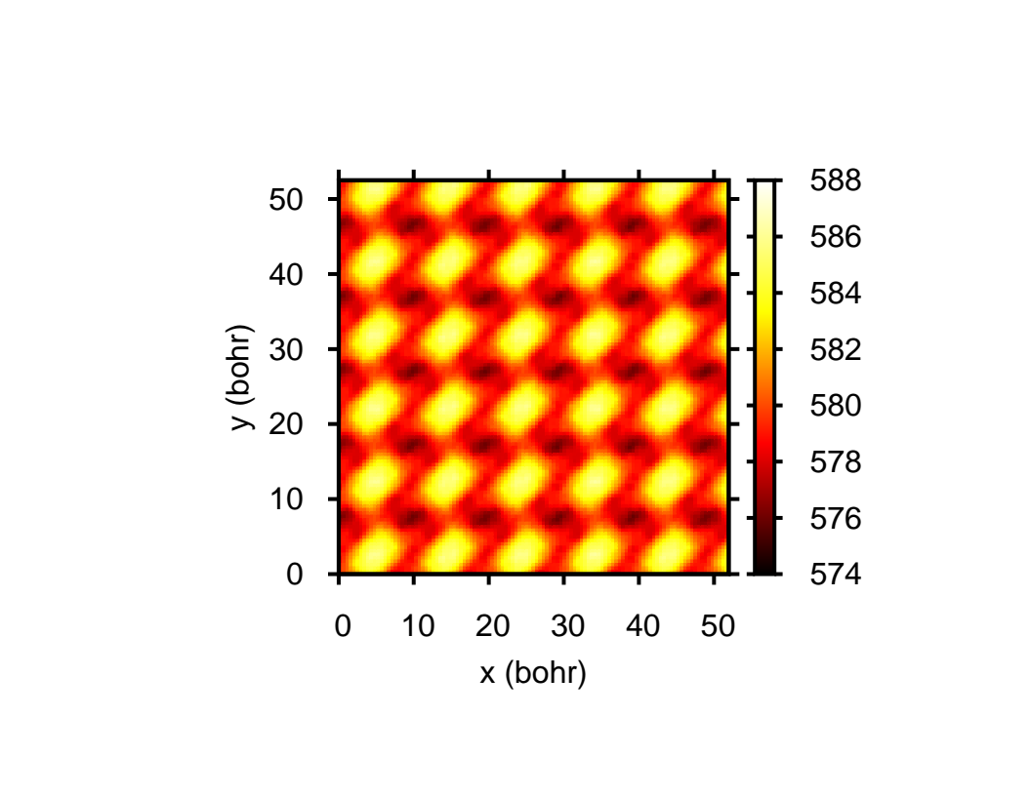
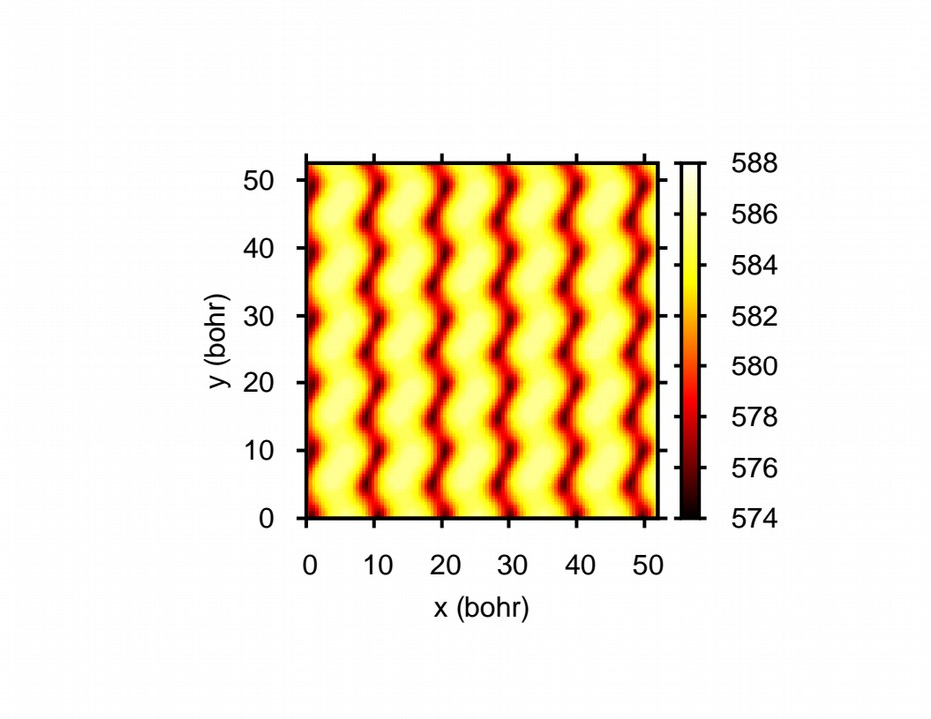
STM: Stoich. BVO (001), LDOS
Influence of sampling bias
VBs
CBs
2.0 eV
1.2 eV

Slide 12
Bringing Theory and Experiment together: STM imaging
Simulated and measured STM images for the as-grown and
base-treated (010) surface are in good agreement
 | Epitaxial | Simulated
Δ_{x}; Δ_{y} (Å) | ~ 4.5–5.5 | 5.17
Δh (Å) | ~ 0.4–0.6 | 0.56
 | Epitaxial | Simulated
Δ_{x}; Δ_{y} (Å) | ~ 5.0–6.0 | 5.17
Δh (Å) | ~ 0.8–1.1 | 1.54
Analyzed with
Gwyddion

Slide 13

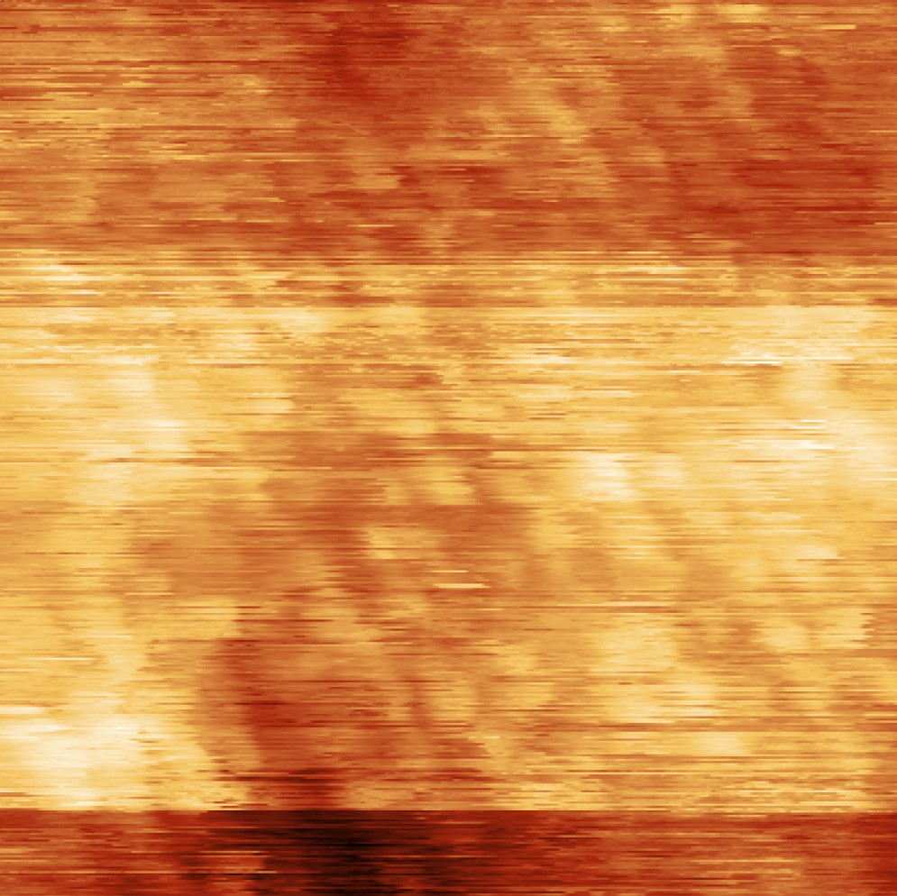
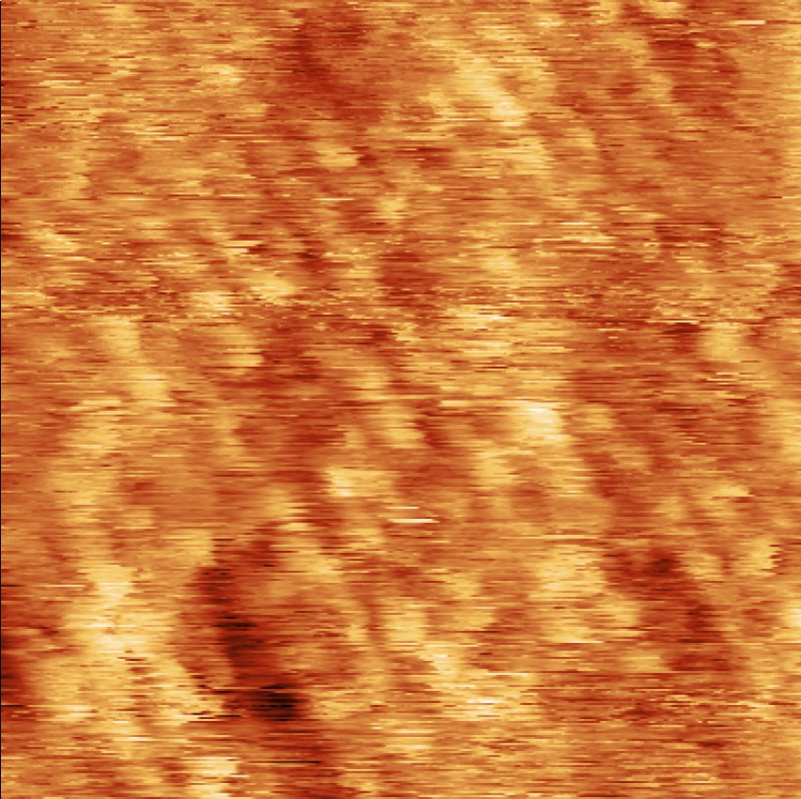
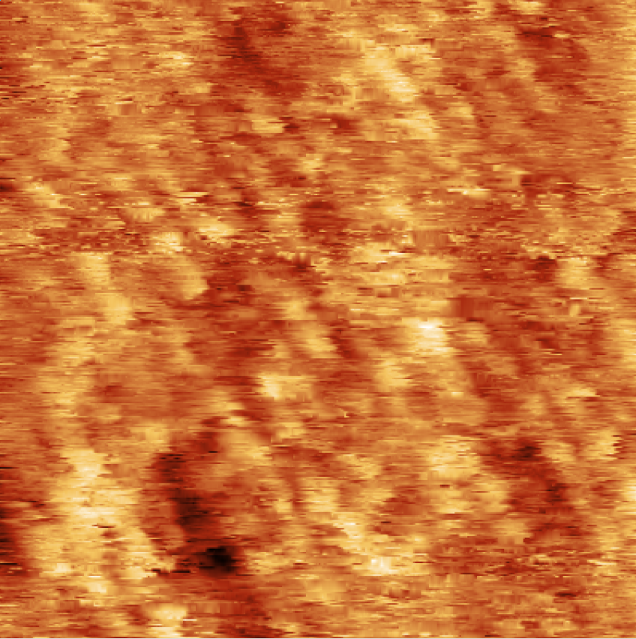
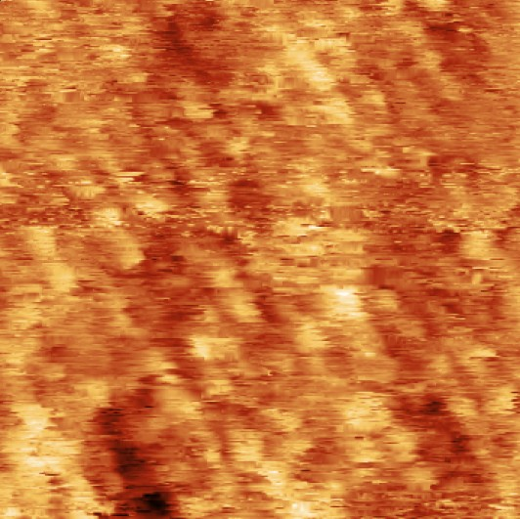
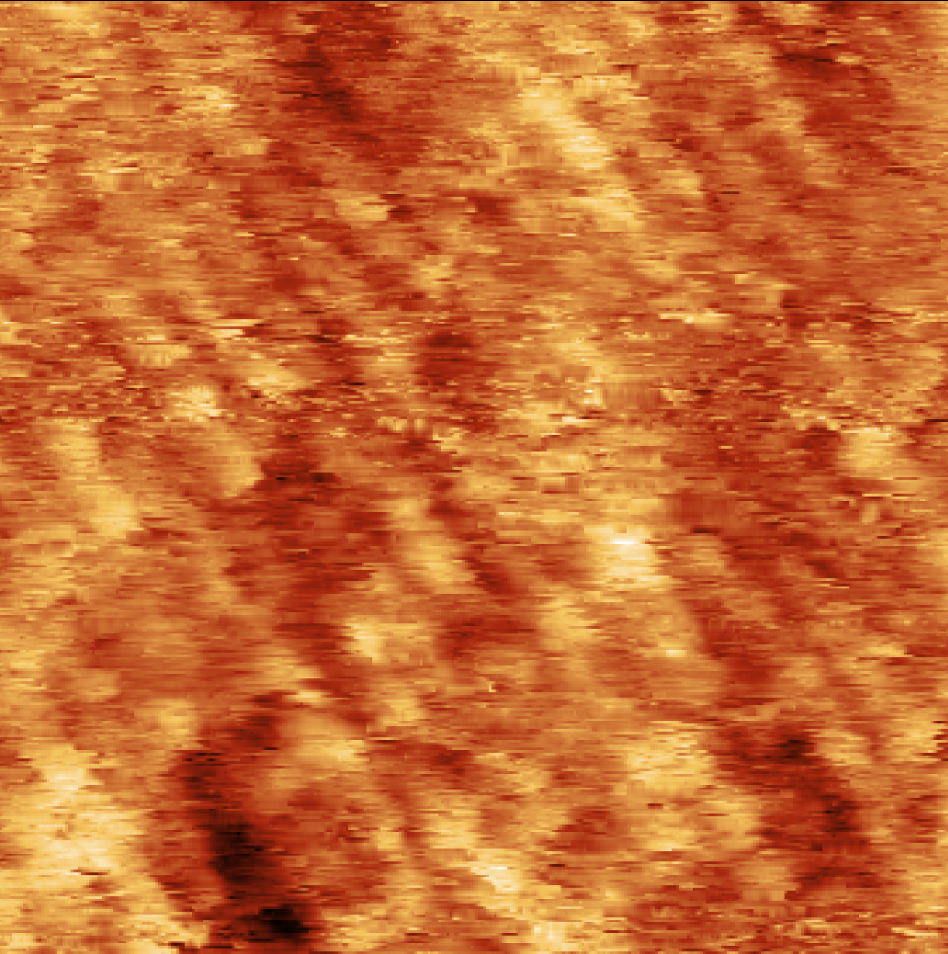
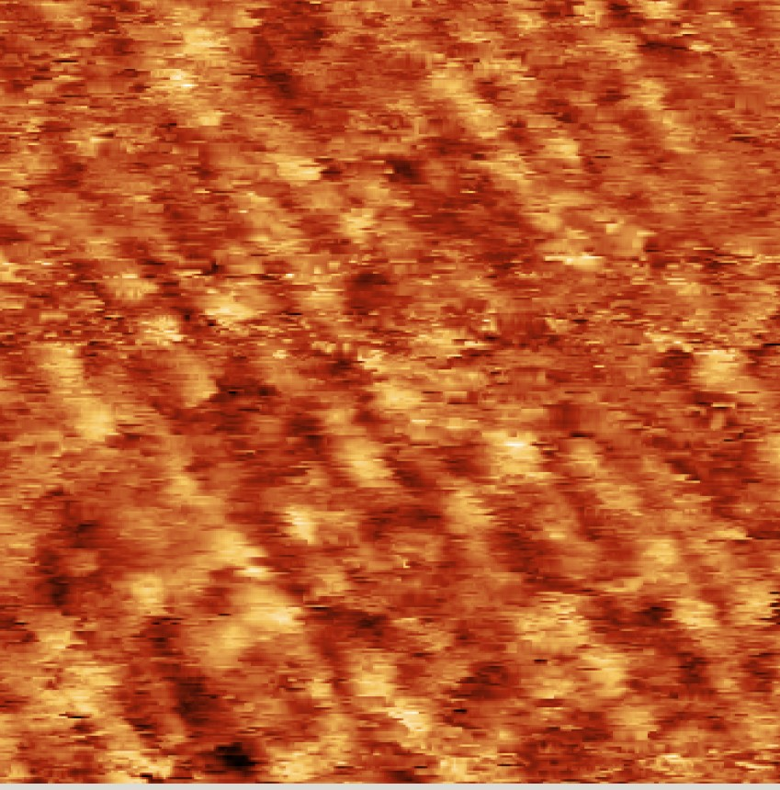
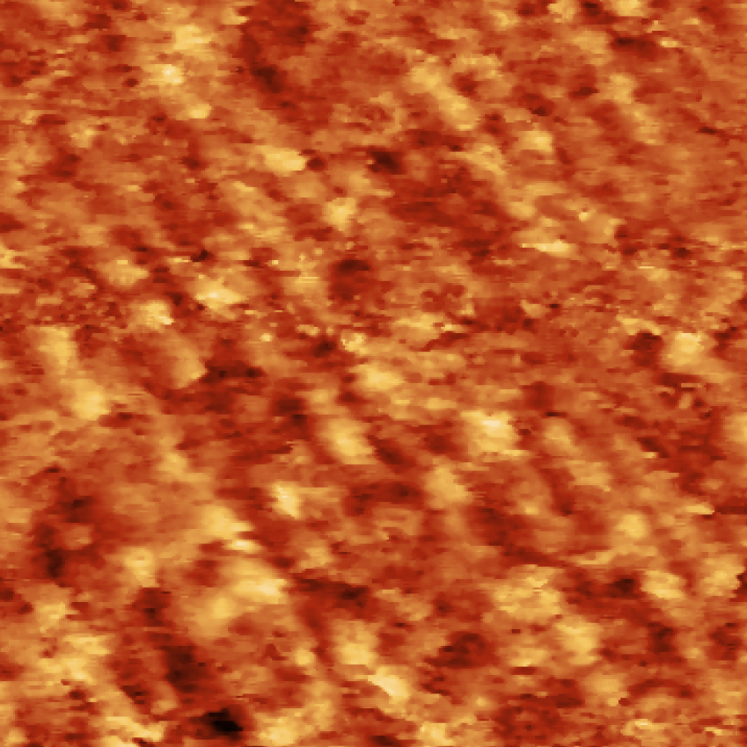
STM image post-processing procedure (Gwyddion)
As grown epitaxial
2) Mean plane
subtraction
3) Polynomial Align Rows (4th order)
4) Remove Horizontal scars x3
1) Raw Data
5) Crop image
6) 2D FFT
7) Conservative
Denoise filter (3px)
8) Median denoise
filter (3px)

Slide 14
Introduction to Tunneling
WKB Approximation- the basic idea

Slide 15
Introduction to Tunneling
Bardeen’s 1D single electron derivation and probability current

Slide 16
Introduction to Tunneling
Bardeen’s 1D single electron derivation and probability current

Slide 17
Introduction to Tunneling
Bardeen’s 1D single electron derivation and probability current

Slide 18
Introduction to Tunneling
Bardeen’s 1D single electron derivation and probability current

Slide 19
Introduction to Tunneling
Bardeen’s 1D single electron derivation and probability current

