Slide 1

Top-k Competitive Location Selection over Moving Object Ping Liu, Meng Wang, Jiangtao Cui, Hui Li School of Computer Science and Technology, Xidian University NDBC 2020

Slide 2

Outline
Background
Motivation
Methodology
Experiments
Conclusion

Slide 3

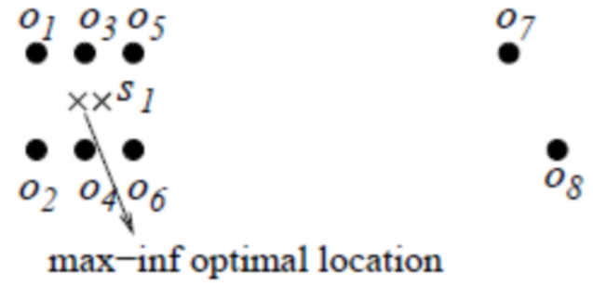
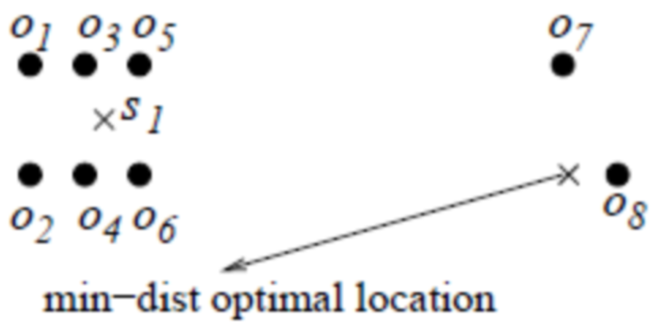
Background
The location selection (LS) problem identifies an optimal site to place a new facility such that its influence on given objects can be maximized.
State-of-the-art LS techniques over moving objects assume the new facility has no competitor, which is too restrictive and unrealistic for real-world business. In this paper we study Competitive Location Selection over Moving objects (CLS-M), which takes into account competition against existing facilities in mobile scenarios.
L1 Space
Notes:
这里插入图信息

Slide 4
Outline
Background
Motivation
Methodology
Experiments
Conclusion

Slide 5
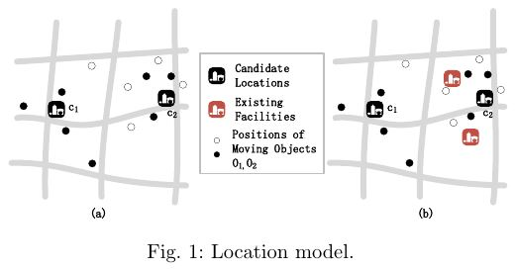

According to PRIME-LS, is chosen as the optimal answer.
However, there are two existing facilities near candidate , while there is no competitor around .
In that case, how can we choose the optimal result to gain better
economic benefits?

Slide 6
Challenge
The location selection problem in a dynamic scenario does not consider competition among facilities. A suitable model for competition among facilities needs to be established.
The location data in dynamic scenarios have been increasing, and the efficiency of selection and calculation needs to be improved.

Slide 7
Outline
Background
Motivation
Methodology
Experiments
Conclusion

Slide 8
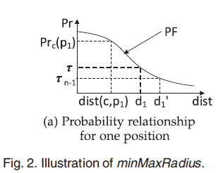
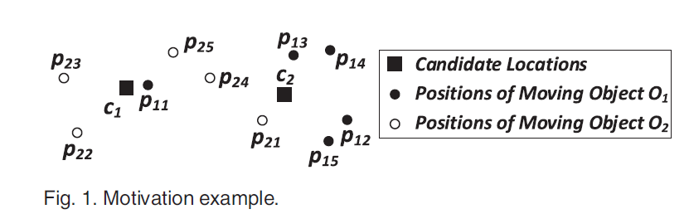


Influence model in dynamic scenarios
Notes:
此处插入一下，函数图像以及函数的应用相关的内容。

Slide 9
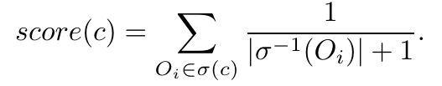
Competition-based influence score
influence score ：
： moving objects influenced by
：existing facilities that influence , where
An example of influence relationships
Candidate | Existing facilities | Influenced objects
c₁ | f₁ | 0₁
c₂ | f₂ | 0₂,0₃
c₃ | f₁ | 0₄
Notes:
此处插入竞争的表格，以及竞争得分的公式

Slide 10
Problem definition (CLS-M)
Given a set of candidate locations , a set of existing facilities ,
a set of moving objects each of which has a series of positions
, and a user-specified number ,
the CLS-M problem aims to mine a subset ,
such that for each , we have
where .

Slide 11
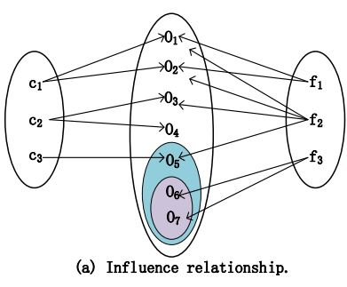
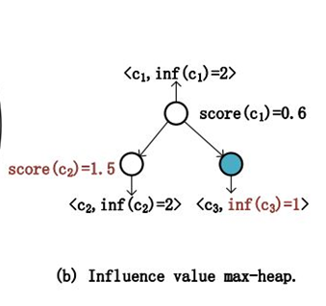
Methodology
NA:
1. For each candidate, we calculate the influenced objects.
2. For each existing facility, we calculate the influenced objects.
3. For each candidate, calculate the competition influence score, and obtain the top k results.
PIV：
The process of calculating the relationship between each object and existing facilities (and candidates)uses IA and NIB strategies.
Notes:
普通遍历方法：
for each candidate
for each object
for each point
Calculate cumulative probability
记录每个候选影响的对象
for each existing facilities
for each object
for each point
Calculate cumulative probability
每个对象被已有设施影响的数目进行记录
for each candidate
计算竞争得分
pino
for each object
IA规则得到一定会影响的candidate，在这些candidate中记录影响的对象
NIB中是潜在的会影响的candidate按算法规则计算，candidate中记录影响的对象
for each object
IA规则得到一定会影响的existing facilities，记录数目
NIB中是潜在的会影响的existing facilities按算法规则计算，记录数目
for each candidate
计算竞争得分
剪枝
for each object
IA规则得到一定会影响的candidate，在这些candidate中记录影响的对象与数目
NIB中是潜在的会影响的candidate按算法规则计算，candidate中记录影响的对象与数目
对candidate影响对象数进行排序
for each object in top-k candidate
IA规则得到一定会影响的existing facilities，记录数目
NIB中是潜在的会影响的existing facilities按算法规则计算，记录数目
计算竞争得分,得到阈值
if sorted candidate 影响对象数<阈值
IA规则得到一定会影响的existing facilities，记录数目
NIB中是潜在的会影响的existing facilities按算法规则计算，记录数目
计算竞争得分,更新阈值
else
得到结果，返回

Slide 12
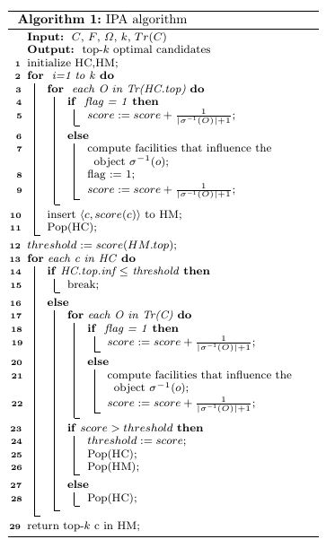
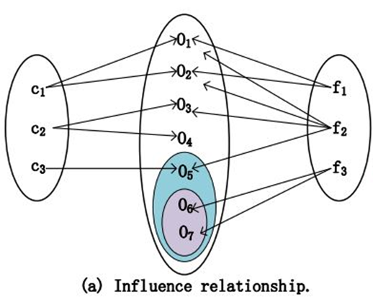
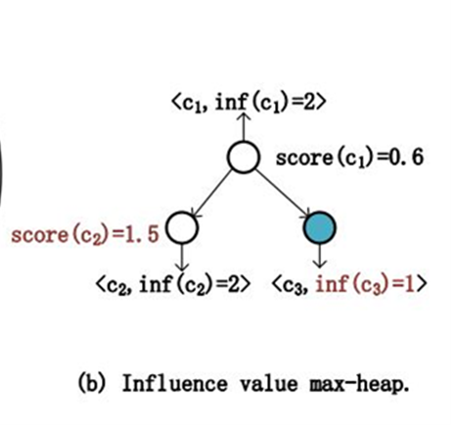
Algorithm
Notes:
着重提一下内部使用堆结构对数据进行了记录

Slide 13
Algorithm
In this case, the two pruning rules cannot be used and the time cost is .
Similarly, candidates are randomly located, then the influence value pruning rule will further prune candidates with less scores, as well as the influence relation ships of the corresponding objects. Hence, the moving objects to be calculated is reduced as and the complexity is .
Experiments will validate the complexity analysis. The best case occurs when the top-k candidates have no competitors, and we can return the result directly. In the special case, the performance of
IPA is equivalent to that of PINOCCHIO-VO.
Notes:
着重提一下内部使用堆结构对数据进行了记录

Slide 14
Outline
Background
Motivation
Methodology
Experiments
Conclusion

Slide 15
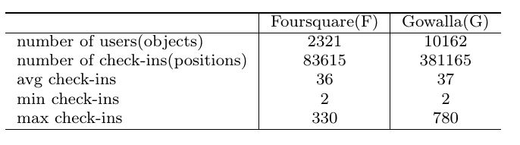
Dataset
Algorithm: NA, PIV, IPA
Parameter setting: k=10, t=0.9, |F|=200,|C|=100

Slide 16
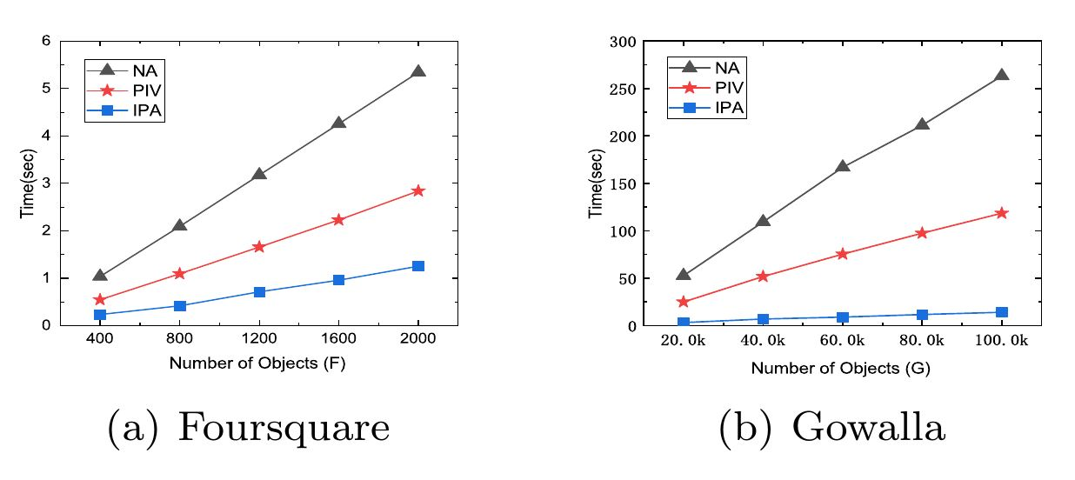
Effect of |Ω|

Slide 17
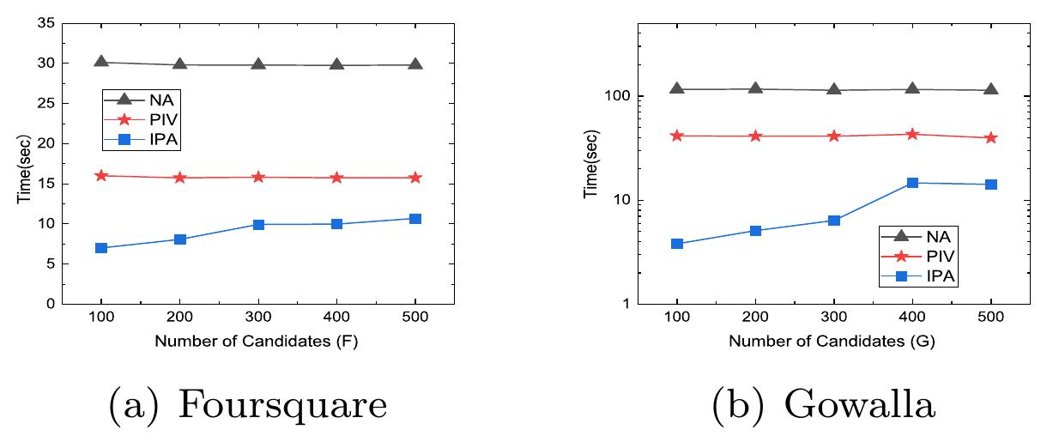
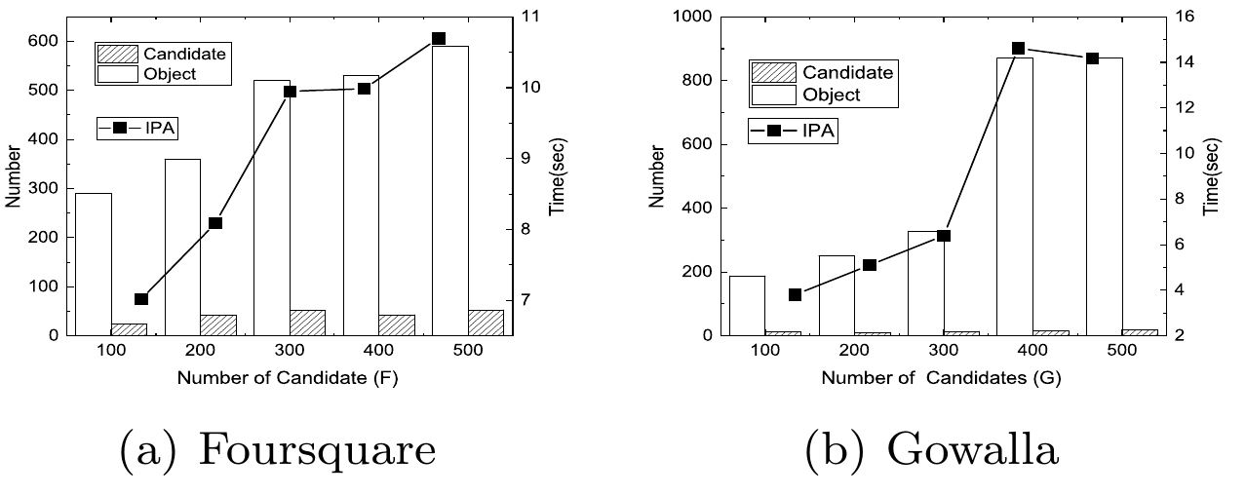
Effect of |C|
Effect of Pruning

Slide 18
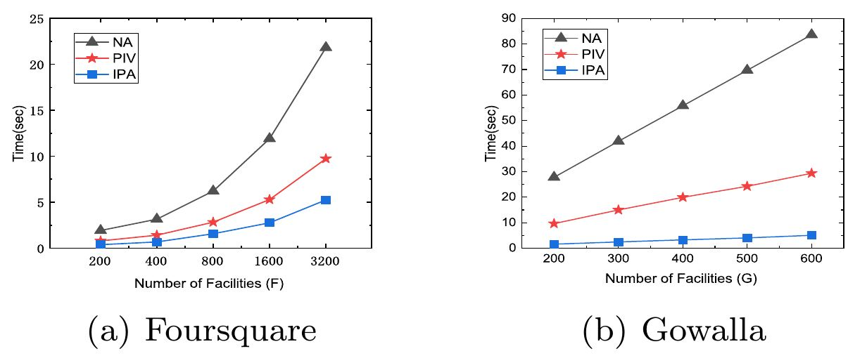
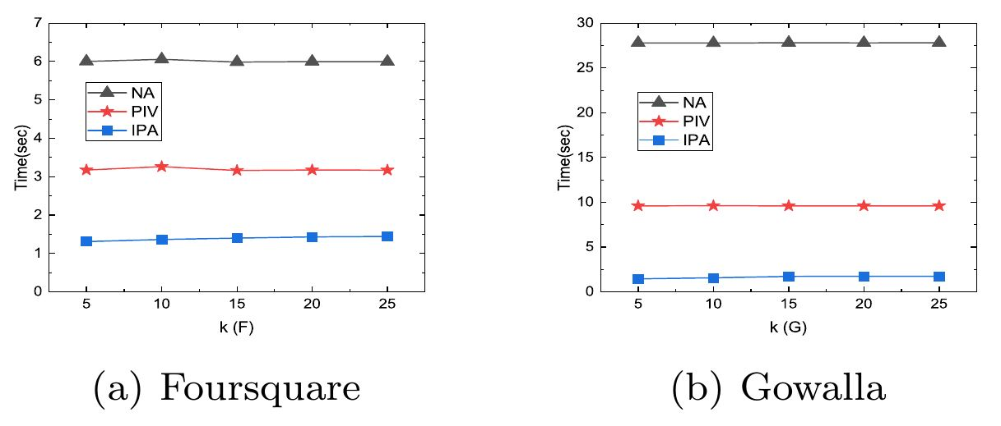
Effect of |F|
Effect of k

Slide 19
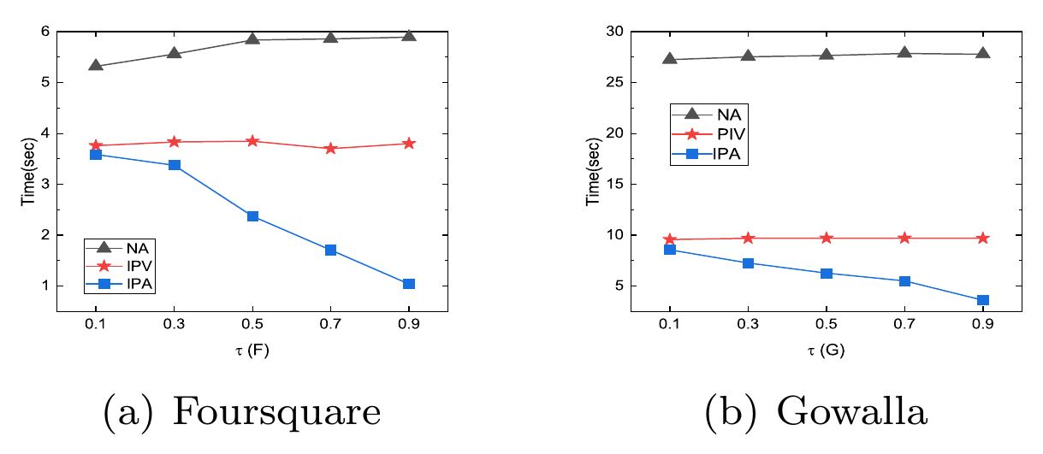
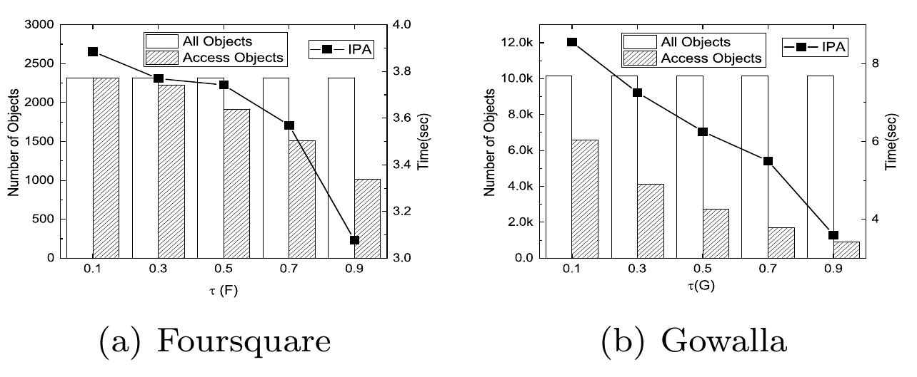
Effect of
Effect of Pruning

Slide 20
Outline
Background
Motivation
Methodology
Experiments
Conclusion

Slide 21
Conclusions
Experimental study over two real-world datasets demonstrates significant superiority of our algorithm in comparison to the baseline method and a state-of-the-art LS technique in terms of efficiency. In future work, we will also consider the influence of cooperation.

Slide 22
Thanks for your watching!

