Slide 1


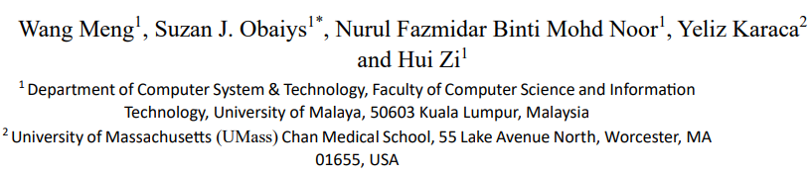
Image and Text Fusion Approach for Multimodal Representation and Intent Prediction

Slide 2
contents
01
Background
03
Experiments
02
Methodology
04
Conclusion
Notes:
22d6503c-a7b0-43b0-a9f4-cb495473eb5b.source.5.zh-Hans

Slide 3
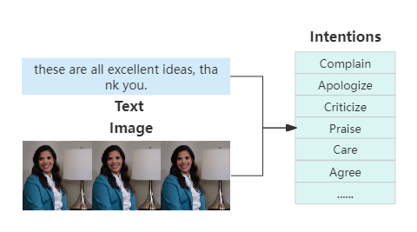
Background
As an important research direction in the fields of artificial intelligence and computer science, intent detection is one of the core technologies of human-computer interaction, aims to accurately identify the user's intent from his input to achieve more intelligent services.
An example of intent detection based on text and image fusion
Notes:
22d6503c-a7b0-43b0-a9f4-cb495473eb5b.source.5.zh-Hans

Slide 4
Background
Modality refers to some way of expressing or perceiving things, each source or form of information.
In multimedia, according to different forms of information presentation, the modality mainly includes video, image, voice and text.
There may also be different modalities under the same form of information, For example, in text task, we can consider two different languages as two different modalities.
Modality?
Notes:
22d6503c-a7b0-43b0-a9f4-cb495473eb5b.source.5.zh-Hans

Slide 5
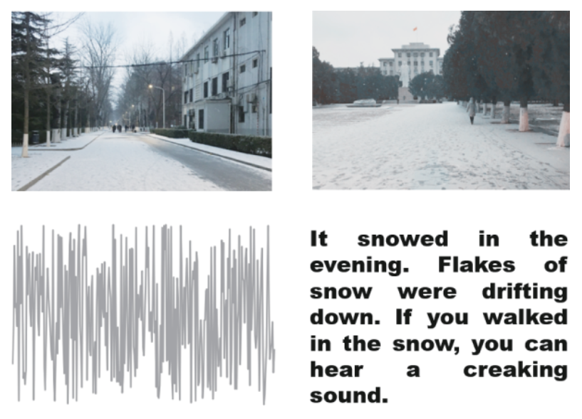
Background
Multi-modality refers to the expression or description of the same object from multiple modalities, generally referring to heterogeneous modalities, such as the relationship between pictures and text language.
Multi-modality?
Video
Image
Audio
Text
Notes:
22d6503c-a7b0-43b0-a9f4-cb495473eb5b.source.5.zh-Hans

Slide 6
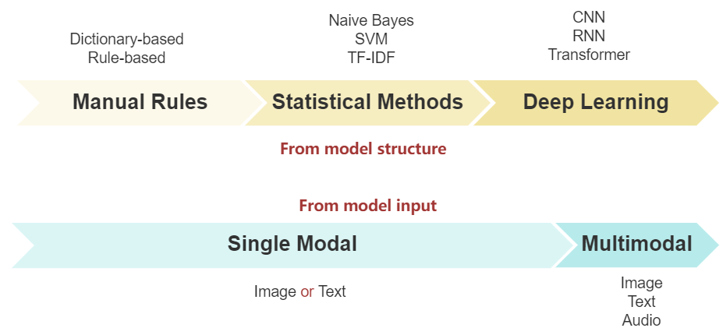
Background
Problem in intent detection
Notes:
22d6503c-a7b0-43b0-a9f4-cb495473eb5b.source.5.zh-Hans

Slide 7
Background
Problem in intent detection
From model structure |  |  | From model input
Type | Method | Problem | Type | Problem
Manual Rules | Rules Graphs | high workload, poor stability | Single Modal | Do not make full use of the rich information of multimedia data, and it is difficult to effectively complete the task in the face of the diversity and complexity of input content
Statistical Method | SVM | Manual feature extraction
Deep Learning | BILSTM BERT | Only for text, low efficiency
 | Attention BERT Faster-CNN Wav2vec | More complex, Higher computational and storage resources | Multimodal | Usually use multiple single-modality pre-training models for different modalities feature extraction, which not only increases the complexity of the system and the computational cost and may also limit the model’s comprehensive understanding of the context
Notes:
22d6503c-a7b0-43b0-a9f4-cb495473eb5b.source.5.zh-Hans

Slide 8
Background
Main contribution
In response to these challenges of insufficient single-modality detection capability and the limitations evident in the existing multimodal methods, this research proposes an intent detection method based on image and text fusion. Inspired by the multimodal pre-training model, we use the CLIP model to achieve feature extraction, alignment, and representation. The model uses contrastive learning to learn the correlation information between modalities in the pre-training stage, so it can better process both image and text data simultaneously and improve the ability of information understanding, and it can also simplify system integration and saves computing resources.
Notes:
22d6503c-a7b0-43b0-a9f4-cb495473eb5b.source.5.zh-Hans

Slide 9
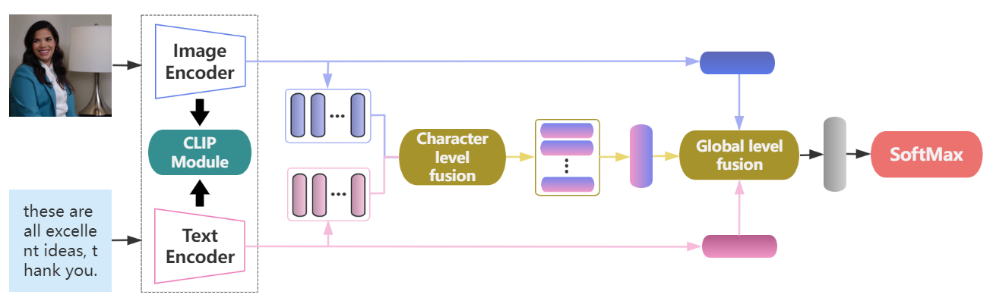
Methodology
Representation
Fusion
Classification
Notes:
22d6503c-a7b0-43b0-a9f4-cb495473eb5b.source.5.zh-Hans

Slide 10
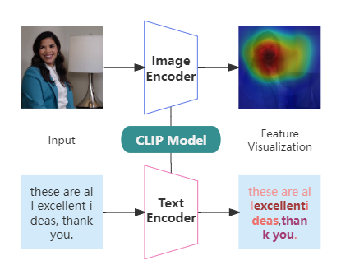
Methodology
CLIP (Contrastive Language–Image Pre-training)
Released by OpenAI
Trained over 400 million image-text pairs
Can process image and text
Adopt Vision Transformer (ViT) and the Text Transformer (Bert)
Include 1.7 billion parameters
Highly efficient, flexible and general
Automatically align text and images
Feature representation based on CLIP
Notes:
22d6503c-a7b0-43b0-a9f4-cb495473eb5b.source.5.zh-Hans

Slide 11
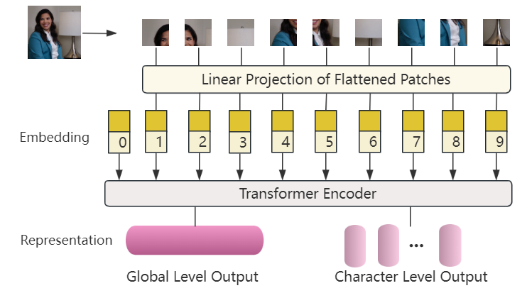
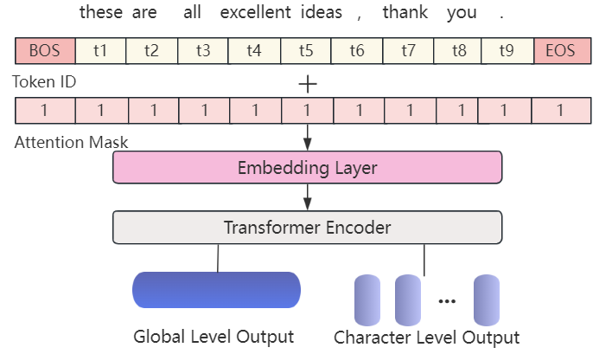
Methodology
Image Encoder
Text Encoder
Notes:
22d6503c-a7b0-43b0-a9f4-cb495473eb5b.source.5.zh-Hans

Slide 12
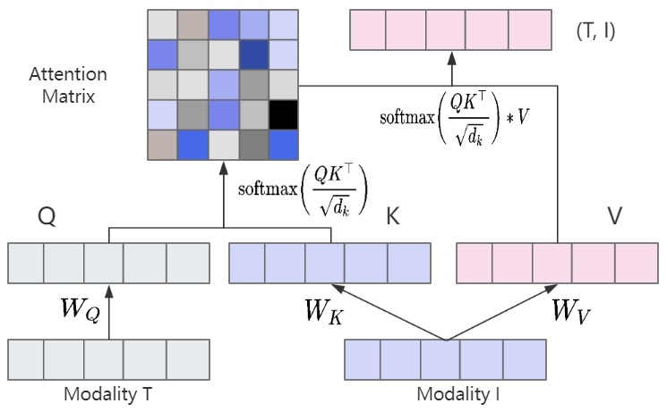



Methodology
Image Feature
Text Feature
Global Output
Character Output
Global Output
Character Output
Cross-attention calculation process
Notes:
22d6503c-a7b0-43b0-a9f4-cb495473eb5b.source.5.zh-Hans

Slide 13
Experiments
First Level | Second Level | Number of samples
Express emotions and attitudes | Complain | 286
 | Praise | 213
 | Apologize | 136
 | Thank | 124
 | Criticize | 117
 | Care | 95
 | Taunt | 62
 | Agree | 59
 | Flaunt | 52
 | Oppose | 51
 | Joke | 51
Achieve goals | Inform | 284
 | Advise | 122
 | Arrange | 110
 | Introduce | 105
 | Comfort | 88
 | Leave | 85
 | Prevent | 73
 | Greet | 60
 | Ask for help | 51
Num of total labels: 20
Num of total samples: 2224
Proportion of division : 6:2:2
Through observation of test results and based on prior knowledge, we set main parameters as follows:
Name | Value
Batch Size | 16
Epoch | 15
Learning Rate | 1.00E-05
Optimizer | Adam
Loss Function | Cross Entropy
Activation Function | ReLu
Dropout Rate | 0.2
Early Stop | 8
Text Dimensions | 512
Image Dimensions | 512
Notes:
22d6503c-a7b0-43b0-a9f4-cb495473eb5b.source.5.zh-Hans

Slide 14
Experiments
Methods | Modalities | ACC | F1 | P | R
ResNet-50 | Image | 17.3 | 7.98 | 8.1 | 7.87
Trans_TAV | Text + Image | 69.44 | 67.06 | 66.7 | 67.43
BERT | Text | 69.89 | 67.2 | 67.16 | 67.25
MulT | Text + Image | 71.24 | 67.85 | 68.32 | 67.39
MAG-BERT | Text + Image | 71.69 | 68.59 | 69.36 | 67.83
OURS* | Text + Image | 71.91 | 68.59 | 69.44 | 67.77
The above table shows the overall comparative experimental results. From the perspective of overall metrics, our approach shows excellent performance on the intent detection dataset compared with baseline models, which verifies the effectiveness of the proposed method.
Notes:
22d6503c-a7b0-43b0-a9f4-cb495473eb5b.source.5.zh-Hans

Slide 15
Experiments
As can be seen from the first two rows, after removing text, only using image data has the worst effect, this shows that text features play an important role in intent detection, while the role of image information is secondary, this is the same as the above experimental conclusion. It can be seen from the third row that it will affect the performance of model if we do not consider the correlation between modalities during feature representation.
Model | ACC | F1 | P | R
- Text | 16.63 | 7.65 | 7.86 | 7.45
- Vision | 68.99 | 66.78 | 66.21 | 67.36
- CLIP | 70.11 | 67.14 | 67.09 | 67.19
- CAF | 68.76 | 66.69 | 66.08 | 67.32
OURS* | 71.91 | 68.59 | 69.44 | 67.77
Notes:
22d6503c-a7b0-43b0-a9f4-cb495473eb5b.source.5.zh-Hans

Slide 16
Experiments
Through the experiment, it is found that different encoders will slightly affect model performance, but the overall difference is not obvious. In general, smaller patches can capture more fine-grained image features, but the actual effect mainly depends on the specific tasks and datasets.
Encoder | ACC | F1 | P | R
CLIP-RN50x16 | 70.56 | 67.92 | 67.9 | 67.95
CLIP-ViT32 | 71.46 | 68.25 | 69.18 | 67.34
CLIP-RN50x64 | 71.69 | 68.53 | 69.4 | 67.69
CLIP-ViT16 | 71.91 | 68.59 | 69.44 | 67.77
Notes:
22d6503c-a7b0-43b0-a9f4-cb495473eb5b.source.5.zh-Hans

Slide 17
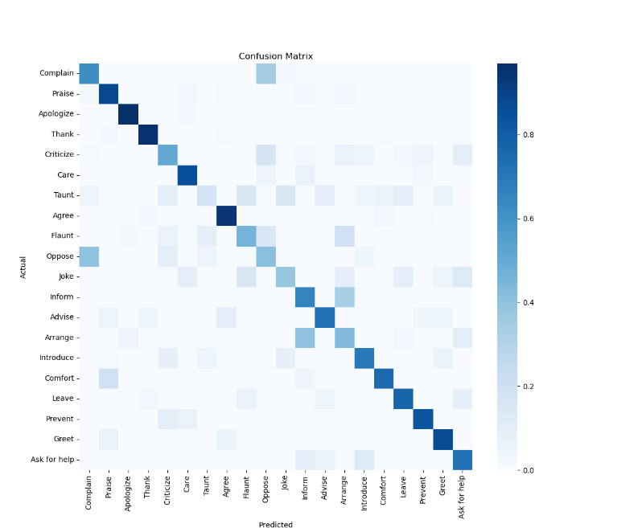
Experiments
Overall, the model shows high accuracy in most categories, but there are also obvious differences in the performance of different intents. Some intents have relatively fixed expression patterns and specific contents, such as Praise, Thank, Apologize, Agree, and Greet, and the model shows better performance in these categories. However, in some complex scenarios, such as Inform and Joke, the model performs generally, which may be because the expressions of these intents are diversified, and the content is relatively abstract. It can be seen from the confusion matrix that the model is easy to confuse Inform and Arrange, Complain and Oppose. These categories themselves have high similarity, which is easy to cause misjudgment. These problems also show that there is still huge room for improvement in the multimodal intent detection task in complex scenes.
Notes:
22d6503c-a7b0-43b0-a9f4-cb495473eb5b.source.5.zh-Hans

Slide 18
Conclusion
This research mainly explores the application of image-text information fusion technology in multimedia intent detection. In order to better utilize the information of these two different modalities, we introduce a Vision-Language large-scale pre-training model (CLIP) to extract text and image features simultaneously to achieve multimodal representation.
Finally, we verify the effectiveness of the proposed method by comparative experiment with the baseline models on the same dataset, and the effectiveness of each module is verified by ablation experiment.
Notes:
22d6503c-a7b0-43b0-a9f4-cb495473eb5b.source.5.zh-Hans

Slide 19
Conclusion
Due to the limitations of data resources and hardware devices, there are still many shortcomings in this study, and there is room for further improvement.
Data Size and Diversity: The size and diversity of training samples is crucial to enhance model robustness and performance, the quantity of total samples used in this research is relatively small compared to the number of labels.
Add other modalities: Only the text and image are used in this research, there are other forms of modality like audio and video, these modalities may provide extra information. For example, audio data can provide insights into tone and emotion, while video data can offer temporal and spatial dynamics that are not captured by static images.
Notes:
22d6503c-a7b0-43b0-a9f4-cb495473eb5b.source.5.zh-Hans

Slide 20
Conclusion
Missing modality: It is common that partial modality is missing in real world, this may affect the robustness of the model in practical application.
In the future research, more information can also be introduced from both internal and external perspectives. From the internal perspective, some user profile features can be added, such as the user's age, release location, release time, etc. From the external perspective, knowledge graph can be introduced to feature improve the performance of the model.
Notes:
22d6503c-a7b0-43b0-a9f4-cb495473eb5b.source.5.zh-Hans

