Slide 1

Model-based Analysis of ChIP-Seq (MACS)
Yong Zhang¤*, Tao Liu¤*, Clifford A Meyer*, Jérôme Eeckhoute†,
David S Johnson‡, Bradley E Bernstein§¶, Chad Nusbaum¶,
Richard M Myers¥, Myles Brown†, Wei Li# and X Shirley Liu*
Notes:
细胞核提取

Slide 2
Background
ChIP-Seq tags represent only the ends of the ChIP fragments, instead of precise protein-DNA binding sites. Often shifted towards the 3' direction,but size of the shift is often unknown.
ChIP-Seq data exhibit regional biases along the genome due to sequencing and mapping biases, chromatin structure and genome copy number variations. Modeled
by control samples and sequenced deeply enough .
Notes:
细胞核提取

Slide 3
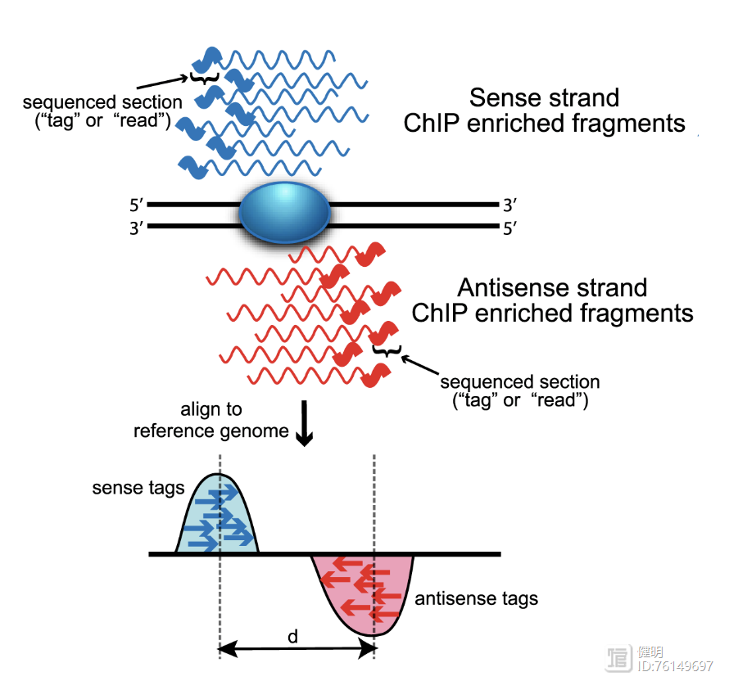
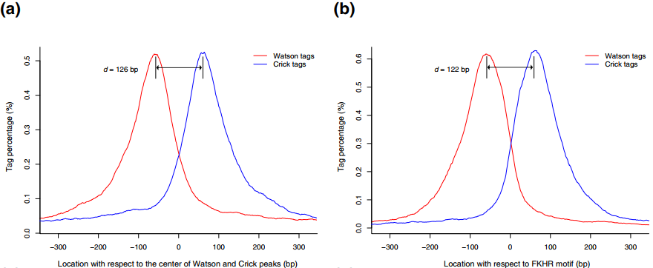
Ⅰ.Modeling the shift size of ChIP-Seq tags
Equally likely to be sequenced from both ends Watson strand enriched upstream and Crick strand enriched downstream.
Given a bandwidth and a high-confidence fold-enrichment (mfold), MACS slides 2bandwidth windows across the genome to find regions with tags more than mfold. randomly samples 1,000 of these high-quality peaks, to calculate ‘d’.
FoxA1 ChIP-Seq MACS estimates the d to be only 126 bp, FKHR motif estimate of 122 bp. NRSF ChIP-Seq the MACS model estimated d as 96 bp ,motif estimate of 70 bp; CTCF ChIP-Seq data the MACS model estimated a d of 76 bp,motif estimate of 62 bp.
Notes:
细胞核提取

Slide 4
Ⅱ.Peak detection
Experiments with a control, MACS linearly scales the total control tag count to be the same as the total ChIP tag count. Removes duplicate tags by the sequencing depth (binomial distribution p-value <10e-5).
MACS shifts every tag by d/2, it slides 2d windows across the genome to find candidate peaks with a significant tag enrichment (Poisson distribution p-value based on λ_{BG}, default 10e-5).
Each tag position is extended d bases from its center, highest fragment pileup, hereafter referred to as the summit, is predicted as the precise binding location.
Notes:
细胞核提取

Slide 5
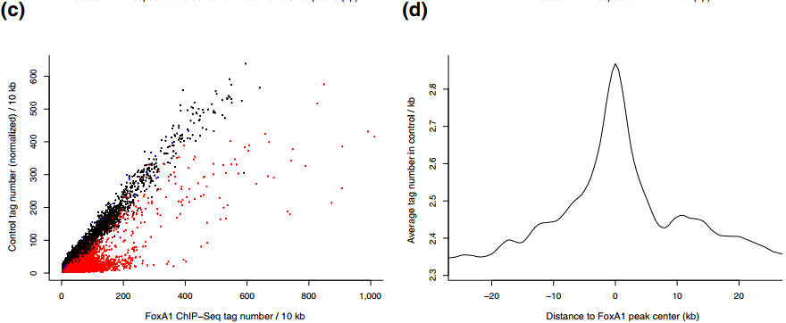

Most ChIP-Seq experiments, tag distribution along the genome could be modeled by a Poisson distribution
Often observe tag distributions with local fluctuations and biases. MACS uses a dynamic parameter, λlocal, defined for each candidate peak as:
MACS uses λ_{local} to calculate the p-value of each candidate peak and removes potential false positives due to local biases
MACS using the same procedure employed in the previous ChIP-chip peak finders MAT and MA2C to estimates the false discovery rate (FDR) .
Notes:
细胞核提取

Slide 6
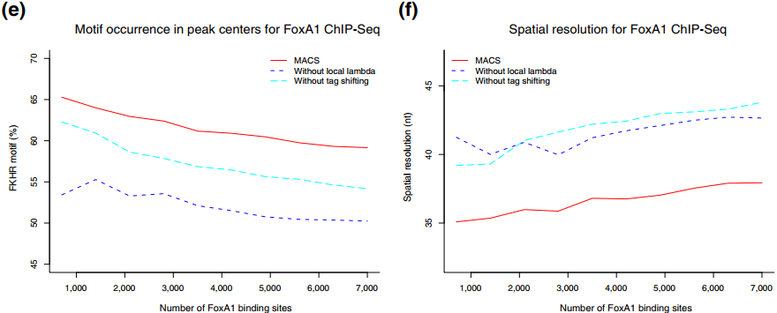
Ⅲ. Model evaluation
Two key features of MACS：empirical modeling of ‘d’ and tag shifting by d/2、use of a dynamic λ_{local} to capture local biases in the genome.
Evaluation MACS by: percentage of predicted peaks with a FKHR motif within 50 bp of the peak summit 、 spatial resolution, defined as the average distance from the peak summit to the nearest FKHR motif.
Greatly improved by using tag shifting and the dynamic λ_{local}
λ_{local} is also effective in capturing the local genomic bias when a control is not available.
To identify 7,000 peaks, the FDR for MACS is only 0.4% when a control is available and λ_{local} is used.
To get 7,000 peaks when a control is not available, the FDR could still remain low at 3.8% if MACS estimates λ_{local}, if MACS uses a global λ_{BG} it would reach 41.2% .
Notes:
细胞核提取

Slide 7
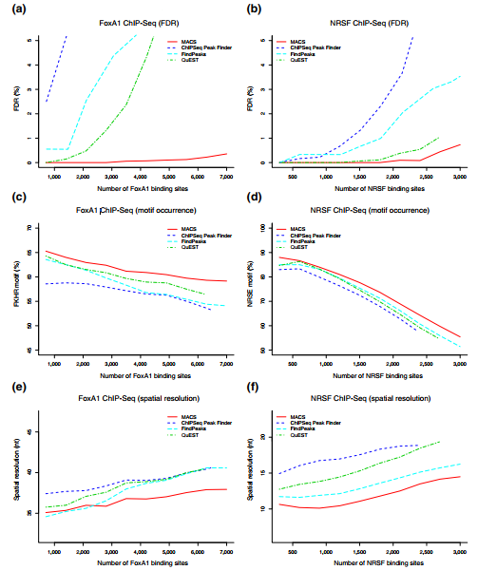
Ⅳ.Method comparisons
Compared MACS with three other publicly available ChIPSeq peak finding methods, ChIPSeq Peak Finder , FindPeaks and QuEST .
FDR 、detection specificity and spatial resolution.
Notes:
细胞核提取

Slide 8
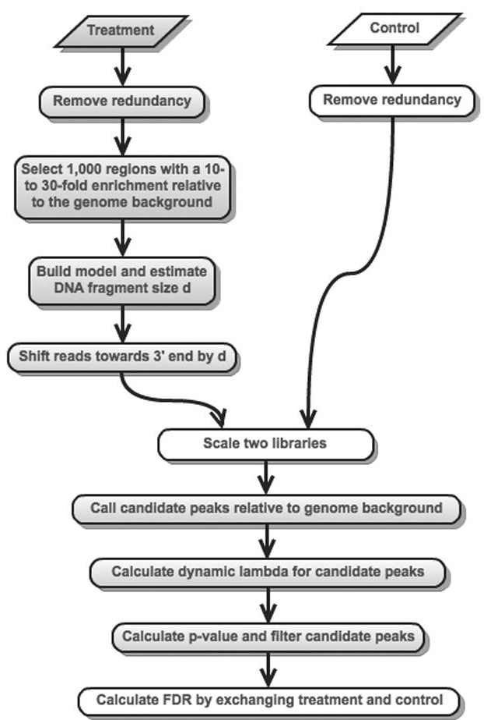
MACS1.4
Removes duplicate tags in excess of what is warranted by the sequencing depth.
slides 2bandwidth windows 、randomly samples 1,000 of these high-quality peaks, to calculate ‘d’
Shifts all the tags by d/2 toward the 3‘ ends .
linearly scales the total control tag count to be the same as the total ChIP tag count.
slides 2d windows across the genome to find candidate peaks with a significant tag enrichment .
uses a dynamic parameter, _{λlocal,} defined for each candidate peak.
uses λ_{local} to calculate the p-value of each candidate peak and removes potential false positives due to local biases
estimates the false discovery rate (FDR) for each detected peak
Notes:
细胞核提取

Slide 9
MACS2 peak calling
1、去除PCR duplication
These duplicates can arise from experimental artifacts, but can also contribute to genuine ChIP-signal
2、选1000个区域进行建模和计算fragment d
这个只是用IP数据，Given a sonication size (bandwidth) and a high-confidence fold-enrichment (mfold), MACS slides two bandwidth windows across the genome to find regions with tags more than mfold enriched relative to a random tag genome distribution.
MACS randomly samples 1,000 of these high-quality peaks, separates their positive and negative strand tags, and aligns them by the midpoint between their centers. The distance between the modes of the two peaks in the alignment is defined as ‘d’ and represents the estimated fragment length.
3、根据d向3’端移动1/2d
MACS shifts all the tags by d/2 toward the 3’ ends to the most likely protein-DNA interaction sites.
4、Scale two library
For experiments in which sequence depth differs between input and treatment samples, MACS linearly scales the total control tag count to be the same as the total ChIP tag count. The default behaviour is for the larger sample to be scaled down.
5、根据基因组背景及动态lambda找到候选的peak（P43-45）
After MACS shifts every tag by d/2, it then slides across the genome using a window size of 2d to find candidate peaks.
The tag distribution along the genome can be modeled by a Poisson distribution. The Poisson is a one parameter model, where the parameter λ is the expected number of reads in that window.
6、计算pvalue过滤peak
A region is considered to have a significant tag enrichment if the p-value < 10e-5 (this can be changed from the default). This is a Poisson distribution p-value based on λ.
7、根据pvalue计算FDR（P46）

Slide 10
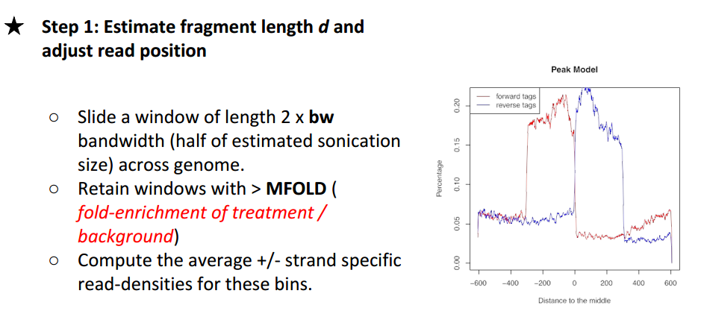
MACS2 peak calling
-m MFOLD MFOLD, --mfold MFOLD MFOLD
Select the regions within MFOLD range of high confidence enrichment ratio against background to build model. Fold-enrichment in regions must be lower than upper limit, and higher than the lower limit. Use as "-m 10 30". This setting is only used while building the shifting model. Tweaking it is not recommended. DEFAULT:5 50

Slide 11
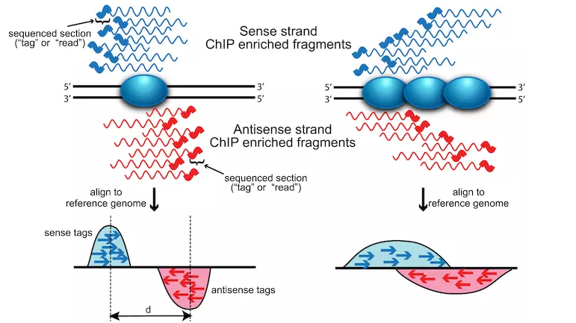
测序得到的片段就是我们转录因子结合位点周围的片段。需要注意的一点是，MACS软件出现的年代是2008年，那时候的测序读长都很短，大约50bp左右，且以单端测序为主，并没有真实反应DNA-蛋白结合片段的长度。所以说，我们如果拿测得的50bp去做reads数目的堆积，势必会与真实的结合位置有一定的偏移。事实上，测序的短reads会在真实的结合位置两侧形成双峰，如下图左侧示。这也是MACS双峰模型构建的理论基础。
在d确定之后，所有的reads都会朝着3'的方向横移（shift）d/2的距离，从而更好地模拟出蛋白-DNA结合位点。
Notes:
1、值得一提的是，像转录因子一类的蛋白与DNA，其结合位点比较narrow，所以双峰模型的构建是比较合理的。但右像图所示的，一些蛋白与DNA会产生较宽的结合区域（诸如一些组蛋白修饰），这时候双峰就不那么显著了。
2、在2012年的Identifying ChIP-seq enrichment using MACS这篇文章中，作者也提到对于一些过度破碎或者有着很宽的结合位点情况，可能会造成算出来的d很小。对于这种情况，我们一般建议用一个特定的片段长度，而非是预测出来的d。
3、注意shift和extend的区别，在MACS2中，这两种情况都存在了。

Slide 12
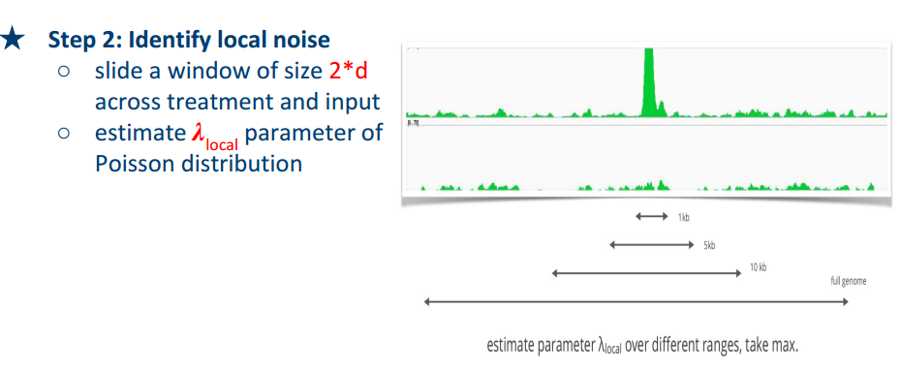
MACS2 peak calling
The lambda parameter is estimated from the control sample and is deduced by taking the maximum value across various window sizes:

Slide 13
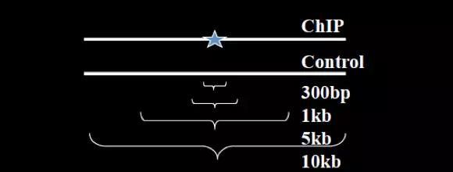
1、基于先前已经调整位置的reads，MACS会在全基因组范围内以2d长度的window来寻找那些有显著富集的区域。
2.有重叠的window会融合成一个候选区域。
3.因为会有许多因素影响不同范围内的reads富集程度，所以MACS用了动态的​参数lambda_{local}来对于reads数目的富集进行泊松分布的建模。
4.动态参数值定义为：
5、lambda_{BG}来自于全基因组的计算，​lambda_{region}则来自在control中的对应区域(候选区域)，剩下的lambda_x​则来自control中，以得到的候选区域为中心，1k，5k，10k范围内的区域计算。
6、如果control不在，则local值只是在Chip的IP样本中计算，而region和1k值也会被舍弃。同时如果Chip-Seq和control的样本测序深度不同，MACS会默认地把测序深度更深的样本缩放。
The ratio between the ChIP-seq tag count and λlocal is reported as the fold enrichment.
Notes:
1、主要是根据利用Control组的数据构建泊松分布。
2、当没有Control时，利用实验组，稍大一点的局部区间（比如50k）的数据构建泊松分布。

Slide 14
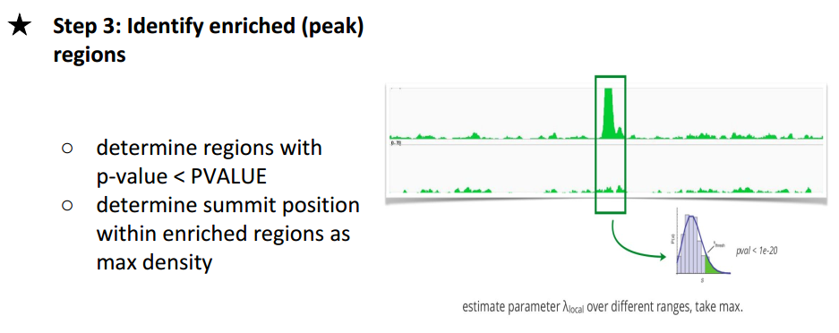
MACS2 peak calling
1、关于​以及p值这一步的计算可能需要看源代码才可以了解，但根据MACS2的wiki来说，似乎p值和​的计算都是以单个碱基为单位考虑的。
2、基于泊松分布的模型，我们就可以以单尾检验，计算出p值了。MACS1.4默认以p=1 x 10-5为阈值。MACS2默认qvalue<0.05为阈值。
Notes:
1、其实也就是说，根据泊松分布，我们可以算出在某个置信概率（如0.00001）下，随机情况下，某个碱基上可以覆盖的read的数目的最小值，当实际观察到的read数目超过这个值（单侧检验）时，我们认为该碱基是TF的一个结合热点。反过来，针对每一个read数目，我们也可以算出对应的置信概率P。

Slide 15
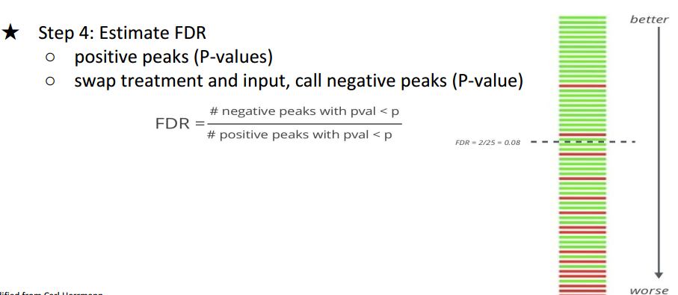
MACS2 peak calling
1、当有对照组实验存在时，MACS会进行两次peak calling。第一次以实验组（Treatment）为实验组，对照组为对照组，第二次颠倒，以实验组为对照组，对照组为实验组。之后，MACS对每一个P计算了相应的FDR（False Discovery Rate）值;
2、negative peaks with pval <p表示第二次peak calling（颠倒的）得到的置信概率小于P的peak的个数；
3、positive peaks with pval <p表示第一次peak calling（颠倒的）得到的置信概率小于P的peak的个数；
4、FDR综合利用了实验组和对照组的信息，显然，FDR越小越好
in MACS2, p-values are now corrected for multiple comparison using the Benjamini-Hochberg correction.

Slide 16
https://github.com/macs3-project/MACS/wiki/Advanced:-Call-peaks-using-MACS2-subcommands
https://hbctraining.github.io/Intro-to-ChIPseq/lessons/05_peak_calling_macs.html

